Slide 1
Using Graphics Processors for Real-Time Global Illumination
Graham Hazel
UK GPU Computing Conference 2011
Notes:
Hello!

Slide 2
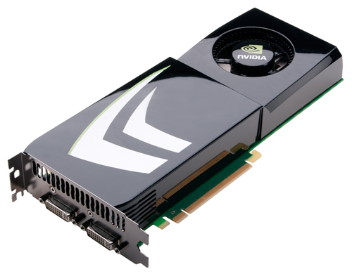
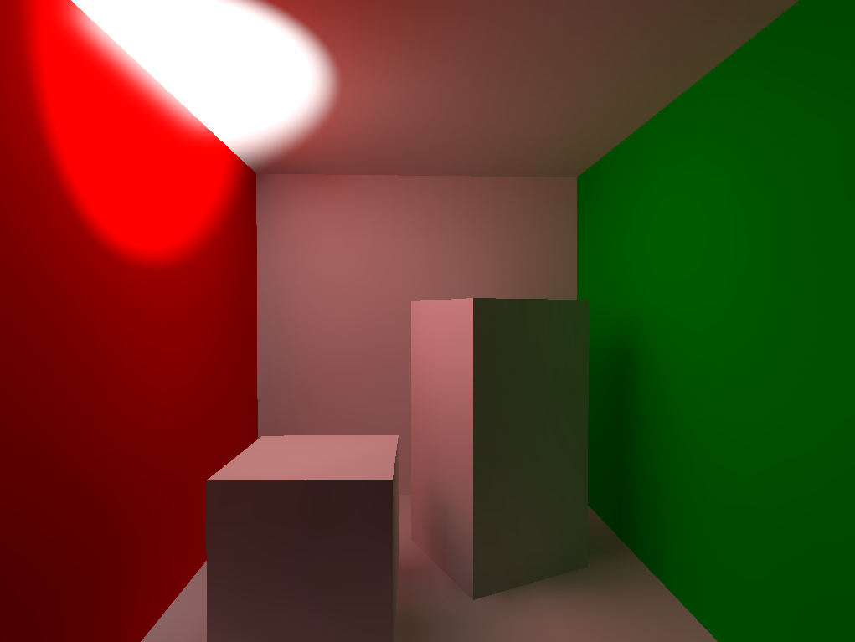
What this talk is about
Notes:
This is an unusual talk for the GPU computing conference. As the programmability of commodity GPUs has increased they have become more attractive for general computation, and traditionally this conference has been about using GPUs away from their home turf.
But not only is this talk about graphics, it’s about real-time graphics for video games! This is perversely mainstream, so I’ll be sure to explain why what we do is relevant here.

Slide 3
Plan for the talk
Who we are and what we do
Why it’s a GPGPU problem
Technical details and results
Videos
Notes:
Geomerics is not the most recognisable name on the programme today, so I’ll give some background about who we are and what we do. Then I’ll explain why we’re now using GPGPU techniques. After that I’ll go deeper into some technical details of our CUDA implementation and its performance, and finally I’ll show some results!

Slide 4

Who we are and what we do
Geomerics is a “middleware” company
We licence our technology to game developers
Our first product is Enlighten, a real-time radiosity solution
Notes:
We research and develop large pieces of reusable technology which would be impractical for single game teams to create themselves. Our first product is Enlighten, which has licensees around the world and is integral to titles selling millions of copies this Christmas.

Slide 5
Real-time radiosity pipeline
Goal: compute light bounces in real time
Scene geometry is fixed
Light sources can move
Small objects can move and are lit correctly but don’t bounce light
Notes:
Enlighten starts from the point of view that most of the geometry in the world is static. In an offline step, we precompute and compress the visibility information of this geometry; after that lights and characters can move freely around the scene and the bounced light updates in real time.
Although these limitations sound prohibitive, this is a big improvement on the situation pre-Enlighten – where the choice was between no bounced light, or static bounced light (still computed in an offline step).
...and at the end of the talk I’ll say some more about removing these restrictions – which is current research.

Slide 6
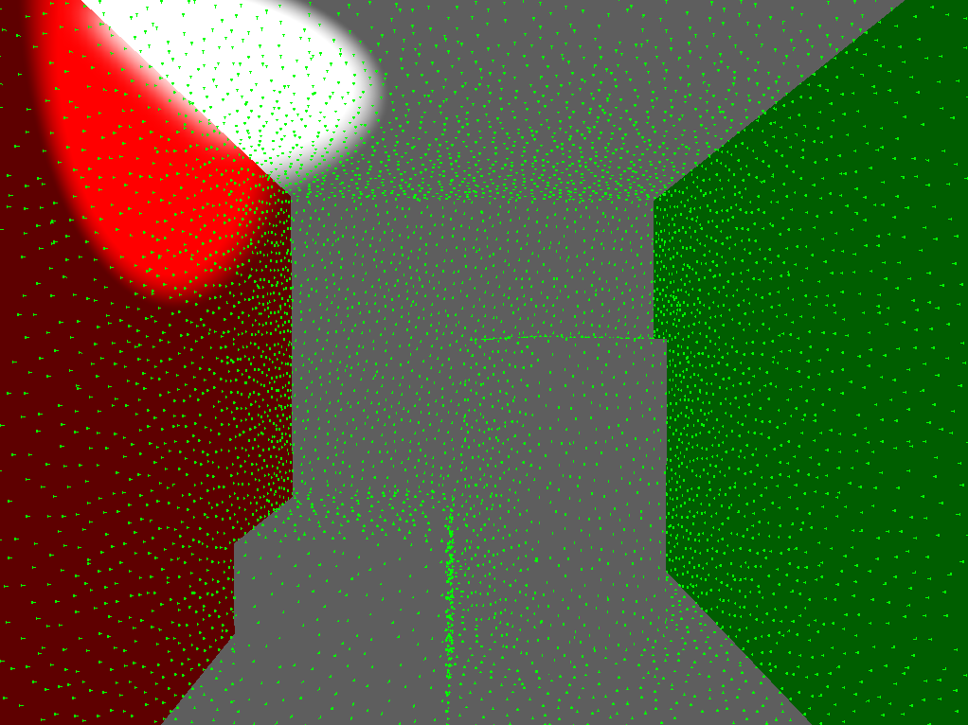
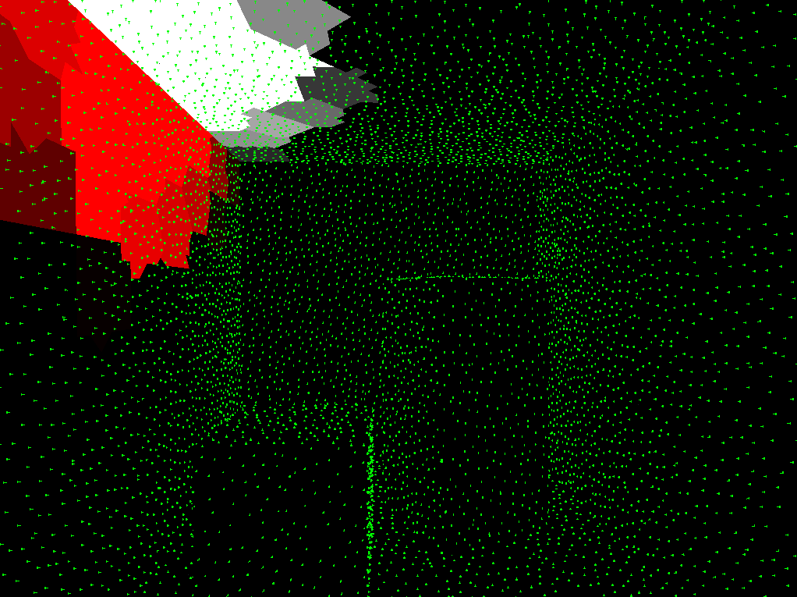
Real-time radiosity pipeline
1. Sample the direct lighting
Notes:
Anyway, here’s a very brief overview of how Enlighten works. Given a scene with some coloured surfaces, and a light source (left picture), we sample the lighting at a set of discrete points, and average the results up in clusters (right picture).

Slide 7
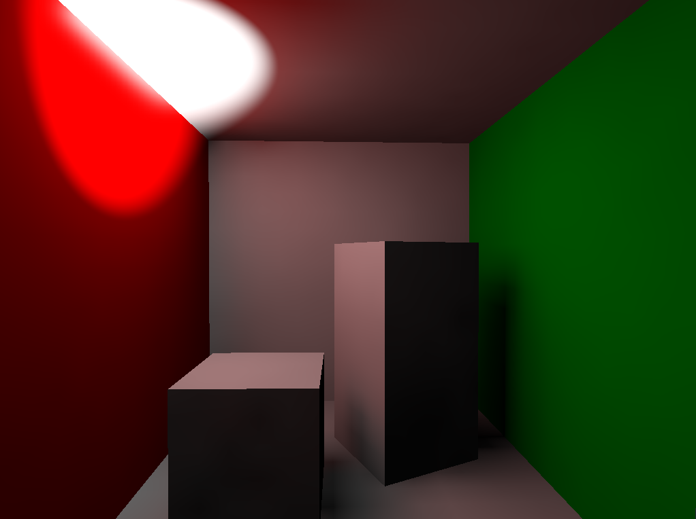
Real-time radiosity pipeline
2. Compute one bounce
Notes:
This clustered lighting and the precomputed geometrical data are the inputs to the Enlighten solver, which writes the resulting bounced lighting into a texture ready for rendering.

Slide 8

Real-time radiosity pipeline
3. Resample the bounce as input and repeat
Notes:
Finally, we resample this bounced output at the sample points and add it to the input for the next frame. This way when we run to convergence we get “infinite” light bounces.
That was a quick look at who we are and the problem we’re trying to solve. Now I need to explain why we’re using GPGPU techniques.

Slide 9
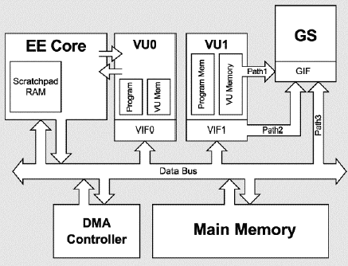
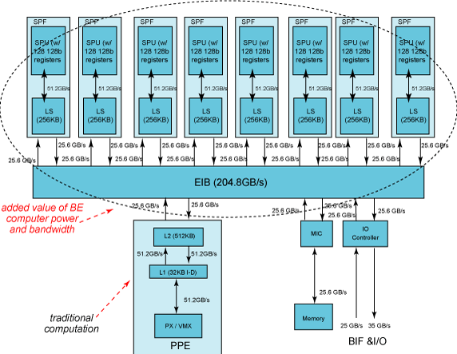
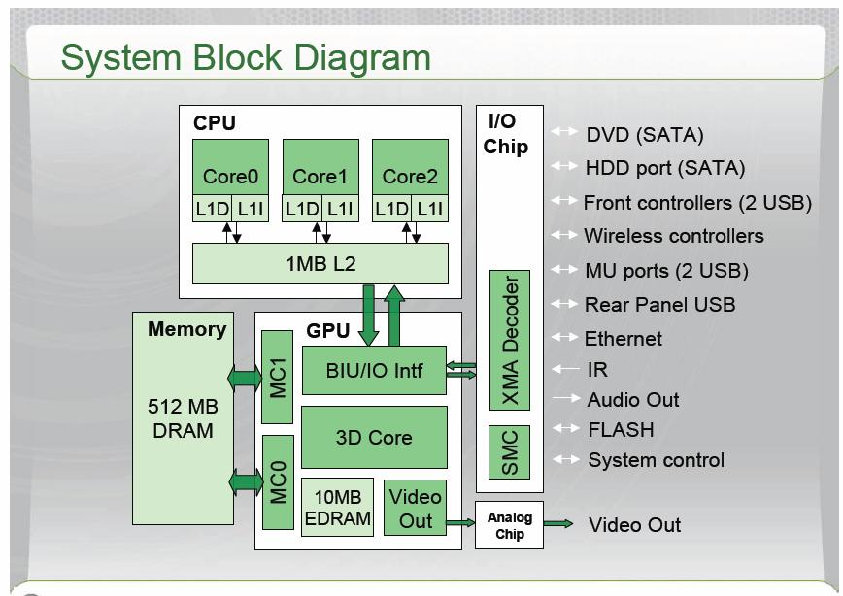
A very brief history of console hardware
...?
Notes:
First a brief diversion into the hardware that powers video games: home consoles. Sony are well known for producing esoteric hardware designs... like the Cell!
On the other hand Microsoft started out with something relatively normal before branching out with the Xbox 360.
As a middleware company we have to be aware of which bits of hardware might be available for us. On the Xbox 360 and PlayStation 3 the GPUs are already heavily used, so we took the decision to put Enlighten on CPUs and SPUs.

Slide 10
Game console observations
Custom hardware is the norm
GPUs yield more FLOPS / $
PC games already use GPGPU
Notes:
The details of the hardware aren’t really important, the point is that custom hardware is expected. Manufacturers prioritise power and cost over ease-of-use, knowing that with a fixed target programmers will jump through hoops for performance.

Slide 11
Why is this a GPGPU problem?
Fastest platform available today
Future-proof?
Notes:
Hopefully this has sufficiently motivated why we’re interested in GPGPU techniques. It’s the fastest platform we have available today – which is great for research – and hopefully will give us a head start when it comes to whatever new hardware might appear.

Slide 12
Technical details
How CUDA and DirectX share the GPU
Optimisations
Performance
Notes:
Now it’s time for some technical details about our current GPU implementation, which uses DirectX for rendering and CUDA for the GPGPU computations. (I believe everything would work the same with OpenGL, but DirectX is the de facto standard for video games.)
First I’ll explain how these two separate parts can share one GPU, then I’ll talk about some critical optimisations we made to maximise CUDA performance. Finally I’ll give a comparison with the CPU version of Enlighten.

Slide 13
How to share memory resources
DirectX device must be specified when creating CUDA context
DirectX resources can be registered for use by CUDA
  cu[da]GraphicsD3D9RegisterResource
  cu[da]GraphicsD3D10RegisterResource
  cu[da]GraphicsD3D11RegisterResource
Notes:
In order to be able to interact with each other at all, you must create a special CUDA context with the DirectX device. After that, rendering resources such as textures and vertex buffers can be registered for reading and writing in CUDA. This is an expensive operation so we do it once, not every frame. Only these two steps depend on the DirectX version.

Slide 14
How to share memory resources
Graphics resources can be mapped and unmapped using
  cu[da]GraphicsMapResources
  cu[da]GraphicsUnmapResources
These are analogous to the DirectX calls
  device->Lock
  device->Unlock
Notes:
However, we do “map” and “unmap” each resource every frame. This is like locking and unlocking in the traditional graphics API, and ensures that the views that DirectX and CUDA have of the data stay consistent with each other. Once a texture is mapped, we can bind it to a CUDA kernel for reading as a texture.

Slide 15
How to share computational resources
CUDA and rendering can’t run simultaneously
Context switch between DirectX and CUDA is expensive
Notes:
As well as reading and writing data, Enlighten needs hardware to run on. Currently, the only way to run CUDA is to take over the whole GPU. This simplifies things! The context switch between DirectX and CUDA is quite expensive, which simplifies our choices even more...

Slide 16
Timeshare the GPU
Render shadow maps
Compute radiosity using CUDA
Render scene with radiosity results
context switch
context switch
Frame start
Frame end
time
Notes:
The only sensible thing we can do is switch between rendering and CUDA once per frame. We choose to do so after we’ve rendered shadow maps for the light sources.

Slide 17
Advantages of running on the GPU
Read from graphics resources directly
Write graphics resources directly
Zero latency
Notes:
The reason for this is we can immediately read from those shadow maps when we sample the input lighting. This is much more convenient than the CPU version of Enlighten, where if we want accurate visibility we have to transfer data from the GPU to the CPU.
Writing graphics resources directly is also much simpler than the CPU alternative. Asynchronous computation on the CPU requires 3 copies of output data – one each for the CPU worker thread, CPU rendering thread and the GPU.
Finally we can use the results immediately, without having to wait until they’re copied to the GPU!

Slide 18
Disadvantage of running on the GPU
Taking time away from rendering
Notes:
The big disadvantage is that time spent in CUDA is time we’re taking away from rendering performance. This means we have to run all of our computations in a fraction of a frame – which, for real-time performance, means a small number of milliseconds at most.

Slide 19
Optimisations
Light samples and sum in the same kernel
Notes:
This brings us on to the optimisations we made to the CUDA version to get maximum performance. First of all we compute the light samples and average them over clusters in one kernel, using shared memory. This makes CUDA more efficient than rendering the points in DirectX, even though lighting a large number of point samples is natural fit for a graphics API.

Slide 20
Compute Capability Confession
The input lighting kernel is “too big” and spills registers to global memory
This kills performance on pre-Fermi cards
Notes:
One reviewer of the talk submission wanted to see a discussion of performance on different Compute Capabilities... so I have a confession to make. The input lighting kernel is not a good match for older graphics cards because it spills registers to global memory, and performance goes through the floor. For CC 1.x cards it would be better to render the samples in DirectX before switching to CUDA.
However, this is forward looking research – frankly we don’t care about older hardware!

Slide 21
Optimisations
Radiosity solver: usual CUDA techniques
Pack threads into blocks
Reorder precomputed data
Use shared memory
Notes:
The key optimisations we made to the Enlighten solver will be familiar to everyone here – pack threads into blocks carefully to increase occupancy; reorder data so that warps load contiguous 128-byte chunks; and use shared memory wherever you can.

Slide 22
Compute Capability Confession #2
Radiosity solver has to gather large amount of lighting data from memory
L1/L2 cache key to performance
Pre-Fermi cards only have texture cache
Notes:
However, the compute capability story here isn’t much better. The radiosity solver relies on the caching of global memory to read lighting data efficiently. If we were targeting CC 1.x we could instead put the lighting data in textures, which would then get at least some caching – but this is slower on more recent GPUs.
Another possibility would be to borrow ideas from our PS3 solver and use specialised warps to “DMA” in input lighting data asynchronously – thus combining all the fun of CUDA _and_ manual DMA!

Slide 23
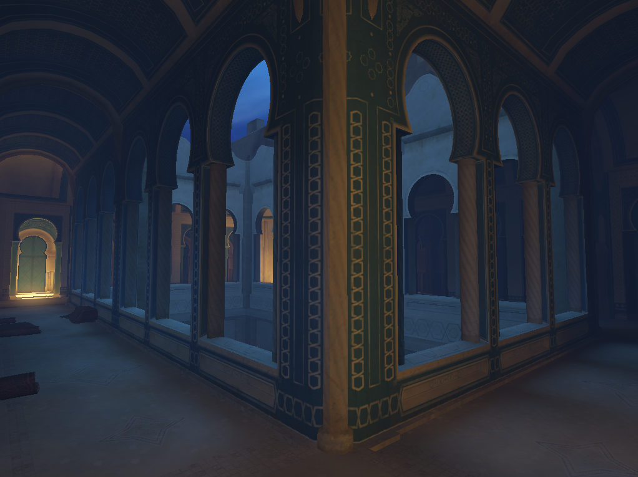
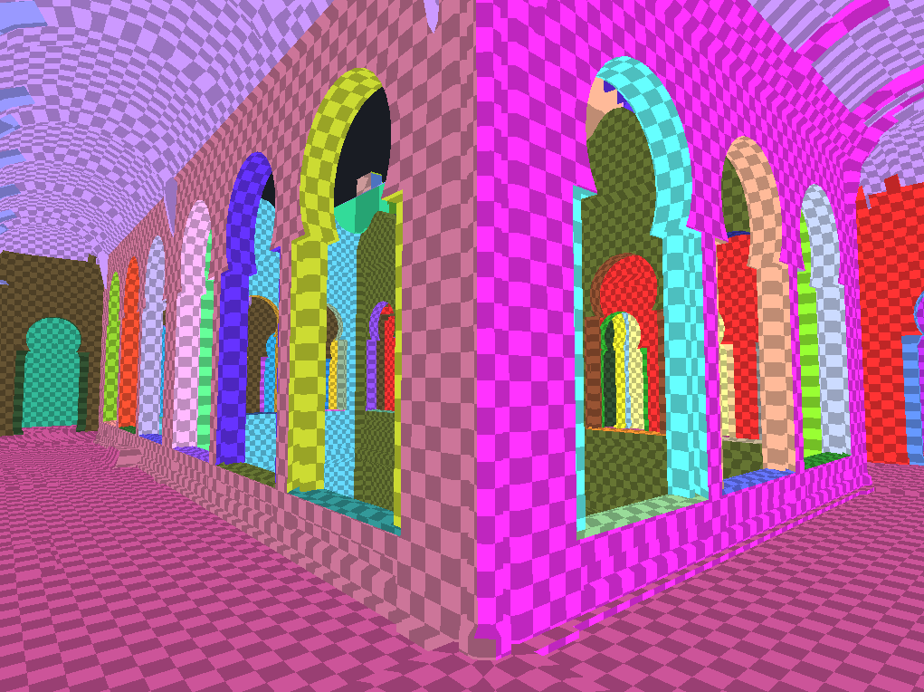
Results
Test scene: “Arches” with high output resolution (~91,000 pixels)
Notes:
After making these optimisations, how well does the CUDA version perform?
Unfortunately, a direct comparison between CPU and GPU is hard. The CPU and SPU solvers are built as single-threaded functions which stream through memory, and parallelism is achieved at the task-level rather than the pixel-level. This design puts the game engine in control – as middleware we can’t take over the whole machine!
But let’s do the comparison anyway. This is one of the test scenes from our SDK, with the output resolution greatly increased. (You don’t need this many pixels to adequately capture indirect lighting.)

Slide 24
Results
CPU
  Intel Core i7
  Hand-optimised vector intrinsics
  Single thread: 33ms
  Whole CPU (8 cores): 4.1ms
  Doesn’t measure CPU-GPU copies
GPU
  NVIDIA GTX 580
  2.0ms (+ 0.5ms CPU)
  Measures all of the required work

Slide 25
Videos
Dockyard demo
Current research
Notes:
But the proof is in the pudding – so I have a couple of videos to show. This first is a demo level we showed at SIGGRAPH Real-Time Live! in August.

Slide 26
Thank you for listening!
Questions?
graham.hazel@geomerics.com
www.geomerics.com

