Slide 1
The landscape of accelerator programming: a view from ARM
Anton Lokhmotov, Media Processing Division
3rd UK GPU Computing Conference, London
14 December 2011

Slide 2
ARM
A company licensing IP to all major semiconductor companies (form of R&D outsourcing)
  Established in 1990 (spin-out of Acorn Computers)
  Headquartered in Cambridge with 28 offices in 13 countries and 2000+ employees
ARM is the most widely used 32-bit CPU architecture
  Dates back to the mid 1980s (Acorn RISC Machine)
  Dominant in the embedded and mobile devices (e.g. in >95% phones)
Mali is one of the most widely licensed GPU architectures
  Dates back to the early 2000s (developed by Falanx, Norway)
  Media Processing Division established in 2006 (acquisition of Falanx)
  Released products:
    Mali-55 (OpenGL ES 1.1), Mali-200, Mali-400 (OpenGL ES 2.0)
    Mali-T604 (OpenGL ES 2.0 + OpenCL 1.1)

Slide 3
Accelerated (heterogeneous) systems
Special-purpose HW can outperform general-purpose HW
  Sometimes, by orders of magnitude
  Importantly, in terms of energy efficiency as well as raw speed
  Parallel execution is key
Non-programmable / somewhat-programmable accelerators
  ASICs, FPGAs, DSPs, early GPUs
Programmable accelerators
  Vector extensions: x86/SSE/AVX, PowerPC/VMX, ARM/NEON
  Sony/Toshiba/IBM Cell (Sony PlayStation 3, HPC)
  ClearSpeed CSX (HPC, embedded)
  Adapteva Epiphany (HPC, mobile)
  Intel MIC (HPC)
  Recent GPUs supporting general-purpose computing (GPGPUs)

Slide 4
Landscape of accelerator programming
5 years ago
Proprietary low-level APIs, typically C-based
  Vector intrinsics
  NVIDIA CUDA
  ATI Brook+
  ClearSpeed Cn
No SW portability, hence no confidence in SW investments
  (e.g. Brook+ and Cn are now defunct)

Slide 5
Landscape of accelerator programming
Today
Interface | CUDA | OpenCL | DirectCompute | RenderScript
Originator | NVIDIA | Khronos (Apple) | Microsoft | Google
Year | 2007 | 2008 | 2009 | 2011
Area | HPC, desktop | Desktop, mobile, embedded, HPC | Desktop | Mobile
OS | Windows, Linux, Mac OS | Windows, Linux, Mac OS (10.6+) | Windows (Vista+) | Android (3.0+)
Devices | GPUs (NVIDIA) | CPUs, GPUs, custom | GPUs (NVIDIA, AMD) | CPUs, GPUs, DSPs
Work unit | Kernel | Kernel | Compute shader | Compute script
Language | CUDA C/C++ | OpenCL C | HLSL | Script C
Distributed | Source, PTX | Source | Source, bytecode | LLVM bitcode
Notes:
http://en.wikipedia.org/wiki/DirectCompute, http://www.danielmoth.com/Blog/DirectCompute.aspx
http://developer.android.com/guide/topics/renderscript/index.html
http://blogs.arm.com/multimedia/617-gpu-computing-in-android-with-arm-mali-t604-renderscript-compute-you-can/

Slide 6
Mali-T600 (Midgard) GPU architecture
  OpenCL v1.1 (full profile) compliant, with focus on:
    Performance, precision, scalability, area and energy efficiency
    System performance (CPU + GPU + interconnect + memory)
  3 pipeline kinds (“tri-pipe”): arithmetic, load/store, texturing
  Barrel-threaded (like AMD/NVIDIA)
  No SIMT execution (unlike AMD/NVIDIA)
    Hardware view: hard to build fast and efficient load/store units
    Software view: hard to understand coalescing rules
    No branch divergence either!
  SIMD execution (like AMD)
    Should use vectors to achieve the highest performance (or rely on automatic vectorisation)
  CPU and GPU share the same physical memory (cached)

Slide 7
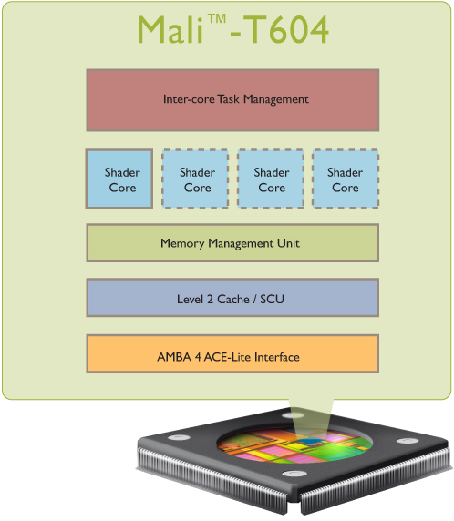
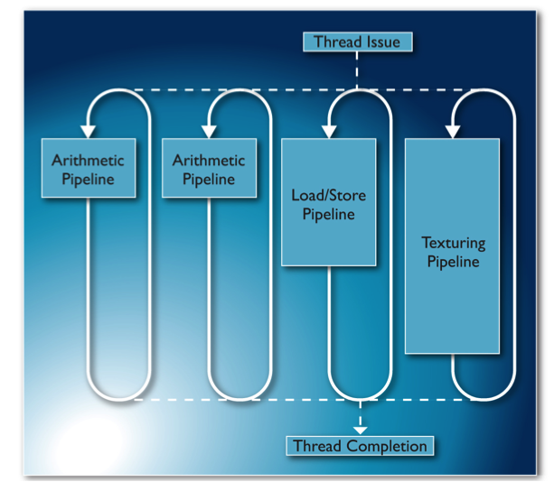
Mali-T604: up to 4 cores / 68 GFLOPS

Slide 8
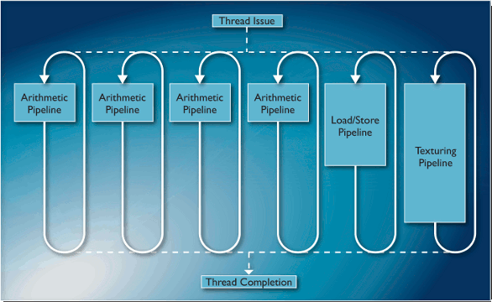
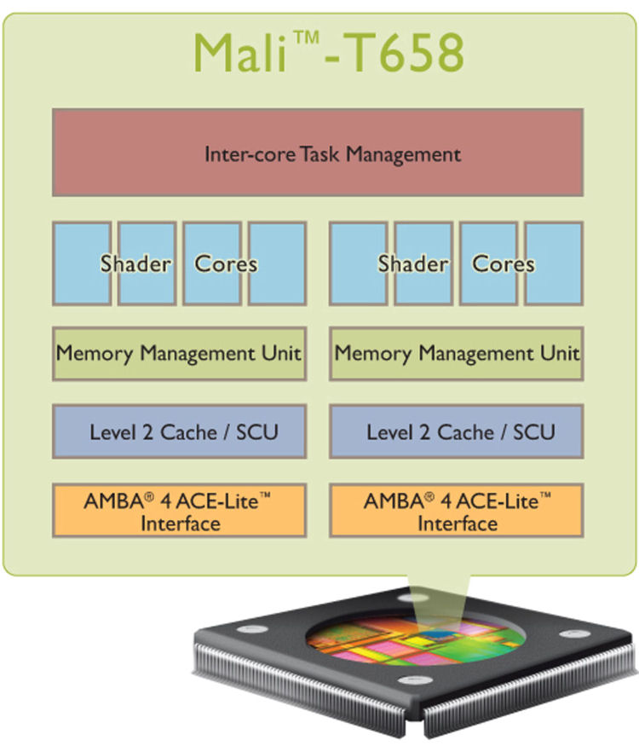
Mali-T658: up to 8 cores / 272 GFLOPS

Slide 9
Samsung Exynos platforms
Exynos 4210 (shipping in Galaxy S2)
  Dual-core Cortex-A9, 1.2 GHz
  Quad-core Mali-400 MP4, 266 MHz
  45 nm
Exynos 4212 (announced 29-Sep-2011)
  Dual-core Cortex-A9, 1.5 GHz
  Quad-core Mali-400 MP4, 400 MHz
  32 nm, High-K Metal Gate (HKMG)
Exynos 5250 (announced 30-Nov-2011)
  Dual-core Cortex-A15, 2.0 GHz
  Quad-core Mali-T604
  32 nm, High-K Metal Gate (HKMG)
  12.8 GB/s bandwidth; support for 2560x1600 (WQXGA) displays
Notes:
http://www.samsung.com/global/business/semiconductor/products/mobilesoc/Exynos/index.html
http://www.samsung.com/global/business/semiconductor/products/mobilesoc/Exynos/news_11.html

Slide 10
Mont Blanc (FP7 project, 2011-2014)
Goal: European scalable and power efficient HPC platform based on low-power embedded technology
PRACE prototypes @ BSC
  256 Tegra2 modules (dual-core Cortex-A9)
    0.5 TFLOPS
    1.7 KW
    0.3 GFLOPS / W
  256 Tegra3 modules (quad-core Cortex-A9) + 256 GeForce 520MX
    38 TFLOPS
    5 KW
    7.5 GFLOPS / W
Mont-Blanc prototype might use an integrated design
Notes:
http://www.montblanc-project.eu
http://www.eesi-project.eu/media/BarcelonaConference/Day2/13-Mont-Blanc_Overview.pdf
http://www.hpcwire.com/hpcwire/2011-11-23/nvidia_tegra_processors_blaze_the_way_for_arm_in_supercomputing.html

Slide 11
Summary
Low-power GPU computing revolution is around the corner
Software portability (and performance portability) is likely to be an issue despite standardisation efforts
We are open to universities and research institutes wishing to work on the opportunities provided by GPU computing!

Slide 12
Woes of accelerator programming
Portability
  I’m a Linux developer.
  So glad I don’t have to think about DirectCompute and RenderScript.
  OK, I’ll go with OpenCL as it’s the most portable interface.
Usability
  Why do I need to write so much host code just to run ‘Hello World’?
  Phew, it’s mostly boilerplate! I’ll reuse this code for something else.
  Now it’s time to write an interesting kernel.
  The results are wrong. How do you mean ‘no debugging means’?
  I need SGEMM. Do I really have to write it myself?
Performance portability
  My kernel runs really fast on device X but really slow on device Y?!
  How do I optimise kernel code for different devices?
  How do I maintain optimised code?

Slide 13
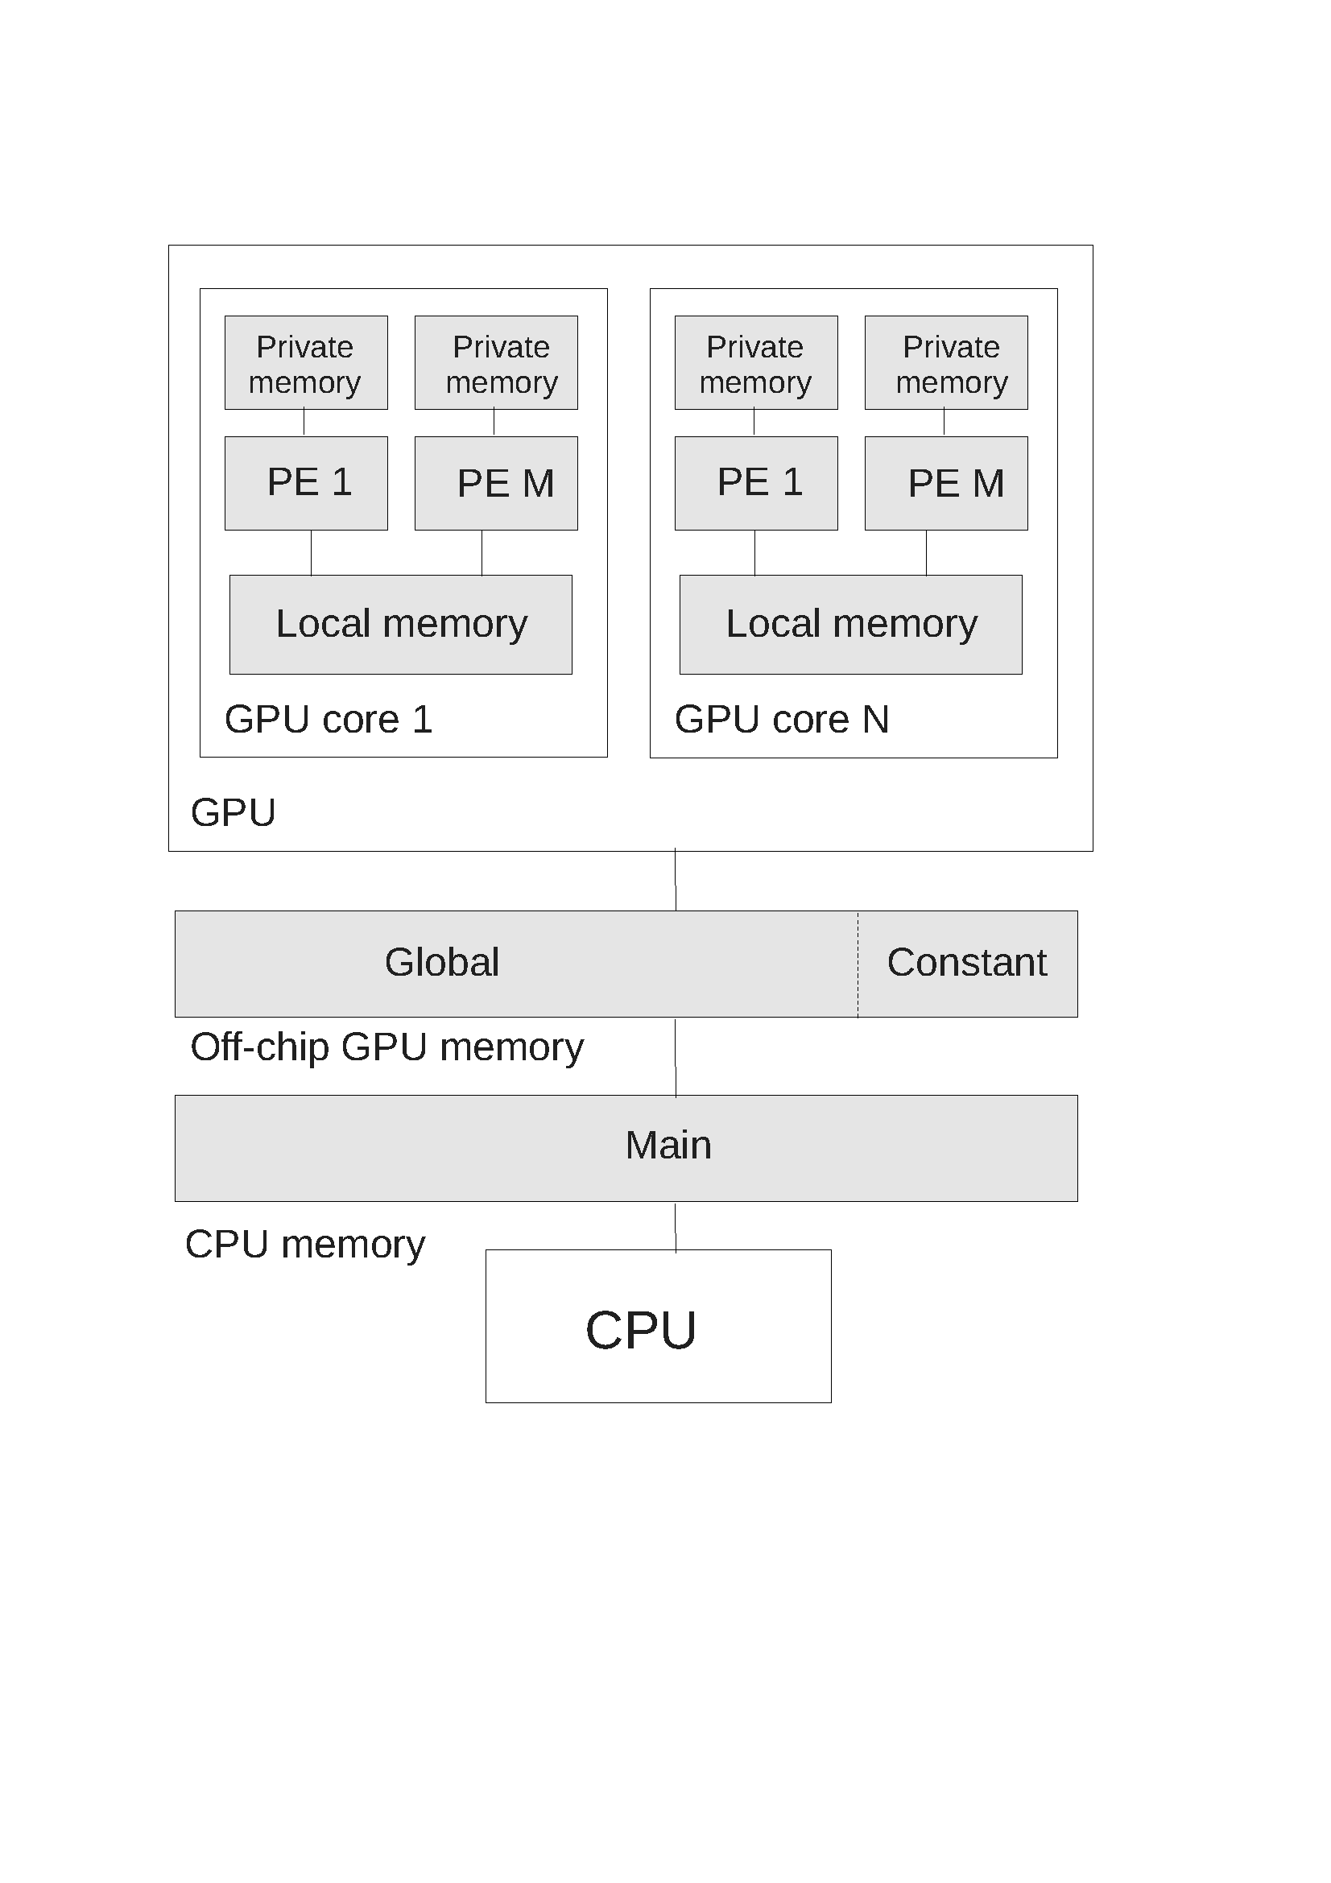
OpenCL – memory system (desktop)
Desktop systems have non-uniform memory
  GPU is on a discrete card along with GPU (__global) memory
Data must be physically copied between CPU (main) memory and GPU memory
  Some algorithms take longer to perform the copying than to execute just on the CPU

Slide 14
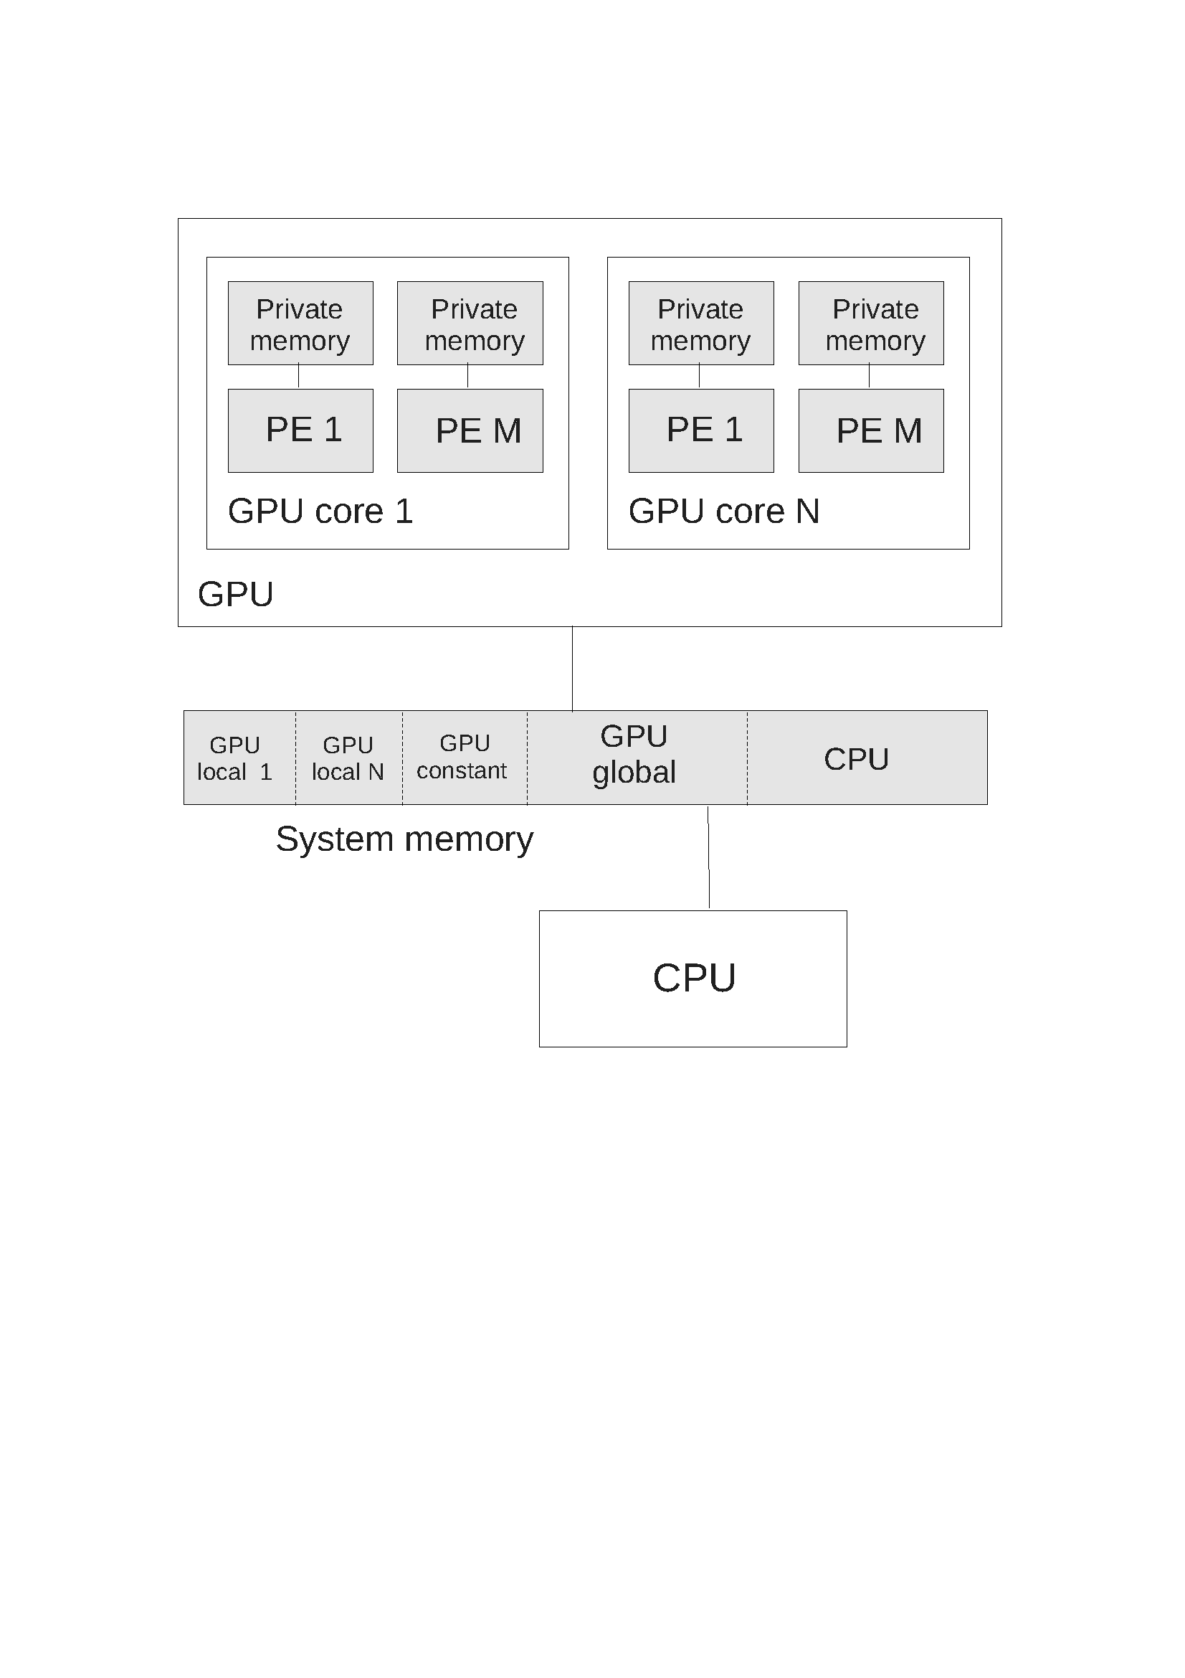
OpenCL – memory system (embedded)
Most ARM-based systems have uniform memory
  GPU __global memory allocated in main memory (but fully cached in the GPU’s caches)
  GPU __local memory is also allocated in main memory
Cheap data exchange between CPU and GPU
  Cache coherency operations are faster than physical copying

Slide 15
OpenCL – applications
Consumer entertainment (including games)
  Jaw-dropping graphics (e.g. using photorealistic ray tracing, or custom-render pipelines)
  Intelligent “artificial intelligence” (e.g. really smart opponents)
  3D spatialisation of sound effects (e.g. multiplayer voice chat)
Advanced image processing
  Computer vision (e.g. automotive safety applications)
  Computational photography (e.g. region-based focussing)
  Augmented reality (e.g. heads-up navigation, “live” gaming)
  3D-mapping (e.g. situational awareness, disaster recovery)
Novel user interfaces (e.g. gesture / eye / speech controlled)
Notes:
Computational photography: http://www.americanscientist.org/issues/pub/computational-photography
Augmented reality: http://cacm.acm.org/magazines/2010/7/95057-mainstreaming-augmented-reality/fulltext
3D-mapping: http://www.fastcompany.com/1792034/second-star-to-the-right-navigation-is-about-to-get-sci-fi-for-real
Eye tracking: http://www.realeyesit.com/

