Slide 1
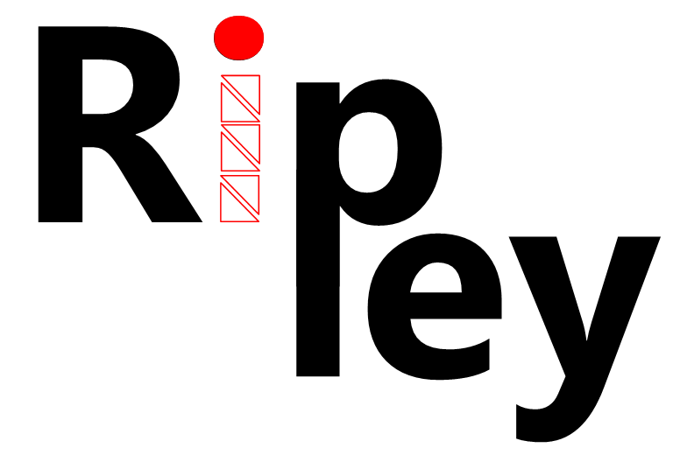
Securing web 2.0 applications through replicated execution
K. Vikram
Cornell University
Abhishek Prateek
IIT Delhi
Ben Livshits
Microsoft Research

Slide 2
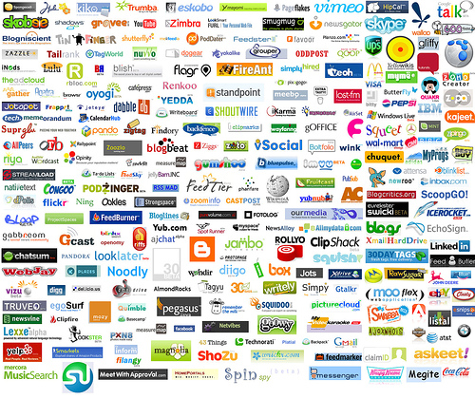
Web 2.0 is Upon Us

Slide 3



Web 1.0 → Web 2.0
Server-side
computation
Advantage of the AJAX model:
greater application responsiveness
JavaScript
+ DHTML
Static HTML
Client-side
computation
Client-side
rendering

Slide 4
Motivation

Slide 5
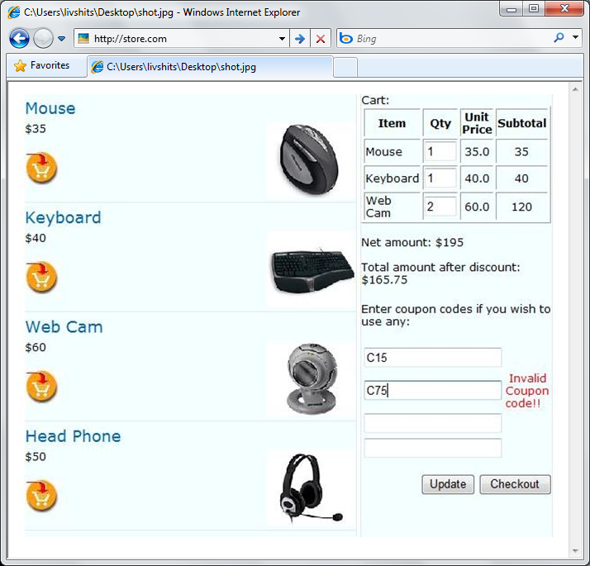
AJAX-based Shopping Cart (Fantasy)
client
server
1 final RPC
Notes:
Note: maybe show a picture of the browser here

Slide 6
Shopping Cart (Reality)
client
server
Notes:
Note: maybe show a picture of the browser here

Slide 7

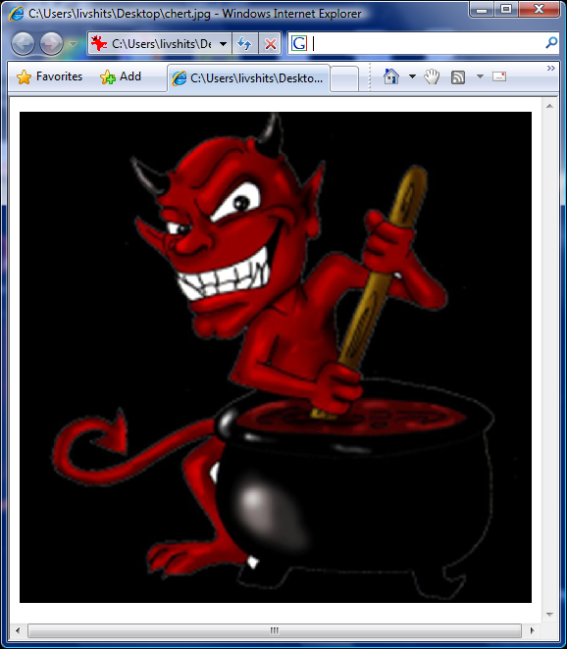
Web Developer’s Mantra
Thou shall not trust the client
No data integrity
No code integrity

Slide 8

Tension Headaches
Move code to the server for security
Move code to client for performance

Slide 9
Security vs. Performance
Web 1.0:
ASP.NET
PHP
With Ripley, placing computation on the client does not reduce
the computational integrity
security
Focus on integrity, not confidentiality
Doesn't not protect against other issues like SQL injection attacks
Ripley
Web 2.0:
AJAX
Silverlight
responsiveness

Slide 10
Architecture

Slide 11



Ripley Architecture
m'
Server
Ripley checker
m
Replica
Client
e
events = {key: ‘a’, id=‘name’; click: id=‘name’}
Keep a replica of the client code
Capture user events & transmit to server for replay
Compare server and client results

Slide 12
Zero-latency RPCs
Client
Replica
Server
Database
JavaScript
.NET
.NET
Notes:
Note: maybe show a picture of the browser here

Slide 13
Seems Too Much Like Magic. Is this Feasible?
Create deterministic replay system
  How to we replicate JavaScript code?
  Cross-browser differences?
  Non-determinism?
How do we scale it?
  Replica overhead on server
  Hundreds of concurrent replicas

Slide 14

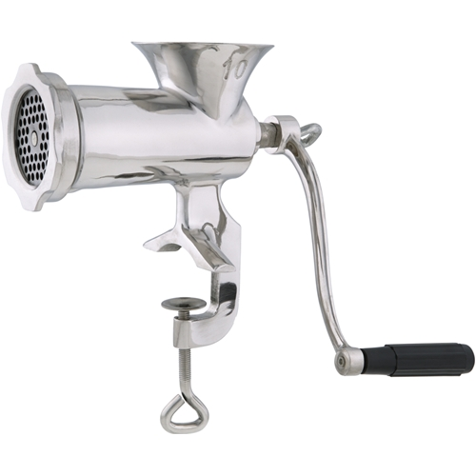

The Volta Distributing Compiler Illustrated
.NET bytecode
IL-to-IL
IL-to-JS
JS
Volta
Replica

Slide 15
Ripley Architecture
m'
Server
Ripley checker
m
Replica
Client
Client-side code instrumented
  Rewrite event handlers
  Capture “default” events
Network overhead
  Buffer events for performance
  Piggy-back on existing RPCs
e
events = {key: ‘a’, id=‘name’; click: id=‘name’}
Keep a replica of the client code
Capture user events & transmit to server for replay
Compare server and client results

Slide 16
Ripley Architecture
Run replica in a Ripley emulator
In .NET, not in JavaScript, 10-100x speed increase
m'
Server
Ripley checker
m
Replica
Client
e
events = {key: ‘a’, id=‘name’; click: id=‘name’}
Keep a replica of the client code
Capture user events & transmit to server for replay
Compare server and client results

Slide 17
Experiments

Slide 18
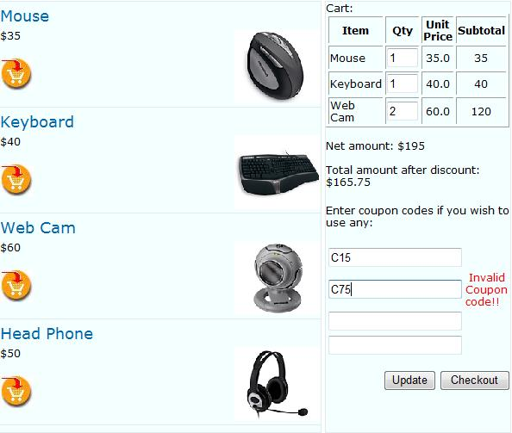
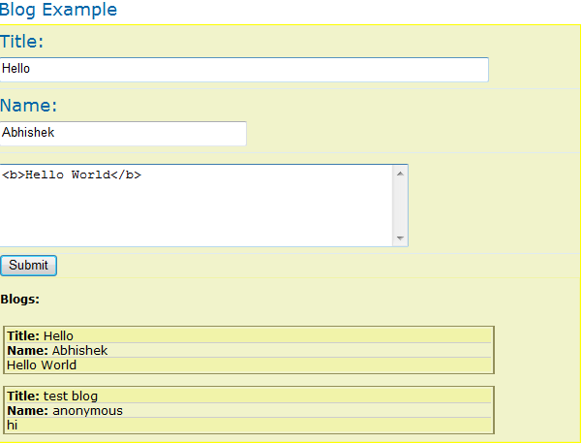
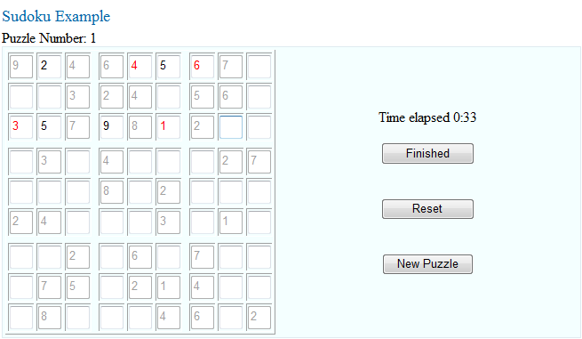
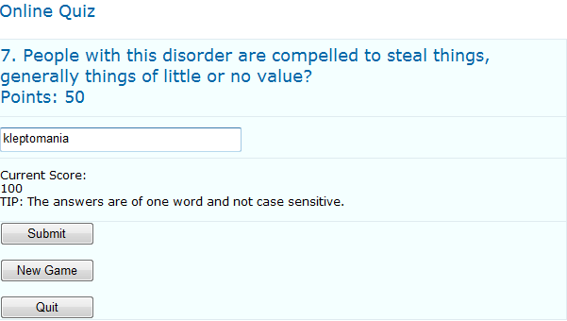
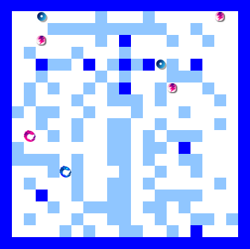
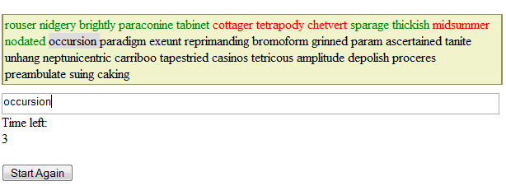
Ripley Applications
  Shopping cart
  Sudoku
  Blog
  Speed typing
  Online Quiz
  Distributed online game

Slide 19
Performance Overhead: Volta Benchmarks
Network:
Event stream compresses extremely well
Memory:
About 1 MB per connected client
2-3 bytes per user event (key press, mouse, etc.)
Can scale to 1,000’s of clients per server
CPU:
Client: Several ms of overhead added for event capture
Server: Several ms for server-side checking

Slide 20
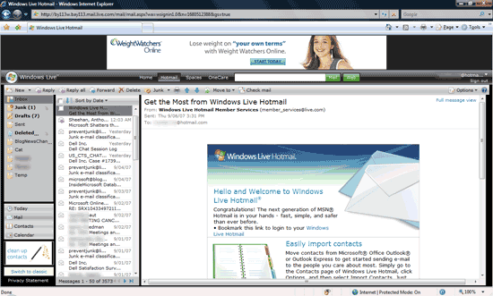
Replicating Hotmail
Hotmail size
  793 KB download
  703 KB JavaScript
  31,000+ lines of code
10 minutes of normal use
Requests: 617 KB
Responses: 3,045 KB

Slide 21
Replicating Hotmail
Ripley traffic:
Memory:
1.4% without compression (8.6 KB)
CPU overhead small:
Most time spent in HTML rendering and data marshaling code
0.4% otherwise (2.8 KB)
< 1.75 MB in total
Can scale up to hundreds of clients
Most: < 15 ms
Email message processing: 125 ms
DOM state in memory: 350 -- 450 KB
JavaScript heap state: 1.3 MB
491 keyboard & mouse events

Slide 22
Conclusions
Strong protection:
  Automatic protection of distributed web apps
  Provides strong integrity guarantees
Easy for developer:
  No developer involvement required
  Protects existing Volta apps out-of-the-box

Slide 23
Ripley: Vision for the Future
Secure-by-construction Software + Services
Web 2.0 App
Ripley server farm

Slide 24
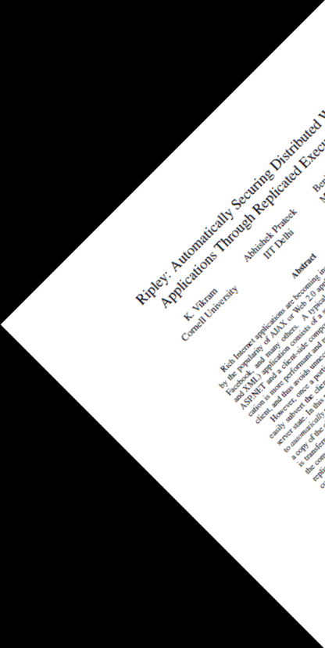

Contact us
Ben Livshits (livshits@microsoft.com)
Microsoft Research Ripley project

Slide 25
Malicious Event Stream
m'
Server
Ripley checker
m
Replica
Client
e
‘$%$^&’
events = {key: ‘$’, id=‘$%$^&’; click: id=‘name’}
Every attack against integrity of the Ripley-protected application was possible against the standalone app

