Slide 1
CLOUT (Computational Logic for Use in Teaching)
with
LPS (Logic-based Production Systems)
Robert Kowalski and Fariba Sadri
Imperial College London
Miguel Calejo
Interprolog.com

Slide 2
Outline:
The Goal
To reconcile and combine computational and logical thinking
The Problem
The Solution

Slide 3
CLOUT (Computational Logic for Use in Teaching)
Algorithmic thinking
using state transitions
Abstraction
Goals and beliefs
Problem decomposition
by backwards reasoning
Top down and bottom up reasoning
(= analysis and synthesis)
Computational
thinking
Logical
thinking

Slide 4
Outline:
The Goal
To reconcile and combine computational and logical thinking
The Problem
Two kinds of systems
The Solution

Slide 5
Two kinds of programming systems
e.g. logic programs
e.g. production systems

Slide 6
reactive rule

Slide 7
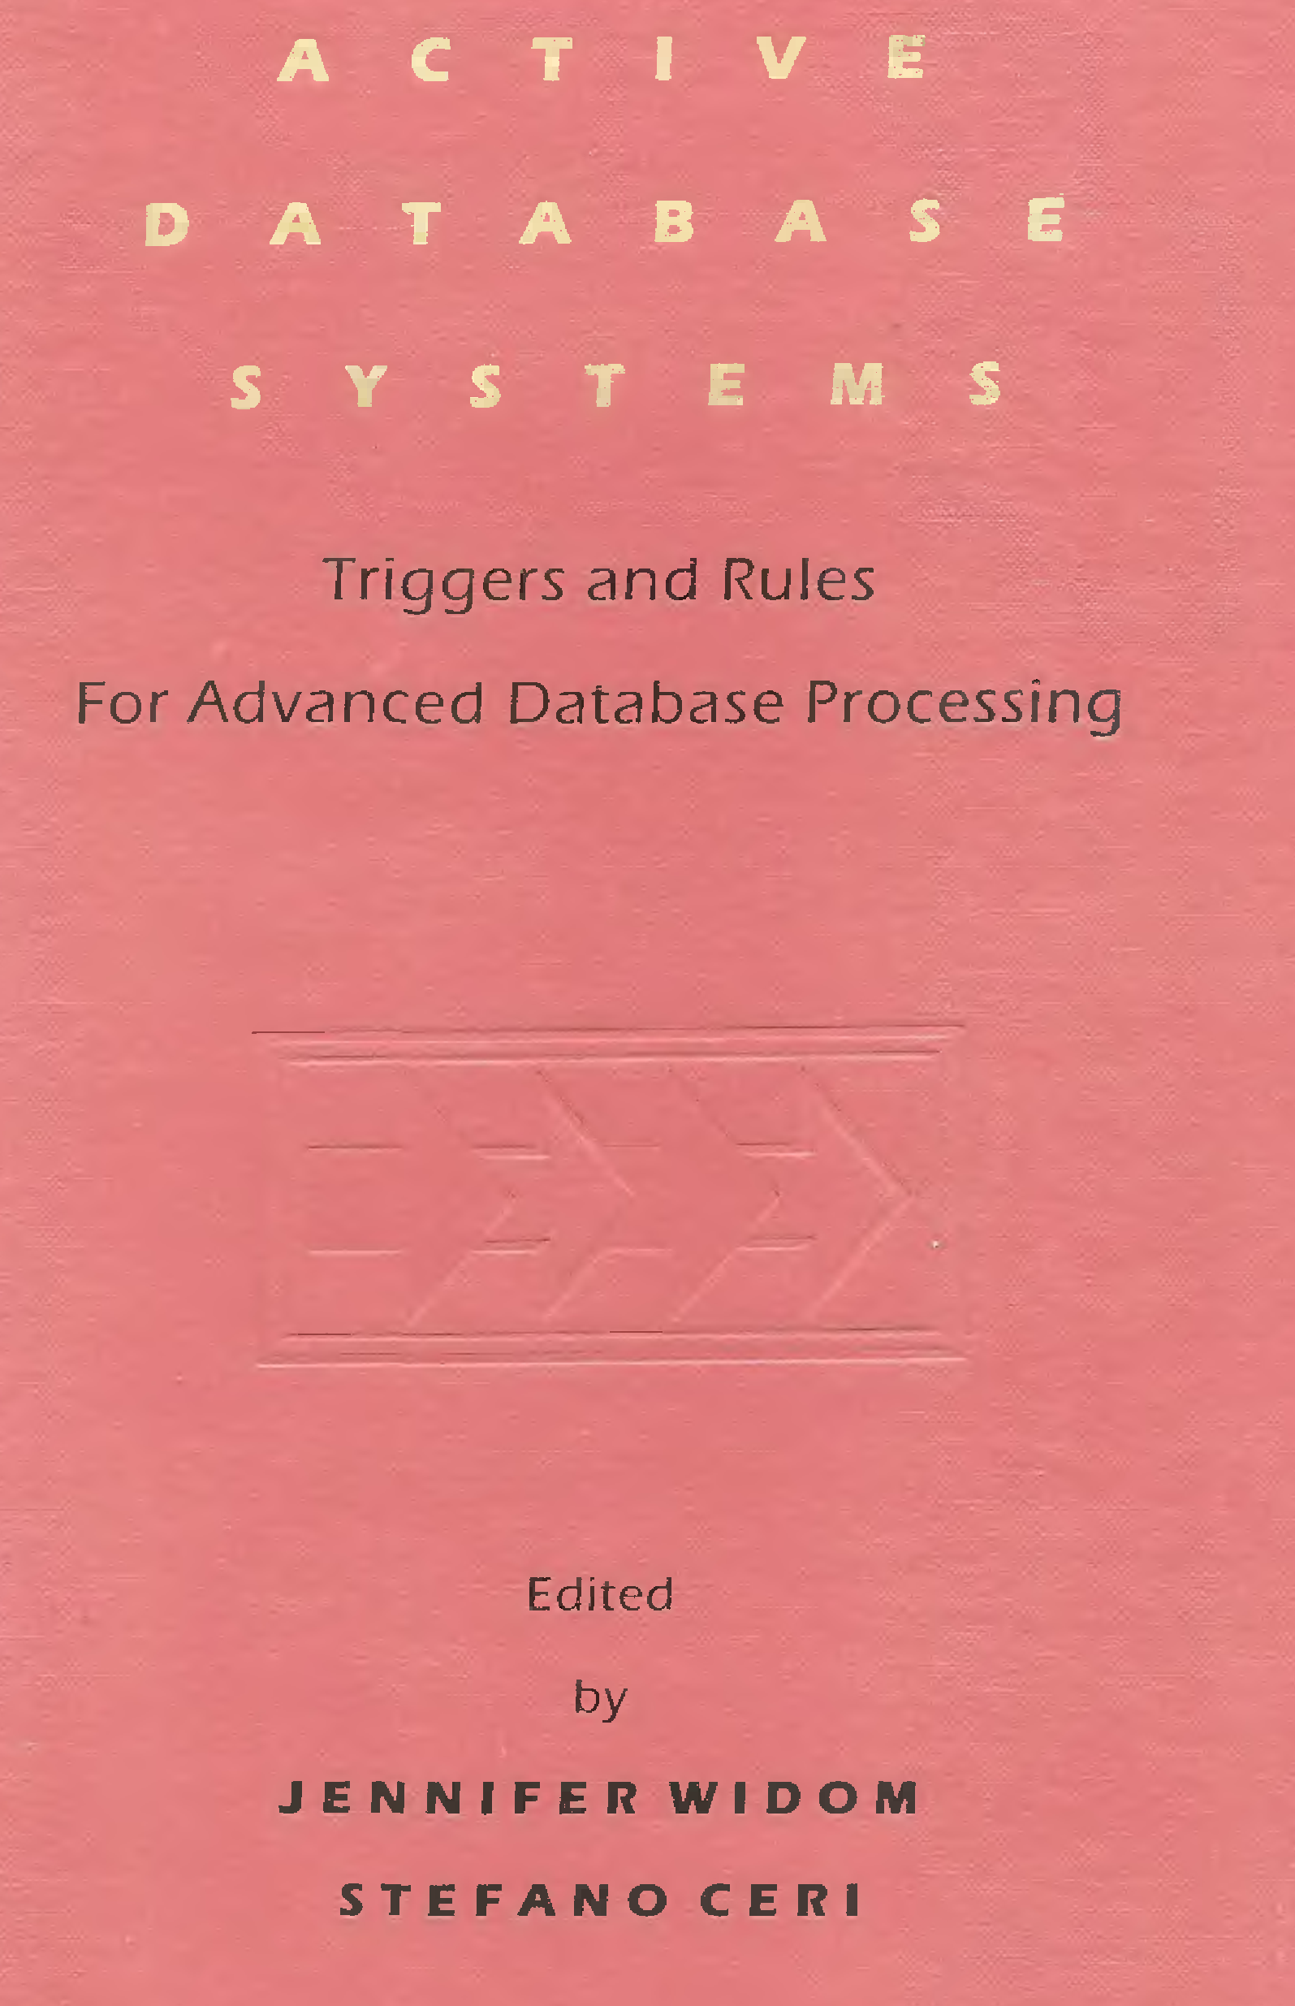
Two kinds of database systems: Active Databases and
Deductive Databases (e.g. Datalog)

Slide 8
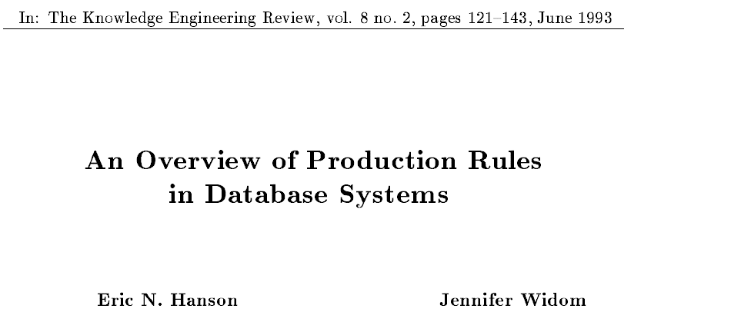
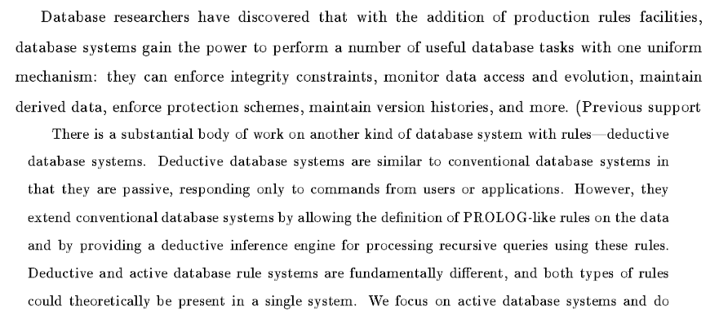

Slide 9
The Problem: Conventional logical languages
are not computationally feasible
e
Q
Q
e initiates q
e terminates p
p, u, v, w
q, u, v, w
time t
time t+1
It is necessary to reason that
u is true at time t+1 because u was true at time t
and u was not terminated from t to t+1.
v is true at time t+1 because v was true at time t
and v was not terminated from t to t+1.
9
w is true at time t+1 because w was true at time t
and w was not terminated from t to t+1.

Slide 10
The Problem: Imperative languages do not have a logical meaning
if A then B means change of state. e.g.
If A holds then do B. (“imperative”)
Programming
state charts
abstract state machines
Databases
active databases
AI
production systems
agent languages
if A then B
does not have a logical meaning
States change
destructively.

Slide 11
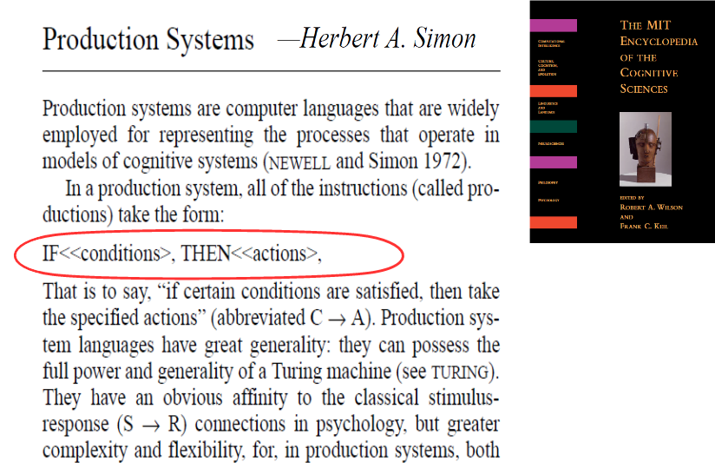
Production systems do not have a logical meaning

Slide 12
Production systems do not have a logical meaning
fire ⇒ deal-with-fire
deal-with-fire ⇒ eliminate
deal-with-fire⇒ escape
Adding fire to working memory.
Triggers two candidate actions eliminate and escape.
Conflict resolution decides between them.

Slide 13
Production rules and logic programs:
It can be hard to tell the difference.
“Rules are if-then structures...
very similar to the conditionals... (of logic)
but they have very different
representational and computational properties.”

Slide 14
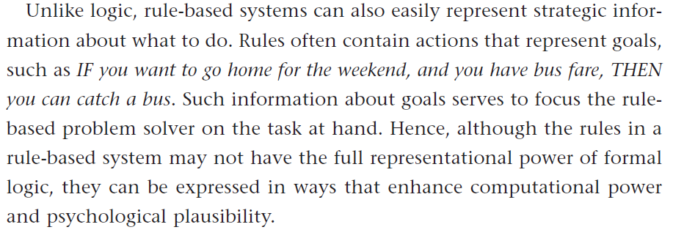
Reactive rules and logic programs:
It can be hard to tell the difference
This production rule in Thagard’s Mind
is a logic program (or belief) in LPS:
You go home from T1 to T2
if you have the bus fare at T1,
you catch a bus from T1 to T2.
(combined with backward reasoning)

Slide 15
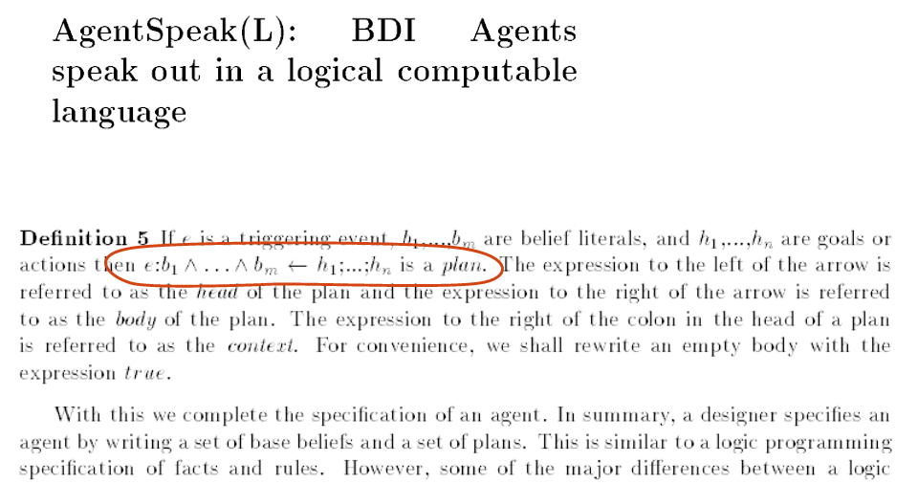
Reactive rules and logic programs:
It can be hard to tell the difference

Slide 16
LPS and BDI agents compared
This “logic programming-like” plan in AgentSpeak
is a reactive rule (or goal) in LPS:
if location(waste, X) at T1, location(robot, X) at T1, location(bin, Y) atT1
then pick(waste) fromT1 to T2,
move-to-location(robot, Y) fromT2 to T3,
drop(waste) from T3 to T4.

Slide 17
Goals and Beliefs:
It can be hard to tell the difference.
All humans are mortal.
All humans are kind.
Goals: if human(X) then mortal(X).
if human(X) then kind(X).
or
Beliefs: mortal(X) if human(X).
kind(X) if human(X).

Slide 18
Outline:
The Goal
To reconcile and combine computational and logical thinking
The Problem
Two kinds of systems
The Solution
Goals and Beliefs
Model generation
(with explicit representation of events and time)

Slide 19
LPS: Computation = Model Generation
Computation executes actions
to generate a world model
to make goals true.
A world model is the minimal model of a
logic program describing beliefs about
states, actions, external events,
intentional predicates, and
complex events and plans.

Slide 20
LPS: Computation generates actions to make reactive rules true
Actions
The current state is updated
destructively
Actions are
chosen and
combined with
external events
Reactive rules whose conditions are true
are triggered.
Logic programs
reduce goals to
subgoals and actions
External events

Slide 21
LPS combines reactive rules, logic programs and causal laws
Reactive rule: if fire then deal-with-fire.
Logic program: deal-with-fire if eliminate.
deal-with-fire if escape.
Causal law: eliminate terminates fire.
Adding fire to the current state.
Generates two alternative actions eliminate or escape.
Generates alternative sequences of states
to make the reactive rule true:
eliminate
escape
escape
Q
fire
or
fire
fire
fire

Slide 22
World models are sequences of states, actions and external events, described by atomic sentences
without time stamps
for efficiency
States are sets of facts (or fluents):
fire
Events (including actions) cause state transitions:
eliminate
with time stamps
for logical semantics
fire(10:15)
eliminate(10:15, 10:16)

Slide 23
The syntax of LPS
Reactive rules in First-order logic:
for all X [ antecedent → there exists Y consequent]
or if antecedent then consequent.
Clauses in logic programming form:
for all X [there exists Y conditions → conclusion]
or conclusion if conditions.

Slide 24
The syntax of LPS
without time stamps
for readability
Reactive rules:
if fire
then deal-with-fire.
Logic programs:
deal-with-fire
if eliminate.
with time stamps
for logical semantics
if fire at T1
then deal-with-fire fromT2 to T3,
T1≤ T2.
deal-with-fire from T1 to T2
if eliminate fromT1 to T2.

Slide 25
State transitions are described by a “programmable” causal theory
Postconditions (effects):
ignite(Object) initiates fire if flammable(Object).
eliminate terminates fire.
Preconditions (constraints):
false eliminate, fire, not water.
Persistence (inertia):
Fact/fluents persist without needing to reason that they persist.

Slide 26
% Fire example with keywords in blue.
fluents fire.
actions eliminate, escape.
events deal_with_fire.
initially fire.
if fire at T1
then deal_with_fire from T1 to T2.
deal_with_fire from T1 to T2
if eliminate from T1 to T2.
deal_with_fire from T1 to T2
if escape from T1 to T2.
eliminate terminates fire.

Slide 27
maxTime(10).
fluents fire, water.
actions eliminate, ignite(_), escape, refill.
observe ignite(sofa) from 1 to 2.
observe ignite(bed) from 4 to 5.
observe refill from 7 to 8.
initially water.
flammable(sofa).
flammable(bed).
if fire at T1
then deal_with_fire from T2 to T3.
deal_with_fire from T1 to T2
if eliminate from T1 to T2.
deal_with_fire from T1 to T2
if escape from T1 to T2.
ignite(Object) initiates fire if flammable(Object).
eliminate terminates fire.
eliminate terminates water.
refill initiates water.
false eliminate, fire, not water.

Slide 28
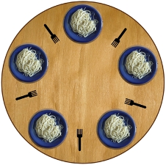
The Dining Philosophers

Slide 29
maxTime(7).
fluents available(_).
actions pickup(_,_), putdown(_,_).
initially available(fork1), available(fork2), available(fork3), available(fork4), available(fork5).
philosopher(socrates).
philosopher(plato).
philosopher(aristotle).
philosopher(hume).
philosopher(kant).
adjacent(fork1, socrates, fork2).
adjacent(fork2, plato, fork3).
adjacent(fork3, aristotle, fork4).
adjacent(fork4, hume, fork5).
adjacent(fork5, kant, fork1).

Slide 30
% dining philosophers
if philosopher(P)
then dine(P) from T1 to T2.
dine(P) from T1 to T3 if
adjacent(F1, P, F2),
pickup(P, F1) from T1 to T2,
pickup(P, F2) from T1 to T2,
putdown(P, F1) from T2 to T3,
putdown(P, F2) from T2 to T3 .
pickup(P, F) terminates available(F).
putdown(P, F) initiates available(F).
false pickup(P, F), not available(F).
false pickup(P1, F), pickup(P2, F), P1 \= P2.

Slide 31
What happens if we replace:
dine(P) from T1 to T3 if
adjacent(F1, P, F2),
pickup(P, F1) from T1 to T2,
pickup(P, F2) from T1 to T2,
putdown(P, F1) from T2 to T3,
putdown(P, F2) from T2 to T3.
with:
dine(P) from T1 to T5 if
adjacent(F1, P, F2),
pickup(P, F1) from T1 to T2,
pickup(P, F2) from T2 to T3,
putdown(P, F1) from T3 to T4,
putdown(P, F2) from T4 to T5.

Slide 32
Conclusions
LPS combines
computational thinking and
logical thinking.
LPS is a practical, logical framework for computing.
LPS is not a full-scale framework for intelligent thinking,
but it can be extended.

Slide 33
maxTime(7).
fluents available(_).
actions pickup(_,_), putdown(_,_).
initially available(fork1), available(fork2), available(fork3), available(fork4), available(fork5).
philosopher(socrates).
philosopher(plato).
philosopher(aristotle).
philosopher(hume).
philosopher(kant).
adjacent(fork1, socrates, fork2).
adjacent(fork2, plato, fork3).
adjacent(fork3, aristotle, fork4).
adjacent(fork4, hume, fork5).
adjacent(fork5, kant, fork1).
if philosopher(P)
then dine(P) from T1 to T2.
dine(P) from T1 to T3 if
adjacent(F1, P, F2),
pickup(P, F1) from T1 to T2,
pickup(P, F2) from T1 to T2,
putdown(P, F1) from T2 to T3,
putdown(P, F2) from T2 to T3 .
pickup(P, F) terminates available(F).
putdown(P, F) initiates available(F).
false pickup(P, F), not available(F).
false pickup(P1, F), pickup(P2, F), P1 \= P2.

Slide 34
% The map colouring problem.
maxTime(5).
actions paint(_, _).
country(sweden).
country(norway).
country(finland).
country(russia).
colour(red).
colour(yellow).
colour(blue).
adjacent(sweden, norway).
adjacent(sweden, finland).
adjacent(norway, finland).
adjacent(norway, russia).
adjacent(finland, russia).
sweden
norway
finland
russia

Slide 35
% The map colouring problem.
maxTime(5).
actions paint(_, _).
country(iz).
country(oz).
country(az).
country(uz).
colour(red).
colour(yellow).
colour(blue).
adjacent(az, iz).
adjacent(az, oz).
adjacent(iz, oz).
adjacent(iz, uz).
adjacent(oz, uz).
az
iz
oz
uz

Slide 36
% The map colouring problem
% For every country X, there exists a colour C.
if country(X)
then colour(C), paint(X, C) from 1 to 2.
% Two adjacent countries cannot be painted the same colour.
false paint(X, C), adjacent(X, Y), paint(Y, C).
/* We can also write
if country(X)
then colour(C), paint(X, C) from T1 to T2.
*/

Slide 37
% The map colouring problem.
maxTime(5).
actions paint(_, _).
country(iz).
country(oz).
country(az).
country(uz).
colour(red).
colour(yellow).
colour(blue).
adjacent(az, iz).
adjacent(az, oz).
adjacent(iz, oz).
adjacent(iz, uz).
adjacent(oz, uz).
if country(X)
then colour(C), paint(X, C) from 1 to 2.
false paint(X, C), adjacent(X, Y), paint(Y, C).

Slide 38
Bubble sort
Keep swapping adjacent elements that are out of order until the array is ordered.
d c b a
c d b a
c b d a
And so on …..
a b c d

Slide 39
% bubble sort with relational data structure .
maxTime(5).
fluents location(_, _).
actions swap(_,_,_,_).
initially location(d, 1), location(c, 2), location(b, 3), location(a,4).
if location(X, N1) at T1, N2 is N1 +1, location(Y, N2) at T1, Y@<X
then swapped(X, N1, Y, N2) from T2 to T3.
% swapped may not work if the order of the two clauses below is
% reversed. Perhaps for good reasons.
swapped(X, N1, Y, N2) from T1 to T2
if location(X, N1) at T1, location(Y, N2) at T1,
Y@<X, swap(X, N1, Y, N2) from T1 to T2.
swapped(X, N1, Y, N2) from T to T
if location(X, N1) at T, location(Y, N2) at T, X@<Y.
swap(X, N1, Y, N2) initiates location(X, N2).
swap(X, N1, Y, N2) initiates location(Y, N1).
swap(X, N1, Y, N2) terminates location(X, N1).
swap(X, N1, Y, N2) terminates location(Y, N2).
false swap(X, N1, Y, N2), swap(Y, N2, Z, N3).

Slide 40
LPS executes actions concurrently
Time 1
d c b a
Time 2
c d a b
Time 3
c a d b
a c b d
Time 4
Time 5
a b c d

Slide 41
Teleo-reactivity
If later an object is moved, the same program will sort them again.
observe swap(a,1,c,3) from 11 to 12.
observe swap(b,2,c,3) from 15 to 16.
a b c d
Time 11
c b a d
Time 12
b c a d
b a c d
a b c d
Time 15
a c b d
Time 16
a b c d

Slide 42
maxTime(20).
fluents location(_, _).
actions swap(_,_,_,_).
observe swap(a,1,c,3) from 11 to 12. %new
observe swap(b,2,c,3) from 15 to 16. %new
initially location(d, 1), location(c, 2), location(b, 3), location(a,4).
if location(X, N1) at T1, N2 is N1 +1, location(Y, N2) at T1, Y@<X
then swapped(X, N1, Y, N2) from T2 to T3.
% swapped may not work if the order of the two clauses below is
% reversed. Perhaps for good reasons.
%
swapped(X, N1, Y, N2) from T1 to T2
if location(X, N1) at T1, location(Y, N2) at T1,
Y@<X, swap(X, N1, Y, N2) from T1 to T2.
swapped(X, N1, Y, N2) from T to T
if location(X, N1) at T, location(Y, N2) at T, X@<Y.
swap(X, N1, Y, N2) initiates location(X, N2).
swap(X, N1, Y, N2) initiates location(Y, N1).
swap(X, N1, Y, N2) terminates location(X, N1).
swap(X, N1, Y, N2) terminates location(Y, N2).
false swap(X, N1, Y, N2), swap(Y, N2, Z, N3).

Slide 43
% bankTransfer
maxTime(9).
actions transfer(From, To, Amount).
fluents balance(Person, Amount).
initially balance(bob, 0), balance(fariba, 100).
observe transfer(fariba, bob, 10) from 0 to 1.
if transfer(fariba, bob, X) from T1 to T2
then transfer(bob, fariba, 10) from T2 to T3.
if transfer(bob, fariba, X) from T1 to T2
then transfer(fariba, bob, 20) from T2 to T3.

Slide 44
% bankTransfer – the Causal Theory.
transfer(From, To, Amount) initiates balance(To, New)
if balance(To, Old), New is Old + Amount.
transfer(From, To, Amount) terminates balance(To, Old).
transfer(From, To, Amount) initiates balance(From, New)
if balance(From, Old), New is Old - Amount.
transfer(From, To, Amount) terminates balance(From, Old).
false transfer(From, To, Amount), balance(From, Old), Old < Amount.
false transfer(From, To1, Amount1),
transfer(From, To2, Amount2), To1 \=To2.
false transfer(From1, To, Amount1),
transfer(From2, To, Amount2), From1 \= From2.

Slide 45
% bankTransfer
maxTime(9).
actions transfer(From, To, Amount).
fluents balance(Person, Amount).
initially balance(bob, 0), balance(fariba, 100).
observe transfer(fariba, bob, 10) from 0 to 1.
if transfer(fariba, bob, X) from T1 to T2
then transfer(bob, fariba, 10) from T2 to T3.
if transfer(bob, fariba, X) from T1 to T2
then transfer(fariba, bob, 20) from T2 to T3.
transfer(From, To, Amount)initiates balance(To, New)
if balance(To, Old), New is Old + Amount.
transfer(From, To, Amount) terminates balance(To, Old).
transfer(From, To, Amount) initiates balance(From, New)
if balance(From, Old), New is Old - Amount.
transfer(From, To, Amount) terminates balance(From, Old).
false transfer(From, To, Amount), balance(From, Old), Old < Amount.
false transfer(From, To1, Amount1),
transfer(From, To2, Amount2), To1 \=To2.
false transfer(From1, To, Amount1),
transfer(From2, To, Amount2), From1 \= From2.

Slide 46
Natural language grammars can be represented by logic programs
sentence -> nounphrase, verbphrase
nounphrase -> adjective, noun
nounphrase -> noun
verbphrase -> verb, nounphrase
verbphrase -> verb
adjective -> my
adjective -> your
noun -> name
noun -> what
noun -> bob
verb -> is
-> is the opposite of logical if.

Slide 47
% sentences as complex events and as complex plans
maxTime(10).
observe say(turing, what) from 0 to 1.
observe say(turing, is) from 1 to 2.
observe say(turing, your) from 2 to 3.
observe say(turing, name) from 3 to 4.
if saying(turing, sentence) from T1 to T2
then saying(robot, sentence) from T3 to T4.
saying(Agent, sentence) from T1 to T3 if
saying(Agent, nounphrase) from T1 to T2,
saying(Agent, verbphrase) from T2 to T3.

Slide 48
saying(Agent, nounphrase) from T1 to T3 if
saying(Agent, adjective) from T1 to T2,
saying(Agent, noun) from T2 to T3.
saying(Agent, nounphrase) from T1 to T2 if
saying(Agent, noun) from T1 to T2.
saying(Agent, verbphrase) from T1 to T3 if
saying(Agent, verb) from T1 to T2,
saying(Agent, nounphrase) from T2 to T3.
saying(Agent, verbphrase) from T1 to T2 if
saying(Agent, verb) from T1 to T2.
saying(Agent, adjective) from T1 to T2 if say(Agent, my) from T1 to T2.
saying(Agent, adjective) from T1 to T2 if say(Agent, your) from T1 to T2.
saying(Agent, noun) from T1 to T2 if say(Agent, name) from T1 to T2.
saying(Agent, noun) from T1 to T2 if say(Agent, what) from T1 to T2.
saying(Agent, noun) from T1 to T2 if say(Agent, bob) from T1 to T2.
saying(Agent, verb) from T1 to T2 if say(Agent, is) from T1 to T2.

Slide 49
fluents said(_,_).
actions say(_,_).
initially said(turing, []), said(robot, []).
say(Agent, Word) initiates said(Agent, NewPhrase)
if said(Agent, OldPhrase),
append(OldPhrase, [Word], NewPhrase).
say(Agent, Word) terminates said(Agent, OldPhrase)
if said(Agent, OldPhrase).
false say(Agent, Word1),
say(Agent, Word2),
Word1 \= Word2.

Slide 50
maxTime(10).
fluents said(_,_).
actions say(_,_).
observe say(turing, what) from 0 to 1.
observe say(turing, is) from 1 to 2.
observe say(turing, your) from 2 to 3.
observe say(turing, name) from 3 to 4.
if saying(turing, sentence) from T1 to T2 then saying(robot, sentence) from T3 to T4.
saying(Agent, sentence) from T1 to T3 if saying(Agent, nounphrase) from T1 to T2,
saying(Agent, verbphrase) from T2 to T3.
saying(Agent, nounphrase) from T1 to T3 if saying(Agent, adjective) from T1 to T2,
saying(Agent, noun) from T2 to T3.
saying(Agent, nounphrase) from T1 to T2 if saying(Agent, noun) from T1 to T2.
saying(Agent, verbphrase) from T1 to T3 if saying(Agent, verb) from T1 to T2,
saying(Agent, nounphrase) from T2 to T3.
saying(Agent, verbphrase) from T1 to T2 if saying(Agent, verb) from T1 to T2.
saying(Agent, adjective) from T1 to T2 if say(Agent, my) from T1 to T2.
saying(Agent, adjective) from T1 to T2 if say(Agent, your) from T1 to T2.
saying(Agent, noun) from T1 to T2 if say(Agent, name) from T1 to T2.
saying(Agent, noun) from T1 to T2 if say(Agent, what) from T1 to T2.
saying(Agent, noun) from T1 to T2 if say(Agent, bob) from T1 to T2.
saying(Agent, verb) from T1 to T2 if say(Agent, is) from T1 to T2.
initially said(turing, []), said(robot, []).
say(Agent, Word) initiates said(Agent, NewPhrase) if said(Agent, OldPhrase), append(OldPhrase, [Word], NewPhrase).
say(Agent, Word) terminates said(Agent, OldPhrase) if said(Agent, OldPhrase).
false say(Agent, Word1), say(Agent, Word2), Word1 \= Word2.

