Slide 1
Logic and Smart Contracts
Robert Kowalski, Imperial College London
Miguel Calejo, Interprolog.com
Fariba Sadri, Imperial College London

Slide 2
Outline
Imperative languages for
smart contracts
Logic for
legal documents
Combining logical and imperative semantics for
smart contracts

Slide 3
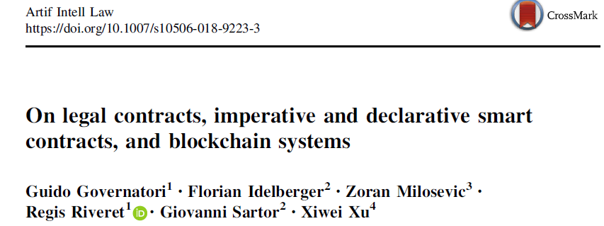
The term ‘smart contract’ was initially proposed in the early 90s for e-commerce
applications (Szabo 1997) but has recently been widely used in the context of
distributed ledger technologies and in particular blockchain technologies ….
In this context, a smart contract is any self-executing program running
in the distributed ledger environment, and it is often meant to implement
automated transactions agreed by the parties….
While not every smart contract has legal significance, many smart contracts are
linked to legal contracts, namely with agreements meant to have legal effect.

Slide 5
Step by step towards creating a safe smart contract:
Lessons and insights from a cryptocurrency lab
K Delmolino, M Arnett, A Kosba, A Miller… - … Conference on Financial …, 2016 – Springer
… pitfalls in programming safe smart contracts. The student is presented with the buggy version of the contract and asked to fix the bugs in a step-by-step, guided manner.
Cited by 118 Related articles All 11 versions

Slide 6
Rock–paper–scissors is
a zero-sum game
played between two people.
Each player simultaneously forms one of three shapes
with an outstretched hand:
rock ✊
paper ✋
scissors ✌️

Slide 7
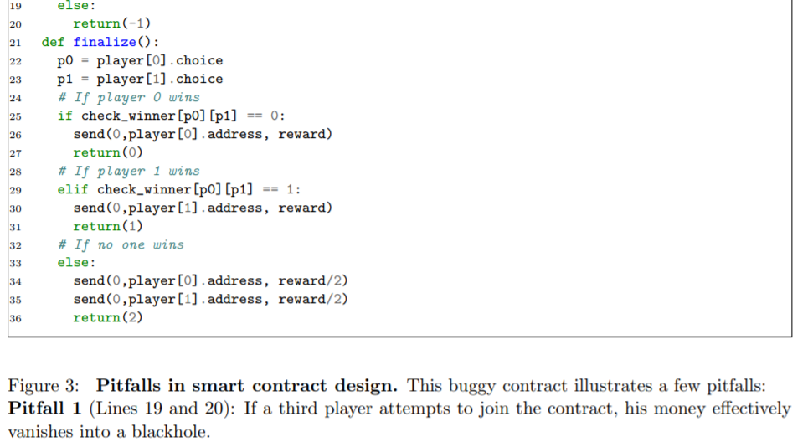
A typical smart contract is written in an imperative programming language with
condition-action rules (sometimes called “conditional logic”).

Slide 8
a consortium of lawyers and organizations,
developing a “functional programming language”, Ergo
“for the formation and execution of smart legal contracts
in a blockchain-agnostic standard implementation”.

Slide 9
Specification
The Late Delivery And Penalty clause in the typical legal contract looks like this:
Late Delivery and Penalty. In case of delayed delivery except for Force Majeure cases, the Seller shall pay to the Buyer for every 2 weeks of delay penalty amounting to 10.5% of total value of the Equipment whose delivery has been delayed. Any fractional part of a week is to be considered a full week. The total amount of penalty shall not, however, exceed 55% of the total value of the Equipment involved in late delivery. If the delay is more than 10 weeks, the Buyer is entitled to terminate this Contract.

Slide 10
namespace org.accordproject.latedeliveryandpenalty
import org.accordproject.common.*
import org.accordproject.latedeliveryandpenalty.*
// Declare a contract over a template model
contract LateDeliveryAndPenalty over TemplateModel {
// Clause checking for late delivery and calculating penalty
clause latedeliveryandpenalty(request : LateDeliveryAndPenaltyRequest) : LateDeliveryAndPenaltyResponse throws Error {
// Guard against calling late delivery clause too early
define variable agreed = request.agreedDelivery;
enforce momentIsBefore(agreed,now()) else
throw new Error{ message : "Cannot exercise late delivery before delivery date" }
;
// Guard against force majeure
enforce !contract.forceMajeure or !request.forceMajeure else
return new LateDeliveryAndPenaltyResponse{
penalty: 0.0,
buyerMayTerminate: true
}
;
// Calculate the time difference between current date and agreed upon date
define variable diff = momentDiffDays(now,agreed);
// Penalty formula
define variable penalty =
(diff / contract.penaltyDuration.amount) * contract.penaltyPercentage/100.0 * request.goodsValue;
// Penalty may be capped
define variable capped = min([penalty, contract.capPercentage/100.0 * request.goodsValue]);
// Return the response with the penalty and termination determination
return new LateDeliveryAndPenaltyResponse{
penalty: capped,
buyerMayTerminate: diff > contract.termination.amount
}
}
}

Slide 11
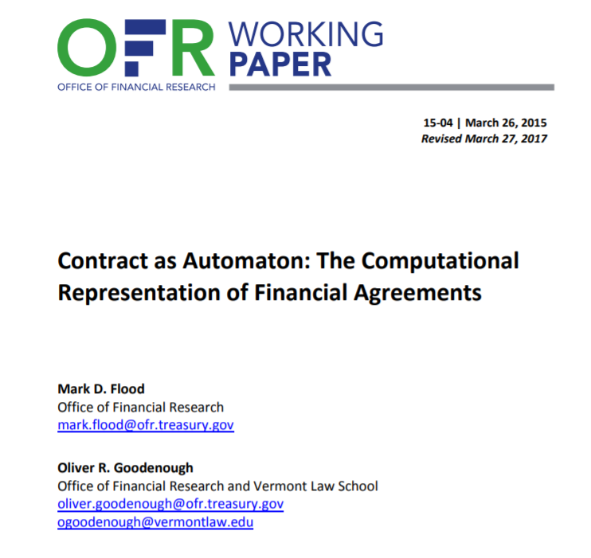
Key Messages
• Financial contracts are structured internally as state-transition systems.
• Discrete finite automata (DFA) are an adequate formalism to represent this structure as finite sets of states, events, and transitions.

Slide 12
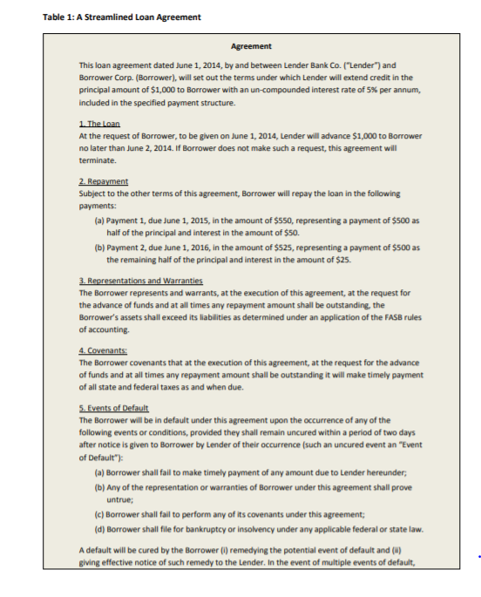

Slide 13
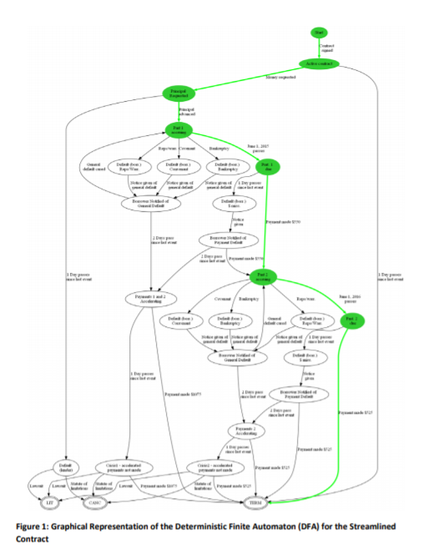

Slide 14
Outline
Imperative languages for
smart contracts
Logic for
legal documents
Combining logical and imperative semantics for
smart contracts

Slide 15
Symbolic logic: a razor-edged tool for drafting and interpreting legal documents, Yale Law J. 66 (1957) 833–879.

Slide 16
Allen & Saxon (1984)
"The University may terminate this lease when the Lessee, having made application and executed this lease in advance of enrollment, is not eligible to enroll or fails to enroll in the University or leaves the University at any time prior to the expiration of this lease, or for violation of any provisions of this lease, or for violation of any University regulation relative to Resident Halls, or for health reasons, by providing the student with written notice of this termination 30 days prior to the effective time of termination; unless life, limb, or property would be jeopardized, the Lessee engages in the sales or purchase of controlled substances in violation of federal, state or local law, or the Lessee is no longer enrolled as a student, or the Lessee engages in the use or possession of firearms, explosives, inflammable liquids, fireworks, or other dangerous weapons within the building, or turns in a false alarm, in which cases a maximum of 24 hours notice would be sufficient".

Slide 17
The clause consists of a single sentence
with the ambiguous form:
A if A1 and A2 or A3 or A4 or A5 or A6 or A7
unless B1 or B2 or B3 or B4 or B5 in which cases B.
Allen & Saxon (1984) identify approximately 80 questions
to disambiguate between all possible interpretations.
They conclude that the intended interpretation is:
((A IF ((A1 AND (A2 OR A3)) OR A4 OR A5 OR A6 OR A7))
IF NOT (B1 OR B2 OR B3 OR B4 OR B5))
AND (IF (B1 OR B2 OR B3 OR B4 OR B5) THEN B).
AND (IF NOT (B1 OR B2 OR B3 OR B4 OR B5) THEN NOT B

Slide 19
The British Nationality Act as a logic program. 1986
Sergot, Sadri, Kowalski, Kriwaczek, Hammond. and Cory
Communications of the ACM, 29(5), pp.370-386.
English
1.-(1) A person born in the United Kingdom after commencement shall be a British citizen
if at the time of the birth his father or mother is
(a) a British citizen; or
(b) settled in the United Kingdom.
Logic Program
X acquires british citizenship by subsection 1.1 at time T
if X is born in the uk at time T
and T is after commencement
and Y is father of X or
Y is mother of X
and Y is a british citizen at time T or Y is settled in the united kingdom at time T.

Slide 20
The University of Michigan lease termination clause
as a logic program
A if A1 and A2 and not exception.
A if A1 and A3 and not exception.
A if A4 and not exception.
A if A5 and not exception.
A if A6 and not exception.
A if A7 and not exception.
exception if B1.
exception if B2.
exception if B3.
exception if B4.
exception if B5.
B if exception.

Slide 21
AI, Logic and Law – State of the Art – notable examples
Defeasible deontic logic - related to LegalRuleML.
Legal Specification Protocol working group.
Accord Project, developing the Ergo language.
Contract Definition Language, at Stanford.
Ergo of Coherent Knowledge.
Legalese developing the L4 language.
Neota “Logic”.
Objects, Logic and English (OLE)

Slide 22
Outline
Imperative languages for
smart contracts
Logic for
legal documents
Combining logical and imperative semantics for
smart contracts.

Slide 23
AI, Logic and smart contracts – next steps
To sum up our comparison of imperative and declarative smart contracts, the
declarative approach has significant advantages over its imperative counterpart.
However, it is arguable that a full representation of a smart contract has to explicitly establish and link the normative effects (rights, obligation, transfers of entitlement) resulting from the contract with the procedure for implementing these rights and obligations through the computational actions performed by the contract, in the given infrastructure.
Hence, a hybrid approach combining imperative and declarative components would help to bridge the gap between smart contracts and their legal counterparts.

Slide 24
reactive rule
logic program clause
LPS aims to close the gap between logical and imperative computer languages,
by performing actions to generate models to make goals of the logical form
if antecedent then consequent true.
Model generation serves as a global imperative,
which generates commands to make consequents true
whenever antecedents become true.
LPS also includes beliefs of the logical form conclusion if conditions.
In addition to their logical interpretation,
beliefs also have an imperative interpretation as procedures,
which make or determine whether a conclusion is true
by making or determining whether the conditions are true.

Slide 25
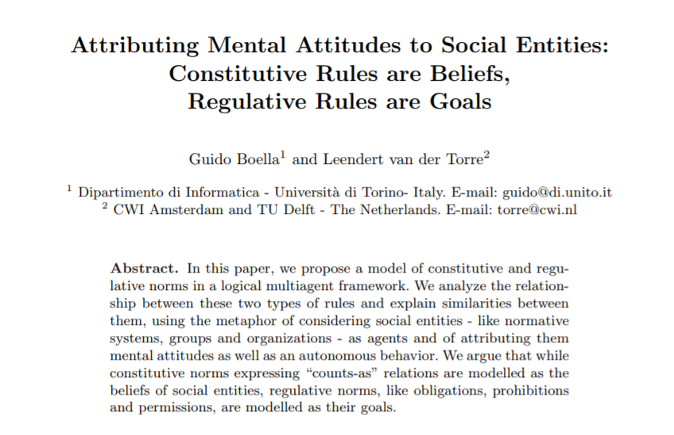
2004. Proceedings of Collective Intentionality CollInt, 4.

Slide 26
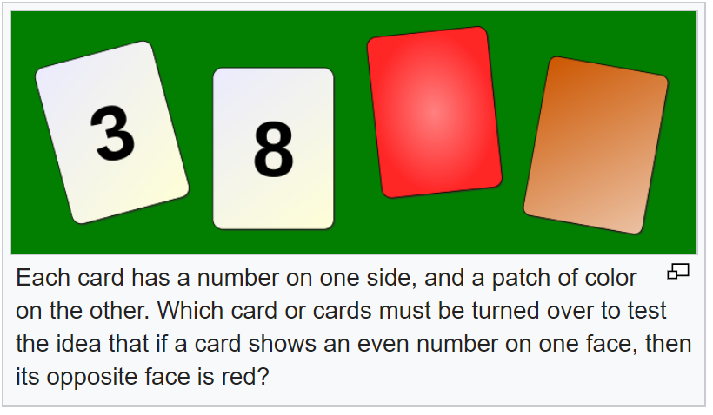
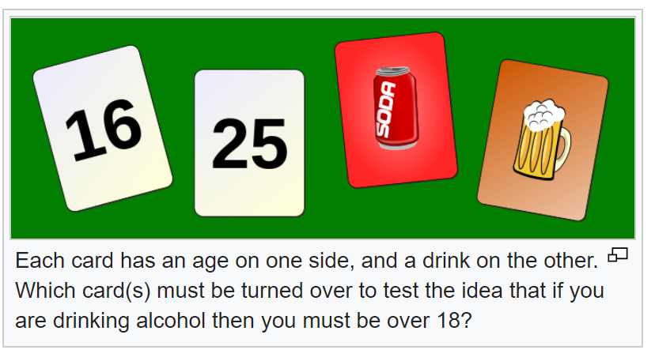
Goals and Beliefs: It can be hard to tell the difference

Slide 27
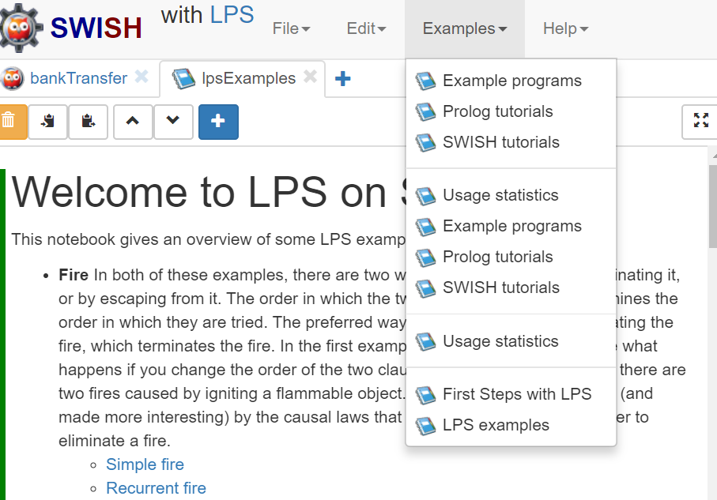

Slide 28
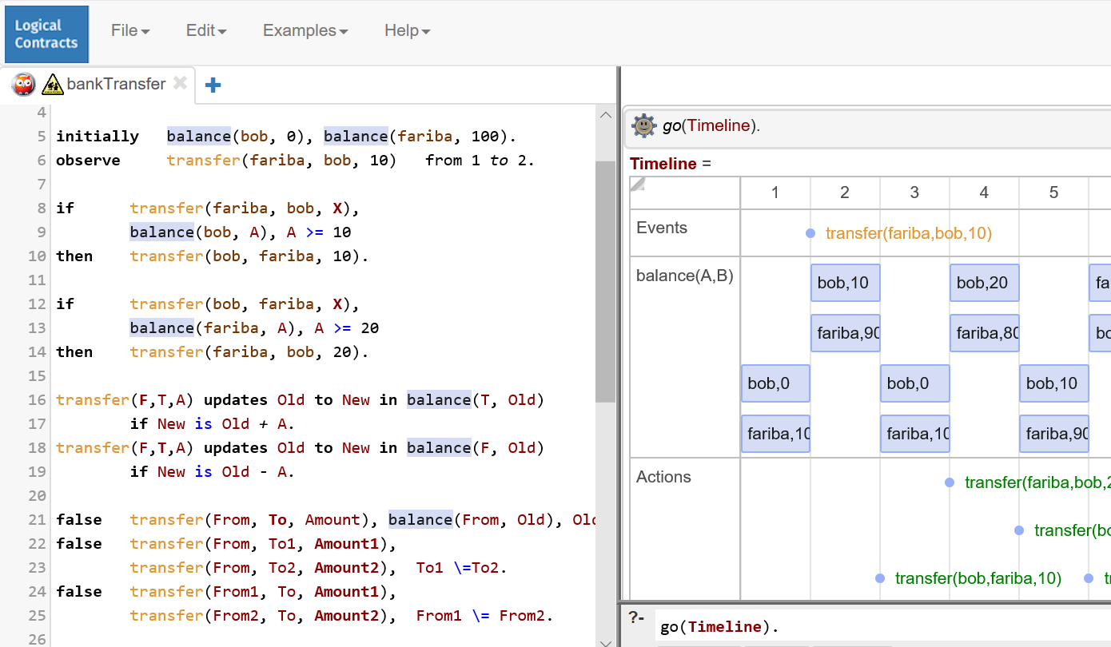
goals: reactive rules
beliefs
goals: constraints

Slide 29
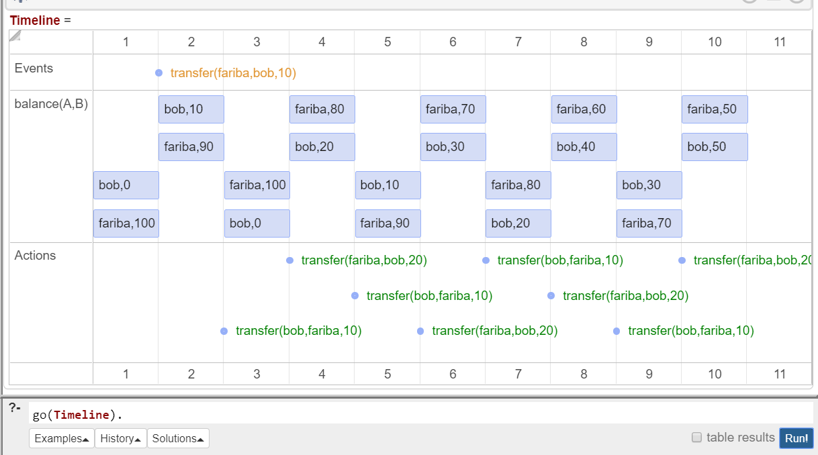

Slide 30
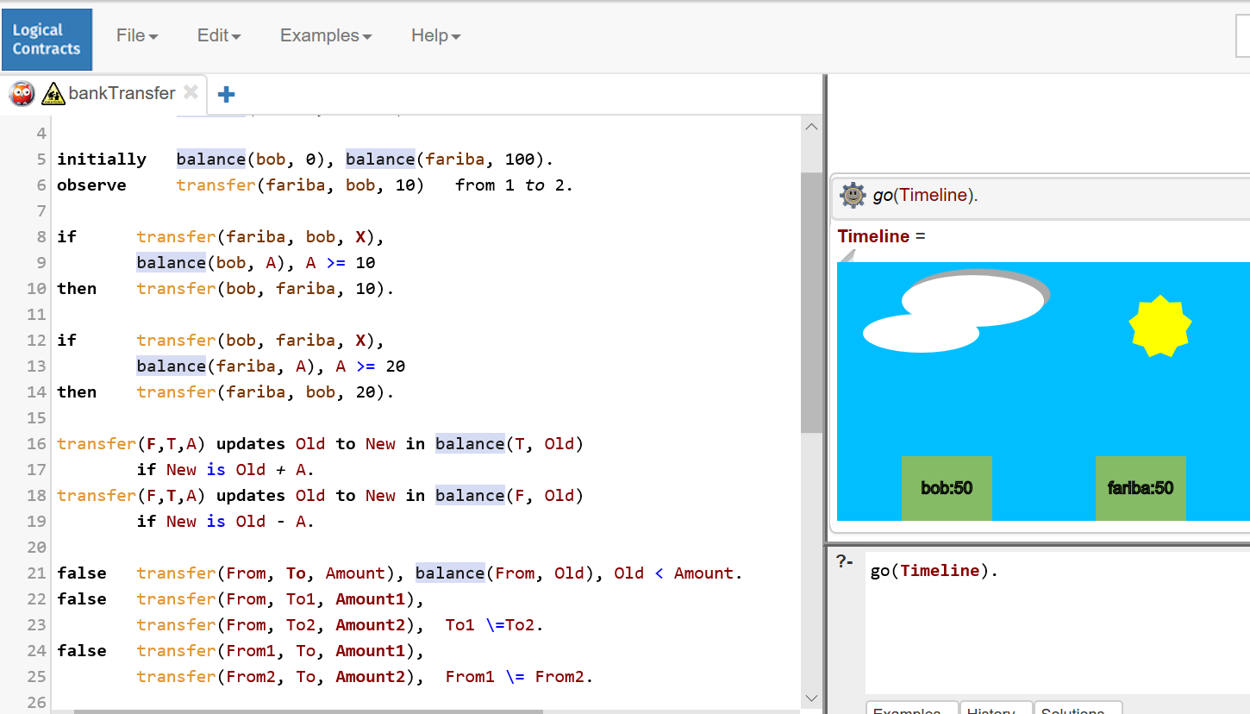
Animation in LPS

Slide 31
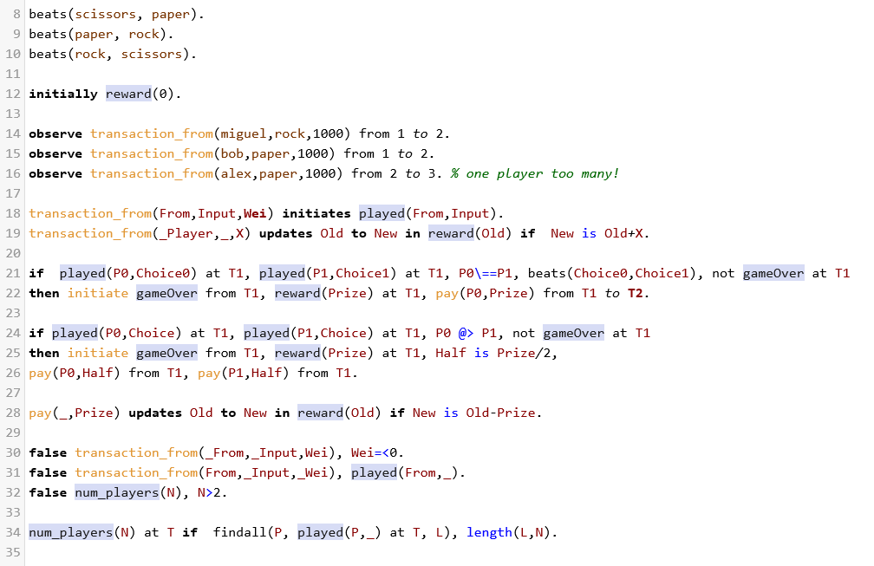
Rock-paper-scissors in LPS

Slide 32
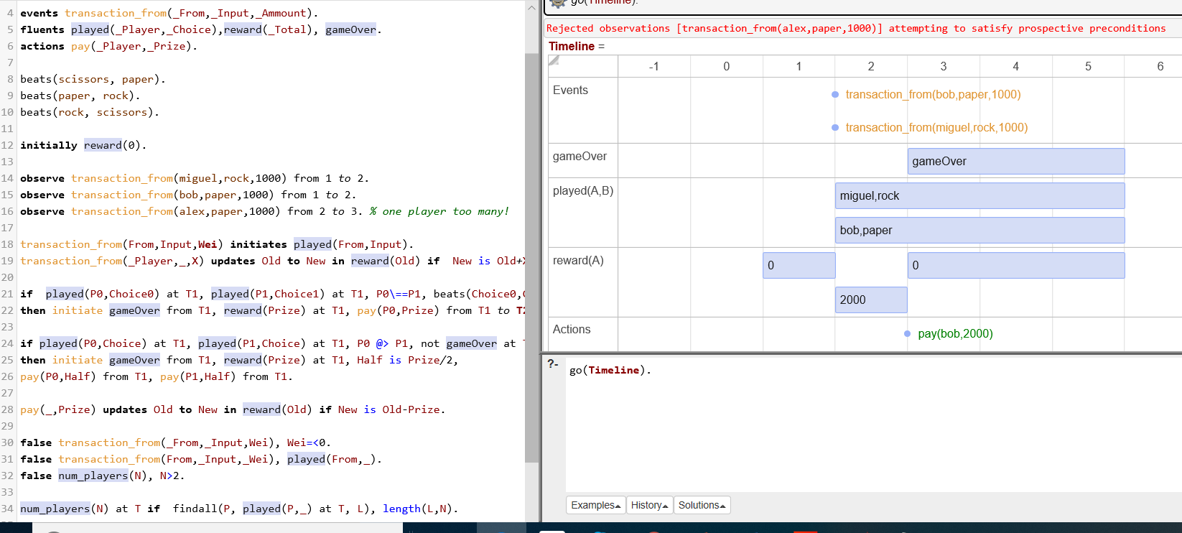

Slide 33
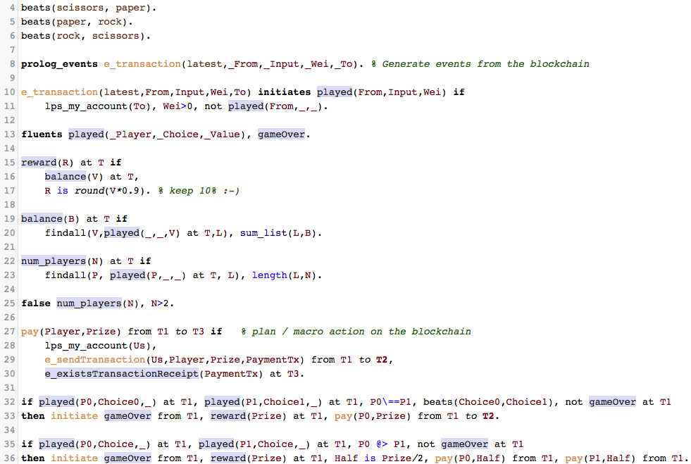
Rock-paper-scissors on Etherium blockchain
Notes:
Demo video: 3:00

Slide 34
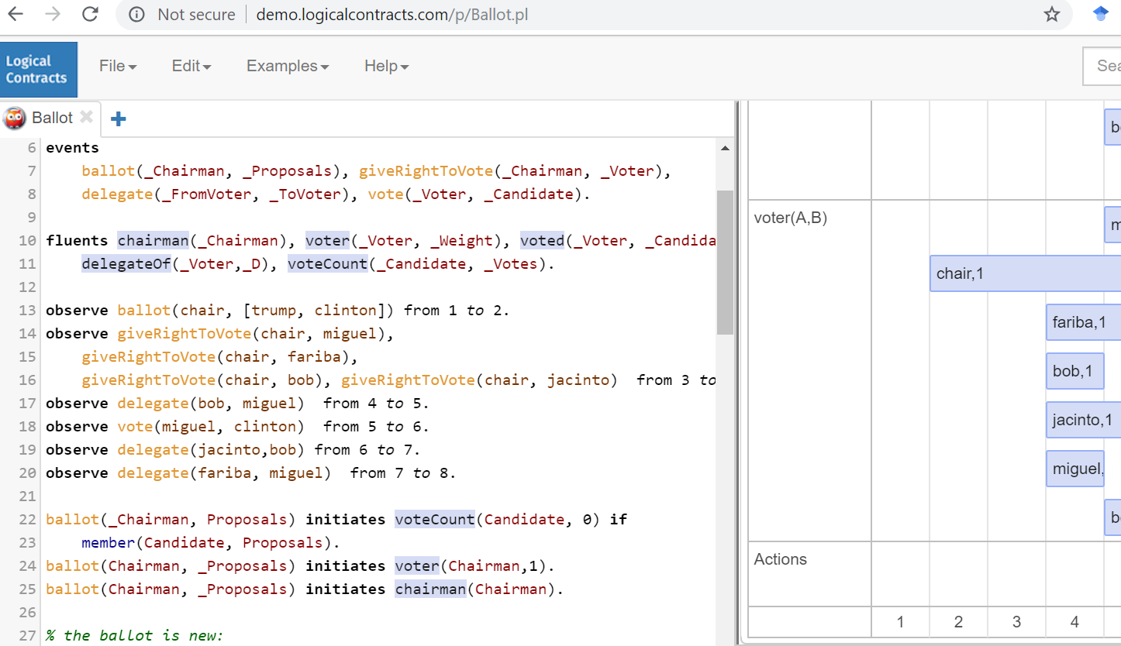

Slide 35
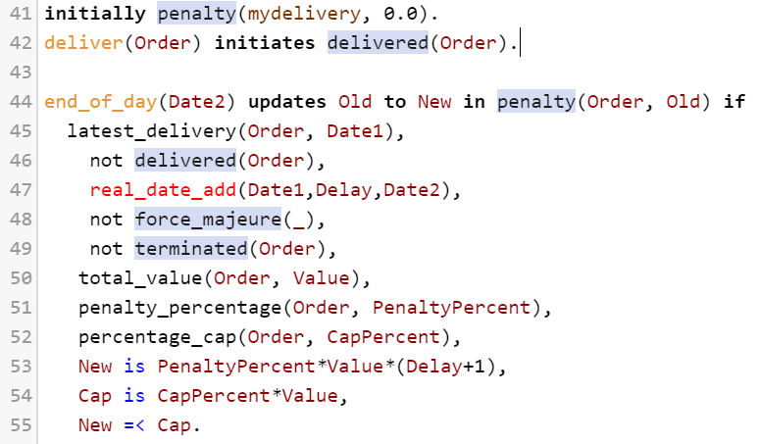
The Accord Project delayed delivery example

Slide 36
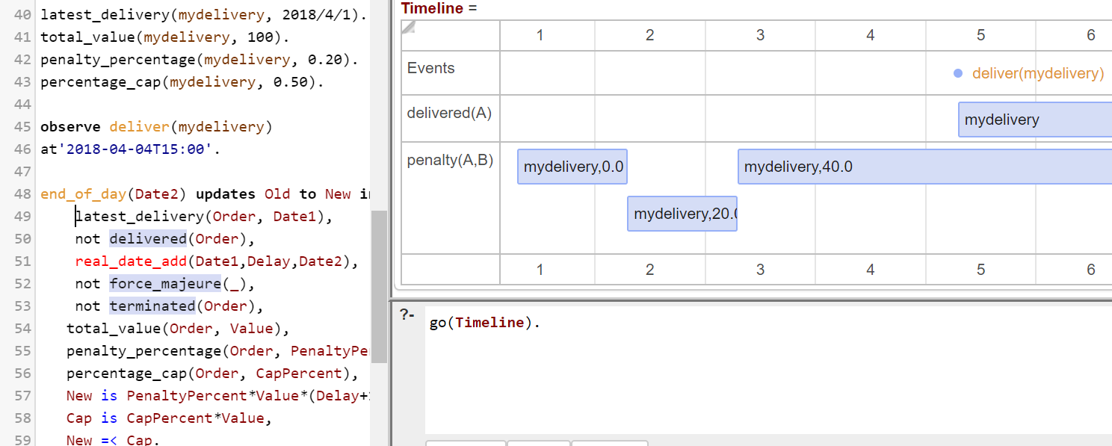

Slide 37
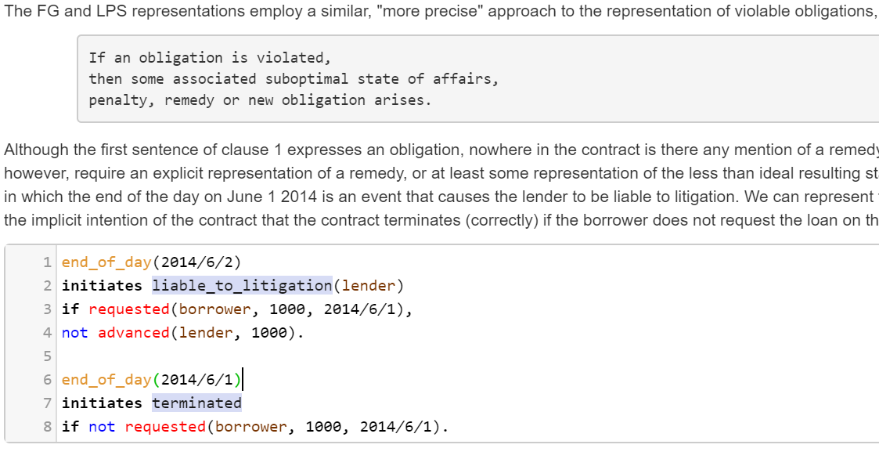
The loan agreement embedded in a SWISH notebook

Slide 38
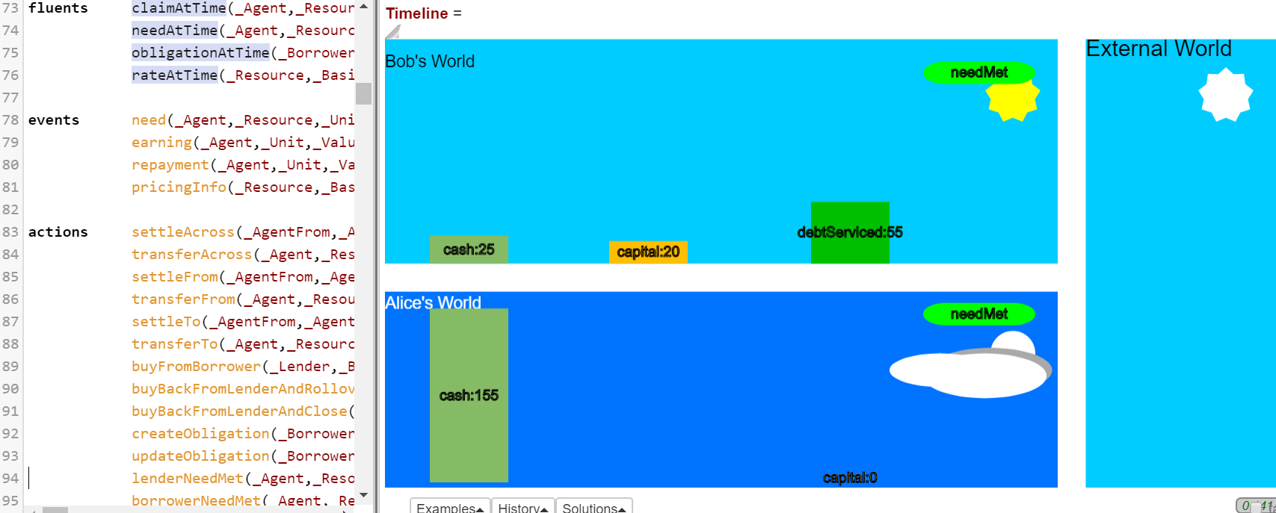

Slide 39
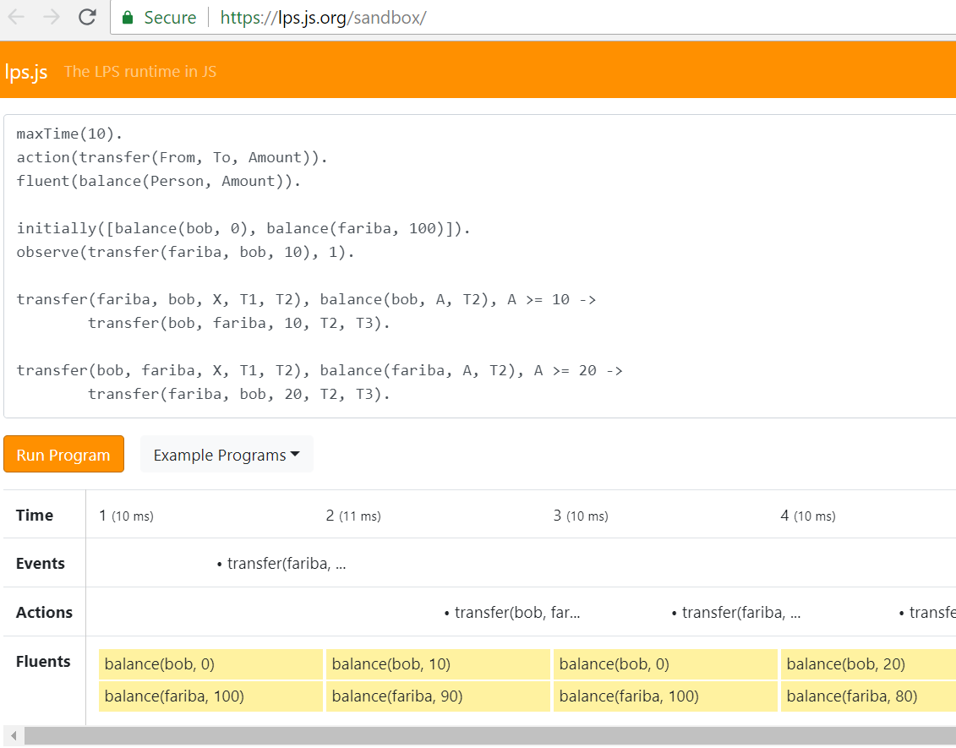

Slide 40
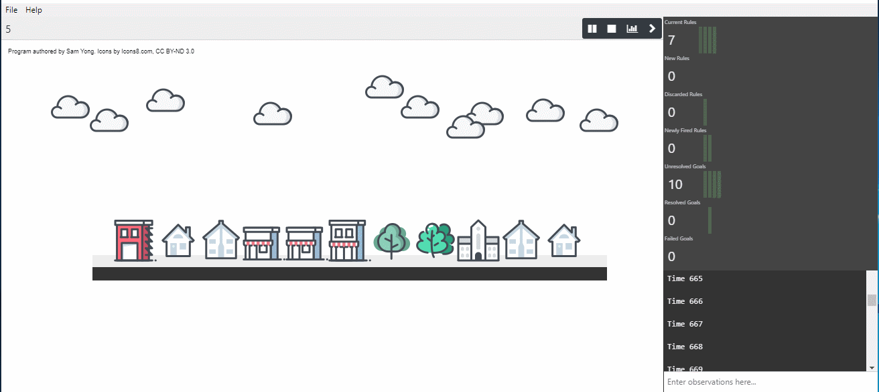

Slide 41
Conclusions
Gap between two approaches:
software engineering and formal methods
logic, AI and Law.
Need a logic that combines
goals and
beliefs.
Need a logic that combines
declarative and
imperative sentences.
The language of well-written legal documents
can be an example for the computer languages of the future.

Slide 42
Complementary Slides
More about smart contracts
More from the Legal Specification Protocol
More from Logic, AI and Law
More from LPS

Slide 43
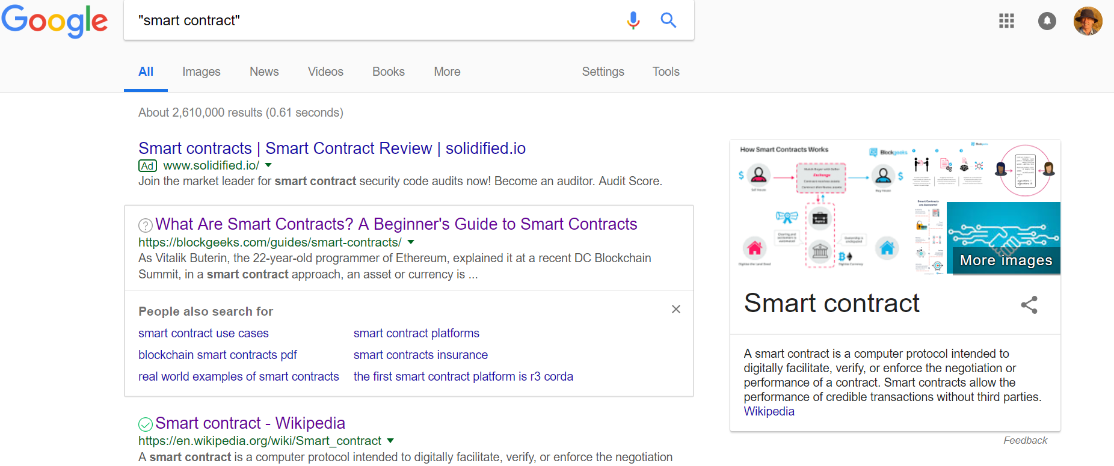

Slide 44
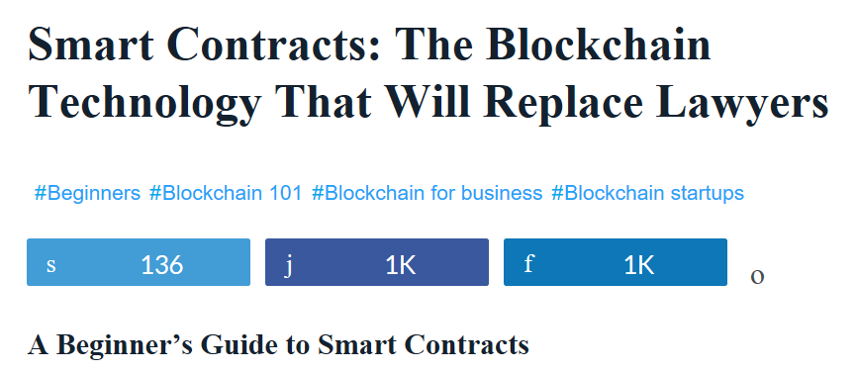
https://blockgeeks.com/guides/smart-contracts/
The best way to describe smart contracts is to compare the technology to a vending machine.
Ordinarily, you would go to a lawyer or a notary, pay them, and wait while you get the document.
With smart contracts, you simply drop a bitcoin into the vending machine (i.e. ledger), and your escrow, driver’s license, or whatever drops into your account.
More so, smart contracts not only define the rules and penalties around an agreement in the same way that a traditional contract does, but also automatically enforce those obligations.

Slide 45
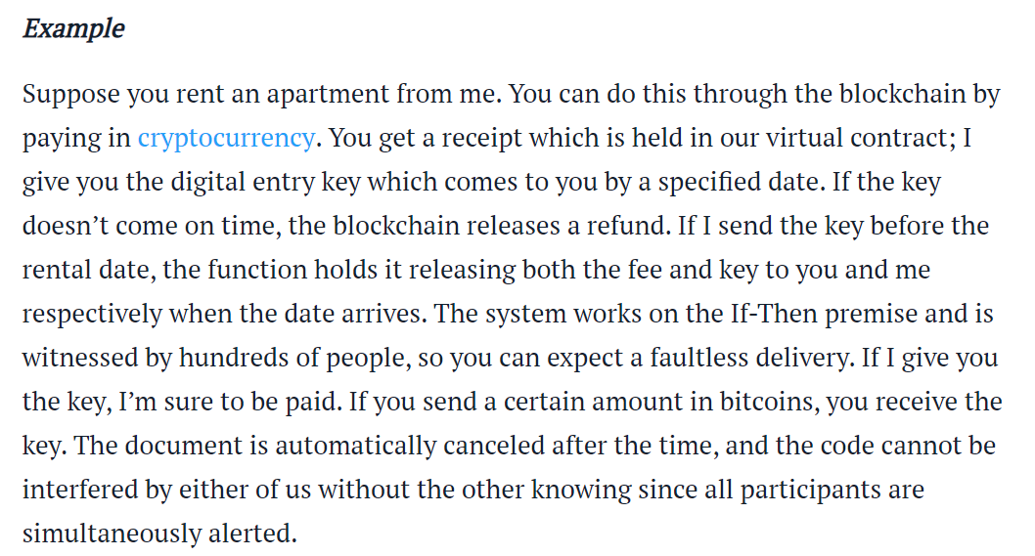
https://blockgeeks.com/guides/smart-contracts/

Slide 46
Logic for
legal documents
Imperative languages for
smart contracts
on blockchains
Smart contracts are contracts whose terms are recorded in a computer language instead of legal language. Smart contracts can be automatically executed by a computing system, such as a suitable distributed ledger system. The potential benefits of smart contracts include low contracting, enforcement, and compliance costs.

Slide 47
Smart contracts combine protocols with user interfaces to formalize and secure relationships over computer networks.
Objectives and principles for the design of these systems are derived from legal principles, economic theory, and theories of reliable and secure protocols.
Similarities and differences between smart contracts and traditional business procedures based on written contracts, controls, and static forms are discussed, …..

Slide 48
From: Developing a Legal Specification Protocol:
Technological Considerations and Requirements
LSP Working Group
Draft of July 28, 2018
Time for a Legal Specification Protocol (LSP)
In many domains of human activity, the application of electronic computing has made once cumbersome tasks quicker and easier.
The automation of portions of legal and regulatory processes holds the similar promise of delivering faster and better service at lower cost.

Slide 49
From: Developing a Legal Specification Protocol:
Technological Considerations and Requirements
Interacting with Blockchain and Distributed Ledger Technology
A point of particular importance will be the ability of computational contracts and other machine executable legal specification to interact with blockchains and other distributed ledger technologies.
The current “smart contract” initiatives, … , have been developed largely in the blockchain context,
and while their use has largely been to specify relatively simple payment trigger transactions, they have the potential for much more complex specification.

Slide 50
Developing a Legal Specification Protocol:
Technological Considerations and Requirements
The boom in blockchain development has included initiatives around the so-called “smart contract.”
Although the rather grand name would seem to imply that the LSP has already occurred, as currently employed most blockchain smart contracts are executable scripts of relatively low contractual expressivity.
For the most part, they are single trigger links between some event or instruction and the delivery of cryptocurrency funds from one holder to another.
As Vitalik Buterin, a leading Ethereum programmer has described it, the smart contract sets up a conditional payment instruction in code:
“and the program runs this code and at some point it automatically validates a condition and it automatically determines whether the asset should go to one person or back to the other person, or whether it should be immediately refunded to the person who sent it or some combination thereof.”

Slide 51
Logic for
legal documents
Imperative languages for
smart contracts
on block chains
propositional logic - Layman Allen - 1950s
logic programming (LP) - British Nationality Act - 1980s
extensions of LP and other logics - 3rd millenium

Slide 52
Rules and exceptions
English
40.-(2) The Secretary of State may
by order deprive a person of a citizenship status
if the Secretary of State is satisfied that deprivation is conducive to the public
good.
40.-(4) The Secretary of State may not
make an order under subsection (2)
if he is satisfied that
the order would make the person stateless.
Logic program
The Secretary of State may by order deprive a person of a citizenship status
if the Secretary of State is satisfied that deprivation is conducive to
the public good
and the Secretary of State is
not satisfied that
the order would make the person stateless.

Slide 53
Logic, AI and Law – what went wrong?
Lack of commercialisation,
due in part to open textured predicates,
such as “good character”, “reasonable effort”,
and the resulting apparent need for case-based reasoning.
(cured by precise definitions or human judgement)
Prolog infinite loops.
(cured by tabling in XSB, forward reasoning in Datalog and grounding in ASP).
Competition from and confusion with production systems,
e.g. Oracle Policy Management (OPM)
http://www.oracle.com/industries/government/pdfs/oracle-haley-enterprisepublic-sector-ds.pdf.
(cured by tabling in XSB?)

Slide 54
Confessions of a production rule vendor (part 2)
Apr 2nd, 2018 by paul@haleyAI.com.
http://haleyai.com/wordpress/2018/04/02/confessions-of-a-production-rule-vendor-part-2/#more-1169
“XSB Prolog provides more powerful reasoning
than production systems.
It can handle logical inconsistences unlike theorem provers.
It is more practical and easier to use than other Prologs.
XSB Prolog is commercial, open-source.
It has been used in IBM Watson and by U.S. Customs.”

Slide 55
AI, Logic and Law – Current State of the Art – selected examples
Accord Project, a consortium of lawyers and organizations, developing a functional programming language, Ergo “for the formation and execution of smart legal contracts in a blockchain-agnostic standard implementation”.
Legal Specification Protocol working group developing “a coordinated, interoperable standard for embodying contracts and other legal formulations as executable computer code”. A draft white paper highlights the use of deterministic finite automata. In the DFA approach, all clauses of a contract are represented in the form current state -> event -> next state.
The R3 consortium of 70 global financial institutions has a conceptual framework, Corda, for smart contracts in finance. Corda is an alternative to conventional blockchain systems. Smart contracts in Corda are compiled into a Java Virtual Machine, standardising on a bytecode set, which is neutral about the language.

Slide 56
AI, Logic and Law – State of the Art – notable examples
Defeasible deontic logic extends LP with defeasible rules, defeaters and priorities. Deontic concepts are expressed by modal operators. Related to LegalRuleML (Athan, Governatori, Palmirani, Paschke, & Wyner. Proc. of the 11th Reasoning Web Summer School, 2015.)
Accord Project, a consortium of lawyers and organizations, using a functional programming language, Ergo “for the formation and execution of smart legal contracts in a blockchain-agnostic standard implementation”.
Legal Specification Protocol working group developing “a coordinated, interoperable standard for embodying contracts and other legal formulations as executable computer code”. A draft white paper highlights the use of deterministic finite automata. In the DFA approach, all clauses of a contract are represented in the form current state -> event -> next state.

Slide 57
AI, Logic and Law – State of the Art – notable examples
Contract Definition Language, part of the computable contracts project at Stanford, used to model several U.S. Federal Acts. It uses LP to encode legal regulations and causal laws. Deontic concepts are encoded using meta-predicates.
Ergo of Coherent Knowledge, implemented in XSB Prolog, used in a POC to automate US Federal Reserve Regulation W, which regulates transactions between banks,. The automation is an extended database of facts and legal rules, with queries that evaluate whether the facts comply with the rules. Deontic concepts are encoded using meta-predicates.
Legalese is a company developing the L4 language for drafting “legal documents the way programmers develop software”. L4 is a modal language, with modal operators for time. It aims to support formal verification of contracts, using model checking techniques.

Slide 58
AI, Logic and Law – Current State of the Art – selected examples
Neota “Logic” is a commercial production rule system for legal applications. Rules represent legal expertise, rather than legal documents.
Objects, Logic and English (OLE) is designed for “managers, legal and financial professionals to read and write their smart contracts in a manner close to their own professional practice using their own language”. The language includes logical rules, transitional rules and constraints, with an English-like, object-oriented syntax. A compiler from OLE to Solidity is being developed for the Ethereum blockchain.

Slide 59
The syntax of LPS
Goals include reactive rules in First-order logic:
for all X [ antecedent → there exists Y consequent]
or if antecedent then consequent.
Beliefs are clauses in logic programming form:
for all X [there exists Y conditions → conclusion]
or conclusion if conditions.

Slide 60
All humans are mortal.
All humans are virtuous.
Belief:
mortal(X) if human(X).
Goal:
if human(X) then virtuous(X).
Psychological studies show that people have trouble
reasoning with conditionals. e.g. the Wason selection task.

Slide 61
