Slide 1
Pony
Sylvan Clebsch, Sebastian Blessing, Sophia Drossopoulou,
Andrew Mc Neil
Causality Ltd and Imperial College London

Slide 2
Pony – a programming language
aiming
for concurrent (distributed) programming,
very fast,
easy to learn, easy to use,
data-race free and atomicity.

Slide 3
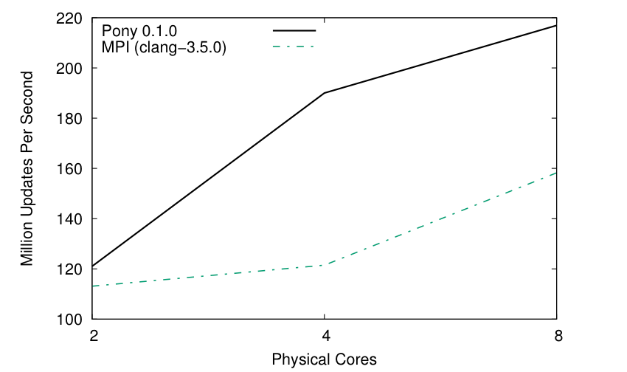
Very fast?
GUPS benchmark (from Linpack suite)
Measures rate of random updates of memory
First Pony implementation
(~4 days of work)
Pony outperforms heavily optimized MPI version
44% source code reduction

Slide 4
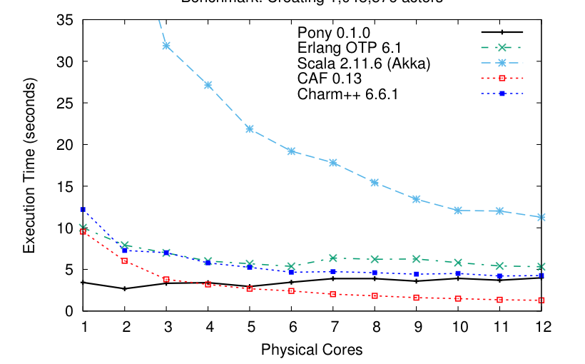
Very fast?
Actor creation - (from CAF suite)
Create ~1M actors
Run on 12 core, 2.3 GHz Opteron, 64 GByte
Pony outperforms all except of CAF
CAF does no gc

Slide 5
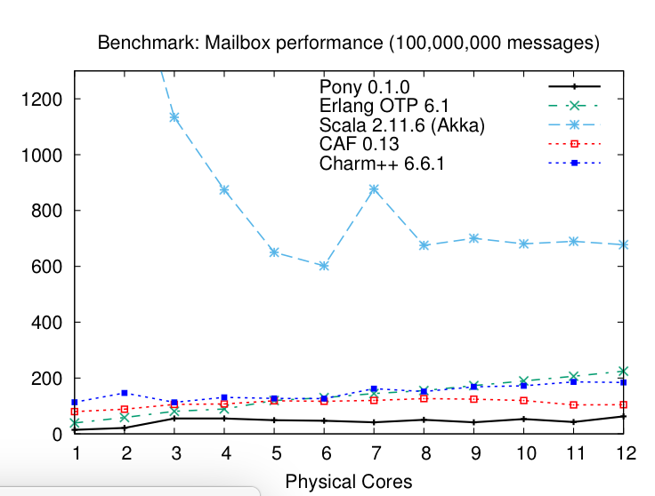
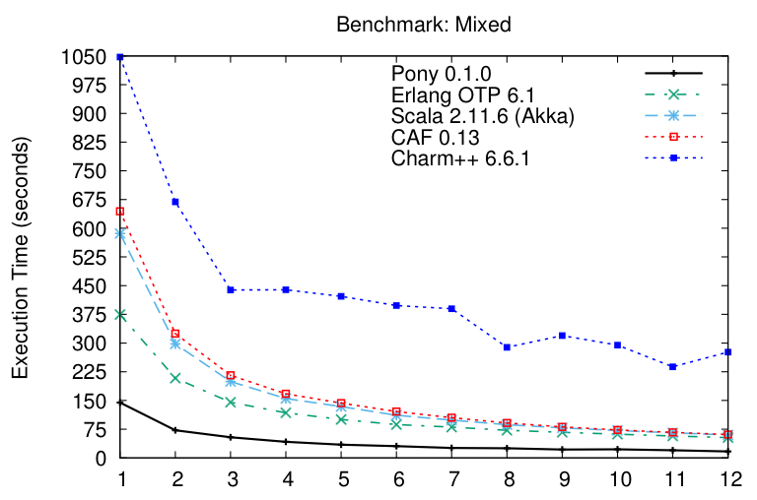
Very fast?
Mailbox and Mixed - (from CAF suite)
Highly contended mailbox, and mixed case (factorizarion)
Run on 12 core, 2.3 GHz Opteron, 64 GByte
Pony outperforms all in both

Slide 6
easy to learn, easy to use?
Pony API adopted as the back-end for the EU project UPSCALE; API currently used by 10 programmers
Pony was taken up by a PhD student after a 2 hour introduction
Pony has been unofficially taken up by another 8 programmers in the financial sector
We have developed a 10K lines Pony standard library (incl. file handling, collections, networking, http client and server, SSL/TLS, timers and timing, random numbers)
We have developed several “real world” analytics programs
Only 10.7% of types require annotations (later)

Slide 7
Remaining talk – Pony language design
Pony concurrency model
Pony Types to prevent data races
Pony_ORCA: Garbage Collection Objects
Pony_AGC: Garbage Collection Actors
Language Design Observations

Slide 8
Pony Concurrency Model
Based on actor paradigm
Actor ~ active object
Actors/objects may send synchronous messages to actors/objects, and asynchronous messages to actors
Asynchronous messages stored in queue; executed one at a time
No other synchronization primitive
Imperative Features
Objects may be passed in messages, no copying

Slide 9
Pony Types to prevent data races
capability annotations for each type;
capabilities ~ points in a matrix of actions denied to local/global aliases
 | deny global read alias | deny global write alias | Deny nothing to glob.alias

Slide 10
Pony Types to prevent data races
capability annotations for each type;
capabilities ~ points in a matrix of actions denied to local/global aliases
 | deny global read alias | deny global write alias | Deny nothing to glob.alias
deny local read alias
deny local write alias
Deny nothing to locl.alias

Slide 11
Pony Types to prevent data races
capability annotations for each type;
capabilities ~ points in a matrix of actions denied to local/global aliases
 | deny global read alias | deny global write alias | Deny nothing to glob.alias
deny local read alias |  | ✗ | ✗
deny local write alias |  |  | ✗
Deny nothing to locl.alias

Slide 12
Pony Types to prevent data races
 | deny global read alias | deny global write alias | Deny nothing to glob.alias
deny local read alias | iso | ✗ | ✗
deny local write alias | trn | val | ✗
Deny nothing to locl.alias | ref | box | tag

Slide 13
Pony Types to prevent data races – what the holder may do
 | deny global read alias | deny global write alias | Deny nothing to glob.alias
deny local read alias | iso | ✗ | ✗
deny local write alias | trn | val | ✗
Deny nothing to locl.alias | ref | box | tag
 | Write | Read | Ident

Slide 14
Sendable references
iso can be sent to other actor after being consumed
val and tag can be sent to other actors
no copying required
 | deny global read alias | deny global write alias | Deny nothing to glob.alias
deny local read alias | iso | ✗ | ✗
deny local write alias | trn | val | ✗
Deny nothing to locl.alias | ref | box | tag
 | Writeable | Readable | Opaque

Slide 15
Valid local aliases
 | deny global read alias | deny global write alias | Deny nothing
deny local read alias | iso | ✗ | ✗
deny local write alias | trn | val | ✗
Deny nothing | ref | box | tag
 | Writeable | Readable | Opaque
iso
trn
ref
val
box

Slide 16
Valid local aliases
 | deny global read alias | deny global write alias | Deny nothing
deny local read alias | iso | ✗ | ✗
deny local write alias | trn | val | ✗
Deny nothing | ref | box | tag
 | Writeable | Readable | Opaque
iso
trn
ref
val
box
box, val
ref
val,
box
ref
box
box

Slide 17
Valid local, and global aliases
 | deny global read alias | deny global write alias | Deny nothing
deny local read alias | iso | ✗ | ✗
deny local write alias | trn | val | ✗
Deny nothing | ref | box | tag
 | Writeable | Readable | Opaque
iso
trn
ref
val
box
ref
val,
box
ref
box
box, val
box
val,
box
val,
box

Slide 18
Permanent alias inside an iso-bubble
iso
???

Slide 19
Permanent alias inside an iso-bubble
iso
iso
trn
CC
ref
val, box
val, box
val
box

Slide 20
Permanent and temporary alias inside a iso-bubble
iso
iso
iso
trn
CC
ref
val, box
val, box
val
box

Slide 21
Permanent alias inside a trn-bubble
trn
box
box
iso
trn
CC
ref
val, box
val, box
val
box

Slide 22
Permanent and temporary alias inside a trn-bubble
trn
box
box
iso
trn
iso
trn
CC
ref
val, box
val, box
val
box

Slide 23
Pony type system
Further issues
Recover expressions
Type if field read (viewpoint adaptation)
Type of method call
Type of field write
Proofs
More at http://www.doc.ic.ac.uk/~scd/fast-cheap.pdf
More features – implemented
Algebraic types and Pattern Matching
Generics
Non-null
More features – perhaps
Reflection

Slide 24
Pony ORCA: Object Garbage Collection
Actors perform GC fully concurrenty.
Objects are owned by the actor which created them.
Actor garbage collect owned objects.
Challenge: objects may be accessible from other actors
Approach: Weighted deferred reference counts: actor keep reference count for a) owned objects reachable from other actors, b) objects owned by other actors and reachable from the actor.

Slide 25
Pony ORCA: Object Garbage Collection.2
Actors (α) , Object (o), owning actor (Own)
Actor keep reference count for a) owned objects reachable from other actors, b) objects owned by other actors and reachable from the actor.
RC(Own(o),o) = Σ_{α≠Own(o)}RC(α,o) +# {(α,i) | Mssg(a,i) reaches o }
When sending/receiving messages, trace, and for all reachable objects adjust RC accordingly.
When tracing, and non-owned object becomes inaccessible

Slide 26
Pony ORCA: Object Garbage Collection.2
Actors (α) , Object (o), owning actor (Own)
Actor keep reference count for a) owned objects reachable from other actors, b) objects owned by other actors and reachable from the actor.
RC(Own(o),o) + Σm_{i} where Mssg(Own(o),i)=INC(m,o) = Σ_{α≠Own(o)}RC(α,o) +# {(α,i) | Mssg(a,i) reaches o }
When sending/receiving messages, trace, and for all reachable objects o adjust RC accordingly. If RC gets to 0 then add k to own, and send to INC(k+1,o) to Onw(o).
When tracing, and non-owned object becomes inaccessible, set own RC to 0, and send INC(-old(RC),o) to Onw(o).

Slide 27
Pony ORCA: Object Garbage Collection.3
Tracing functions using the type system, and therefore no race conditions
Used the actor paradigm (messages) to implement garbage collection.
Used causal message delivery for Garbage Collection.
Object Reference cycles not an issue.
More at http://www.doc.ic.ac.uk/~scd/ogc.pdf

Slide 28
Pony Actor Collection
Actor collection requires detection of Actor Cycles.
This is done by a separate actor – the cycle detector.
Actors keep a count of all external referring actors, and the set of actors they refer to.
When blocking, they send this information to the cycle detector.
This information is sufficient for the cycles detector to identify, and remove cycles.

Slide 29
Pony Actor Collection.2
This is done by a separate actor – the cycle detector.
Actors keep a count of all external referring actors, and the set of actors they refer to.
When blocking, they send this information to the cycle detector.
But, actors’ views of themselves may be out of sync with “real” state (another actor drops/gains reference to them).
Also, cycle detector’s view of actor may be out of sync with actor’s view (a blocked actor may wake up).

Slide 30
Pony Actor Collection.3
This is done by a separate actor – the cycle detector.
Actors keep a count of all external referring actors, and the set of actors they refer to.
When blocking, they send this information to the cycle detector.
But, actors’ views of themselves may be out of sync with “real” state (another actor drops/gains reference to them). In this case, send appropriate INC/DEC messages.
Also, cycle detector’s view of actor may be out of sync with actor’s view (a blocked actor may wake up). The cycle detector sends ACK, and awaits CONF messages from blocked actors.

Slide 31
Pony Actor Collection.4
Adaptation of reference counting protocol.
Used the actor paradigm.
Causal Message Delivery a prerequisite.
Fun Proof.
More at S. Clebsch and S. Drossopoulou. Fully concurrent garbage collection of actors on many-core machines. OOPLSA 2013.

Slide 32
More on Pony
Native code compiler
Pony actor runtime, including scheduler, memory allocator, message queues, and garbage collector
Debugger
Several applications developed
Implementation fast; language relatively easy to learn/use
Even though model is subtle, language feels simple
Good defaults and good error messages are crucial
Tutorial at http://causalityltd.github.io/pony-tutorial/
Sandbox implementation at http://sandbox.ponylang.org
Cheers, Jeers, Help, Collaboration, Feedback, welcome

Slide 33
Language Design Conclusions
Actor Paradigm applied to the GC problem; messages sent when an actor’s view of world out of sync with the state of world
Data Race freedom, Causal Message Delivery prerequisites for Garbage Collection – and distribution.
Starting from Principles Delivers
Formal Models Deliver
Finding the Invariant is key
Finding ways not to think of time is key

