Slide 1
Automated functional program verification using fixpoint fusion
William Sonnex
University of Cambridge
(Imperial College at heart)
Notes:
Talking about how we can use fixpoint fusion to do everything automated proof by induction can do.
FPF also goes by the names “deforestation” and “supercompilation”, but they are the same technique implemented in different ways.

Slide 2

Proof by simplification
Start with:
$$E_{1}=E_{2}$$
Simplify:
$$E_{1}^{′}=_{α}E_{2}^{′}$$
Notes:
Simplify to the point of alpha equality, or until a property is trivially true.

Slide 3
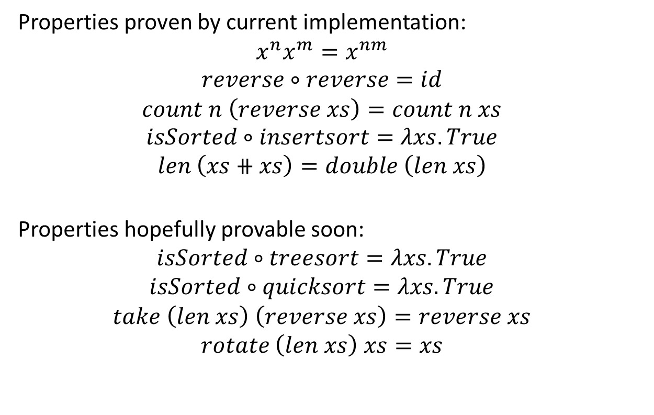
Properties provable
Properties proven by current implementation:
$$x^{n}x^{m}=x^{nm}$$
$$reverse∘reverse=id$$
$$count n \left(reverse xs\right)=count n xs$$
$$isSorted∘insertsort=λxs.True$$
$$len \left(xs⧺xs\right)=double \left(len xs\right)$$
Properties hopefully provable soon:
$$isSorted∘treesort=λxs.True$$
$$isSorted∘quicksort=λxs.True$$
$$take \left(len xs\right) \left(reverse xs\right)=reverse xs$$
$$rotate \left(len xs\right) xs=xs$$
Notes:
Explain what is implemented and what is not
I understand without a working implementation this is a less than strong point, but there we go

Slide 4

Functional language used
Simply typed lambda calculus with general recursion, absurdity and algebraic data-types (constructors and pattern matching).
$$τ∷=τ_{1}→τ_{2} | 𝔹 \left| ℕ \right| List_{ℕ} \left| Tree_{ℕ} \right| …$$

Slide 5
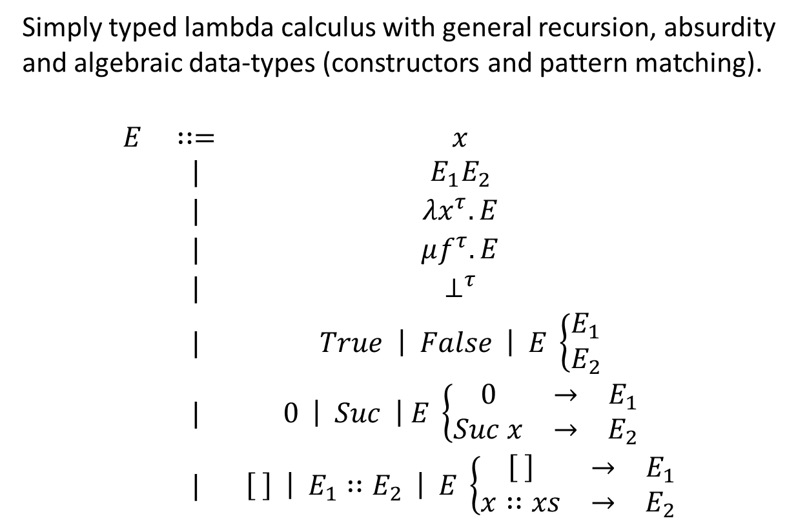
Functional language used
Simply typed lambda calculus with general recursion, absurdity and algebraic data-types (constructors and pattern matching).
$$\begin{matrix}E & ∷= & x \\ & | & E_{1}E_{2} \\ & | & λx^{τ}.E \\ & | & μf^{τ}.E \\ & | & ⊥^{τ} \\ & | & True \left| False \right| E \left\{\begin{matrix}E_{1} \\ E_{2}\end{matrix}\right. \\ & | & 0 \left| Suc \right| E \left\{\begin{matrix}0 & → & E_{1} \\ Suc x & → & E_{2}\end{matrix}\right. \\ & | & \left[ \right] \left| E_{1}∷E_{2} \right| E \left\{\begin{matrix}\left[ \right] & → & E_{1} \\ x∷xs & → & E_{2}\end{matrix}\right.\end{matrix}$$
Notes:
Essentially this is PCF with absurdity

Slide 6
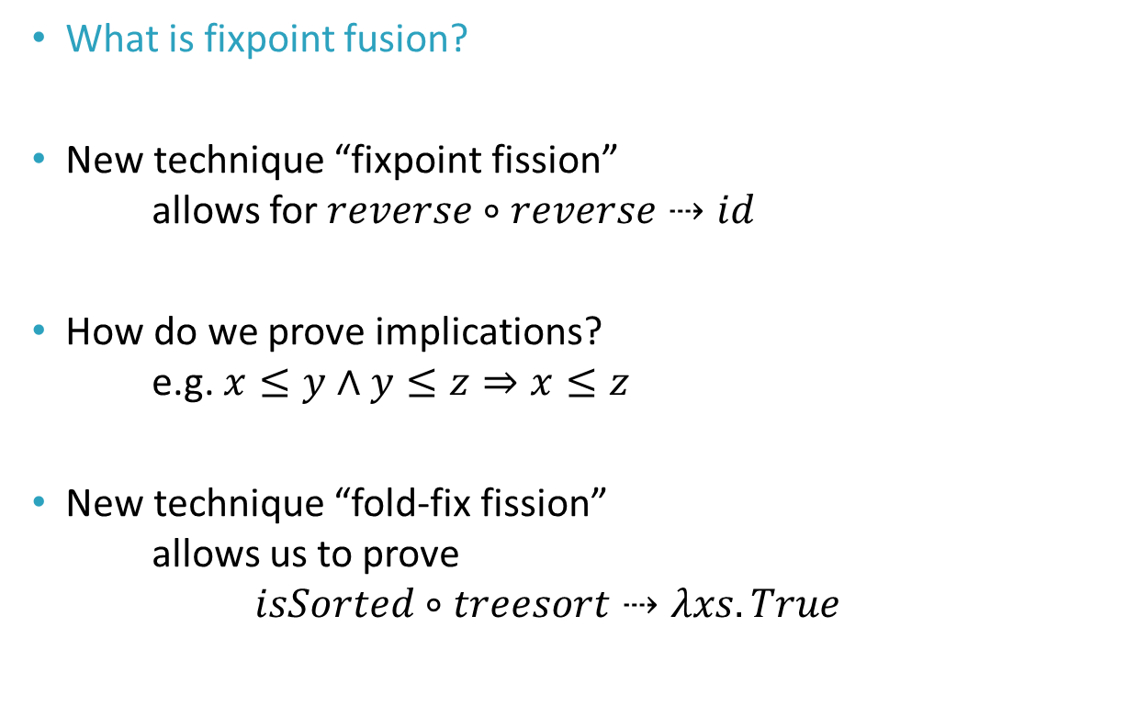
Contents
What is fixpoint fusion?
New technique “fixpoint fission”
allows for $reverse∘reverse⇢id$
How do we prove implications?
e.g. $x≤y∧y≤z⇒x≤z$
New technique “fold-fix fission”
allows us to prove
$isSorted∘treesort⇢λxs.True$

Slide 7

Fixpoint fusion
Turns a context containing a recursive function
into just a recursive function:
$$C\left[μf.E_{f}\right]⇢μg.E_{g}$$
Notes:
We have C[\mu f . E_f] and fusion discovers E_g

Slide 8
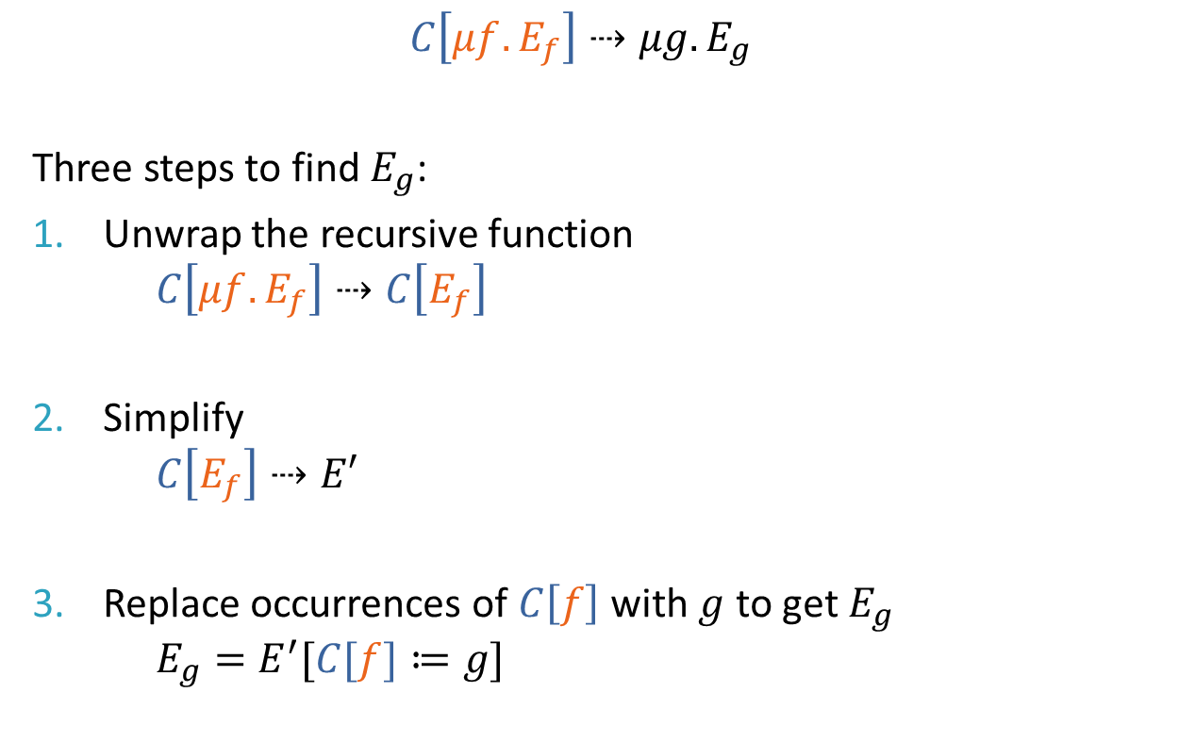
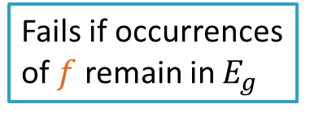
Fixpoint fusion
$$C\left[μf.E_{f}\right]⇢μg.E_{g}$$
Three steps to find $E_{g}$:
Unwrap the recursive function
$C\left[μf.E_{f}\right]⇢C\left[E_{f}\right]$
Simplify
$C\left[E_{f}\right]⇢E′$
Replace occurrences of $C\left[f\right]$ with $g$ to get $E_{g}$
$E_{g}=E^{′}[C[f]≔g]$
Fails if occurrences of $f$ remain in $E_{g}$
Notes:
Disclaimer: I did not invent this process. I am not smart enough.
Here unwrap means we leave the function variable uninterpreted, we just drop the mu from the outside, so f becomes free

Slide 9

Fixpoint fusion
$$C\left[μf.E_{f}\right]≡μg.E_{g}$$
if
$$C\left[E_{f}\left[f≔μf.E_{f}\right]\right]≡E_{g}\left[g≔μf.E_{f}\right]$$
Sidenote:
This is the free theorem (a la Wadler)
of the type of the Y-combinator
$Y :∀a. \left(a→a\right)→a$
Notes:
This is the sound mathematical theorem which underlies this.

Slide 10

Fusing reverse and append
$$let reverse=μ rev. λxs. xs\left\{\begin{matrix}\left[ \right] & → & \left[ \right] \\ y∷ys & → & rev ys⧺\left[y\right]\end{matrix}\right.$$
$$let xs⧺ys =\left(μ app_{ys}. λxs.xs\left\{\begin{matrix}\left[ \right] & → & ys \\ z∷zs & → & z∷app_{ys} zs\end{matrix}\right.\right) xs$$
Let’s run fusion on:
$reverse \left(xs⧺\left[y\right]\right)$
Notes:
These are macros, let is not a part of the language

Slide 11
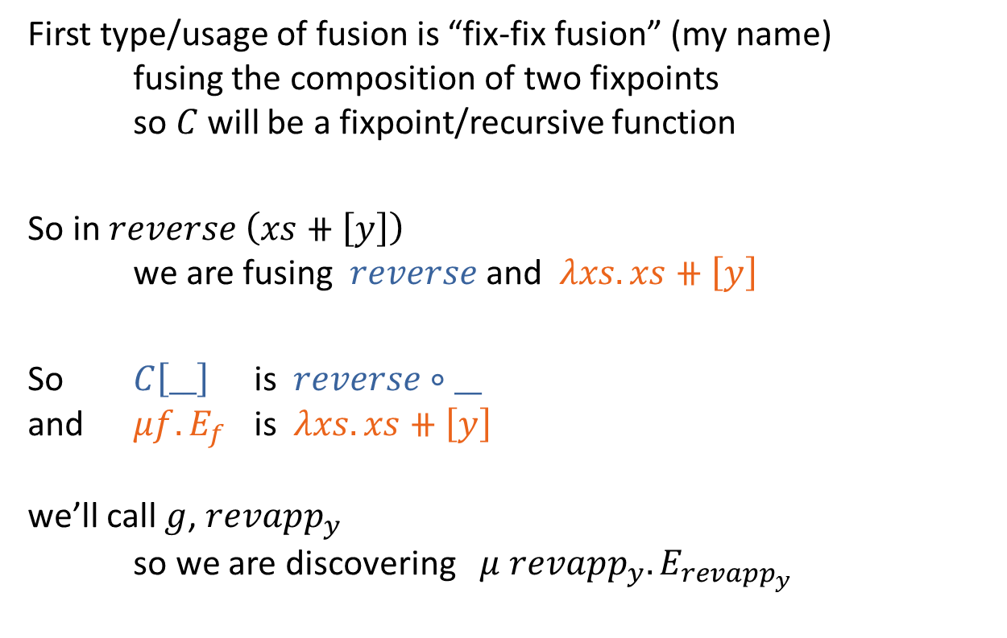
Fix-fix fusion
First type/usage of fusion is “fix-fix fusion” (my name)
fusing the composition of two fixpoints
so $C$ will be a fixpoint/recursive function
So in $reverse \left(xs⧺\left[y\right]\right)$
we are fusing $reverse$ and $λxs.xs⧺\left[y\right]$
So $C\left[__\right]$ is $reverse∘__$
and $μf.E_{f}$ is $λxs.xs⧺\left[y\right]$
we’ll call $g$, $reva{pp}_{y}$
so we are discovering $μ reva{pp}_{y}.E_{reva{pp}_{y}}$
Notes:
To fit it into the framework we were using before, here are the two fixpoints we are fusing
Deforestation is fix fix fusion, as is supercompilation

Slide 12
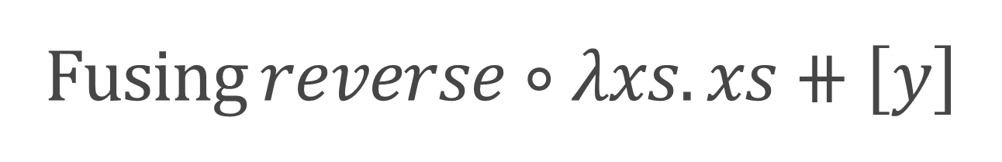
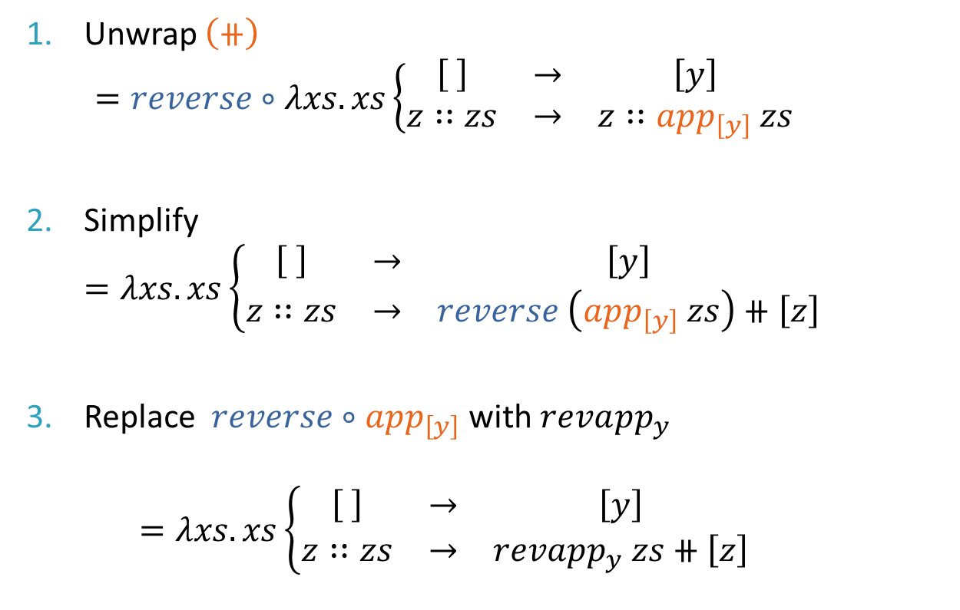
Fusing $reverse∘λxs.xs⧺\left[y\right]$
Unwrap $\left(⧺\right)$
$=reverse∘λxs.xs\left\{\begin{matrix}\left[ \right] & → & \left[y\right] \\ z∷zs & → & z∷app_{\left[y\right]} zs\end{matrix}\right.$
Simplify
$=λxs.xs\left\{\begin{matrix}\left[ \right] & → & \left[y\right] \\ z∷zs & → & reverse \left(app_{\left[y\right]} zs\right)⧺\left[z\right]\end{matrix}\right.$
Replace $reverse∘app_{\left[y\right]}$ with $reva{pp}_{y}$
$=λxs.xs\left\{\begin{matrix}\left[ \right] & → & \left[y\right] \\ z∷zs & → & reva{pp}_{y} zs⧺\left[z\right]\end{matrix}\right.$
Notes:
I have rather a lot of talk to get through, so you’ll just have to trust me with these simplifications…
Remember $reverse∘$ was the context

Slide 13
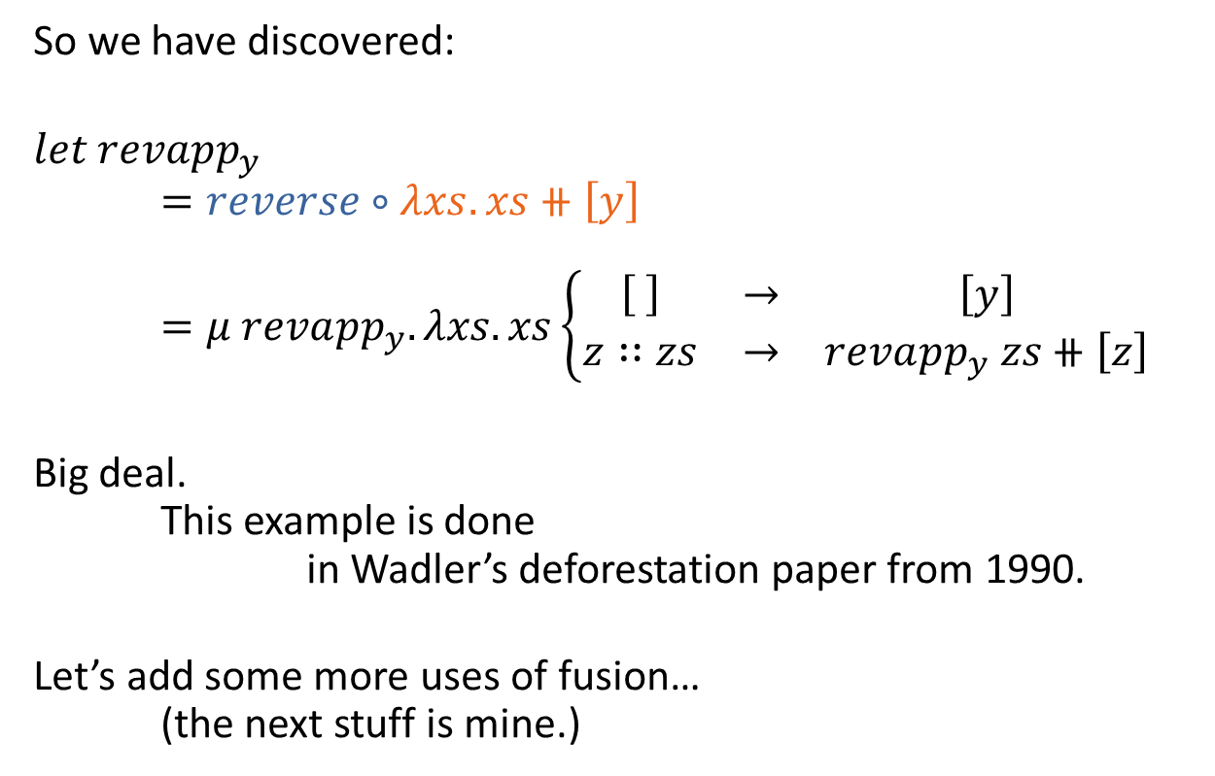
Fusing $reverse∘λxs.xs⧺\left[y\right]$
So we have discovered:
$$let {revapp}_{y}$$
$=reverse∘λxs.xs⧺\left[y\right]$
$=μ reva{pp}_{y}. λxs.xs\left\{\begin{matrix}\left[ \right] & → & \left[y\right] \\ z∷zs & → & reva{pp}_{y} zs⧺\left[z\right]\end{matrix}\right.$
Big deal.
This example is done
in Wadler’s deforestation paper from 1990.
Let’s add some more uses of fusion…
(the next stuff is mine.)

Slide 14
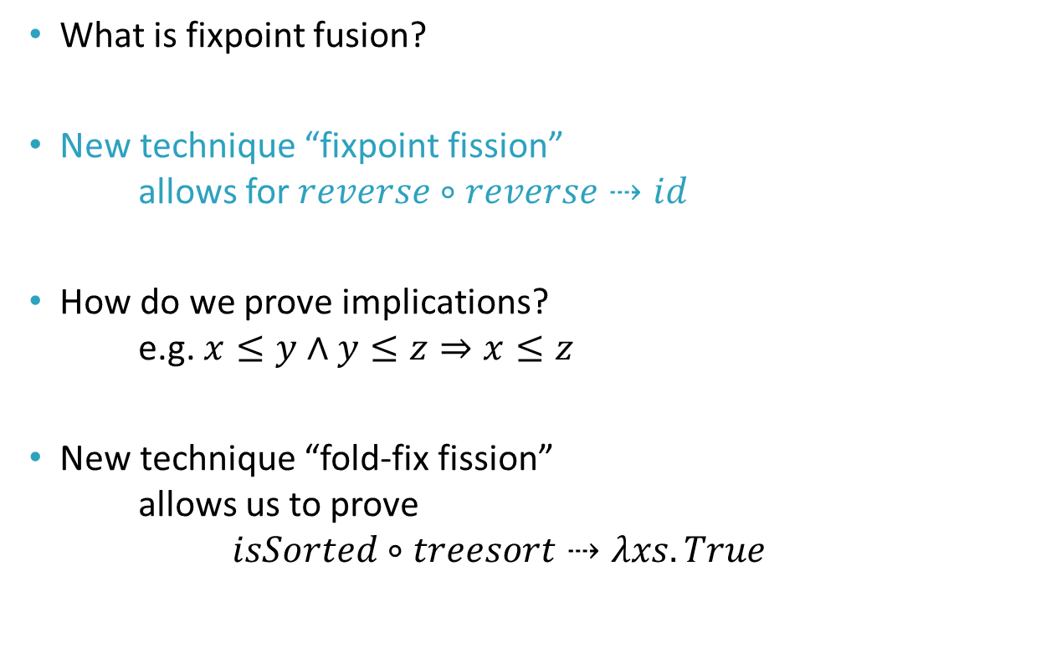
Contents
What is fixpoint fusion?
New technique “fixpoint fission”
allows for $reverse∘reverse⇢id$
How do we prove implications?
e.g. $x≤y∧y≤z⇒x≤z$
New technique “fold-fix fission”
allows us to prove
$isSorted∘treesort⇢λxs.True$

Slide 15
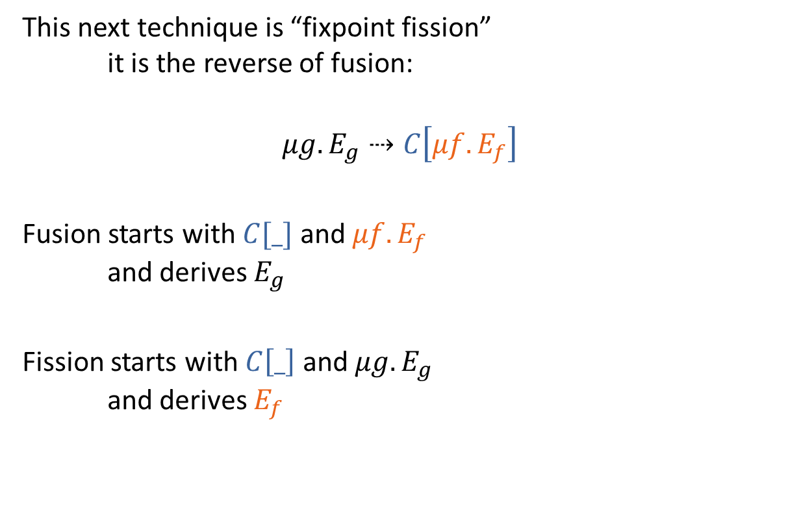
Fixpoint fission
This next technique is “fixpoint fission”
it is the reverse of fusion:
$$μg.E_{g}⇢C\left[μf.E_{f}\right]$$
Fusion starts with $C[_]$ and $μf.E_{f}$
and derives $E_{g}$
Fission starts with $C\left[_\right]$ and $μg.E_{g}$
and derives $E_{f}$
Notes:
10 minute mark here is optimal

Slide 16

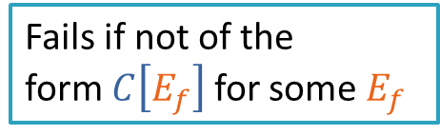
Fixpoint fission
$$μg.E_{g}⇢C\left[μf.E_{f}\right]$$
Backwards three steps of fusion:
Start with $E_{g}$ and replace $g$ with $C\left[f\right]$
$E^{′}=E_{g}\left[g≔C\left[f\right]\right]$
Simplify
$E^{′}⇢C\left[E_{f}\right]$
Drop $C\left[_\right]$ to get $E_{f}$
Fails if not of the
form $C\left[E_{f}\right]$ for some $E_{f}$
Notes:
Remember the previous way you wrapped $E_{f}$ in $C$, then simplified, then replaced $C\left[f\right]$ with $g$, the exact opposite process

Slide 17

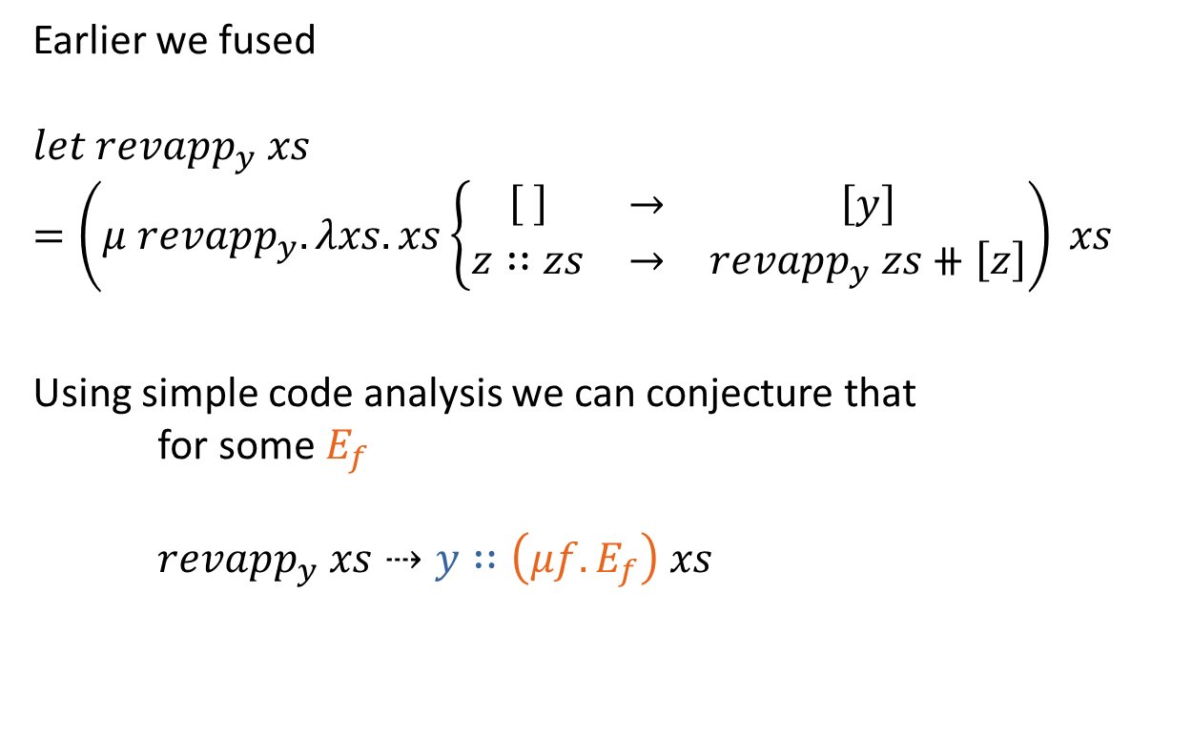
Fissioning $revapp_{y} xs$
Earlier we fused
$$let revapp_{y} xs \\ =\left(μ reva{pp}_{y}. λxs.xs\left\{\begin{matrix}\left[ \right] & → & \left[y\right] \\ z∷zs & → & reva{pp}_{y} zs⧺\left[z\right]\end{matrix}\right.\right) xs$$
Using simple code analysis we can conjecture that
for some $E_{f}$
$revapp_{y} xs⇢y∷\left(μf.E_{f}\right) xs$
Notes:
Here I’ve called the function we invented revapp for simplicity

Slide 18
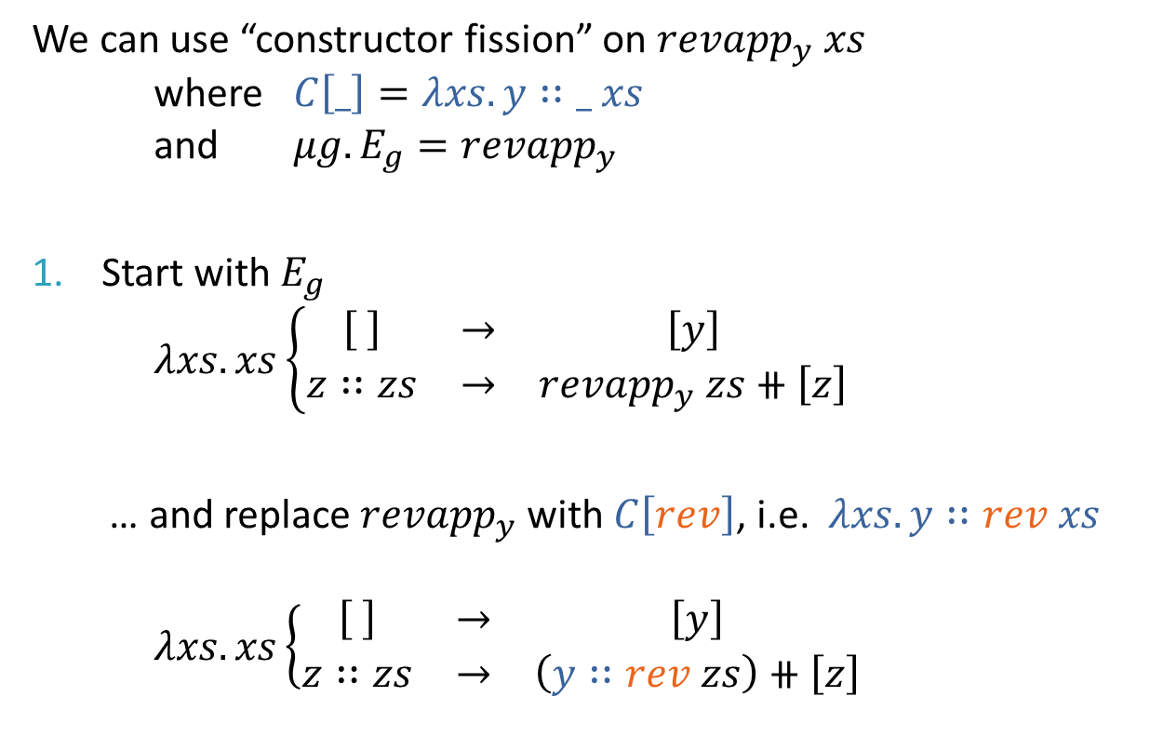
Fissioning $revapp_{y} xs$
We can use “constructor fission” on $revapp_{y} xs$
where $C\left[_\right]=λxs. y∷_ xs$
and $μg.E_{g}=revapp_{y}$
Start with $E_{g}$
$λxs.xs\left\{\begin{matrix}\left[ \right] & → & \left[y\right] \\ z∷zs & → & revapp_{y} zs⧺\left[z\right]\end{matrix}\right.$
… and replace $revapp_{y}$ with $C\left[rev\right]$, i.e. $λxs.y∷rev xs$
$λxs.xs\left\{\begin{matrix}\left[ \right] & → & \left[y\right] \\ z∷zs & → & \left(y∷rev zs\right)⧺\left[z\right]\end{matrix}\right.$
Notes:
I call this specific technique constructor fission
Here rev is just what we’re using for f, just like we used revapp earlier for g

Slide 19
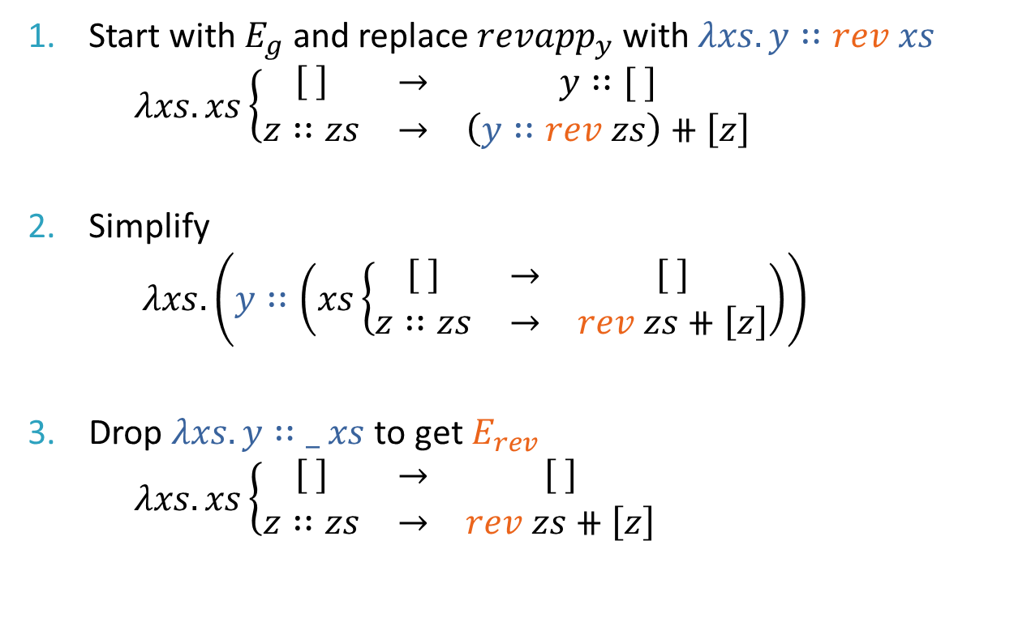
Fissioning $revapp_{y} xs$
Start with $E_{g}$ and replace $revapp_{y}$ with $λxs.y∷rev xs$
$λxs.xs\left\{\begin{matrix}\left[ \right] & → & y∷[ ] \\ z∷zs & → & \left(y∷rev zs\right)⧺\left[z\right]\end{matrix}\right.$
Simplify
$λxs.\left(y∷\left(xs\left\{\begin{matrix}\left[ \right] & → & \left[ \right] \\ z∷zs & → & rev zs⧺\left[z\right]\end{matrix}\right.\right)\right)$
Drop $λxs.y∷_ xs$ to get $E_{rev}$
$λxs.xs\left\{\begin{matrix}\left[ \right] & → & \left[ \right] \\ z∷zs & → & rev zs⧺\left[z\right]\end{matrix}\right.$
Notes:
This technique of floating a constructor out of each branch outside the pattern match is only sound for strict semantics.
Everything else works with lazy semantics

Slide 20
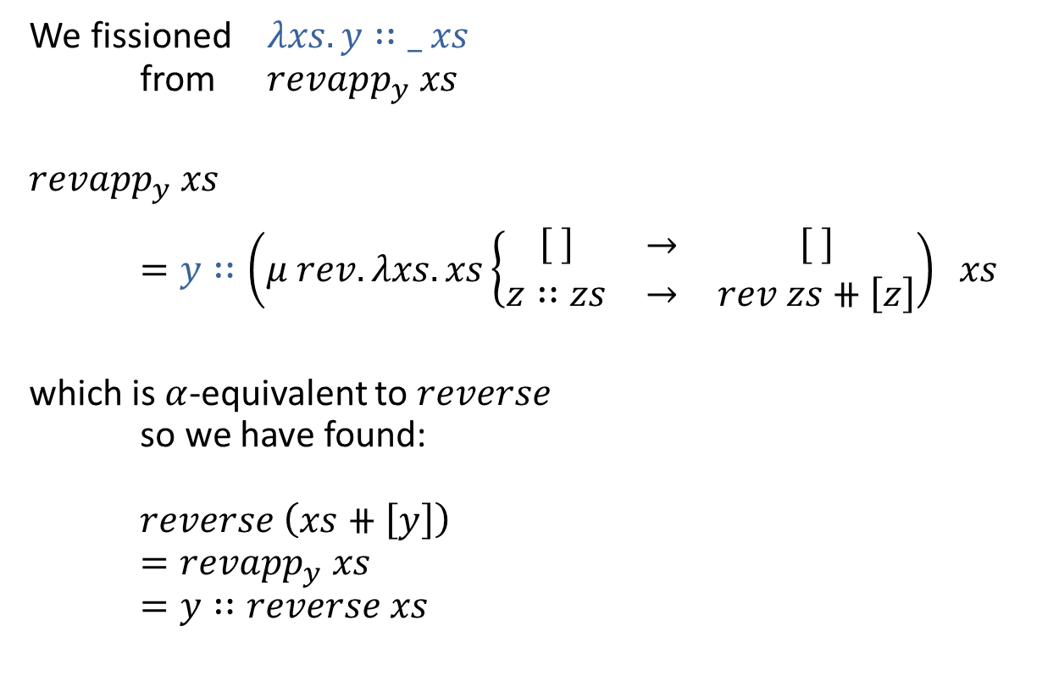
Fissioning $revapp_{y} xs$
We fissioned $λxs.y∷_ xs$
from $revapp_{y} xs$
$${revapp}_{y} xs$$
$=y∷\left(μ rev.λxs.xs\left\{\begin{matrix}\left[ \right] & → & \left[ \right] \\ z∷zs & → & rev zs⧺\left[z\right]\end{matrix}\right.\right) xs$
which is $α$-equivalent to $reverse$
so we have found:
$reverse \left(xs⧺\left[y\right]\right)$
$=revapp_{y} xs$
$=y∷reverse xs$
Woo, lemma discovery
using simplification ☺
Notes:
This technique of floating a constructor down each branch outside the pattern match is only sound for strict semantics.

Slide 21

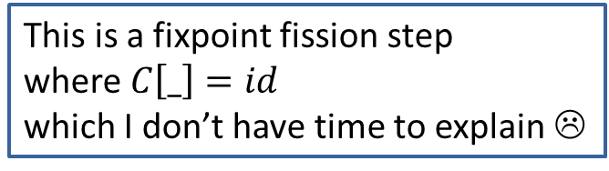

Fusing $reverse∘reverse$
With the sub-simplification:
$$reverse \left(xs⧺\left[y\right]\right)⇢y∷reverse xs$$
We can use fix-fix fusion on:
$reverse∘reverse$
$=μ revrev. λxs.xs\left\{\begin{matrix}\left[ \right] & → & [ ] \\ y∷ys & → & y∷revrev ys\end{matrix}\right.$
$=id$
This is a fixpoint fission step
where $C\left[_\right]=id$
which I don’t have time to explain ☹

Slide 22
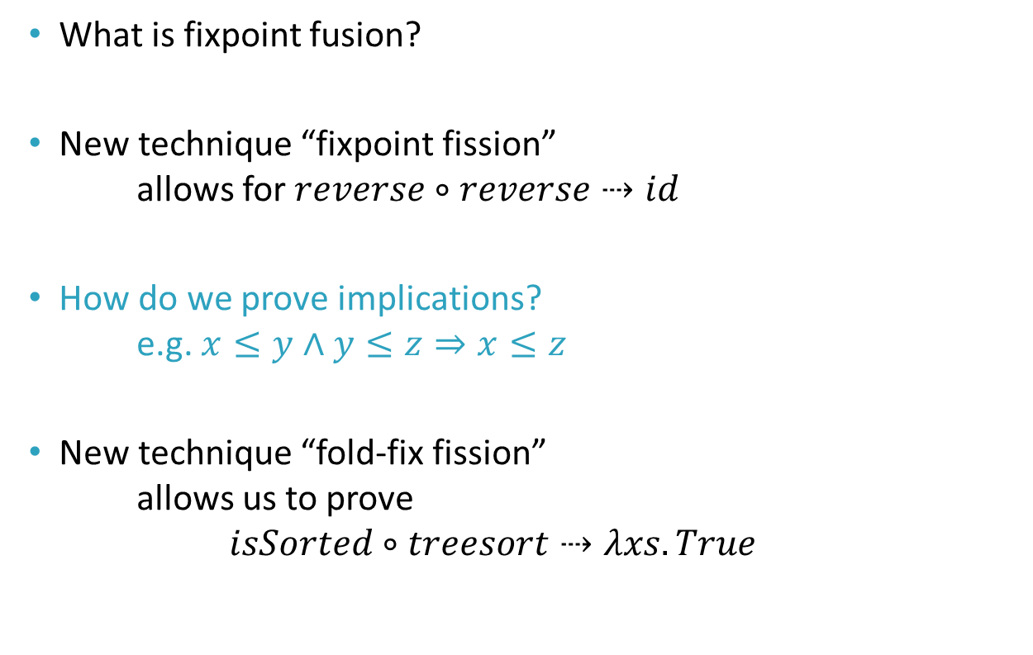
Contents
What is fixpoint fusion?
New technique “fixpoint fission”
allows for $reverse∘reverse⇢id$
How do we prove implications?
e.g. $x≤y∧y≤z⇒x≤z$
New technique “fold-fix fission”
allows us to prove
$isSorted∘treesort⇢λxs.True$

Slide 23
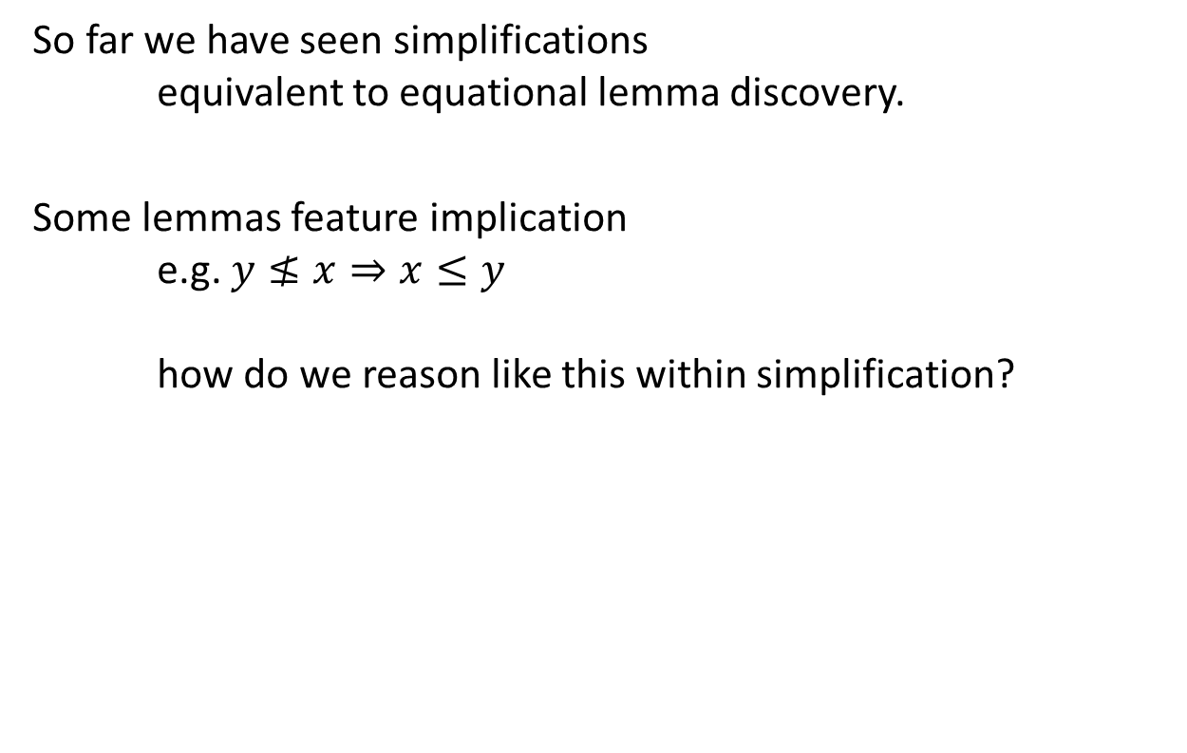
What about implication?
So far we have seen simplifications
equivalent to equational lemma discovery.
Some lemmas feature implication
e.g. $y≰x⇒x≤y$
how do we reason like this within simplification?

Slide 24
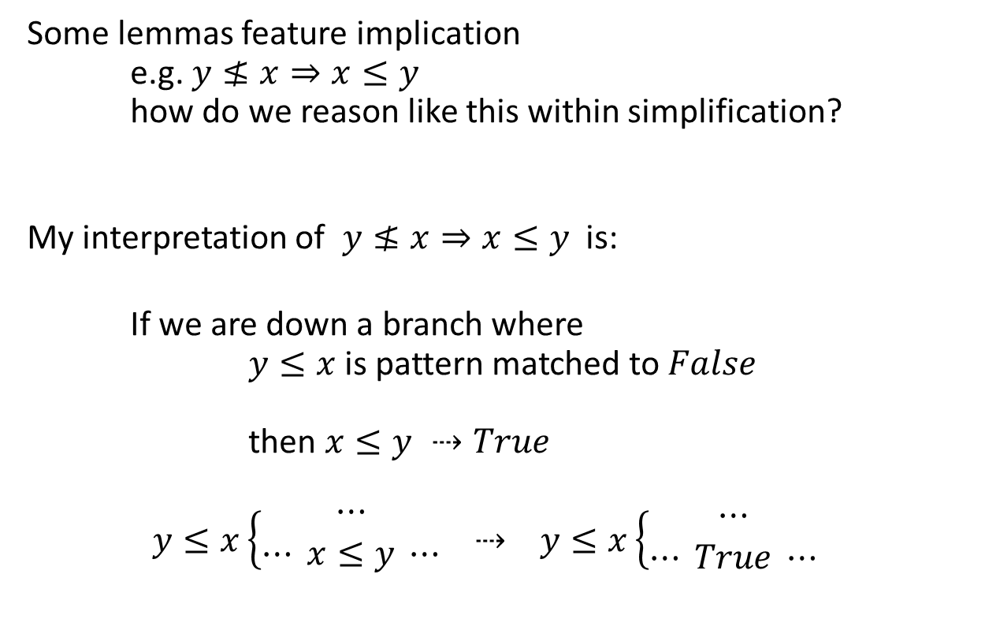
What about implication?
Some lemmas feature implication
e.g. $y≰x⇒x≤y$
how do we reason like this within simplification?
My interpretation of $y≰x⇒x≤y$ is:
If we are down a branch where
$y≤x$ is pattern matched to $False$
then $x≤y ⇢True$
$$y≤x\left\{\begin{aligned}⋯ \\ ⋯ x≤y ⋯\end{aligned}\right. ⇢ y≤x\left\{\begin{aligned}⋯ \\ ⋯ True ⋯\end{aligned}\right.$$
Notes:
Remember the compressed notation for pattern matching over booleans

Slide 25


Definition of $\left(≤\right)$
$$let x≤y$$
$$=\left(μ leq.λxλy.x\left\{\begin{matrix}0 & → & True \\ Suc x^{′} & → & y\left\{\begin{matrix}0 & → & False \\ Suc y^{′} & → & leq x^{′} y^{′}\end{matrix}\right.\end{matrix}\right.\right) x y$$

Slide 26

What about implication?
We want:
$y≤x\left\{\begin{aligned}⋯ \\ ⋯ x≤y ⋯\end{aligned}\right. ⇢ y≤x\left\{\begin{aligned}⋯ \\ ⋯ True ⋯\end{aligned}\right.$
Since we have an inner recursive function ($≤$)
and an outer context (the pattern match)
we can use fusion!

Slide 27
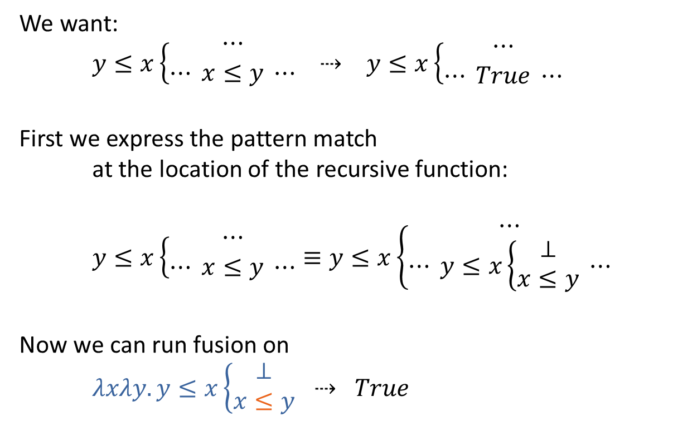
What about implication?
We want:
$y≤x\left\{\begin{aligned}⋯ \\ ⋯ x≤y ⋯\end{aligned}\right. ⇢ y≤x\left\{\begin{aligned}⋯ \\ ⋯ True ⋯\end{aligned}\right.$
First we express the pattern match
at the location of the recursive function:
$y≤x\left\{\begin{aligned}⋯ \\ ⋯ x≤y ⋯\end{aligned}\right.≡y≤x\left\{\begin{aligned}⋯ \\ ⋯ y≤x\left\{\begin{aligned}⊥ \\ x≤y\end{aligned}\right. ⋯\end{aligned}\right.$
Now we can run fusion on
$λxλy.y≤x\left\{\begin{aligned}⊥ \\ x≤y\end{aligned}\right. ⇢ True$
Notes:
Explain that we can’t just use the whole thing as a context, which works but wasn’t what we were going for
It also messes up more complex steps later…
TAKE YOUR TIME ON THIS ONE
This C is not the same C as we’d use for fusion, just a context…
Expressing a pattern match this way is also my idea (have been told I need to point out what stuff is mine more)

Slide 28

What about implication?
Now we can run fusion on
$λxλy.y≤x\left\{\begin{aligned}⊥ \\ x≤y\end{aligned}\right. ⇢ True$
where $C\left[_\right]=λxλy.y≤x\left\{ \begin{aligned}⊥ \\ _ x y\end{aligned}\right.$
and $μf.E_{f}=\left(≤\right)$

Slide 29


What about implication?
$$λxλy.y≤x\left\{\begin{aligned}⊥ \\ x≤y\end{aligned}\right.$$
Unwrap $\left(≤\right)$
$λxλy.y≤x\left\{ \begin{aligned}⊥ \\ \left(λxλy.x\left\{\begin{matrix}0 & → & True \\ Suc x^{′} & → & y\left\{\begin{matrix}0 & → & False \\ Suc y^{′} & → & leq x^{′} y^{′}\end{matrix}\right.\end{matrix}\right.\right)x y\end{aligned}\right.$
Simplify
$λxλy.x\left\{\begin{matrix}0 & → & y≤0\left\{\begin{aligned}⊥ \\ True\end{aligned}\right. \\ Suc x^{′} & → & y\left\{\begin{matrix}0 & → & 0≤Suc x^{′}\left\{\begin{aligned}⊥ \\ False\end{aligned}\right. \\ Suc y^{′} & → & Suc y^{′}≤Suc x^{′}\left\{\begin{aligned}⊥ \\ leq x^{′} y^{′}\end{aligned}\right. \end{matrix}\right.\end{matrix}\right.$
Notes:
Here’s the thing we’re simplifying (top right) for context
For the simplify step we are showing the reduction of all the leqs

Slide 30

What about implication?
$$λxλy.y≤x\left\{\begin{aligned}⊥ \\ x≤y\end{aligned}\right.$$
Unwrap $\left(≤\right)$
$λxλy.y≤x\left\{ \begin{aligned}⊥ \\ \left(λxλy.x\left\{\begin{matrix}0 & → & True \\ Suc x^{′} & → & y\left\{\begin{matrix}0 & → & False \\ Suc y^{′} & → & leq x^{′} y^{′}\end{matrix}\right.\end{matrix}\right.\right)x y\end{aligned}\right.$
Simplify
$λxλy.x\left\{\begin{matrix}0 & → & y≤0\left\{\begin{aligned}⊥ \\ True\end{aligned}\right. \\ Suc x^{′} & → & y\left\{\begin{matrix}0 & → & True\left\{\begin{aligned}⊥ \\ False\end{aligned}\right. \\ Suc y^{′} & → & Suc y^{′}≤Suc x^{′}\left\{\begin{aligned}⊥ \\ leq x^{′} y^{′}\end{aligned}\right. \end{matrix}\right.\end{matrix}\right.$
Notes:
For the simplify step we are showing the reduction of all the leqs

Slide 31

What about implication?
$$λxλy.y≤x\left\{\begin{aligned}⊥ \\ x≤y\end{aligned}\right.$$
Unwrap $\left(≤\right)$
$λxλy.y≤x\left\{ \begin{aligned}⊥ \\ \left(λxλy.x\left\{\begin{matrix}0 & → & True \\ Suc x^{′} & → & y\left\{\begin{matrix}0 & → & False \\ Suc y^{′} & → & leq x^{′} y^{′}\end{matrix}\right.\end{matrix}\right.\right)x y\end{aligned}\right.$
Simplify
$λxλy.x\left\{\begin{matrix}0 & → & y≤0\left\{\begin{aligned}⊥ \\ True\end{aligned}\right. \\ Suc x^{′} & → & y\left\{\begin{matrix}0 & → & ⊥ \\ Suc y^{′} & → & Suc y^{′}≤Suc x^{′}\left\{\begin{aligned}⊥ \\ leq x^{′} y^{′}\end{aligned}\right. \end{matrix}\right.\end{matrix}\right.$
Notes:
Important point, this branch is now absurd

Slide 32

What about implication?
Unwrap $\left(≤\right)$
$λxλy.y≤x\left\{ \begin{aligned}⊥ \\ \left(λxλy.x\left\{\begin{matrix}0 & → & True \\ Suc x^{′} & → & y\left\{\begin{matrix}0 & → & False \\ Suc y^{′} & → & leq x^{′} y^{′}\end{matrix}\right.\end{matrix}\right.\right)x y\end{aligned}\right.$
Simplify
$λxλy.x\left\{\begin{matrix}0 & → & y≤0\left\{\begin{aligned}⊥ \\ True\end{aligned}\right. \\ Suc x^{′} & → & y\left\{\begin{matrix}0 & → & ⊥ \\ Suc y^{′} & → & y^{′}≤x′\left\{\begin{aligned}⊥ \\ leq x^{′} y^{′}\end{aligned}\right. \end{matrix}\right.\end{matrix}\right.$
Notes:
Another reduction

Slide 33

What about implication?
$$λxλy.y≤x\left\{\begin{aligned}⊥ \\ x≤y\end{aligned}\right.$$
Simplify
$λxλy.x\left\{\begin{matrix}0 & → & y≤0\left\{\begin{aligned}⊥ \\ True\end{aligned}\right. \\ Suc x^{′} & → & y\left\{\begin{matrix}0 & → & ⊥ \\ Suc y^{′} & → & y^{′}≤x′\left\{\begin{aligned}⊥ \\ leq x^{′} y^{′}\end{aligned}\right. \end{matrix}\right.\end{matrix}\right.$
Replace occurrences of $λxλy.y≤x\left\{\begin{aligned}⊥ \\ leq x y\end{aligned}\right.$ with $leq_{total}$
$λxλy.x\left\{\begin{matrix}0 & → & y≤0\left\{\begin{aligned}⊥ \\ True\end{aligned}\right. \\ Suc x^{′} & → & y\left\{\begin{matrix}0 & → & ⊥ \\ Suc y^{′} & → & leq_{total} x^{′} y′\end{matrix}\right.\end{matrix}\right.$
Notes:
Now we can do step 3

Slide 34

What about implication?
We have fused $λxλy.y≤x\left\{ \begin{aligned}⊥ \\ _ x y\end{aligned}\right.$ with $\left(≤\right)$
yielding:
$$μ leq_{total}.λxλy.x\left\{\begin{matrix}0 & → & y≤0\left\{\begin{aligned}⊥ \\ True\end{aligned}\right. \\ Suc x^{′} & → & y\left\{\begin{matrix}0 & → & ⊥ \\ Suc y^{′} & → & leq_{total} x^{′} y′\end{matrix}\right.\end{matrix}\right.$$
which simplifies to just:
$λxλy.True$
Notes:
This last step is actually just fixpoint fission again
This \mu(g) is a function which represents the value of x<=y given that y not <= x
It expresses constraints on the domain of the function

Slide 35

Recap of match-fix fusion
We had: $y≤x\left\{\begin{aligned}⋯ \\ ⋯ x≤y ⋯\end{aligned}\right.$
We expressed $y≰x$ where $x≤y$ was:
$y≤x\left\{\begin{aligned}⋯ \\ ⋯ y≤x\left\{\begin{aligned}⊥ \\ x≤y\end{aligned}\right. ⋯\end{aligned}\right.$
We ran fusion:
$y≤x\left\{\begin{aligned}⋯ \\ ⋯ True ⋯\end{aligned}\right.$
I call this match-fix fusion ☺

Slide 36
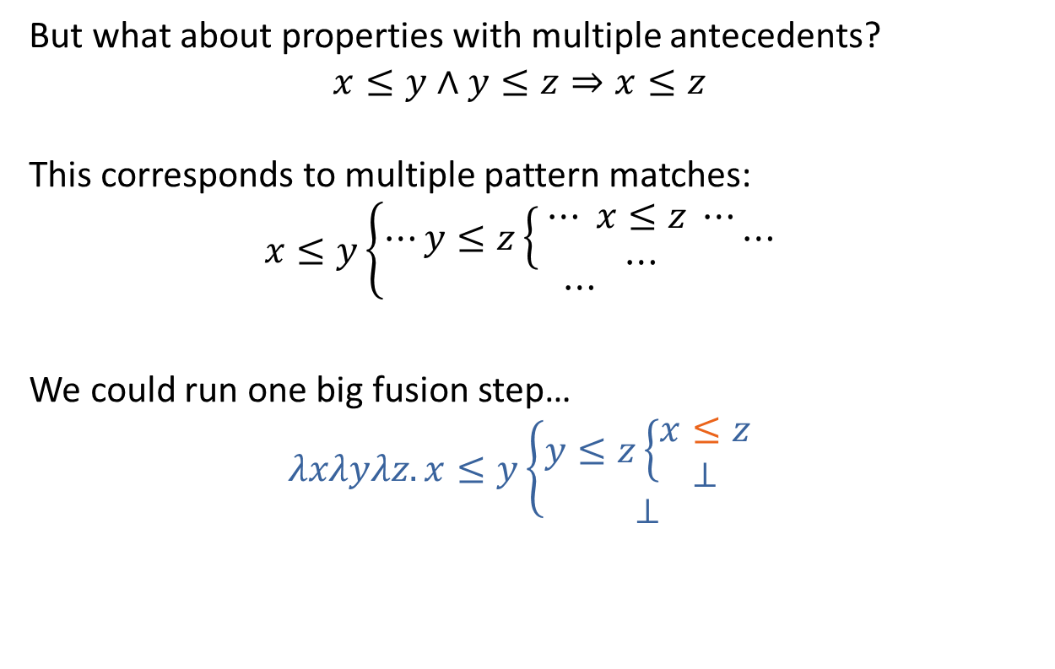
Match-fix fusion
But what about properties with multiple antecedents?
$$x≤y∧y≤z⇒x≤z$$
This corresponds to multiple pattern matches:
$$x≤y\left\{\begin{aligned}⋯y≤z\left\{ \begin{aligned}⋯ x≤z ⋯ \\ ⋯\end{aligned}\right.⋯ \\ ⋯\end{aligned}\right.$$
We could run one big fusion step…
$$λxλyλz.x≤y\left\{\begin{aligned}y≤z\left\{\begin{aligned}x≤z \\ ⊥\end{aligned}\right. \\ ⊥\end{aligned}\right.$$

Slide 37
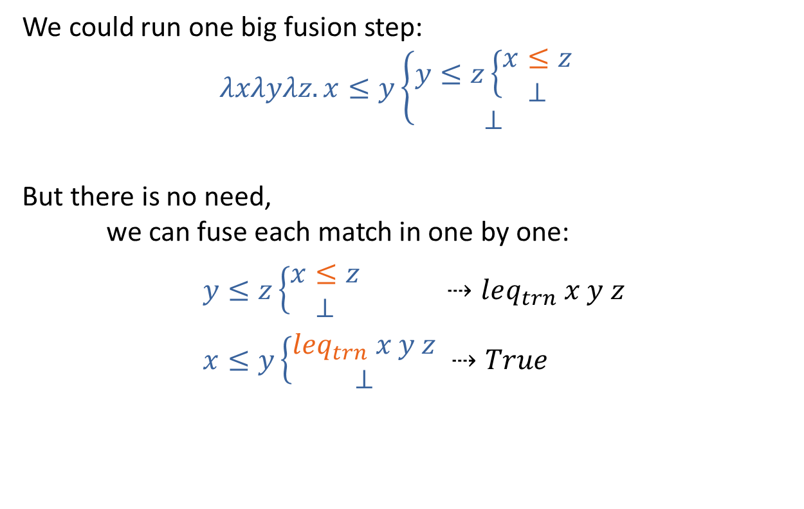
Match-fix fusion
We could run one big fusion step:
$$λxλyλz.x≤y\left\{\begin{aligned}y≤z\left\{\begin{aligned}x≤z \\ ⊥\end{aligned}\right. \\ ⊥\end{aligned}\right.$$
But there is no need,
we can fuse each match in one by one:
$y≤z\left\{\begin{aligned}x≤z \\ ⊥\end{aligned}\right. ⇢leq_{trn} x y z$
$x≤y\left\{\begin{aligned}leq_{trn} x y z \\ ⊥\end{aligned}\right. ⇢True$
Notes:
Leq_trn here is a three valued recursive function
Which represents x <= z when y <= z, the y argument only constrains the input
There will be absurds floating around in the code which will represent the constraints

Slide 38
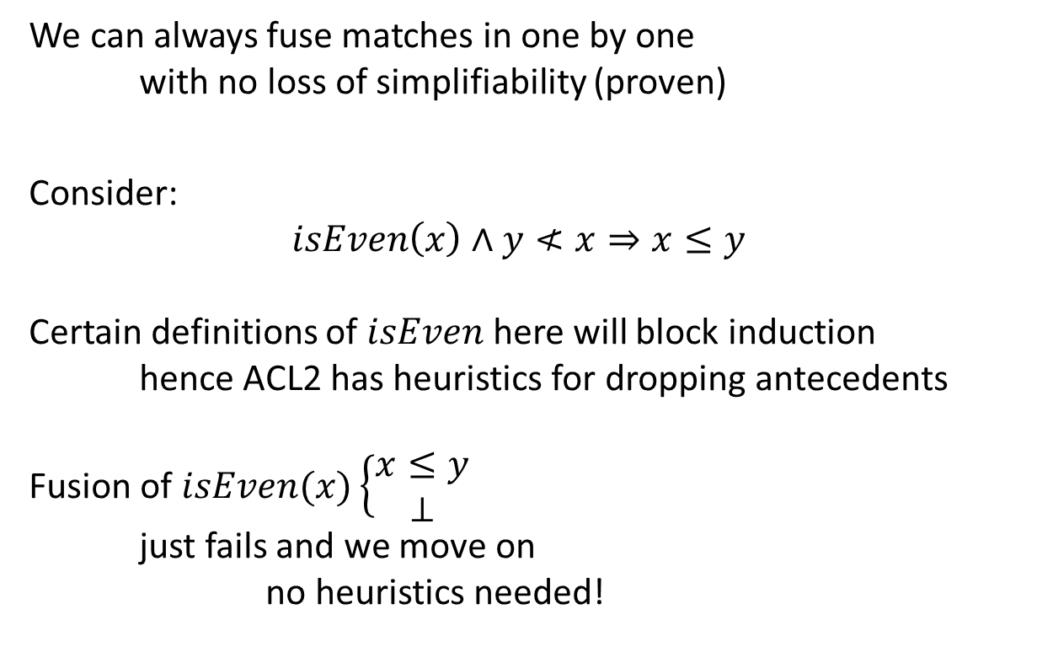
Match-fix fusion
We can always fuse matches in one by one
with no loss of simplifiability (proven)
Consider:
$$isEven\left(x\right)∧y≮x⇒x≤y$$
Certain definitions of $isEven$ here will block induction
hence ACL2 has heuristics for dropping antecedents
Fusion of $isEven(x)\left\{\begin{aligned}x≤y \\ ⊥\end{aligned}\right.$
just fails and we move on
no heuristics needed!

Slide 39

Compositionality of fusion
Fusion is a compositional approach
each step can be run one by one, e.g.
$isEven\left(x\right)∧y≰x⇒double x≤double y$
$double x≤double y$

Slide 40

Compositionality of fusion
Fusion is a compositional approach
each step can be run one by one, e.g.
$isEven\left(x\right)∧y≰x⇒double x≤double y$
$double x≤double y$

Slide 41

Compositionality of fusion
Fusion is a compositional approach
each step can be run one by one, e.g.
$isEven\left(x\right)∧y≰x⇒double x≤double y$
$double x≤double y$
$⇢x≤_{double−left}double y$

Slide 42

Compositionality of fusion
Fusion is a compositional approach
each step can be run one by one, e.g.
$isEven\left(x\right)∧y≰x⇒double x≤double y$
$double x≤double y$
$⇢x≤_{double−left}double y$

Slide 43
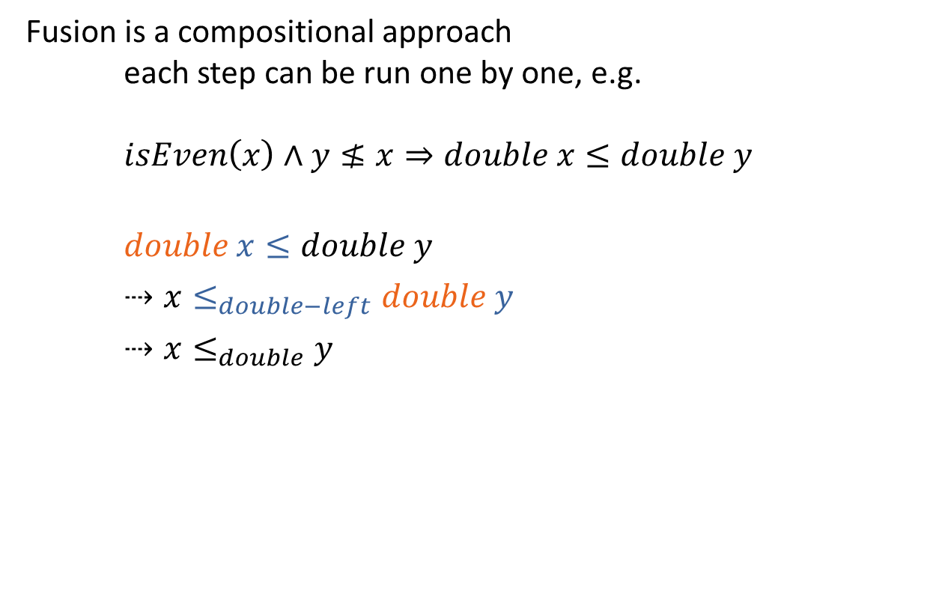
Compositionality of fusion
Fusion is a compositional approach
each step can be run one by one, e.g.
$isEven\left(x\right)∧y≰x⇒double x≤double y$
$double x≤double y$
$⇢x≤_{double−left}double y$
$⇢x≤_{double}y$

Slide 44
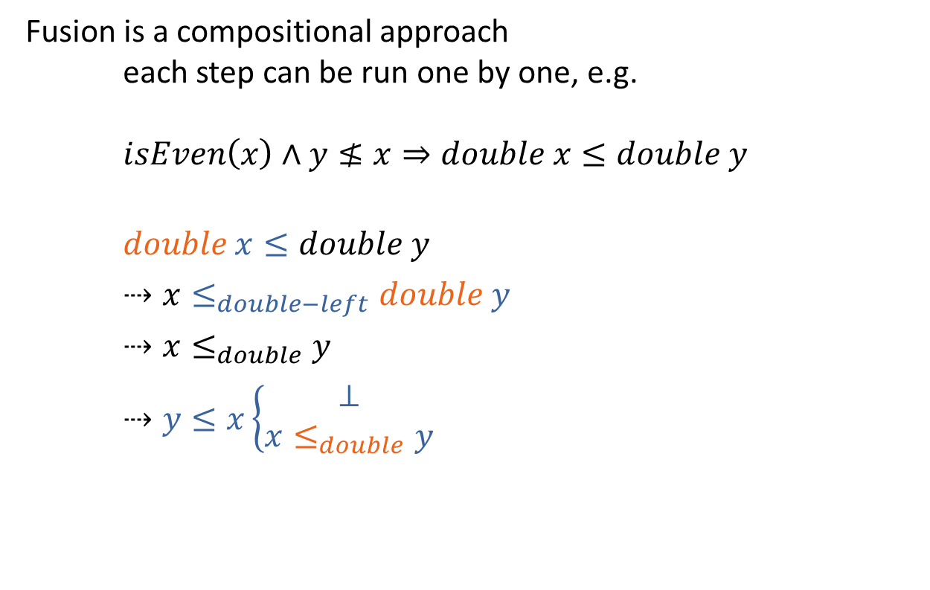
Compositionality of fusion
Fusion is a compositional approach
each step can be run one by one, e.g.
$isEven\left(x\right)∧y≰x⇒double x≤double y$
$double x≤double y$
$⇢x≤_{double−left}double y$
$⇢x≤_{double}y$
$⇢y≤x\left\{\begin{aligned}⊥ \\ x≤_{double}y\end{aligned}\right.$

Slide 45

Compositionality of fusion
Fusion is a compositional approach
each step can be run one by one, e.g.
$isEven\left(x\right)∧y≰x⇒double x≤double y$
$double x≤double y$
$⇢x≤_{double−left}double y$
$⇢x≤_{double}y$
$⇢y≤x\left\{\begin{aligned}⊥ \\ x≤_{double}y\end{aligned}\right.$
$⇢True$

Slide 46
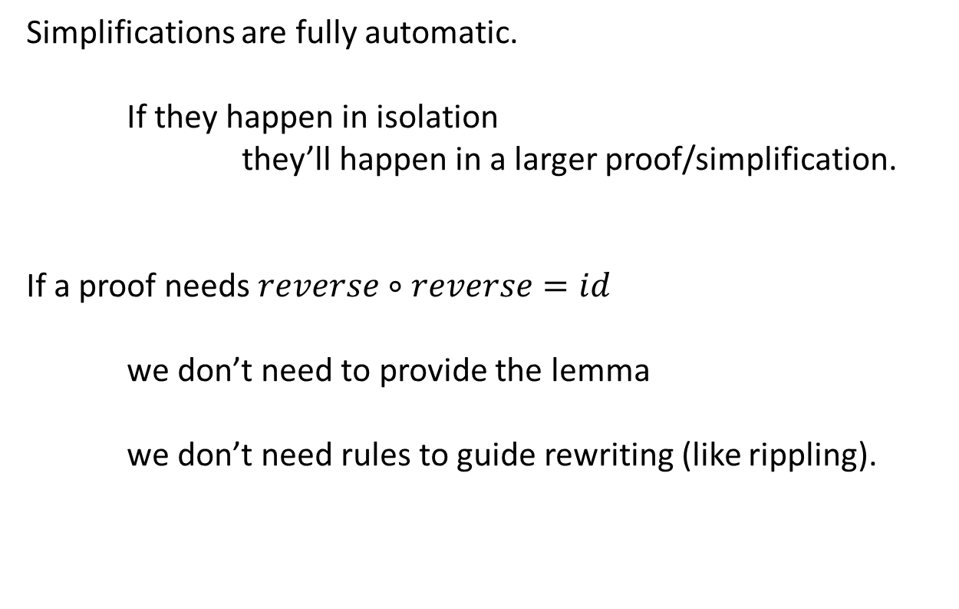
Fusion doesn’t require search
Simplifications are fully automatic.
If they happen in isolation
they’ll happen in a larger proof/simplification.
If a proof needs $reverse∘reverse=id$
we don’t need to provide the lemma
we don’t need rules to guide rewriting (like rippling).

Slide 47
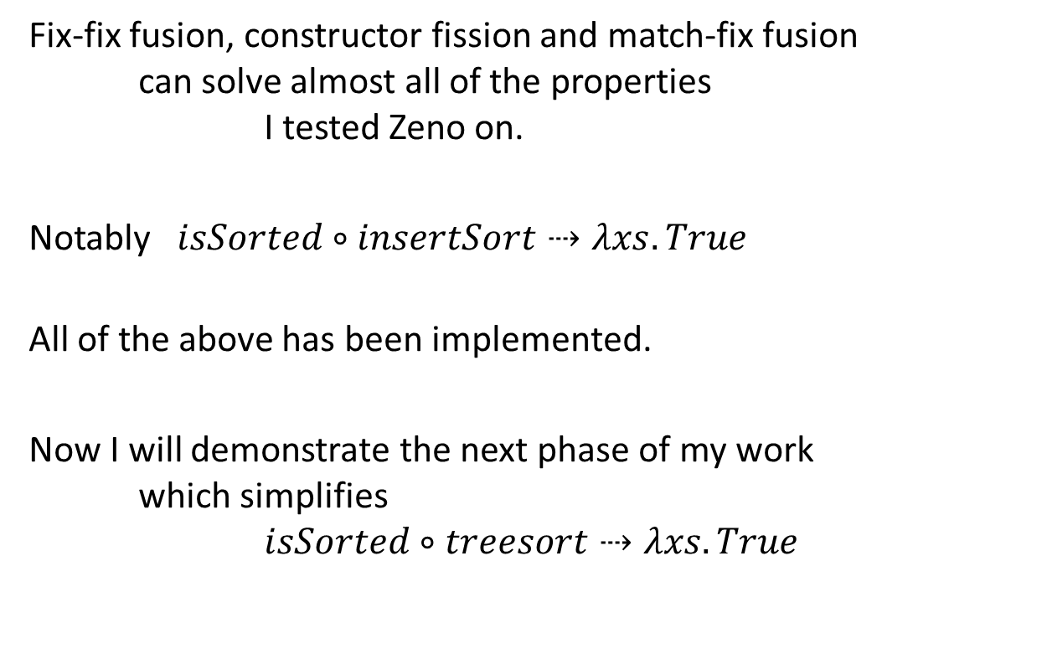
So far…
Fix-fix fusion, constructor fission and match-fix fusion
can solve almost all of the properties
I tested Zeno on.
Notably $isSorted∘insertSort⇢λxs.True$
All of the above has been implemented.
Now I will demonstrate the next phase of my work
which simplifies
$isSorted∘treesort⇢λxs.True$
Notes:
Missing reverse composed with filter, and taking the length of a list from its reverse is the same as just reversing it

Slide 48
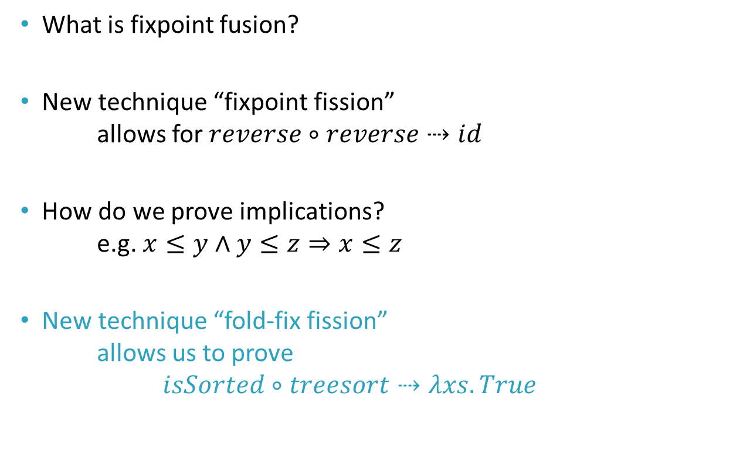
Contents
What is fixpoint fusion?
New technique “fixpoint fission”
allows for $reverse∘reverse⇢id$
How do we prove implications?
e.g. $x≤y∧y≤z⇒x≤z$
New technique “fold-fix fission”
allows us to prove
$isSorted∘treesort⇢λxs.True$

Slide 49


Verifying $treesort$
$$let treesort=flatten∘build$$
$$let build=…$$
$$let flatten=μ flat. λt.t\left\{\begin{matrix}Leaf & → & \left[ \right] \\ t_{1}〈x〉t_{2} & → & flat t_{1}⧺x∷flat t_{2}\end{matrix}\right.$$

Slide 50

Verifying $treesort$
Proving $isSorted \left(treesort xs\right)$ requires the lemma:
$isSorted \left(flatten t_{1}\right)$
$∧isSorted \left(flatten t_{2}\right)$
$∧rightmost t_{1}≤x$
$∧x≤leftmost t_{2}$
$⟹isSorted \left(flatten t_{1}⧺x∷flatten t_{2}\right)$
This lemma is not a generalisation of a sub-goal (sorry ACL2).
This lemma contains functions
which are not in the original definition
$leftmost$, $rightmost$ (sorry HipSpec).

Slide 51


Verifying $treesort$
We start with:
$isSorted \left(treesort xs\right)$
$$=\left(isSorted∘flatten∘build\right) xs$$
Mathematically impossible
to fuse $flatten$ with $build$
Notes:
Looks like two fix-fix fusion steps.
This bit is impossible because the act of unwrapping build loses the information that the list is sorted
All we have left is the type List -> Tree, this loss of information blocks fusion
Dependent types to the rescue maybe?

Slide 52


Verifying $treesort$
We start with:
$isSorted \left(treesort xs\right)$
$$=\left(isSorted∘flatten∘build\right) xs$$
Let’s fuse $isSorted$
with $flatten$

Slide 53

Verifying $treesort$
Unwrap $flatten$
$isSorted∘λt.t\left\{\begin{matrix}Leaf & → & \left[ \right] \\ t_{1}〈x〉t_{2} & → & flat t_{1}⧺x∷flat t_{2}\end{matrix}\right.$
Simplify
$λt.t\left\{\begin{matrix}Leaf & → & True \\ t_{1}〈x〉t_{2} & → & isSorted \left(flat t_{1}⧺x∷flat t_{2}\right)\end{matrix}\right.$
No instances of $isSorted∘flat$ to replace ☹
Notes:
Fusion has failed because we are left with free instances of $f$, since we could replace anything with $g$

Slide 54


Verifying $treesort$
The problem is we have:
$isSorted \left(flat t_{1}⧺x∷flat t_{2}\right)$
And we want:
$F_{x} \left(isSorted \left(flat t_{1}\right), isSorted \left(flat t_{2}\right)\right)$
We need to discover the definition of $F$.
So we can rewrite
$$isSorted∘flat$$
Notes:
Lots of “remember this was our aim”

Slide 55

Fold-fix fission
We have $isSorted \left(flat t_{1}⧺x∷flat t_{2}\right)$
First the algorithm will fix-fix fuse
$isSorted∘λxs.xs⧺x∷ys$
into some new function
$sortedNode_{x} xs ys$
$≡isSorted \left(xs⧺x∷ys\right)$
Notes:
I invented this technique, and have called it fold-fix fission
Fix-fix fusion here takes two fixpoints and fuses them into one single recursive function, which I’ll just call sortedNode
I am glossing over the details for time, plus the function definitions are a bit unwieldy

Slide 56

Fold-fix fission
Now we want
$$sortedNode_{x} xs ys⇢F_{x} \left(isSorted xs, isSorted ys\right)$$

Slide 57

Fold-fix fission
Now we want
$$sortedNode_{x} xs ys⇢F_{x} \left(isSorted xs, isSorted ys\right)$$
This is just fission!
$$μg.E_{g}⇢C\left[μf.E_{f}\right]$$
But this time instead of
knowing $C[_]$ and $E_{g}$, and discovering $E_{f}$
we know $E_{f}$ and $E_{g}$, and must discover $C[_]$

Slide 58


Discovering $F_{x} :𝔹×𝔹→𝔹$
The trick is to assume $F_{x} :𝔹×𝔹→𝔹$
is a fold function
A fold function over two booleans
is two nested pattern matches
So we assume, for some $E_{1}$, $E_{2}$, $E_{3}$, and $E_{4}$
$$F_{x} {(b}_{1},b_{2})=b_{1}\left\{\begin{aligned}b_{2}\left\{\begin{aligned}E_{1} \\ E_{2}\end{aligned}\right. \\ b_{2}\left\{\begin{aligned}E_{3} \\ E_{4}\end{aligned}\right.\end{aligned}\right.$$

Slide 59


Discovering $F_{x} :𝔹×𝔹→𝔹$
$$F_{x}\left(b_{1},b_{2}\right)=b_{1}\left\{\begin{aligned}b_{2}\left\{\begin{aligned}E_{1} \\ E_{2}\end{aligned}\right. \\ b_{2}\left\{\begin{aligned}E_{3} \\ E_{4}\end{aligned}\right.\end{aligned}\right.$$
$$F_{x}\left(isSorted xs, isSorted ys\right)$$
$$≡sortedNode_{x} xs ys$$
Give us:
$E_{1}=sortedNode_{x} xs ys$ when $\left\{\begin{matrix}isSorted xs=True \\ isSorted ys=True\end{matrix}\right.$
$E_{2}=sortedNode_{x} xs ys$ when $\left\{\begin{matrix}isSorted xs=True \\ isSorted ys=False\end{matrix}\right.$
$E_{3}=sortedNode_{x} xs ys$ when $\left\{\begin{matrix}isSorted xs=False \\ isSorted ys=True\end{matrix}\right.$
$E_{4}=sortedNode_{x} xs ys$ when $\left\{\begin{matrix}isSorted xs=False \\ isSorted ys=False\end{matrix}\right.$
and
Notes:
Combining these two equations we are trying to solve

Slide 60

Discovering $F_{x} :𝔹×𝔹→𝔹$
$$E_{1}=isSorted xs\left\{\begin{aligned}isSorted ys\left\{\begin{aligned}sortedNode_{x} xs ys \\ ⊥\end{aligned}\right. \\ ⊥\end{aligned}\right.$$
$$E_{2}=isSorted xs\left\{\begin{aligned}isSorted ys\left\{\begin{aligned}⊥ \\ sortedNode_{x} xs ys\end{aligned}\right. \\ ⊥\end{aligned}\right.$$
$$E_{3}=isSorted xs\left\{\begin{aligned}⊥ \\ isSorted ys\left\{\begin{aligned}sortedNode_{x} xs ys \\ ⊥\end{aligned}\right.\end{aligned}\right.$$
$$E_{4}=isSorted xs\left\{\begin{aligned}⊥ \\ isSorted ys\left\{\begin{aligned}⊥ \\ sortedNode_{x} xs ys\end{aligned}\right.\end{aligned}\right.$$
Notes:
Now we can use match-fix fusion to solve these equations

Slide 61

Discovering $F_{x} :𝔹×𝔹→𝔹$
$$E_{1}=isSorted xs\left\{\begin{aligned}isSorted ys\left\{\begin{aligned}sortedNode_{x} xs ys \\ ⊥\end{aligned}\right. \\ ⊥\end{aligned}\right.$$
$$E_{2}=isSorted xs\left\{\begin{aligned}isSorted ys\left\{\begin{aligned}⊥ \\ sortedNode_{x} xs ys\end{aligned}\right. \\ ⊥\end{aligned}\right.$$
$$E_{3}=isSorted xs\left\{\begin{aligned}⊥ \\ isSorted ys\left\{\begin{aligned}sortedNode_{x} xs ys \\ ⊥\end{aligned}\right.\end{aligned}\right.$$
$$E_{4}=isSorted xs\left\{\begin{aligned}⊥ \\ isSorted ys\left\{\begin{aligned}⊥ \\ sortedNode_{x} xs ys\end{aligned}\right.\end{aligned}\right.$$
Notes:
Now we can use match-fix fusion to solve these equations

Slide 62

Discovering $F_{x} :𝔹×𝔹→𝔹$
$$E_{1}=isSorted xs\left\{\begin{aligned}isSorted ys\left\{\begin{aligned}sortedNode_{x} xs ys \\ ⊥\end{aligned}\right. \\ ⊥\end{aligned}\right.$$
$$E_{2}=False$$
$$E_{3}=isSorted xs\left\{\begin{aligned}⊥ \\ isSorted ys\left\{\begin{aligned}sortedNode_{x} xs ys \\ ⊥\end{aligned}\right.\end{aligned}\right.$$
$$E_{4}=isSorted xs\left\{\begin{aligned}⊥ \\ isSorted ys\left\{\begin{aligned}⊥ \\ sortedNode_{x} xs ys\end{aligned}\right.\end{aligned}\right.$$
Notes:
Now we can use match-fix fusion to solve these equations

Slide 63

Discovering $F_{x} :𝔹×𝔹→𝔹$
$$E_{1}=isSorted xs\left\{\begin{aligned}isSorted ys\left\{\begin{aligned}sortedNode_{x} xs ys \\ ⊥\end{aligned}\right. \\ ⊥\end{aligned}\right.$$
$$E_{2}=False$$
$$E_{3}=False$$
$$E_{4}=isSorted xs\left\{\begin{aligned}⊥ \\ isSorted ys\left\{\begin{aligned}⊥ \\ sortedNode_{x} xs ys\end{aligned}\right.\end{aligned}\right.$$
Notes:
Now we can use match-fix fusion to solve these equations

Slide 64

Discovering $F_{x} :𝔹×𝔹→𝔹$
$$E_{1}=isSorted xs\left\{\begin{aligned}isSorted ys\left\{\begin{aligned}sortedNode_{x} xs ys \\ ⊥\end{aligned}\right. \\ ⊥\end{aligned}\right.$$
$$E_{2}=False$$
$$E_{3}=False$$
$$E_{4}=False$$
Notes:
Now we can use match-fix fusion to solve these equations

Slide 65

Discovering $F_{x} :𝔹×𝔹→𝔹$
$$E_{1}="last xs≤x∧x≤head ys"$$
$$E_{2}=False$$
$$E_{3}=False$$
$$E_{4}=False$$
Notes:
$E_{1}$ is not shaped this way, but it behaves this way. Some recursive function which behaves exactly like this.

Slide 66

Discovering $F_{x} :𝔹×𝔹→𝔹$
$$E_{1}="last xs≤x∧x≤head ys"$$
$$E_{2}=False$$
$$E_{3}=False$$
$$E_{4}=False$$
$$F_{x} {(b}_{1},b_{2})=b_{1}\left\{\begin{aligned}b_{2}\left\{\begin{aligned}E_{1} \\ E_{2}\end{aligned}\right. \\ b_{2}\left\{\begin{aligned}E_{3} \\ E_{4}\end{aligned}\right.\end{aligned}\right.$$

Slide 67

Discovering $F_{x} :𝔹×𝔹→𝔹$
$$E_{1}="last xs≤x∧x≤head ys"$$
$$E_{2}=False$$
$$E_{3}=False$$
$$E_{4}=False$$
$$F_{x} {(b}_{1},b_{2})=b_{1}\left\{\begin{aligned}b_{2}\left\{\begin{aligned}"last xs≤x∧x≤head ys" \\ False\end{aligned}\right. \\ b_{2}\left\{\begin{aligned}False \\ False\end{aligned}\right.\end{aligned}\right.$$

Slide 68

Discovering $F_{x} :𝔹×𝔹→𝔹$
We have discovered $F_{x}$
$$F_{x} {(b}_{1},b_{2})=b_{1}\left\{\begin{aligned}b_{2}\left\{\begin{aligned}"last xs≤x∧x≤head ys" \\ False\end{aligned}\right. \\ b_{2}\left\{\begin{aligned}False \\ False\end{aligned}\right.\end{aligned}\right.$$
Hence
$$F_{x} \left(isSorted xs, isSorted ys\right)$$
$$=isSorted xs\left\{\begin{aligned}isSorted ys\left\{\begin{aligned}"last xs≤x∧x≤head ys" \\ False\end{aligned}\right. \\ isSorted ys\left\{\begin{aligned}False \\ False\end{aligned}\right.\end{aligned}\right.$$

Slide 69

Discovering $F_{x} :𝔹×𝔹→𝔹$
We have discovered $F_{x}$
$$F_{x} {(b}_{1},b_{2})=b_{1}\left\{\begin{aligned}b_{2}\left\{\begin{aligned}"last xs≤x∧x≤head ys" \\ False\end{aligned}\right. \\ b_{2}\left\{\begin{aligned}False \\ False\end{aligned}\right.\end{aligned}\right.$$
Hence
$$F_{x} \left(isSorted xs, isSorted ys\right)$$
$$=isSorted xs∧isSorted ys$$
$∧"last xs≤x∧x≤head ys"$

Slide 70


Back to $isSorted∘flatten$
Unwrap $flatten$
$isSorted∘λt.t\left\{\begin{matrix}Leaf & → & \left[ \right] \\ t_{1}〈x〉t_{2} & → & flat t_{1}⧺x∷flat{ t}_{2}\end{matrix}\right.$
Simplify
$λt.t\left\{\begin{matrix}Leaf & → & True \\ t_{1}〈x〉t_{2} & → & sortedNode_{x} \left(flat t_{1}\right) \left(flat t_{2}\right)\end{matrix}\right.$
Use fold-fission on $sortedNode_{x}$
$$λt.t\left\{\begin{matrix}Leaf & → & True \\ t_{1}〈x〉t_{2} & → & \begin{aligned}isSorted \left(flat t_{1}\right)∧isSorted (flat t_{2}) \\ ∧"last \left(flat t_{1}\right)≤x∧x≤head \left(flat t_{2}\right)"\end{aligned}\end{matrix}\right.$$
Notes:
Now we can use our fold-fix fission step to allow us to complete fusion

Slide 71

Back to $isSorted∘flatten$
… use fold-fission on $sortedNode_{x}$
$λt.t\left\{\begin{matrix}Leaf & → & True \\ t_{1}〈x〉t_{2} & → & \begin{aligned}isSorted \left(flat t_{1}\right)∧isSorted (flat t_{2}) \\ ∧"last \left(flat t_{1}\right)≤x∧x≤head \left(flat t_{2}\right)"\end{aligned}\end{matrix}\right.$
Replace $isSorted∘flat$ with $sortedTree$
$λt.t\left\{\begin{matrix}Leaf & → & True \\ t_{1}〈x〉t_{2} & → & \begin{aligned}sortedTree{ t}_{1}∧sortedTree t_{2} \\ ∧"last \left(flat t_{1}\right)≤x∧x≤head \left(flat t_{2}\right)"\end{aligned}\end{matrix}\right.$
Notes:
The need to be able to apply this final step 3. requires us to have instances of $isSorted∘f$, which guides the fold-fix fission step.
So here we use the name sortedTree for our g variable

Slide 72

Back to $isSorted∘flatten$
$$isSorted∘flatten$$
$=μ sortedTree.$
$λt.t\left\{\begin{matrix}Leaf & → & True \\ t_{1}〈x〉t_{2} & → & \begin{aligned}sortedTree{ t}_{1}∧sortedTree t_{2} \\ ∧"last \left(flat t_{1}\right)≤x∧x≤head \left(flat t_{2}\right)"\end{aligned}\end{matrix}\right.$
Put the definition of $flat$ back in
(remember $flat$ is the uninterpreted form of $flatten$):
$$=μ sortedTree. \\ λt.t\left\{\begin{matrix}Leaf & → & True \\ t_{1}〈x〉t_{2} & → & \begin{aligned}sortedTree{ t}_{1}∧sortedTree t_{2} \\ ∧"last \left(flatten t_{1}\right)≤x∧x≤head \left(flatten t_{2}\right)"\end{aligned}\end{matrix}\right.$$
Notes:
Okay, so we have occurrences of $f$ remaining, so this is not the correct success condition for fusion.
Right now I am using the heuristic that is has replaced as many occurrences of $f$ as there were in the original unwrapped inner function.
But this needs more research.

Slide 73

Back to $isSorted∘flatten$
$$=μ sortedTree. \\ λt.t\left\{\begin{matrix}Leaf & → & True \\ t_{1}〈x〉t_{2} & → & \begin{aligned}sortedTree{ t}_{1}∧sortedTree t_{2} \\ ∧"last \left(flatten t_{1}\right)≤x∧x≤head \left(flatten t_{2}\right)"\end{aligned}\end{matrix}\right.$$
Notes:
So we have discovered the definitions of leftmost and rightmost!
The definition pops out exactly as a human would have implemented it ☺

Slide 74

Back to $isSorted∘flatten$
$$=μ sortedTree. \\ λt.t\left\{\begin{matrix}Leaf & → & True \\ t_{1}〈x〉t_{2} & → & \begin{aligned}sortedTree{ t}_{1}∧sortedTree t_{2} \\ ∧"last \left(flatten t_{1}\right)≤x∧x≤head \left(flatten t_{2}\right)"\end{aligned}\end{matrix}\right.$$
Fix-fix fusion will fuse
$last∘flatten⇢rightmost$
$head∘flatten⇢leftmost$
$$=μ sortedTree. \\ λt.t\left\{\begin{matrix}Leaf & → & True \\ t_{1}〈x〉t_{2} & → & \begin{aligned}sortedTree{ t}_{1}∧sortedTree t_{2} \\ ∧"rightmost t_{1}≤x∧x≤leftmost t_{2}"\end{aligned}\end{matrix}\right.$$
Notes:
So we have discovered the definitions of leftmost and rightmost!
The definition pops out exactly as a human would have implemented it ☺

Slide 75

If we recall our lemma…
$isSorted \left(flatten t_{1}\right)$
$∧isSorted \left(flatten t_{2}\right)$
$∧rightmost t_{1}≤x$
$∧x≤leftmost t_{2}$
$⟹isSorted \left(flatten t_{1}⧺x∷flatten t_{2}\right)$
This is the definition we get from fusing $isSorted∘flatten$!
$$μ sortedTree. \\ λt.t\left\{\begin{matrix}Leaf & → & True \\ t_{1}〈x〉t_{2} & → & \begin{aligned}sortedTree{ t}_{1}∧sortedTree t_{2} \\ ∧"rightmost t_{1}≤x∧x≤leftmost t_{2}"\end{aligned}\end{matrix}\right.$$
Notes:
Here the implication is working in a function logic sense

Slide 76

Verifying $treesort$
$$let sortedTree=μg.λt.t\left\{\begin{matrix}Leaf & → & True \\ t_{1}〈x〉t_{2} & → & \begin{aligned}g{ t}_{1}∧g t_{2} \\ ∧rightmost t_{1}≤x \\ ∧x≤leftmost t_{2}\end{aligned}\end{matrix}\right.$$
$$isSorted \left(treesort xs\right) \\ =\left(isSorted∘flatten∘build\right) xs$$
Notes:
We can fuse sortedTree with build no problem, even though flatten and build couldn’t be fused

Slide 77

Verifying $treesort$
$$let sortedTree=μg.λt.t\left\{\begin{matrix}Leaf & → & True \\ t_{1}〈x〉t_{2} & → & \begin{aligned}g{ t}_{1}∧g t_{2} \\ ∧rightmost t_{1}≤x \\ ∧x≤leftmost t_{2}\end{aligned}\end{matrix}\right.$$
$$isSorted \left(treesort xs\right) \\ =\left(isSorted∘flatten∘build\right) xs \\ =\left(sortedTree∘build\right) xs$$
Notes:
We can fuse sortedTree with build no problem, even though flatten and build couldn’t be fused

Slide 78

Verifying $treesort$
$$let sortedTree=μg.λt.t\left\{\begin{matrix}Leaf & → & True \\ t_{1}〈x〉t_{2} & → & \begin{aligned}g{ t}_{1}∧g t_{2} \\ ∧rightmost t_{1}≤x \\ ∧x≤leftmost t_{2}\end{aligned}\end{matrix}\right.$$
$$isSorted \left(treesort xs\right) \\ =\left(isSorted∘flatten∘build\right) xs \\ =\left(sortedTree∘build\right) xs \\ =\left(λxs.True\right) xs \\ =True$$
Notes:
We can fuse sortedTree with build no problem, even though flatten and build couldn’t be fused

Slide 79

Fold-fix fission
I demonstrated fold-fix fission
over a non-recursive datatype ($𝔹$)
But it generalises to recursive datatypes too!
I didn’t use the fission process much with $𝔹$
it becomes necessary for recursive datatypes
No time to explain though ☹

Slide 80
Conclusion
Fix-fix fusion and constructor fission
will do automated inductive proof
for equational properties.
Match-fix fusion will do automated inductive proof
for implication properties.
Fusion is compositional
and requires no search space.
Fold-fix fission is awesome.

Slide 81
Future work
Finish implementation
Proofs of completeness w.r.t. proof by induction
Dependently typed fusion

