Slide 1

Managing Large Data Storage Systems in the Visual Effects Industry
Chris Bowden
Alexandra Douglass-Bonner
Simon Edwards-Parton
Mark Hensel
Jennifer Steele
Geng Tian

Slide 2
Outline
Problem Statement
Existing System
Solution Demonstration
Architecture
Implementation Challenges
Testing
Evaluation
Future Work

Slide 3
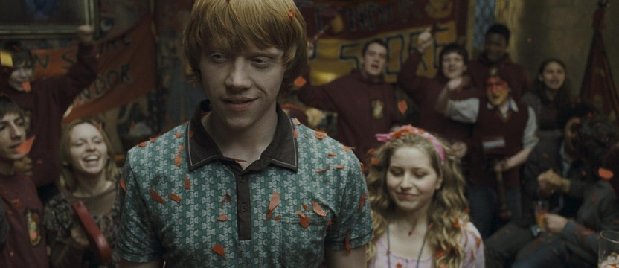
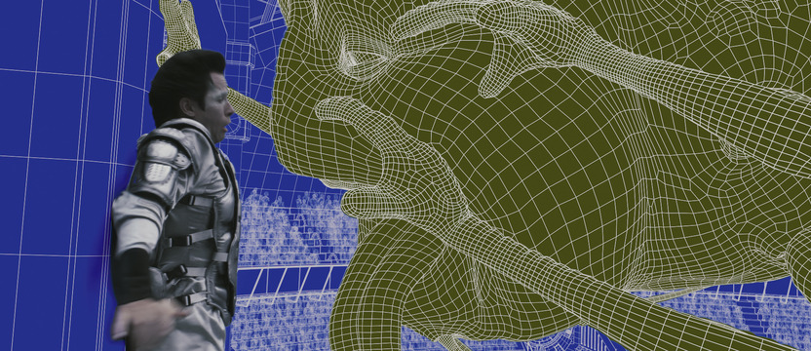

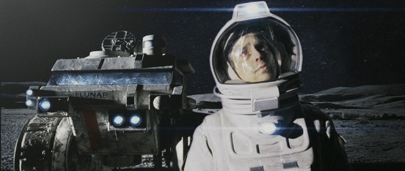
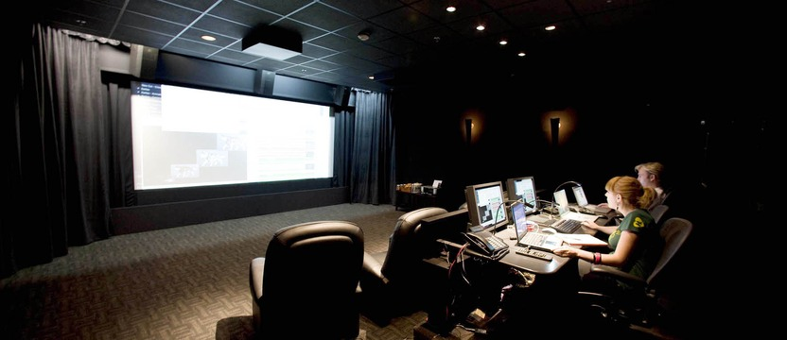
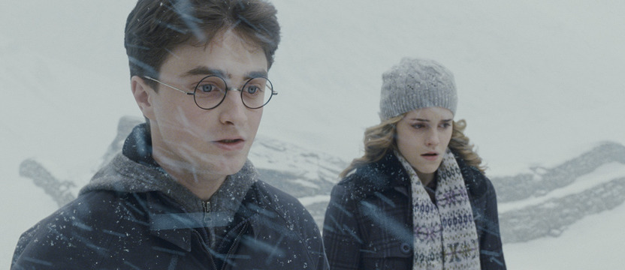

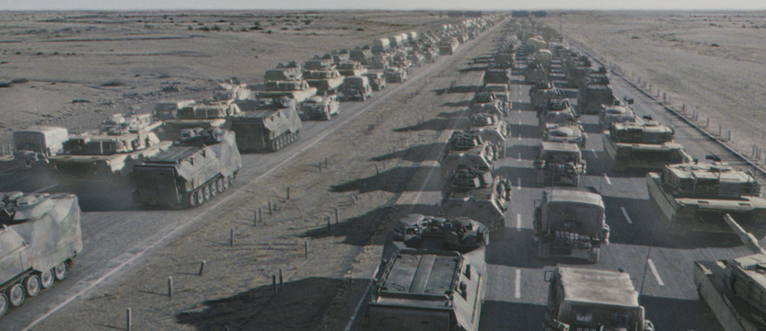
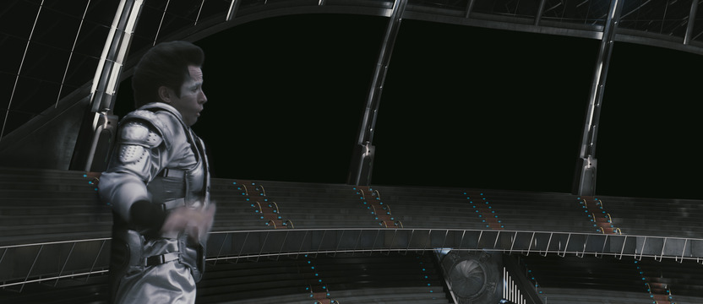
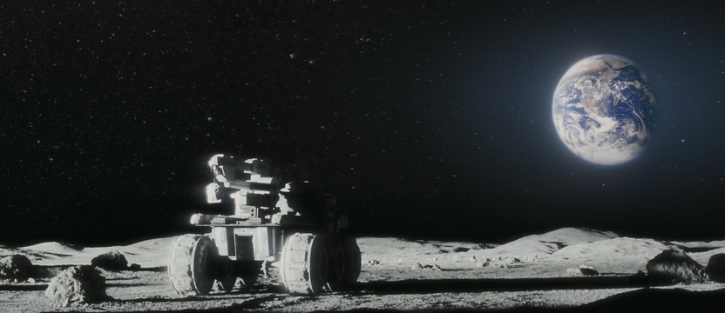
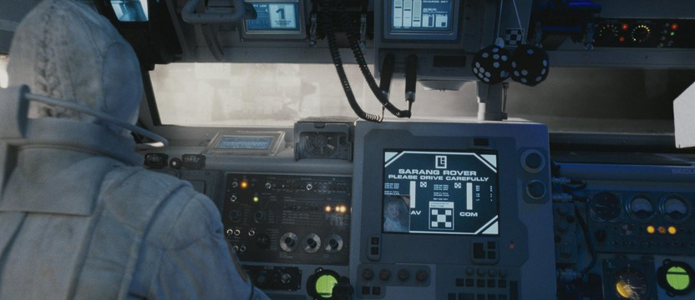
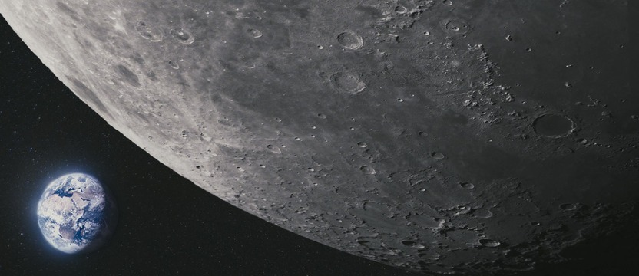
Cinesite and their Business Problem
Cinesite
Harry Potter
The Golden Compass
Generation Kill
Bedtime Stories
Moon
background

Slide 4
Problem Statement
How, when and where is file space being used?
background

Slide 5
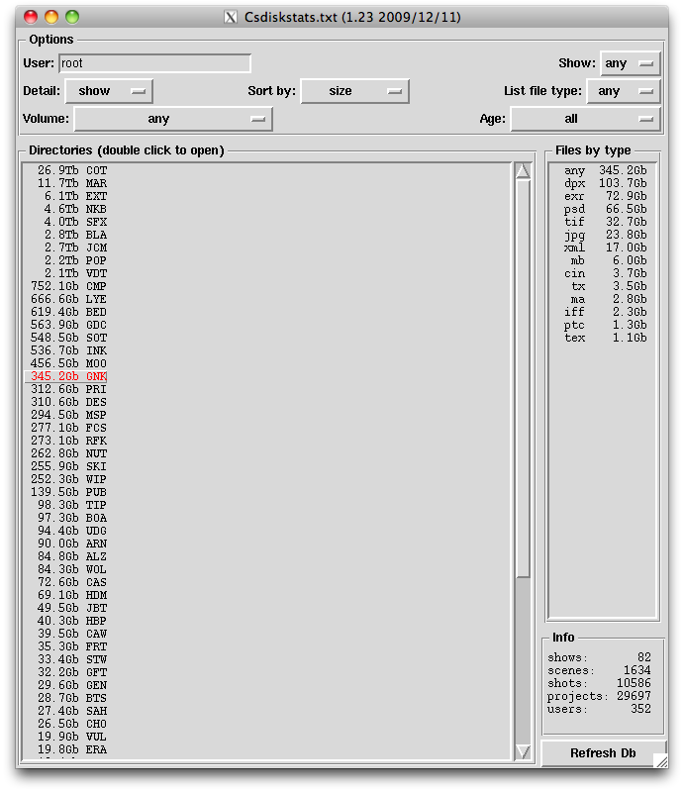
Existing System
4 days to perform a scan of the system
Stale snapshot
Machine specific
Doesn’t scan entire file system
No historical data
Poor UI performance
Consequence: incomplete understanding of file space usage.
background

Slide 6
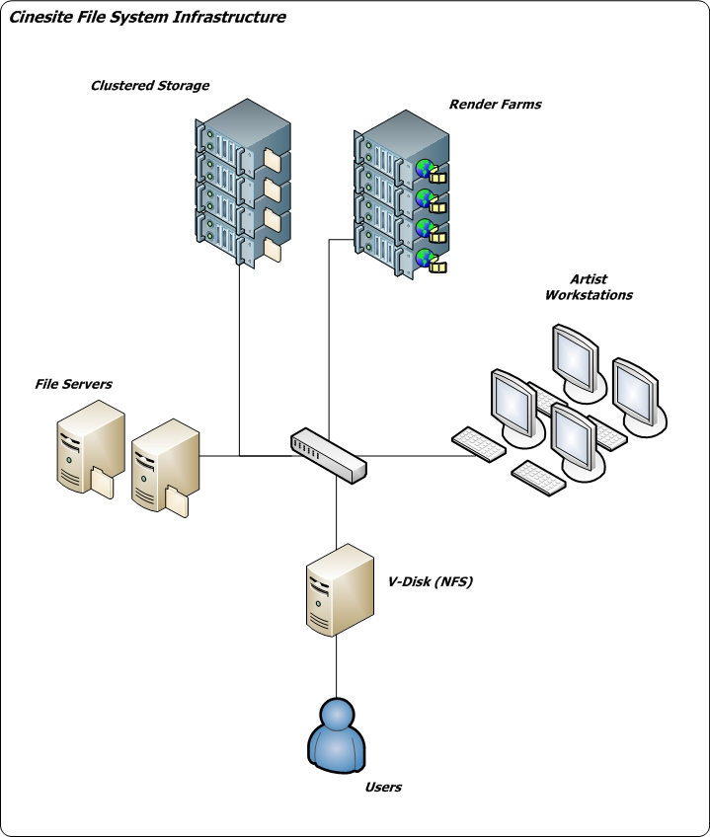
Solution Requirements
File System
350 TB
NAS, Workstations, Servers
Unix, Windows, Mac
Virtual Disk
User Access
Company wide
Visualisation
Text view
Scanning Latency
Refreshed every 6 hours
Directory Information
Richer data set
Historical usage trends
Graphical view
solution

Slide 7
demonstration
solution

Slide 8
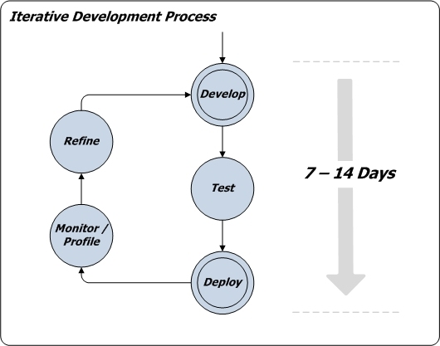
Development Approach
Leap into the unknown
Agile approach
  Develop scanning prototype and refine
  Develop web front-end in parallel
Modularity and “Separation of Concerns”
‘Open-Closed’ principle
Third party components
methodology

Slide 9
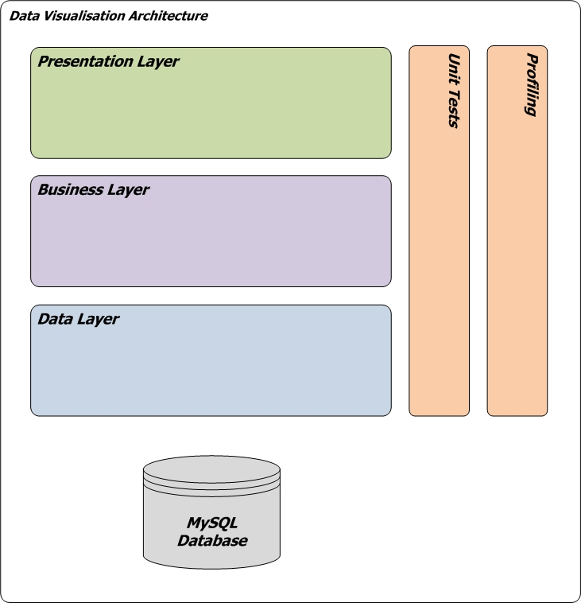
Application Architecture
User Interface
  Visual interface
  Admin interface
Business Layer
  File system scanner
  Scheduler
  Threading
  Domain classes
Data Layer
  MySQL Database
  Data Access Code
  Caching
  SpringFramework
  C3PO – connection pooling
methodology

Slide 10
Implementation Challenges
Meeting the scale and latency requirements was non-trivial
Significant Challenges:
  Functional
  Engineering
  Scalability
  Performance
  Component Configuration
Implementation challenges

Slide 11
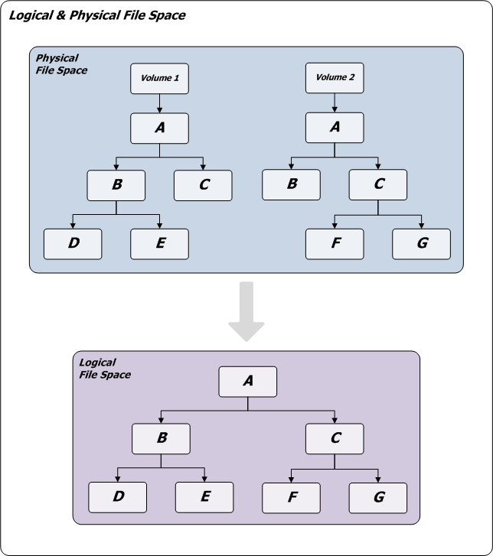
Physical to Logical File Mapping I
Problem: 2 views of the file space
  Physical directories
  Logical user space (projects)
Unique id for logical paths
Tag physical directories with logical id
Competing threads:
  Guarantee uniqueness
  Potential bottleneck
Implementation challenges

Slide 12
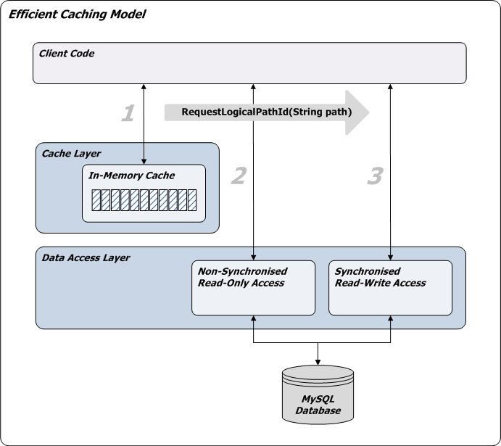
Physical to Logical File Mapping II
Solution:
Limited in-memory cache of shallowest paths
160 bit hash of paths
Logical id – 3 level lookup:
  In-memory cache
  Read-only database query
  Synchronised read-write insert : last resort
Implementation challenges

Slide 13
Low Latency: Reducing Scan Times I
Problem: Scanning the file space in minimal amount of time
Attempted Solutions:
Simple Threading – one thread per physical volume
  Start at depth 0
  Scan latency: 100 hours
Naive Multi-Threading – one thread per physical directory
  Start at depth +1
  Scan latency: 24 hours
Implementation challenges

Slide 14
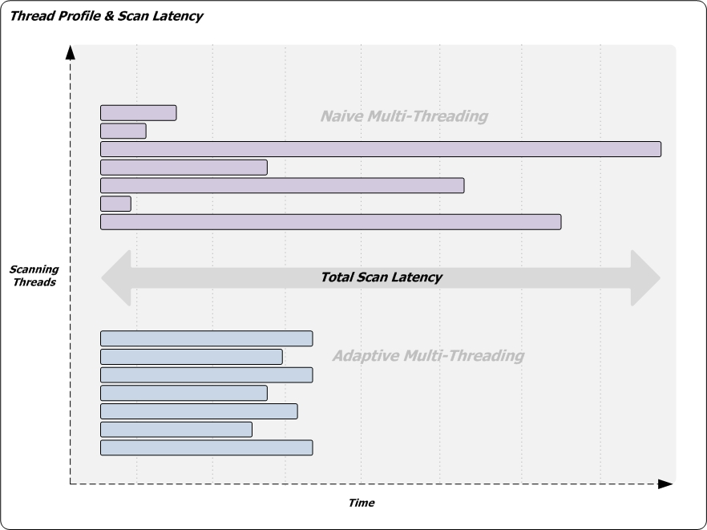
Low Latency: Reducing Scan Times II
Implementation challenges

Slide 15
Low Latency: Reducing Scan Times III
Current Solution:
Adaptive Multi-Threading
  Reduce thread profiles
  Smooth ‘lumps’ in the file space
  Adapt to changes in the file space over time
Implementation:
  Define threshold: time or size
  Divide file space into units of work with threshold
  First pass: Naive Approach
  Subsequent scans: Adaptive Approach
Implementation challenges

Slide 16
Low Latency: Reducing Scan Times IV
Dividing the file space
0-1 Multiple Knapsack Optimisation Problem
NP-Hard to solve optimally
Our implementation:
  Heuristic
  Greedy algorithm
  Not a bottleneck
Implementation challenges

Slide 17
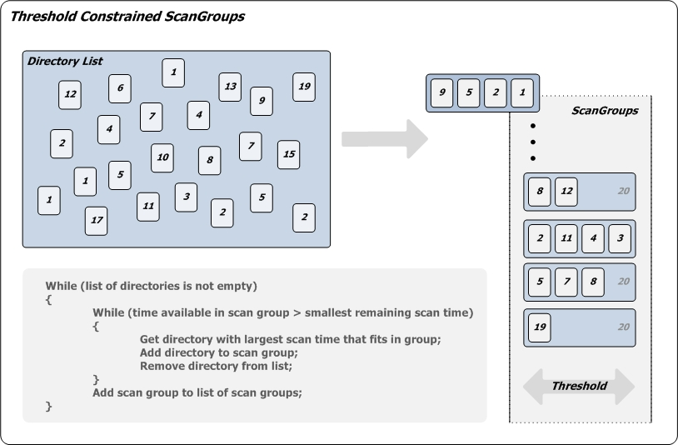
Low Latency: Reducing Scan Times V
Implementation challenges

Slide 18
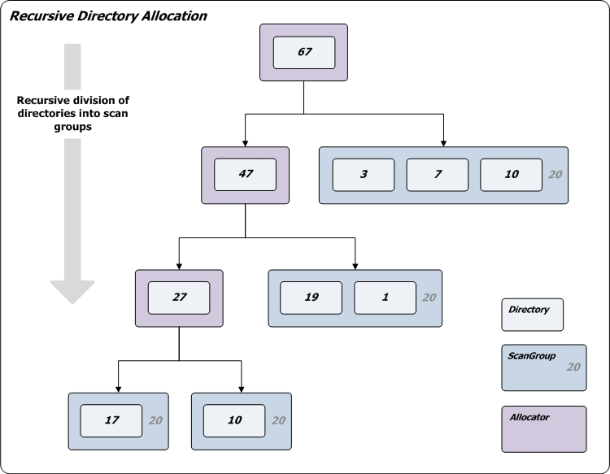
Low Latency: Reducing Scan Times VI
Implementation challenges

Slide 19
Low Latency: Reducing Scan Times VII
But this causes coordination issues:
400+ threads
  Starting at arbitrary depth
  Finishing at different times
Concurrent Modification Exceptions deep in file space
Solution:
Control the execution cycle and synchronise threads
Java 1.5 concurrency libraries – Java.util.Concurrent
Implementation challenges

Slide 20
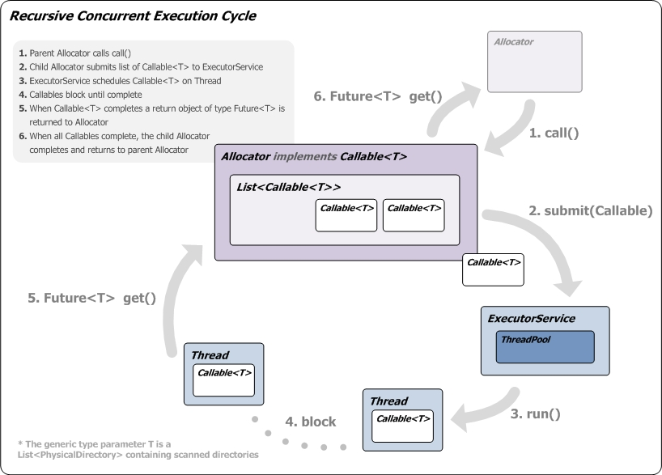
Low Latency: Reducing Scan Times VIII
Implementation challenges

Slide 21
File System Heterogeneity I
Problem:
Varied Operating Systems and storage devices
  Windows, Unix, Mac
Java.IO only provides a limited subset of directory information
  No file ‘created date’
  No symbolic link capability
Implementation challenges

Slide 22
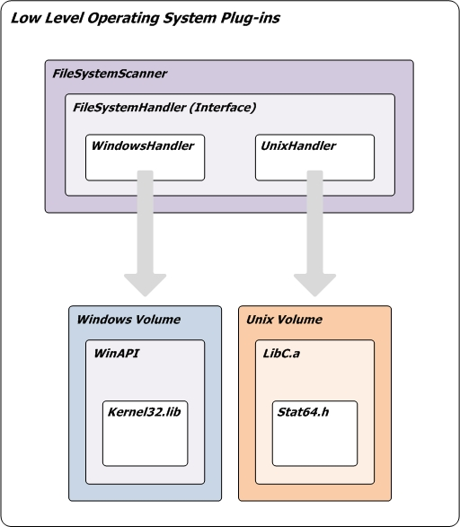
File System Heterogeneity II
Solution:
Low-level OS specific plug-ins
Dynamic loading depending on device type
Unix
  C++ and JNI
Windows
  Win32API and JNA
Implementation challenges

Slide 23
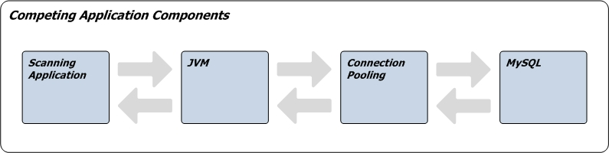
Scalability: Tuning at the Limit
Achieving low latency means pushing every component to its limits
Components competing for resources:
  Memory
  CPU
Small changes to one component have knock-on effects on others
Careful configuration and tuning
Implementation challenges

Slide 24
Scalability: Memory
Careful profiling
  Retained size of objects
Eliminate wasteful memory usage
  Memory efficient collections
    List<T> instead of HashMap<T> where access allows
  Use byte instead of short, short instead of int
  Reduce use of String
  Minimal number of thread - pool and reuse where possible
  Intelligent recursion- pass minimal parameters
  Release objects early
Switch to 64 bit Java Virtual Machine (IcedTea7)
Implementation challenges

Slide 25
Scalability: Data Layer
Problem: High levels of contention, large amounts of data
Solution:
Query Batching - 20-50% gains
Stored Procedures - 5% gains
LOAD_DATA_INFILE - 6,000% gains
MySQL Tuning
  connections, buffers, caching and threads
Implementation challenges

Slide 26
Testing Methods and Tools
Functional
Unit
Profiling and Monitoring
JVisualVM
YourKit Java Profiler
JConsole
Development
1,000-20,000 directories
Production
Cinesite file system
200,000-1,000,000+ directories
testing

Slide 27
Features Implemented
Requirement | Achieved
Operating Scope | 
User Access | 
Directory Information | 
Visualisation | 
Stubs | 
Latency | 
Trend Analysis | 
Also partially implemented reporting and scheduling.
evaluation

Slide 28
Future Work
Modular structure
Solid foundations
Extend front-end
  early warning system
  hot zones
  automatic management reports
Future work

Slide 29
Summary
Achieved target requirements
Key challenge: Scaling
Created a modular, extensible system which Cinesite can build upon

Slide 31
Trend Analysis I
Problem: How to capture detailed directory information
  Churn, activity and growth
Solution: Capture rich directory data
  Created date
  Date last modified
  Size of files
  Size of directories
  File extensions – type and volume
Implementation challenges

Slide 32
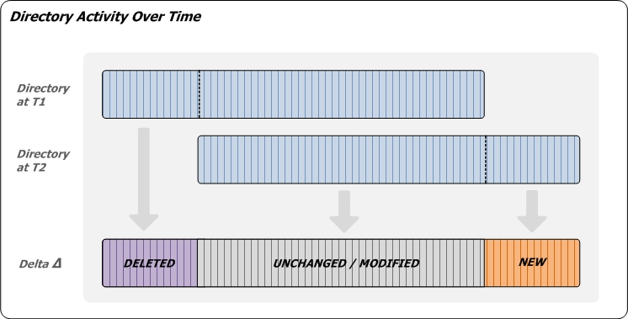
Trend Analysis II
Implementation challenges

