Slide 1
Fluxo: Simple Service Compiler
Emre Kıcıman, Ben Livshits, Madanlal Musuvathi
{emrek, livshits, madanm}@microsoft.com

Slide 2
Architecting Internet Services
Difficult challenges and requirements
24x7 availability
Over 1000 request/sec
CNN on election day: 276M page views
Akamai on election day: 12M req/sec
Manage many terabytes or petabytes of data
Latency requirements <100ms
Notes:
http://newteevee.com/2008/11/05/historic-election-day-sets-traffic-records/
http://newteevee.com/2009/01/20/the-obama-inauguration-live-stream-stats/

Slide 3
Flickr: Photo Sharing
Cache
Databases
App Servers
Page
Request
$
Image
Request
$
Cache
Images
Cal Henderson, “Scalable Web Architectures: Common Patterns and Approaches,” Web 2.0 Expo NYC

Slide 4
Common Architectural Patterns
(In no particular order)
Tiering: simplifies through separation
Partitioning: aids scale-out
Replication: redundancy and fail-over
Data duplication & de-normalization: improve locality and perf for common-case queries
Queue or batch long-running tasks

Slide 5
Everyone does it differently!
Many caching schemes
Client-side, front-end, backend, step-aside, CDN
Many partitioning techniques
Partition based on range, hash, lookup
Data de-normalization and duplication
Secondary indices, materialized view, or multiple copies
Tiering
3-tier (presentation/app-logic/database)
3-tier (app-layer / cache / db)
2-tier (app-layer / db)
Notes:
Caching:
MSN Messenger -> client-side caching
Many folks do the other ones
YouTube -> uses CDN for popular videos
Partitioning techniques
Data denormalization
FriendFeed -> secondary indices
Flickr -> comments are stored twice; background job maintains consistency
LinkedIn -> Replicates data into graph view, and again into user-specific view

Slide 6
Flickr: Photo Sharing
Different caching schemes!
Cache
Databases
App Servers
Page
Request
$
Image
Request
$
Cache
Images
Cal Henderson, “Scalable Web Architectures: Common Patterns and Approaches,” Web 2.0 Expo NYC

Slide 7
Flickr: Photo Sharing
Cache
Databases
App Servers
Page
Request
$
Different partitioning and replication schemes!
Image
Request
$
Cache
Images
Cal Henderson, “Scalable Web Architectures: Common Patterns and Approaches,” Web 2.0 Expo NYC

Slide 8
Differences for good reason
Choices depend on many things
Component performance and resource requirements
Workload distribution
Persistent data distribution
Read/write rates
Intermediate data sizes
Consistency requirements

Slide 9
Differences for good reason
Choices depend on many things
Component performance and resource requirements
Workload distribution
Persistent data distribution
Read/write rates
Intermediate data sizes
Consistency requirements
These are all measurable in real systems!

Slide 10
Differences for good reason
Choices depend on many things
Component performance and resource requirements
Workload distribution
Persistent data distribution
Read/write rates
Intermediate data sizes
Consistency requirements
These are all measurable in real systems!
Except this one!

Slide 11
Fluxo
Goal: Separate service’s logical programming from necessary architectural choices
E.g., Caching, partitioning, replication, …
Techniques:
Restricted programming model
Coarse-grained dataflow with annotations
Runtime request tracing
Resource usage, performance and workload distributions
Analyze runtime behavior -> determine best choice
Simulations, numerical or queuing models, heuristics…

Slide 12
Architecture
Environment
Info
Runtime
Profile
Dataflow Program
+
Annotations
Deployable Program
Analysis
Module
Analysis
Module
Analysis
Module
Program
Transform
Thin Execution
Layer
Fluxo Compiler
Notes:
** ADD ANALYSIS MODULE TO DIAGRAM
Use the compiler analogy here (if not earlier)

Slide 13
Dataflow Program
CloudDB::
Messages
Merge
message
lists
List<Msg>
html
UserID
Restrictions
All components are idempotent
No internal state
State update restrictions
List<Msg>
CloudDB::
Friends
CloudDB::
Messages
List<UserID>

Slide 14
What do We Annotate?
CloudDB::
Messages
Merge
message
lists
List<Msg>
html
Volatile<0>
Annotate Semantics
Consistency requirements
(No strong consistency)
Side-effects
UserID
List<Msg>
CloudDB::
Friends
CloudDB::
Messages
List<UserID>
Volatile<5hr>
Volatile<3min>

Slide 15
What do We Measure?
CloudDB::
Messages
Merge
message
lists
List<Msg>
html
UserID
On every edge
Data content/hash
Data size
Component performance and resource profiles
Queue info
List<Msg>
CloudDB::
Friends
CloudDB::
Messages
List<UserID>

Slide 16
How do we transform? Caching
CloudDB::
Friends
Messages
Cache
Messages
Cache
Pick First

Slide 17
How do we transform? Caching
Messages
Cache
Messages
Cache
Pick First

Slide 18
So, where do we put a cache?
Analyze Dataflow:
Identify subgraphs with single input, single output
2. Check Annotations:
Subgraphs should not contain nodes with side-effects; or volatile<0>
3. Analyze measurements
Data size -> what fits in cache size?
Content hash -> expected hit rate
Subgraph perf -> expected benefit
CloudDB::
Messages
Merge
message
lists
List<Msg>
html
Volatile<0>
UserID
List<Msg>
CloudDB::
Friends
CloudDB::
Messages
List<UserID>
Volatile<5hr>
Volatile<3min>

Slide 19
Related Work
MapReduce/Dryad – separates app from scalability/reliability architecture but only for batch
WaveScope – uses dataflow and profiling for partitioning computation in sensor network
J2EE – provides implementation of common patterns but developer still requires detailed knowledge
SEDA – event driven system separates app from resource controllers
Notes:
SEDA uses a staged event driven architecture
to separate application event processing from
controllers that handle resource allocation decisions

Slide 20
Conclusion
Q: Can we automate architectural decisions?
Open Challenges:
Ensuring correctness of transformations
Improving analysis techniques
Current Status: In implementation
Experimenting with programming model restrictions and transformations
If successful would enable easier development and improve agility

Slide 21
Extra Slides

Slide 22
Utility Computing Infrastructure
On-demand compute and storage
Machines no longer bottleneck to scalability
Spectrum of APIs and choices
Amazon EC2, Microsoft Azure, Google AppEngine
Developer figures out how to use resources effectively
Though, AppEngine and Azure restrict programming model to reduce potential problems

Slide 23
Flickr: Photo Sharing
High-Level
App Server
Database
Web Server
Images
Cal Henderson, “Scalable Web Architectures: Common Patterns and Approaches,” Web 2.0 Expo NYC

Slide 24
Fault Model
Best-effort execution layer provides machines
On failure, new machine is allocated
Deployed program must have redundancy to work through failures
Responsibility of Fluxo compiler

Slide 25
Storage Model
Store data in an “external” store
S3, Azure, Sql Data Services
may be persistent, session, soft, etc.
Data written as delta-update
Try to make reconciliation after partition easier
Writes have deterministic ID for idempotency

Slide 26
Getting our feet wet…
Built toy application: Weather service
Read-only service operating on volatile data
Run application on workload traces from Popfly
Capture performance and intermediate workload distributions
Built cache placement optimizer
Replays traces in simulator to test a cache placement
Simulated annealing to explore the space of choices

Slide 27
Caching choices vary by workload
31%
4%
65%
62%
22%
9%
13%
13%
52%
13%

Slide 28
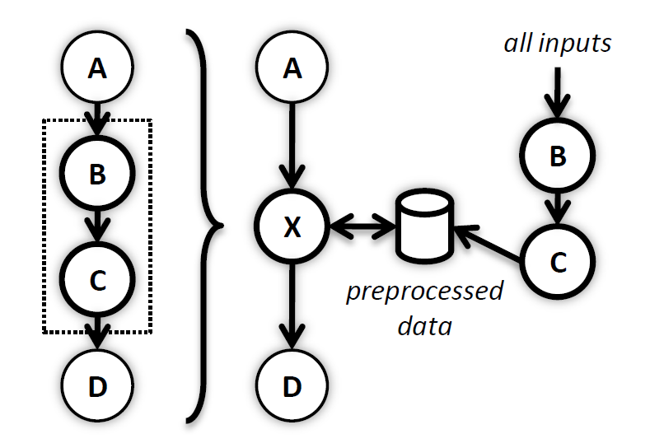
Example #2: Pre/post compute

