Slide 1
A Guide To Alloy

Slide 2

Introduction
About this Presentation
Overview of the Alloy Language
Using Alloy and the Alloy Analyzer
Summary
Quiz (Donuts!)
Q & A

Slide 3
Introduction
About this Presentation
Modeling language based on first-order logic
Heavily inspired by Z (Schemas!)
Z is not easily analyzable
Alloy tries to overcome this
Sacrifices some of Z's power to be able to do so

Slide 4
Overview of Alloy
Scope: Z > Alloy > Test Cases
Unlike Z, Alloy is not used to prove correctness.
The Alloy Analyzer allows automatic verification within a finite scope
Relies on Small Scope Hypothesis
Test cases
Scope complete

Slide 5
A Worked Example: Computer
Modelling a Computer in Alloy
How can we do this in Alloy?
Aim to represent a computer and its components:
  CPU
  Memory
  HardDisk
Extremely simple example, full power of Alloy better illustrated with bigger examples.

Slide 6
Alloy in Real Life
Example just given was very simplistic
Alloy has been used for much more complex systems, e.g.
  Cryptography
  Document Structuring
  Railway Switching
Taught at many universities around the world

Slide 7
Summary
Alloy is a modeling language inspired by Z.
In contrast to Z, it is automatically analyzable.
The Alloy Analyzer allows visualizing instances of models and checking assertions within a finite scope.
Easy to incrementally explore design ideas
Alloy is a good starting point for beginners to specification languages

Slide 8
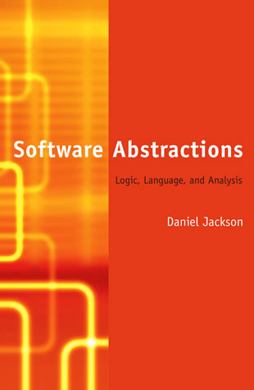
Further Resources
Alloy Website :
  http://alloy.mit.edu
Our Website :
  http://www.doc.ic.ac.uk/project/2007/271j/g06271j01/Web
Software Abstractions
  by Daniel Jackson

