Slide 1
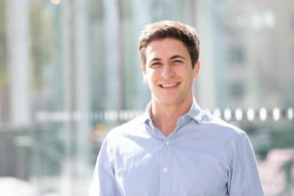
Argumentative Explanations in AI
Antonio Rago & Francesca Toni
ECAI2020 Tutorial
30 August 2020

Slide 2
Tutorial Overview
Part 1 - Introduction to XAI & Background on (Abstract, Bipolar, Gradual) Argumentation
Part 2 - Building Explainable Systems with Argumentative Foundations
Argumentation for tree-based explanations for recommender systems
Explainable Review Aggregation with Argumentation
Part 3 - Extracting Argumentative Explanations from Existing Systems
Aspect-Item Recommender Systems
Counterfactual Explanations for Bayesian Classifiers
Support Argumentation Frameworks for Explaining Bayesian Networks
Part 4 – Conclusions & Discussion
Notes:
FT: 15 min
FT: 30 min
AR: 30 min
FT: 15 min
Q&A: 15 minutes ???

Slide 3
Part 0 – Introduction to XAI and Background on (Abstract, Bipolar, Gradual) Argumentation
TOO MANY ARTICLES ON XAI METHODS – A RECENT SURVEY IS: A Survey of Methods for Explaining Black Box Models.
Guidotti, Monreale, Ruggieri, Turini, Giannotti, Pedreschi; ACM Comput. Surv. 2019
Explanation in artificial intelligence: Insights from the social sciences.
Miller; AIJ 2019
On the Acceptability of Arguments and its Fundamental Role in Nonmonotonic Reasoning, Logic Programming and n-Person Games.;
Dung; AIJ 1995.
On the Acceptability of Arguments in Bipolar Argumentation Frameworks;
Cayrol, Lagasquie-Schiex: ECSQARU 2005
Discontinuity-Free Decision Support with Quantitative Argumentation Debates;
Rago, Toni, Aurisicchio, Baroni ; KR2016
From fine-grained properties to broad principles for gradual argumentation: A principled spectrum;
Baroni, Rago, Toni, IJAR 2019

Slide 4
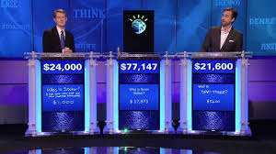
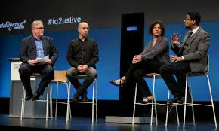
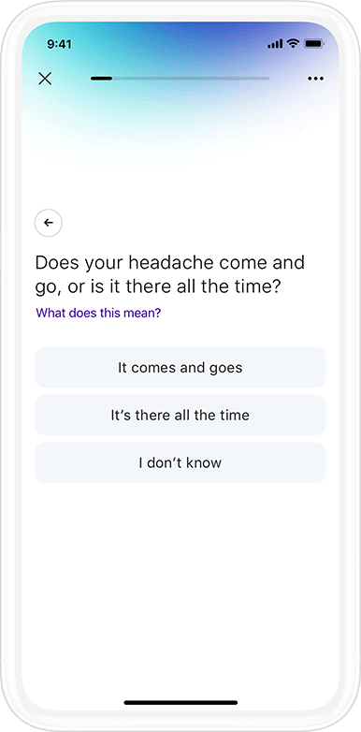
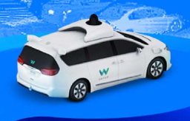
What can AI do today?
Answer queries
Debate
Play (and win) games
Recognise speech
Recognise faces
Translate across languages
Detect & Diagnose
Diseases
Vacuum clean
Drive vehicles

Slide 5
Why explanations?
Transparent information, communication…
AI systems and their decisions should be explained in a manner adapted to the stakeholder concerned.
Intelligible AI:
technical transparency
explainability
Notes:
Information Commissioner’s Office (The UK’s independent authority set up to uphold information rights in the public interest, promoting openness by public bodies and data privacy for individuals.)

Slide 6
Existing XAI solutions
output
AI (e.g
machine learning)
DENIED
Explanation (for output)
(e.g. feature attribution, counterfactual)
Audience/Beneficiaries
(e.g. expert developer,
customer, regulator)
Explanation as feature attribution:
Counterfactual explanation:
Card denied because client is credit unworthy, despite good salary
Had the client had a good credit score the card would have been granted

Slide 7
Use explainable models instead …
… of explaining black-box models, especially when high-stake decisions are involved, as in healthcare and criminal justice
Cynthia Rudin. Stop explaining black box machine learning models for high stakes decisions and use interpretable models instead. Nature Machine Intelligence 1: 206–215. 2019

Slide 8
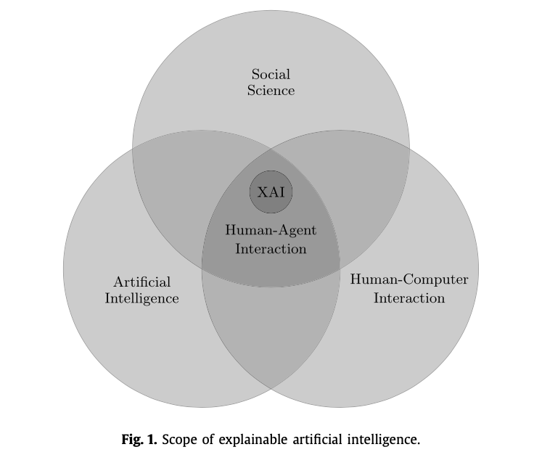
XAI and the social sciences
“looking at how humans explain to each other can serve as a useful starting point for explanation in artificial intelligence” Tim Miller AIJ2019
Social explanations: how do people communicate explanations?
Argumentative explanations
“The function of reasoning is …to devise and evaluate arguments intended to persuade.” Mercier, Sperber: BEHAVIORAL AND BRAIN SCIENCES (2011)

Slide 9
Computational Argumentation (alias “Argumentation in AI”)
Argumentation Framework
(abstraction of debate)
Argumentation Semantics
(evaluation of debate)
Properties (goodness of semantics)
preferences, probabilities
algorithms, systems
applications
$$\{α, …\}⊢\overline{β}$$
structured argumentation (ABA, DeLP,…)
abstract argumentation: admissible extension (set of “winning” arguments)
-
-
Existence
Uniqueness
abstract argumentation
+
$$\{β, …\}⊢γ$$
0.5
0.25
0.625
Monotonicity:
attacks decrease strength, supports increase strength
bipolar argumentation
single arrows=attack (-)
0.5
double arrows=support (+)
quantified bipolar argumentation frameworks (QBAFs):
Arguments have an intrinsic strength
Semantics (e.g. DF-QuAD) to determine dialectical strength
Notes:
CAN WE GET RID OF AA FRAMEWORK AFTER ANIMATION 5 WHEN SHOWING 6?

Slide 10
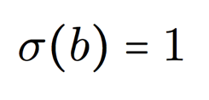
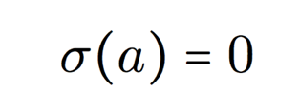
Argumentation Frameworks and Gradual Semantics
Abstract Argumentation Frameworks consider an attack relation only
Bipolar Argumentation Frameworks (BFs) introduce a support relation:
−
+
b
a
c
Tripolar Argumentation Frameworks (TFs) introduce a third type of relation.
Gradual Semantics uses numerical values, i.e. a strength σ, for argument evaluation (e.g. DF-QuAD).
−
+
b
a
c

Slide 11
Example gradual semantics – DF-QuAD
To compute the strenght SF of argument x the function C combines three elements:
the base
score of x
a factor summarizing the attackers of x
a factor summarizing the supporters of x
using the sequence of the strengths of the attackers/supporters of x

Slide 12
Properties of Gradual Semantics
Many works^{[1]} have defined properties for different frameworks, e.g:
Property P1 - Adding an attacker decreases the strength of an argument.
Property P2 - Increasing the strength of an attacker decreases the strength of an argument.
Property P3 - Adding a supporter increases the strength of an argument.
Property P4 - Increasing the strength of a supporter increases the strength of an argument.
Property 1 - Adding (removing) an attacker decreases (increases, respectively) the strength of an argument.
Property 2 - Increasing (decreasing) the strength of an attacker decreases (increases, respectively) the strength of an argument.
Property 3 - Adding (removing) a supporter increases (decreases, respectively) the strength of an argument.
Property 4 - Increasing (decreasing) the strength of a supporter increases (decreases, respectively) the strength of an argument.
−
+
b
a
c
σ(a) = 0
σ(a) = 0.25
σ(c) = 0.5
σ(a) = 0.75
σ(a) = 0.5
σ(b) = 0.5
σ(a) = 1
σ(c) = 0.6
σ(b) = 1
σ(a) = ?
σ(c) = 1
σ(b) = 0.4
Even the seemingly obvious properties may not be compatible with one another, e.g. P1 & P3.

Slide 13
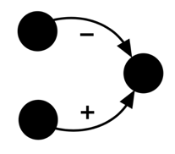
Argumentative explanations = Solving the argumentation “equation”
Argumentation Framework
(e.g. bipolar)
Argumentation Semantics
(e.g. DF-QuAD strength)
Properties
(e.g. monotonicity)
Argumentation Framework
?
Properties
?
Argumentation Semantics
Properties
Notes:
Both ways to solve the equation are useful to support the vision of explainable AI

Slide 14
Part 1 – Building Explainable Systems with Argumentative Foundations
Argument-based mixed recommenders and their application to movie suggestion;
Briguez, Budán, Deagustini, Maguitman, Capobianco & Simari; Expert Systems with Applications 2014
On Computing Explanations in Argumentation;
Fan & Toni; AAAI 2015
Extracting Dialogical Explanations for Review Aggregations with Argumentative Dialogical Agents;
Cocarascu, Rago and Toni; AAMAS 2019.

Slide 15
Argument-based mixed recommenders and their application to movie suggestion
Combine a basic quantitative method with a qualitative approach, using arguments for or against recommendations to a user.
Arguments are obtained from (strict and defeasible) rules and priorities between them, in a form of structured argumentation (i.e., defeasible logic programming (DeLP))
Rules represent intuitive postulates, e.g.
the postulate “A user may like a movie if the average movie’s rating is above the average general rating” is represented by rule
good_movie (Movie) ← avg_rating (Movie) > 3.8
the postulate “A user may dislike a movie if it has a most disliked genres” is represented by rule
disikes_by_genre (Movie, User) ← bottom_genre (User, Genre), genre (Movie, Genre)
Conflicting arguments are built from rules and priorities, argumentation semantics needed to resolve conflicts
Explanations as dialectical trees (of arguments)
Notes:
? Preferences over postulates enforce priorities between rules

Slide 16
On Computing Explanations in Argumentation
Explanations as dispute trees (i.e. disputes between a proponent and an opponent)
E.g. given abstract argumentation framework:
the following are (example) dispute trees explaining why argument a is dialectically acceptable:
−
−
−
−
−
b
a
c
f
d
e
−
Proponent: a
/ \
Opponent: b Opponent: c
| |
Proponent: d Proponent: f
Proponent: a
/ \
Opponent: b Opponent: c
| |
Proponent: e Proponent: e
Notes:
ANTONIO: IF YOU COULD IMPROVE THE GRAPH GREAT – ALSO IF WE MAKE IT A SINGLE ENTITY WE CAN ANIMATE MORE…

Slide 17
Explainable Review Aggregation (for recommendation) with Argumentation
Products' online recommendations are widespread, but
Recommendations are based on scores, aggregated from individual user-given scores
Reviews express opinions relevant to users’ decision making
Reading reviews is time consuming
Solution (idea): aggregation of reviews
allows users to check the quality of a product
needs to match (somewhat) aggregated scores
Solution (technically, overview):
Argumentation framework
Score aggregations
Users’ reviews + scores
Argumentation semantics
Recommendations
Explanations

Slide 18
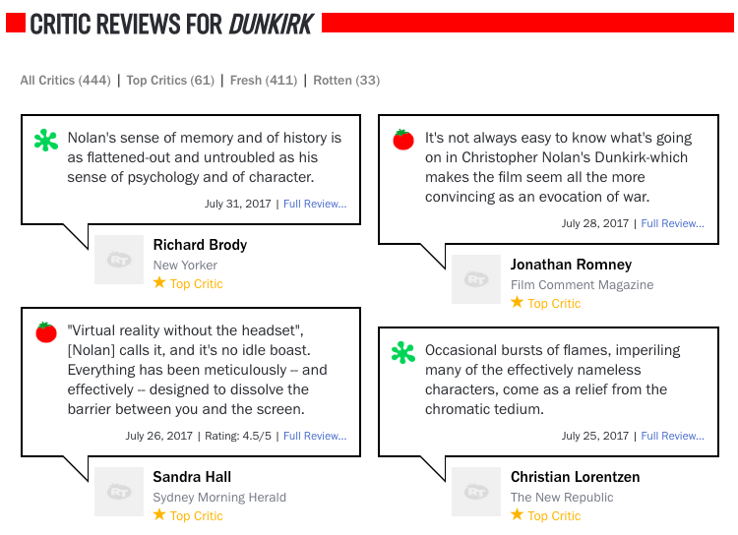
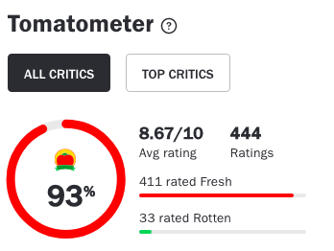
Application to movie recommendations: Rotten Tomatoes
Thanks to O Cocarascu
If the RT score is 60% or above then the movie is “recommended”

Slide 19
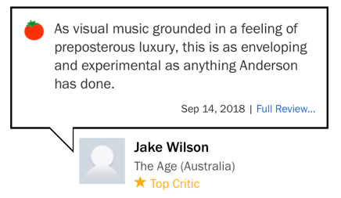
Application to movie recommendations: Rotten Tomatoes
Thanks to O Cocarascu
Rotten tomatoes score aggregation:
Each review is classified (by critic):
Fresh (positive)
$$Score= \frac{|\left\{fresh reviews\right\}|}{|\left\{ total reviews\right\}|}$$
Rotten (negative)
Features
Votes
Arguments
Acting
Themes
Clothing

Slide 20
Main steps
Thanks to O Cocarascu
Feature-based characterisation of movies
Extracting phrases representing potential arguments
Extracting Review Aggregations
Augmenting review aggregations
Extracting QBAFs + Applying argumentation semantics
Explanations

Slide 21
Step 1: Feature-based characterisation of movies
Thanks to O Cocarascu
Types of features:
Single (with one sub-feature), or Multiple (with more than one sub-feature)
Predetermined (using metadata and an ontology), or Mined (using NLP methods)
Four common features for movies:
a movie
has:
features
has:
sub-features
e.g. Wonder Wheel
e.g. acting
e.g. Kate Winslet
acting
writing
directing
themes
multiple
predetermined
single
predetermined
single
predetermined
multiple
mined
e.g. Kate Winslet
e.g. Woody Allen
e.g. Woody Allen
e.g. Amusement Parks

Slide 22
Step 1: Feature-based characterisation of movies
Thanks to O Cocarascu
a movie
features
sub-features

Slide 23
Step 2: Extracting phrases representing potential arguments
Thanks to O Cocarascu
We analyse each critic's review independently
We tokenise each review into sentences
We split sentences into phrases when specific keywords (but, although, though, otherwise, however, unless, whereas, despite) occur
Each phrase may then constitute a potential argument from its critic (contributing a vote in the review aggregation at Step 3)
Consider the following review for m = Wonder Wheel from a critic
c1: Despite a stunning performance by Winslet and some beautiful cinematography by Vittorio Storaro, Wonder Wheel loses its charms quickly and you’ll soon be begging to get off this particular ride.
We extract two phrases:
p1: Despite a stunning performance by Winslet and some beautiful cinematography by Vittorio Storaro
p2: Wonder Wheel loses its charms quickly and you’ll soon be begging to get off this particular ride

Slide 24
Step 3: Extracting Review Aggregations
Thanks to O Cocarascu
Votes can be mined using NLP techniques such as sentiment analysis or argument mining:
A positive/negative vote from a critic on a (sub-)feature of the movie signifies positive/negative stance on that (sub-)feature
A positive/negative vote on m signifies positive/negative stance on the overall movie
We use a glossary to determine the features/movie (arguments) on which the votes act, e.g.
G(m) = {movie, film, work};
G(f_{D}) = {director};
G(f_{A}) = {acting, cast, portrayal, performance};
G(f_{W}) = {writer, writing, screenplay, screenwriter, screenwriting, script, storyline, character}

Slide 25
Step 3: Extracting Review Aggregations
Thanks to O Cocarascu
Votes (positive/negative) are extracted from reviews on movies and (sub-)features
= votes generally positive
= votes generally negative
“Despite a stunning performance by Winslet and some beautiful cinematography by Vittorio Storaro, Wonder Wheel loses its charms quickly and you’ll soon be begging to get off this particular ride."
“…like the fairground ride for which it’s named, Wonder Wheel is entertaining.”
“As we watch Allen worry and nitpick over the way women fret over aging, painting Ginny as pathetic, jealous, insecure, and clownish, it's dull, unoriginal, and offensive. Frankly, we've had enough Woody Allen takes on this subject.”

Slide 26
Step 4: Augmenting review aggregations
Thanks to O Cocarascu
A review aggregation can be augmented by exploiting the parent relation
A vote for/against an argument is a vote for/against the argument's parent

Slide 27
Step 5: Extracting QBAFs
Thanks to O Cocarascu
The item and the (sub-)features become arguments
Each argument is assigned a base score, an aggregation of reviewers’ extracted votes on it
attacks are assigned along the parent relations where the votes have opposing polarities:
supports are assigned along the parent relations where the votes have the same polarity:
−
−
generally
– votes
generally
+ votes
generally
+ votes
generally
– votes
+
+
generally
+ votes
generally
+ votes
generally
– votes
generally
– votes

Slide 28
Step 5: Extracting QBAFs
Thanks to O Cocarascu
Positive arg f’_{A1} supports positive arg f_{A}
Neutral arg f’_{A2} neither attacks not supports positive arg f_{A}
Positive arg f_{A} supports positive arg m
Negative arg f_{D} attacks positive arg m
Neutral arg f_{W} neither attacks nor supports positive arg m
Positive arg f’_{T1} supports positive arg f_{T}
Positive arg f_{T} supports positive arg m
+
+
−
+
+

Slide 29
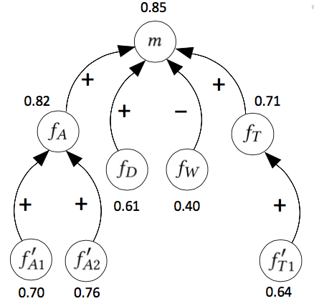
Step 5: Applying argumentation semantics
Thanks to O Cocarascu
This allows to obtain dialectical strength of arguments,
e.g. using DF-QuAD (with intrinsic strengths given by critics’ votes)
Dialectical strengths need to “match” TS scores
As an example
(dialectical strengths are the numerical labels):

Slide 30
Step 6: Explanations
Thanks to O Cocarascu
A conversation between a user and the system consists of questions put forward by the user U to which the system S responds with explanations based on the underlying graph
U: Why was The Post highly rated?
S: This movie was highly rated because the acting was good,
although the writing was poor.
U: Why was the acting considered to be good?
S: The acting was considered to be good thanks to
Tom Hanks and particularly Meryl Streep.
U: What did critics say about Meryl Streep being good?
S: “...Streep’s hesitations, rue, and ultimate valor
are soul-deep...”

Slide 31
Part 2 – Extracting Argumentative Explanations from Existing Systems
Argumentation-Based Recommendations: Fantastic Explanations and How to Find Them;
Rago, Cocarascu and Toni; IJCAI 2018.
Argumentation as a Framework for Interactive Explanations for Recommendations;
Rago, Cocarascu, Bechlivanidis and Toni; KR 2020.
Relation-Based Counterfactual Explanations for Bayesian Network Classifiers;
E Albini, A Rago, P Baroni & F Toni; IJCAI 2020
Explaining Bayesian Networks Using Argumentation;
S Timmer, JJ Meyer, H Prakken, S. Renooij & B Veheij; ECSQARU 2015

Slide 32
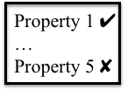
Extracting Argumentation Frameworks
Gradual argumentation properties can be used to extract argumentation frameworks from existing AI systems using this inverted process:
Step 1
Determine suitable properties for representing relationships between entities in application
Step 2
Extract arguments and relations using relationships between entities satisfying properties
AI System
Gradual Properties
Argumentation Framework
Suitable AI systems include:
Recommender systems (RSs)
Bayesian classifiers (BCs)
RSs which calculate predicted ratings (quantitative evaluations) on items (entities) linked by associations (relationships) seem particularly well-suited to this method.

Slide 33
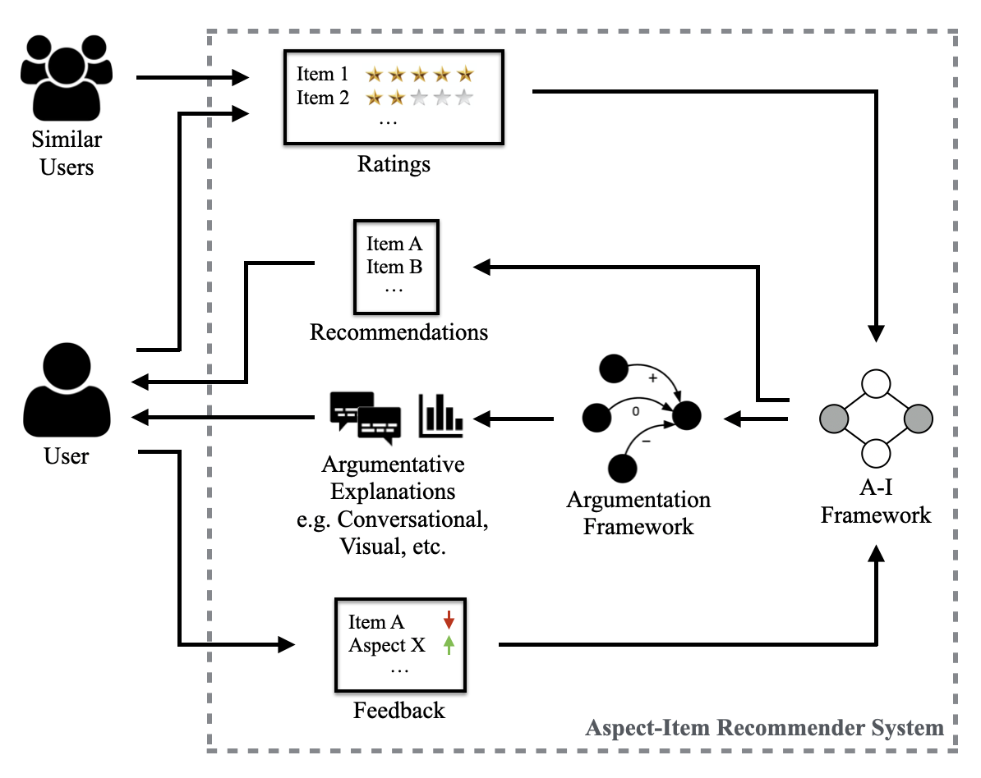
The Aspect-Item Recommender System
Argumentation-Based Recommendations: Fantastic Explanations and How to Find Them;
Rago, Cocarascu and Toni; IJCAI 2018.

Slide 34
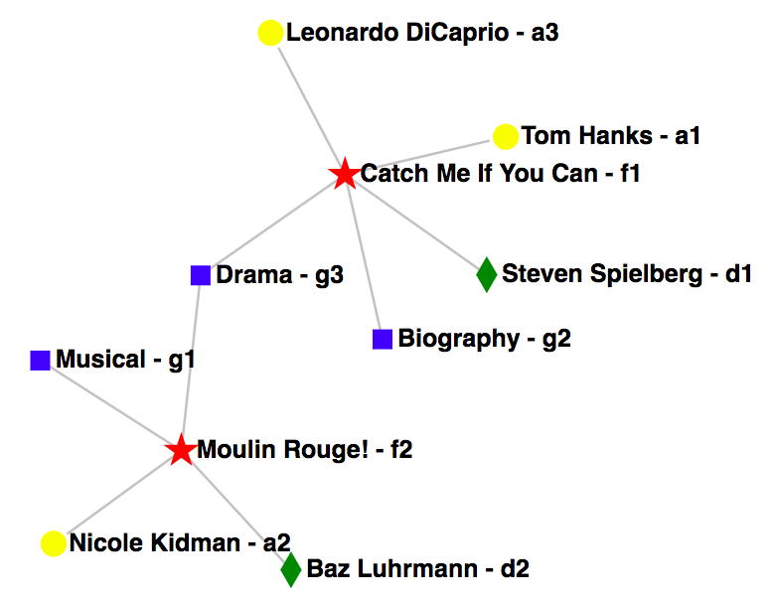
Aspect-Item Frameworks
An Aspect-Item framework (A-I) for supporting recommendations comprises:
items representing the entities to be recommended;
aspects representing the features of the items,
each with a specific type;
links showing which items hold which aspects;
users which give
ratings on item-aspects.
For a given user, predicted ratings are calculated for each item-aspect based on:
the user’s ratings;
user-specific constants;
similar users’ ratings.

Slide 35
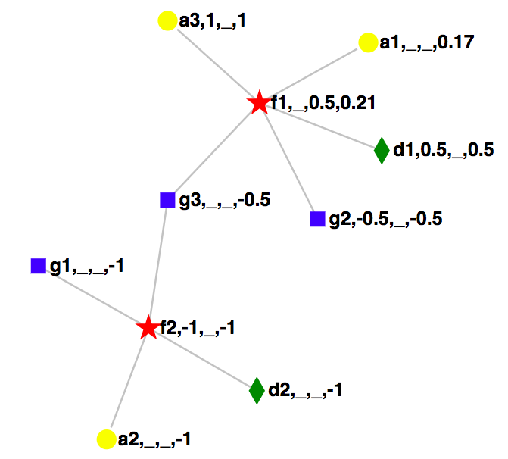
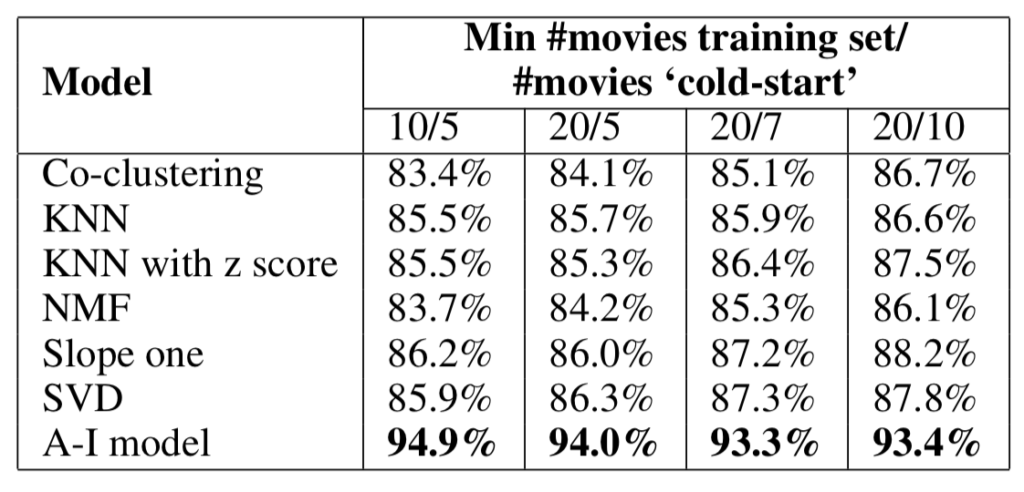
Aspect-Item Recommender Systems
Predicted ratings on a scale of [-1,1] propagate through the graph.
Averaging techniques for each item-aspect’s effect.
Unique weighting parameters for user similarities and preferences.
Unrated items with the highest predicted ratings are then recommended.
Accuracy is competitive with ML techniques:
Key: id, user rating, average similar user rating, predicted rating
Notes:
change

Slide 36
Extracting Argumentation Frameworks
We show how entities/relationships in an AI system can be viewed as arguments/relations:
Items/features may be seen as arguments that a user (dis)likes those items/features.
+
+
Relations may be extracted from the links between features and items.
i₁
f₁
i₂
?
?
If i₁ and i₂ hold f₁, and we have a positive rating from the user on i₁, how does this affect our arguments of whether the user likes the items/features?
Positive rating on i₁ → argument becomes “the user likes i₁”.
No rating on f₁ or i₂ → predicted ratings using their links to other items/features.
Since f₁ (without rating) is held by i₁ (with rating) → i₁ affects f₁.
The rating of i₁ is positive → i₁ affects f₁ positively (supports f₁).
No other effects from other entities → argument becomes “the user likes f₁”.
Since f₁ (with predicted rating) is held by i₂ (without rating) → f₁ affects i₂.
The rating of f₁ is positive → f₁ affects i₂ positively (supports i₂).
No other effects from other entities → argument becomes “the user likes i₂”.

Slide 37
Extracting Argumentation Frameworks
A summary of a method for extracting argumentation frameworks with relations of attack, support and neutralize is given here:
An item affects an aspect it holds iff the item has a rating from a user but the aspect does not.
An aspect affects an item iff the item does not have a rating from the user.
These effects are characterised as follows:
attacks iff the affecting item-aspect has a negative predicted rating;
supports iff the affecting item-aspect has a positive predicted rating;
neutralisers iff the affecting item-aspect has a predicted rating of zero.
Attacks/supports/neutralisers reduce/increase/neutralise an item-aspect’s predicted rating.
The argumentation framework is thus shown to satisfy a form of weak balance.

Slide 38
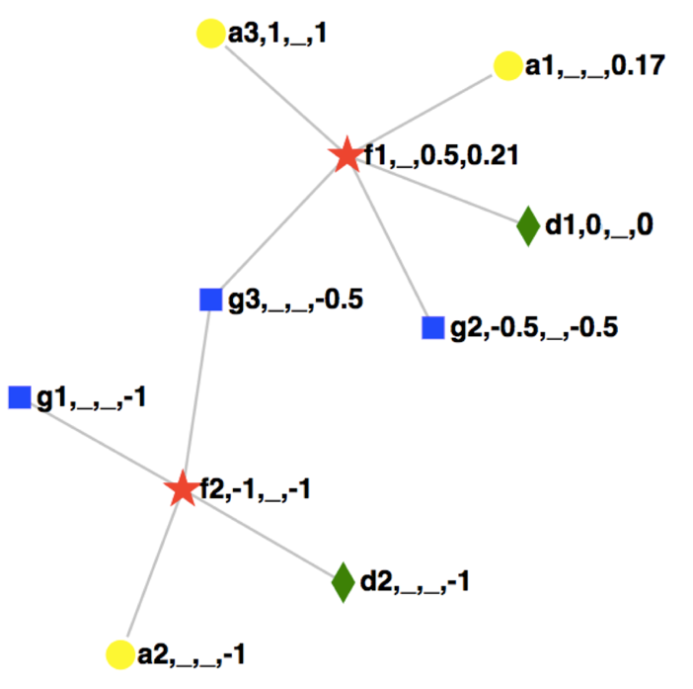
Extracting Argumentation Frameworks
The extracted argumentation graph contains attacks, supports and neutralisers:
+
a₃
a₁
+
+
f₁
g₁
0
−
−
+
−
d₁
−
f₂
g₃
g₂
a₂
−
−
Key: id, user rating, average similar user rating, predicted rating
d₂
This system provides the capability for more varied interactions and user feedback.

Slide 39
Generating Argumentative Explanations
Argumentation frameworks support various styles of interactive explanation, e.g. conversational:
User: Why didn’t you recommend Catch Me If You Can (f₁) to me?
System: It was mainly due to the genres of the film, particularly Drama (g₃).
User: I don’t care about the genres of a film, reduce their importance.
+
a₃
a₁
The argumentation explanation for an argument is the subgraph of all nodes with a path to it
+
+
f₁
Aspects with biggest negative effects on f₁’s predicted rating determined
0
−
−
+
−
d₁
f₂
g₃
g₂
The RS may then reduce the user’s unique constant for genres of a film.
This reduces f₁’s predicted rating, therefore improves the RS’s accuracy.

Slide 40
Generating Argumentative Explanations
Further, since the user hasn’t given a rating to g₃, they could ask for reasoning on it:
User: Why do you think I don’t like Dramas (g₃)?
System: It was mainly due to the fact that you didn’t like Moulin Rouge (f₂).
User: I made a mistake, I like this film.
This actual rating could then be corrected.
This would allow mistakes or changes in rating over time to be allowed for.
f₁
The argumentation explanation for g₃:
−
−
+
Items with biggest negative effects on g₃’s predicted rating highlighted
f₂
g₃

Slide 41
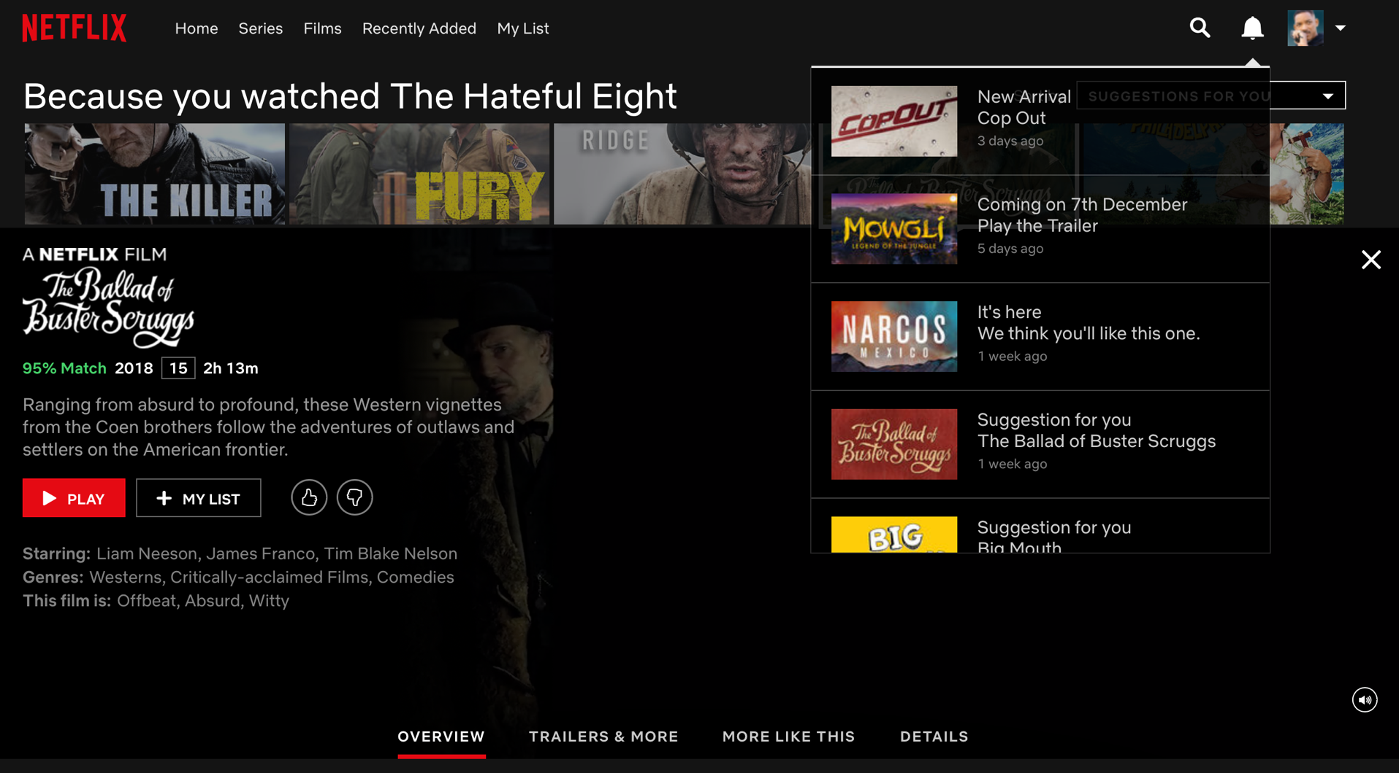
Example Applications – Netflix
Netflix provides some recommendations without any reasoning.
A % match score is given for movies, but the user has minimal ways to interact and adjust these scores or recommendations in general.

Slide 42
Example Applications – Netflix
Why do we recommend this?
Why do we recommend this?
Why?
Why do we recommend this?
Why do we recommend this?
Recommendations equipped with explanations and potential interactions.
The % match score for a user is also explainable, interactive and adjustable.

Slide 43
Example Applications – Netflix
The Ballad Of Buster Scruggs has a high match percentage because we thought you’d like the acting, mainly that of James Franco.
Users may interact with the system to provide feedback, including requesting deeper explanations.
Indeed, I like him!
Actually, I don’t like him.
Why did you think I like him?
Why did you think I like him?
We thought you’d like him because similar users liked 127 Hours, in which he acted.
Okay thanks!
I don’t care about similar users.
These users are not similar to me.
I don’t care about similar users.
Got it, updating your recommendations!
Feedback can be guaranteed to affect recommendations intuitively, e.g. here, similar users would be used less and the match score reduced.

Slide 44
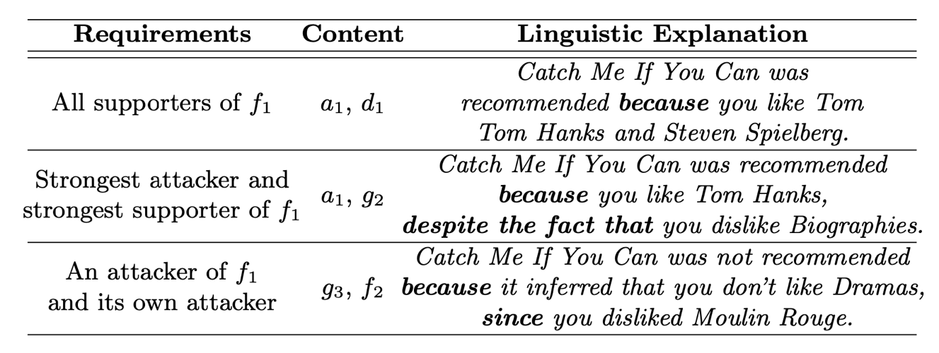
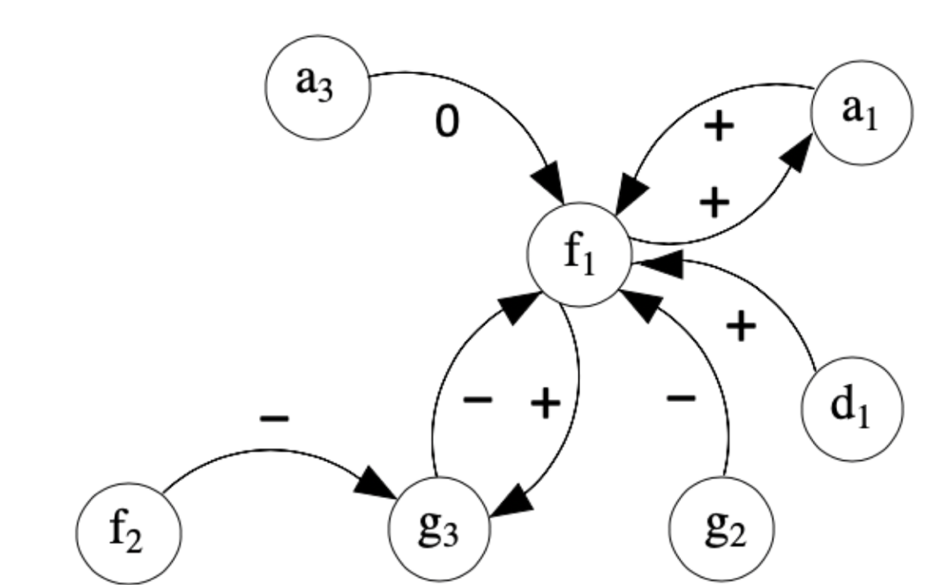
Types of Explanations - Content
The content of an explanation is the information taken from the argumentation framework.
Requirements for this content may be selected based on the user and the application of the explanation.
Some simple ways to vary this content are by relation types or whether depth or width in the argumentation framework is utilised.

Slide 45
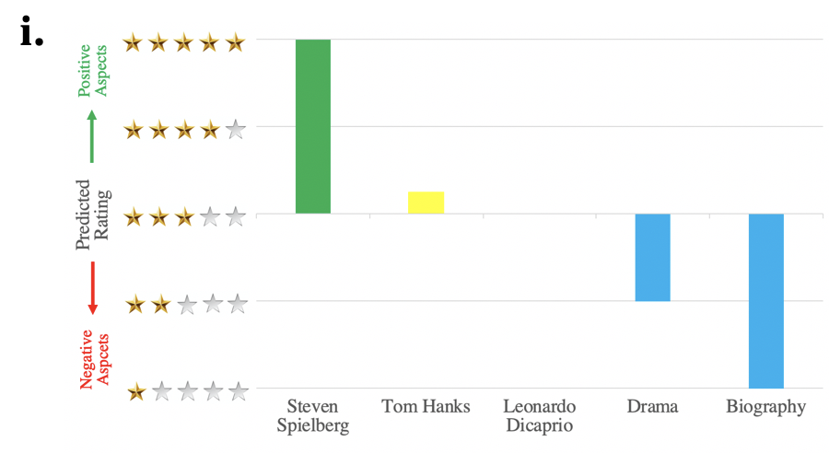
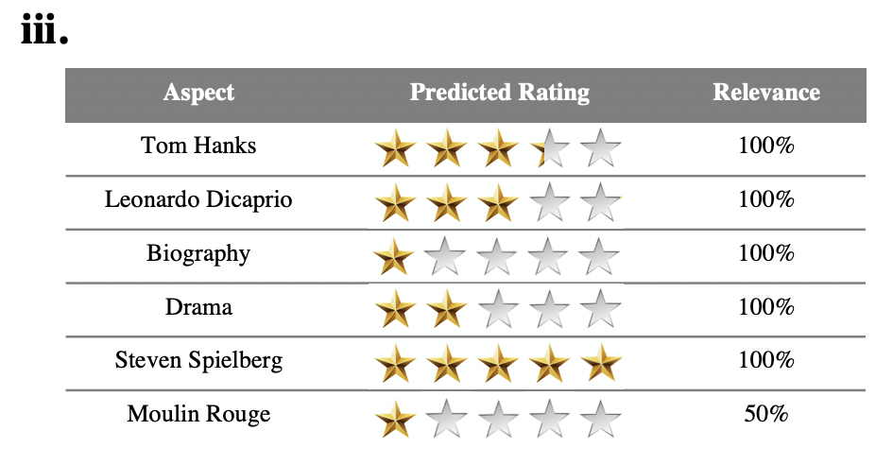
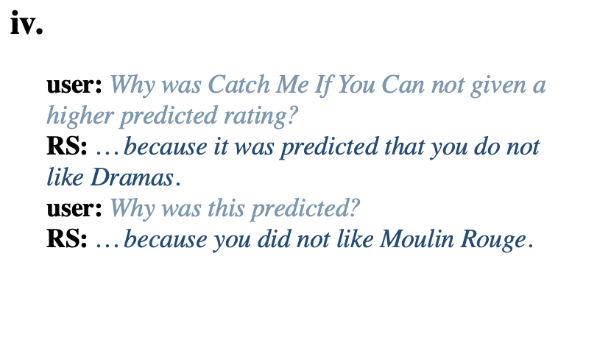
Types of Explanations - Format
The same explanatory content can also be delivered in a range of formats, e.g. chart-based (i), linguistic narrative (ii), tabular (iii) and linguistic conversational (iv):

Slide 46
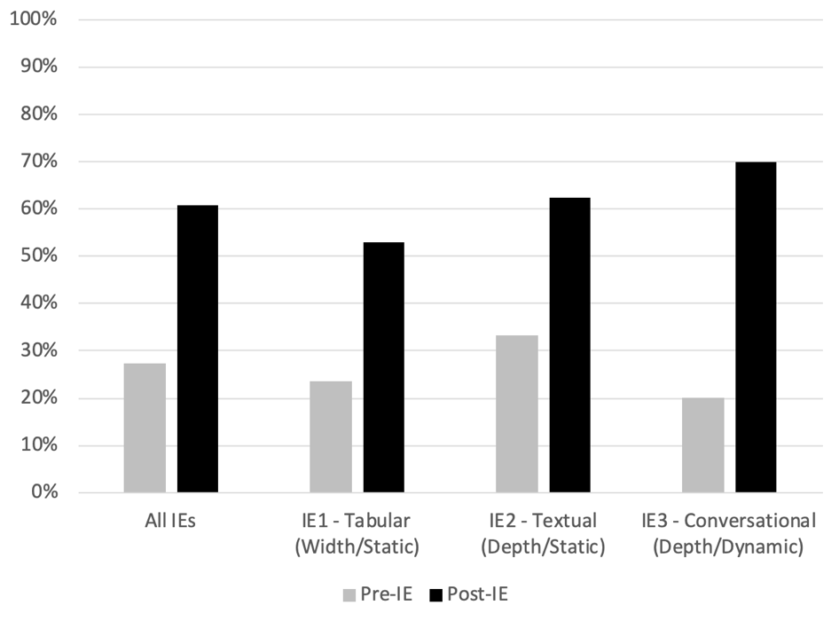
User Studies
A user study was completed with the following interactive explanation (IE) styles:
IE1: Tabular format, utilising width, delivered statically;
IE2: Textual format, utilising depth, delivered statically;
IE3: Conversational format, utilising depth, delivered dynamically.
All explanation styles showed improvements in transparency:
Users were asked how the system works and the % correct increased after all types of IE.
Argumentation as a Framework for Interactive Explanations for Recommendations;
Rago, Cocarascu, Bechlivanidis and Toni; KR 2020.

Slide 47
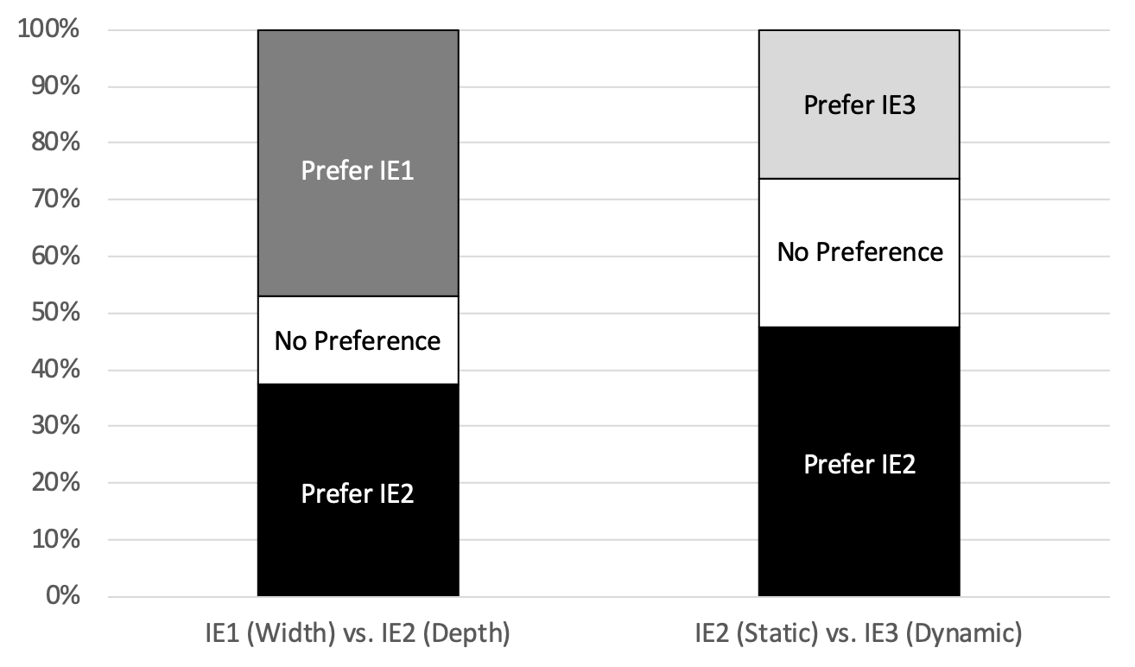
User Studies
Users were also asked which they preferred of the IEs in pairwise comparisons:
IE1 (Tabular) vs. IE2 (Textual), giving a comparison of depth vs. width;
IE2 (Textual) vs. IE3 (Conversational), giving a comparison of static vs. dynamic.
There was no clear favourite, showing user preferences are diverse.

Slide 48
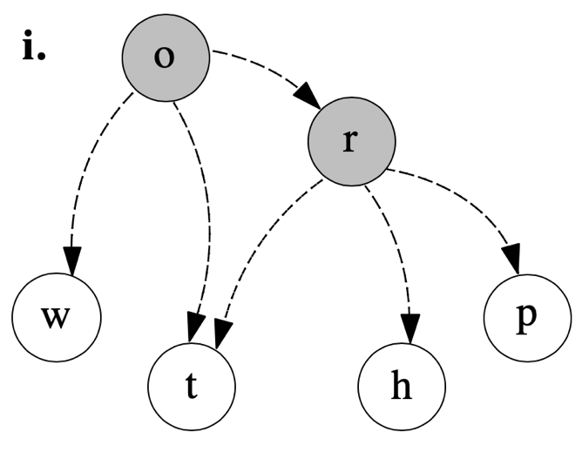
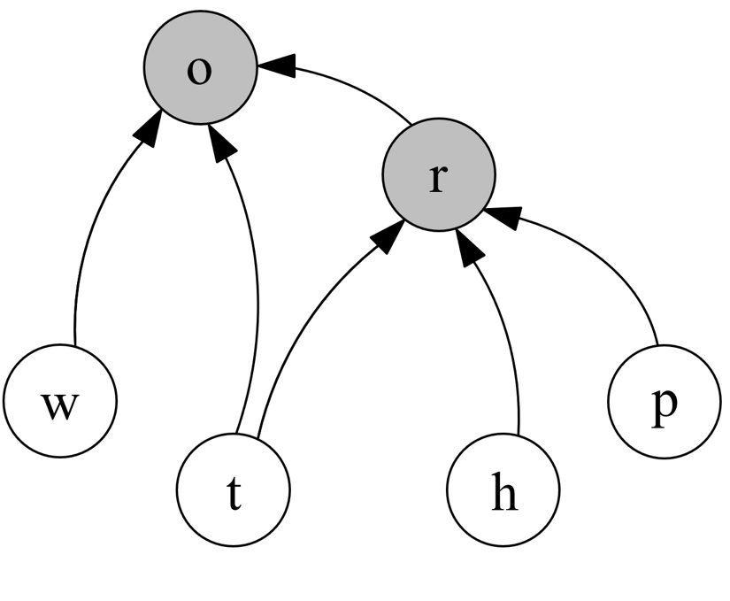
Bayesian Network Classifiers
Another AI method which allows the extraction of argumentative explanations is the BC.
In counterfactual explanations (CFXs), variables may be treated as arguments and relations constructed based on influences.
$$play$$
$$\underline{o}utside$$
classifications
$$\underline{r}ain$$
$$\underline{w}ind$$
$$\underline{p}ressure$$
$$\underline{t}emperature$$
$$\underline{h}umidity$$
conditional dependencies
influences
observations
Relation-Based Counterfactual Explanations for Bayesian Network Classifiers;
Albini, Rago, Baroni and Toni; IJCAI 2020.
48

Slide 49
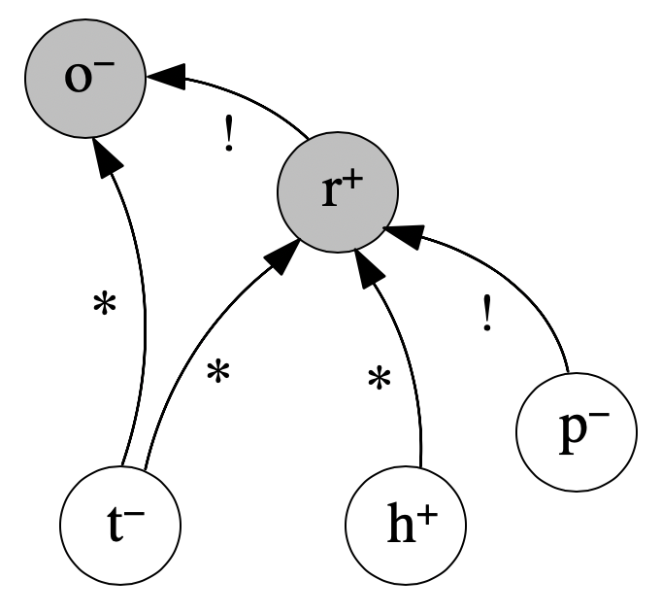
Counterfactual Explanations
Influences may then be categorised as specified relations in the CFX:
A variable 𝛼 critically influences 𝛽 iff any change to variable 𝛼 directly brings a change in variable 𝛽.
A variable 𝛼 potentially influences 𝛽 iff a change to variable 𝛼 does not directly bring about a change in variable 𝛽 but it brings you closer to it.
A change of $p$ from $−$ to $+$
changes $r$ from $+$ to $−$
w–
A change of $h$ from $+$ to $−$
brings closer a change of $r$ from $+$ to $−$

Slide 50
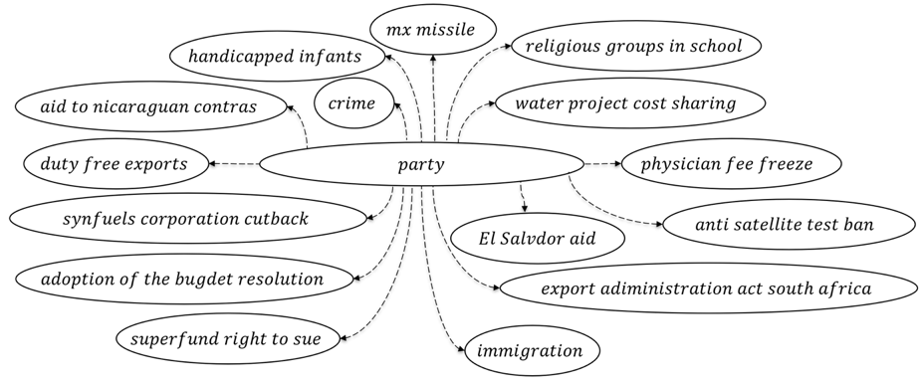
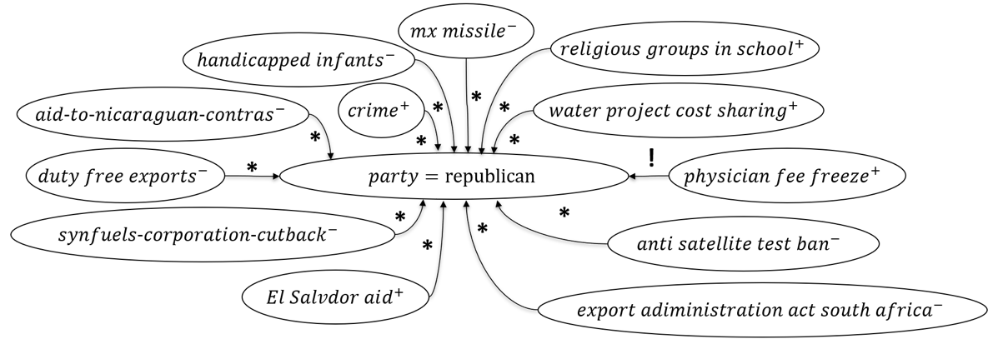
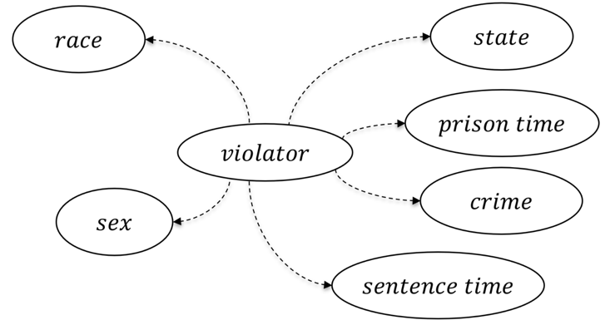
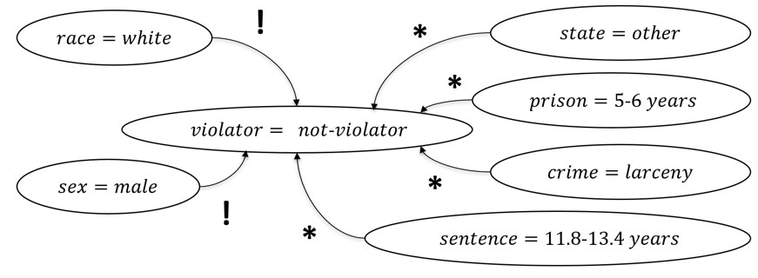
Application Examples
In a naïve BC which predicts the class of a congressman given votes, indicating counterfactuals.
In a naïve BC that predicts the parole violation, identifying discriminatory bias.
Discrimination
Notes:
Un esempio d’applicazione di questo tipo di spiegazioni controfattuali è l’identificazione di classificatori discrimatori.
Per testare queste spiegazioni ho creato un classificatore Bayesiano che prevede se un carcerato violerà o meno la libertà vigilata.
Ho incluso volutamente tra le feature il sesso e l’etnia del carcerato.
Come visualizzato in questo esempio, una relazione di supporto critico è stata trovata:
tra il sesso e la classe
e tra l’etnia e la classe
evidenziando quindi una potenziale attitudine discriminatoria del classificatore.

Slide 51
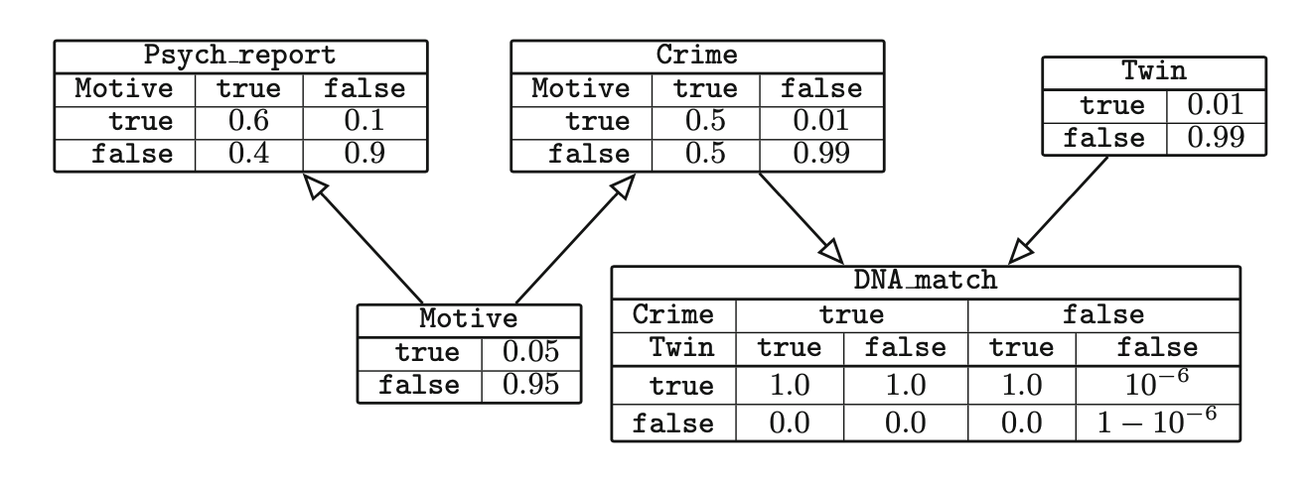
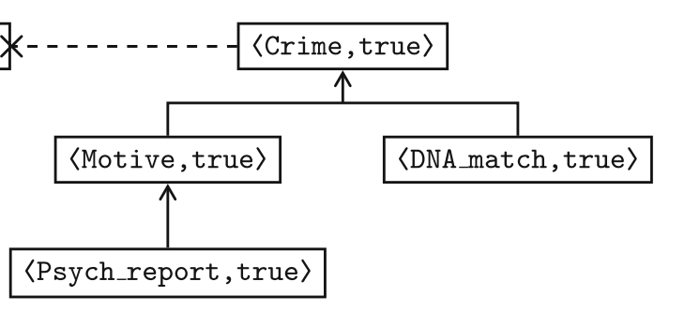
Support Argumentation Frameworks for Bayesian Networks
CFXs were inspired by a similar work which extracted support argumentation frameworks as explanations from Bayesian networks.
Distinctive characteristics of this method:
Relations are extracted from the full Markov blanket of a variable;
Only one relation of support used, which is not counterfactual;
A variable may result in more than one argument.
Explaining Bayesian Networks Using Argumentation;
S Timmer, JJ Meyer, H Prakken, S. Renooij & B Veheij; ECSQARU 2015

Slide 52
Part 4 – Conclusions
Argumentation for Explainable Scheduling;
Cyras, Letsios, Misener and Toni; AAAI 2019.
AI-assisted Schedule Explainer for Nurse Rostering;
Cyras, Karamlou, Lee, Letsios, Misener, Toni; AAMAS 2020
Data-empowered argumentation for dialectically explainable predictions;
Cocarascu, Stylianou, Cyras, Toni; ECAI 2020

Slide 53
Summary
Machine arguing can empower (interactive) explanations
of a recommender system for movies
of a hybrid (collaborative filtering/content-based) recommender system for movies
Other examples of uses of machine arguing for explanation of
scheduling systems
(argumentation-based) predictions from data
Bayesian network classifiers
Argumentation Framework
?
Properties
?
Argumentation
Semantics
Properties

Slide 54
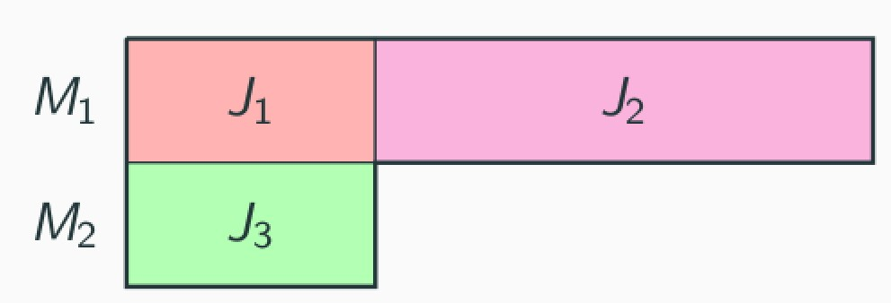
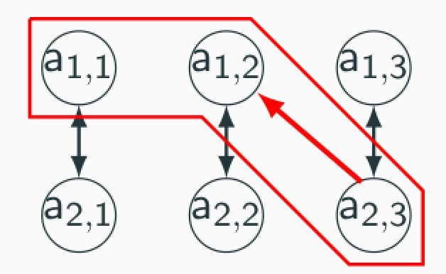
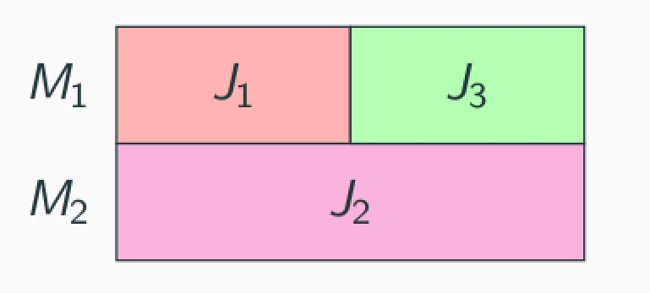
(Dialectically) explaining why schedules are (not) “quasi-optimal”
schedule S is efficient only if and
why is schedule S ≈ {x_{1,1} =1, x_{1,2} =1, x_{2,3} =1} not efficient?
The attack from a_{2,3} to a_{1,2} explains why S is not efficient:
Mined AF from S:
Because S can be improved by swapping jobs J3 and J2
between machines (e.g. nurses) M2 and M1.
Cyras, Letsios, Misener, Toni AAAI 2019
Notes:
Job-shop scheduling is widely usable, e.g. for nurse rostering. But how to explain what optimisers compute? For example, gor the given notion of feasibility, how to explain to a nurse M2 that she cannot just do job 3, as this would give rise to an inefficient schedule? We mine an AF (all edges are attacks) from the given schedule, proposed by the nurse, and map the schedule onto a “losing” set of arguments (the bit surrounded in red), and then extract an explanation from it

Slide 55
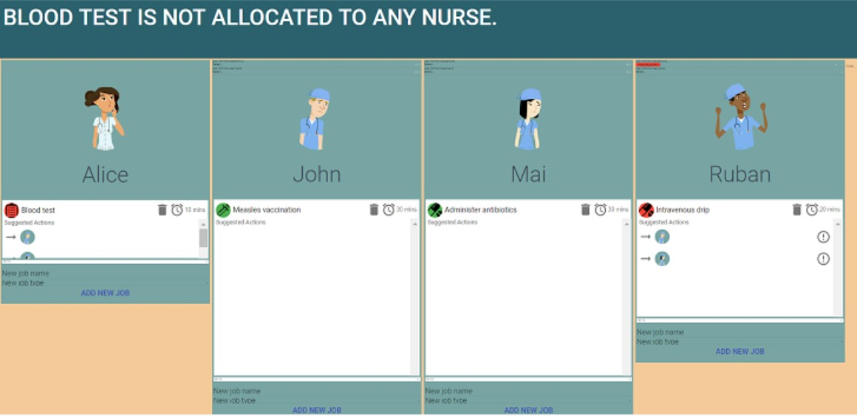
Best (innovative) demo at AAMAS 2020

Slide 56
Data-Empowered Argumentation (DEAr)
Grounded extension
(rather than gradual semantics)
Cocarascu, Stylianou, Cyras, Toni ECAI2020

Slide 57
Conclusions
Computational argumentation can support explanations of various forms (trees, conversations) for a variety of systems (recommenders and beyond)
Argumentation frameworks are mined from the systems (and underpinning data), guided by properties
Argumentation semantics as “matching” counterparts of decision processes in the systems
Open questions
Can machine arguing be applied to black-box models?
Is there a role for structured argumentation, preferences, probabilities in explanation?
Can argumentation-based explanations pave the way to human feedback to debug machines? What is their potential impact on manipulability?
Can we develop a scientific theory of argumentation-based explanation?
Thanks for your attention
Questions?

Slide 58
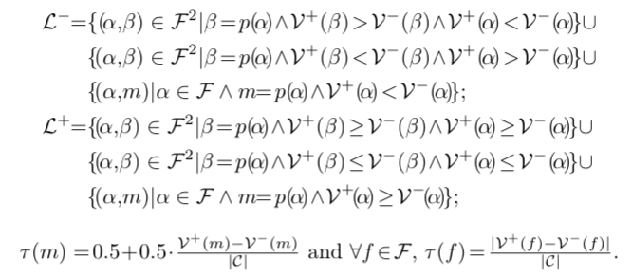
Step 5: Extracting QBAFs
58 / 56

Slide 59
Step 2: Extracting phrases representing potential arguments
Thanks to O Cocarascu
Consider reviews from other critics and the phrases extracted:
c2: Like the fairground ride for which it's named, it is entertaining.
p3: like the fairground ride for which it’s named, the film is entertaining
c3: As we watch Allen worry and nitpick over the way women fret over aging, painting Ginny as pathetic, jealous, insecure, and clownish, it's dull, unoriginal, and offensive. Frankly, we’ve had enough Woody Allen takes on this subject.
p4: As we watch Allen worry and nitpick over the way women fret over aging, painting Ginny as pathetic, jealous, insecure, and clownish, it's dull, unoriginal, and offensive
p5: Frankly, we've had enough Woody Allen takes on this subject.

Slide 60
Recommender Systems Background
An RS will provide recommendations to a user to help them discover items that may be of interest by ranking them or predicting a rating from the user.
Three main types of methods:
Content-based filtering (operating on information about users and their tastes);
Collaborative filtering (looking at similar users or similar items);
Knowledge-based approaches (operating on some knowledge about the user/domain).
Common methods:
Latent factor models (based on matrix factorisation).
Nearest neighbour models between items or users.
4 of the desirable features^{[Tintarev & Masthoff, 2015]}:
Effectiveness - using preferences to increase the systems' accuracy.
Transparency - explaining how recommendations are generated
Scrutability - allowing feedback
Trust - correcting based on feedback
We show, for an effective RS, how the other three features can be achieved with argumentative explanations.
60 / 26

Slide 61
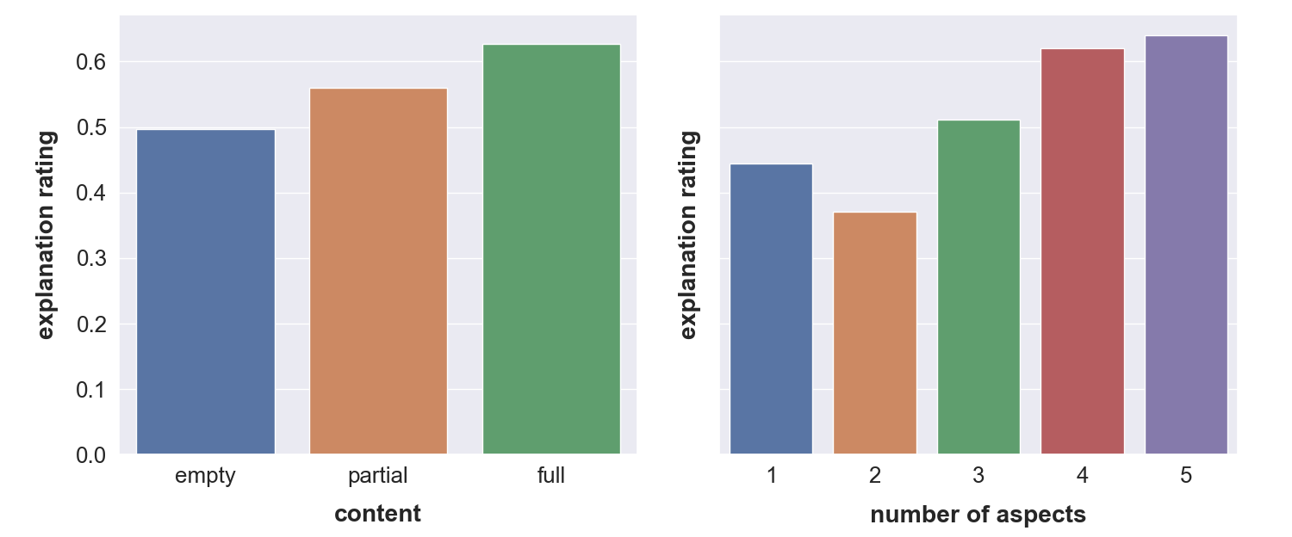
User Studies
We completed a user study in which we asked users to rate explanations which were:
empty: we said similar users liked the film without using the argumentation framework;
partial: we showed aspects supporting the recommendation but nothing deeper;
full: we added items supporting the aspects to the partial explanations.
The results showed that full explanations were preferred with more aspects.

Slide 62
User Studies
We also asked users which they preferred of the IEs in pairwise comparisons:
IE1 (Tabular) vs. IE2 (Textual), giving a comparison of depth vs. width;
IE2 (Textual) vs. IE3 (Conversational), giving a comparison of static vs. dynamic.
There was no clear favourite, showing user preferences are diverse.

