Slide 1





Argumentative Explanations in AI
Antonio Rago & Francesca Toni
KR2020 Tutorial
14 September 2020
Notes:
FT – 25 minutes

Slide 2
Tutorial Overview
Part 1 - Introduction to explainable AI (XAI)
Why argumentation for AI?
Part 2 - Background on Argumentation
Part 3 - Argumentative Explanations for a variety of systems:
Recommendations based on aggregation of textual reviews
Aspect-Item Recommender Systems
Prediction from data (DEAr - Data-Empowered Argumentation)
Scheduling
PageRank
Bayesian Classifiers
Part 4 – Discussion &Conclusions

Slide 3
Part 1 – Introduction to XAI
A Survey of Methods for Explaining Black Box Models.
Guidotti, Monreale, Ruggieri, Turini, Giannotti, Pedreschi; ACM Comput. Surv. 2019
Explanation in artificial intelligence: Insights from the social sciences.
Miller; AIJ 2019

Slide 4






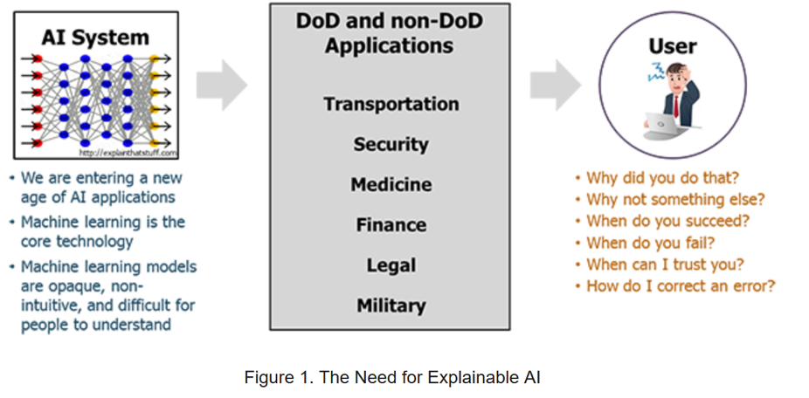
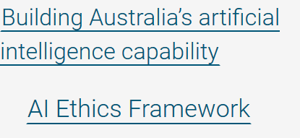
Why XAI?
“AI can do a lot. But it works best when humans are there to hold its hand.”
Transparent information, communication…
AI systems and their decisions should be explained in a manner adapted to the stakeholder concerned.
Transparency and explainability
Notes:
Information Commissioner’s Office (The UK’s independent authority set up to uphold information rights in the public interest, promoting openness by public bodies and data privacy for individuals.)

Slide 5



(Currently) Dominant XAI Vision
output
AI
(e.g. machine learning)
DENIED
Explanation (for output)
(e.g. feature attribution, counterfactual)
Audience/Beneficiaries
(e.g. expert developer,
customer, regulator)
Explanation as feature attribution:
Counterfactual explanation:
Card denied because client is credit unworthy, despite good salary
Had the client had a good credit score the card would have been granted
Notes:
Feature attribution: sometimes dialectical

Slide 6
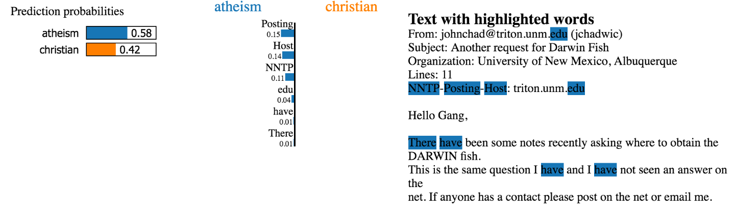
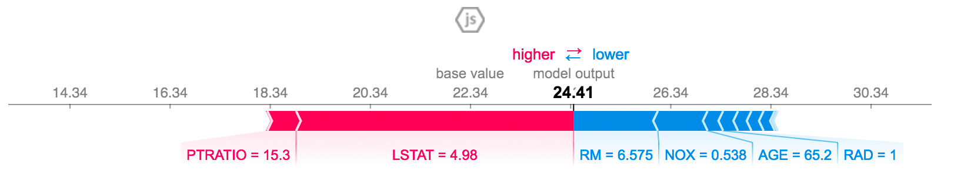
Examples of XAI: (model agnostic) feature attribution methods
Local Interpretable Model-Agnostic Explanations (LIME)
Why Should I Trust You?": Explaining the Predictions of Any Classifier. Ribeiro et al, KDD16
SHapley Additive exPlanations(SHAP)
A Unified Approach to Interpreting Model Predictions. Lundberg&Lee, NeurIPS 2017
Notes:
Mention categorisations: Model agnostic vs model specific (and Pre- vs post-hoc?)
Attribution methods: mention categorisation:
Perturbation (shown)
Gradient (LRP) - next

Slide 7
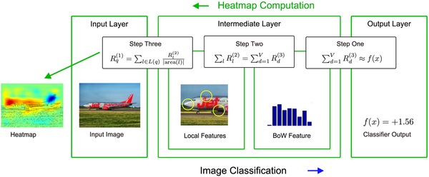
Examples of XAI: (model specific) feature attribution methods
Layer-wise Relevance Propagation (LRP)
On pixel-wise explanations for non-linear classifier decisions by layer-wise relevance propagation. Bach et al. PLoS ONE 10(7) 2015

Slide 8
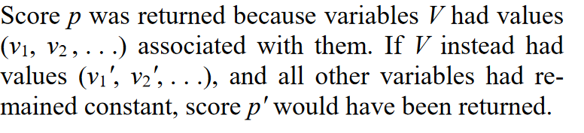
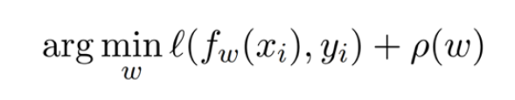
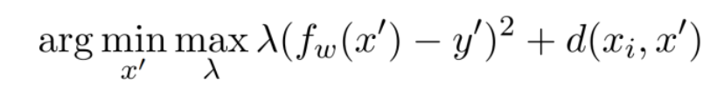
Examples of XAI: counterfactual explanations
Counterfactual Explanations without Opening the Black Box: Automated Decisions and the GDPR. Wachter et al. Harvard Journal of Law & Technology 31(2) 2018
Machine Learning Classifier:
Counterfactual explanation for f_{w}(x_{i})=y_{i} is (x'y') such that
(here d(.,.) is a distance measure):
Several other recent proposals, for example:
FACE (Feasible and Actionable Counterfactual Explanations) Poyiadzi et al, AIES20
DICE (Explaining Machine Learning Classifiers through Diverse Counterfactual Explanations) Mothilal et al, FAT*20
CLEAR (Measurable Counterfactual Local Explanations for Any Classifier) White&Garcez. ECAI2020
Notes:
Machine Learning Classifiers are trained by finding the optimal set of weights w that minimises an objective (l in the slide) over a set of training data – in the slides yi is the label for data point xi and ρ(·) is a regulariser over the weights.
We wish to find a counterfactual x’ as close to the original point xi as possible such that fw(x’) is equal to a new target y’. We can find x' by holding w fixed and minimizing the related objective given in the slide, where d(·,·)is a distance function that measures how far the counter-factual x’ and the original data point xi are from one another.
The other examples have the following flavour: FACE: actionability of changes suggested; DICE: framework for evaluation? ; CLEAR: an appropriate fidelity measure? THESE ARE ALL EXAMPLE-BASED?

Slide 9



XAI: other approaches
Use surrogate/twin (interpretable) models
decision trees
KNN
logic
decision graphs
…
“Use explainable models instead of explaining black-box models especially when high-stake decisions are involved, as in healthcare and criminal justice”
Interpretable model
Data
Black-box model
Output
Distilling a Neural Network Into a Soft Decision Tree. Frosst&Hinton. CEx@AI*IA 2017
Twin-Systems to Explain Artificial Neural Networks using Case-Based Reasoning: Comparative Tests of Feature-Weighting Methods in ANN-CBR Twins for XAI. Kenny&Keane. IJCAI2019
Towards Trustable Explainable AI. Ignatiev. IJCAI2020
Compiling Bayesian Network Classifiers into Decision Graphs. Shi et al. AAAI 2019
…
Stop explaining black box machine learning models for high stakes decisions and use interpretable models instead. Rudin. Nature Machine Intelligence 2019

Slide 10
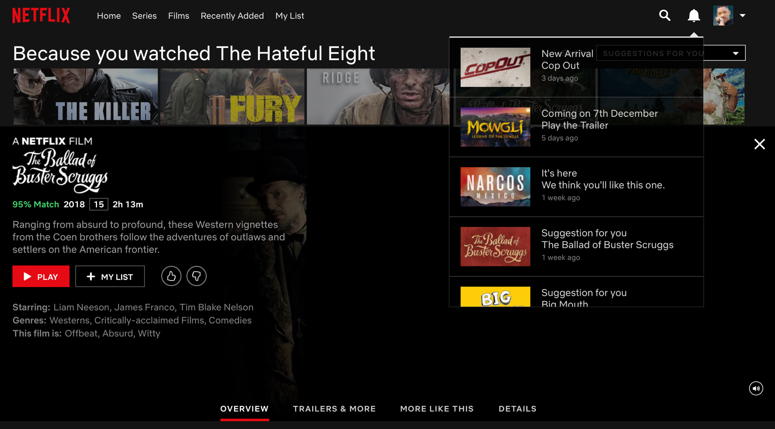
Explanations for recommender systems
Some suggestions
A % match score
Notes:
Wha about recommender systems? A“commercial” examples
These are explanations “of sorts”

Slide 11
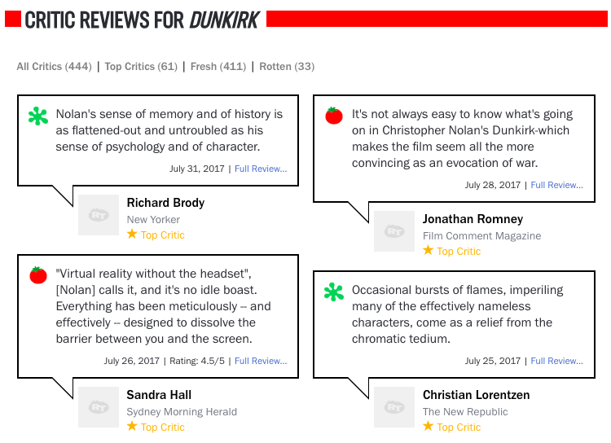
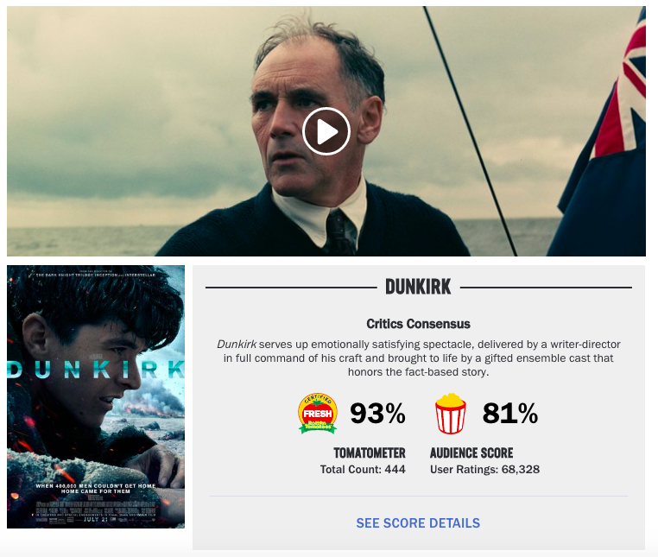
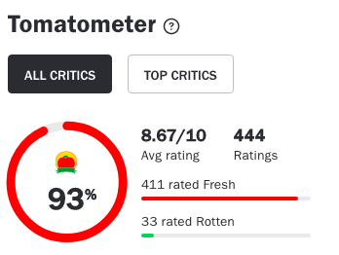
Explanations for review aggregation systems
Thanks to O Cocarascu
Aggregated scores
Critics’ reviews
Notes:
Another commercial example (for recommendations based on review aggregations). These are also explanations “of sorts”

Slide 12
Evaluating explanations (for machine learning models)
For generic explanations:
Functional Requirements (e.g., Computational Complexity)
Operational Requirements (e.g., Explanatory Medium: summarisation, visualisation, textualisation, formal argumentation, etc., or mixture)
Usability Requirements (e.g., Fidelity, “Cognitive” Complexity)
Safety Requirements (e.g. potential for Misuse)
Validation Requirements (e.g. User Studies or Synthetic Experiments)
For special explanatory media, e.g. for example-based counterfactual explanations:
Validity: returned examples (as explanations) need to actually be counterfactuals
Proximity: examples that are closest to the input (whose output is to be explained) can be the most useful to a user
Sparsity (towards feasibility): a counterfactual example will be more feasible if it makes changes to fewer features
Diversity: different examples need to be as diverse as possible
Explainability Fact Sheets: A Framework for Systematic Assessment of Explainable Approaches. Sokol&Flach. FAT* ’20
Explaining Machine Learning Classifiers through Diverse Counterfactual Explanations. Mothilal et al, FAT*20
Notes:
In the first category also: Problem Supervision Level: supervised, unsupervised, reinforcement etc; Problem Type: classification, regression, clustering; Explanation Target: data, model, prediction; Relation to the Predictive System: ante-hoc (predict and explain), post-hoc (predict then explain), mimic (twin).
Misuse: , can explanations be used by adversaries to game a model?

Slide 13
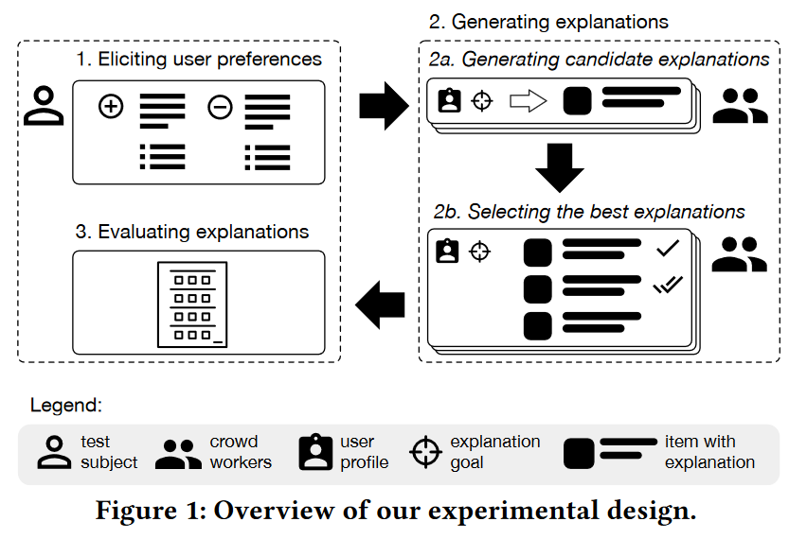
Evaluating explanations (for recommender systems)
Effectiveness: Help users make good decisions
Efficiency: Help users make decisions faster
Persuasiveness: Convince users to try or buy
Satisfaction: Increase the ease of use or enjoyment
Scrutability: Allow users to tell the system it is wrong
Transparency: Explain how the system works
Trust: Increase users’ confidence in the system
Explaining Recommendations: Design and Evaluation. Tintarev and Masthoff. RecSys Handbook 2015
Measuring Recommendation Explanation Quality: The Conflicting Goals of Explanations. Balog&Radlinski. SIGIR2020
Notes:
By no means exhaustive list, e.g. Hoffman et al, Metrics for XAI, arxiv 2018, https://arxiv.org/abs/1812.04608

Slide 14
Most XAI solutions today
Shallow, even when the underlying model to be explained is deep (e.g. non-naïve Bayesian classifiers, deep learning)
One-way – rather than two-ways/interactive
Machine-oriented, rather than human-oriented
Notes:
no interactions? Questioning and feedback… 9also see Russel’s keynote at ecai? Possibly add a quote from one of his papers)

Slide 15



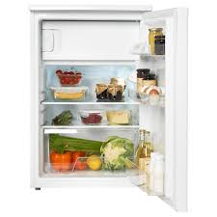
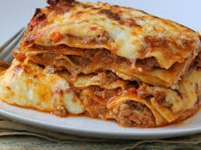



“Shallow” vs “deep” explanations: intuition
input
System
(e.g. machine learning)
output
Explanation
“Shallow”
“Very deep”
“Deep”
15/27
Notes:
no interactions? Questioning and feedback… 9also see Russel’s keynote at ecai? Possibly add a quote from one of his papers)

Slide 16

“One-way” vs “two-ways/interactive” explanations: intuition
input
System
(e.g. machine learning)
output
Explanation
“one-way”:
and/or
Make the sauce and the bechamel, then …
“two-ways/
interactive”:
How do I make the sauce?
16/27
Notes:
no interactions? Questioning and feedback… 9also see Russel’s keynote at ecai? Possibly add a quote from one of his papers)

Slide 17
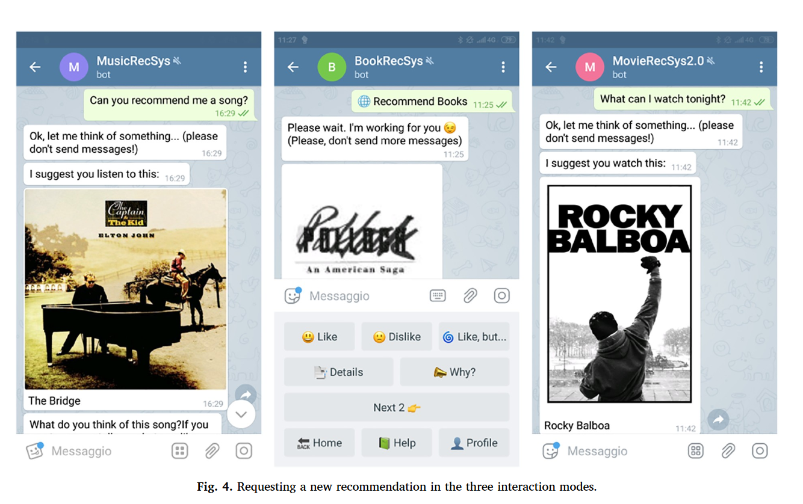
Two-way, conversational explanations for recommender systems
Conversational Recommender Systems and natural language: A study through the ConveRSE framework. Iovine et al, DSS2020
Notes:
With Narducci and Semeraro

Slide 18
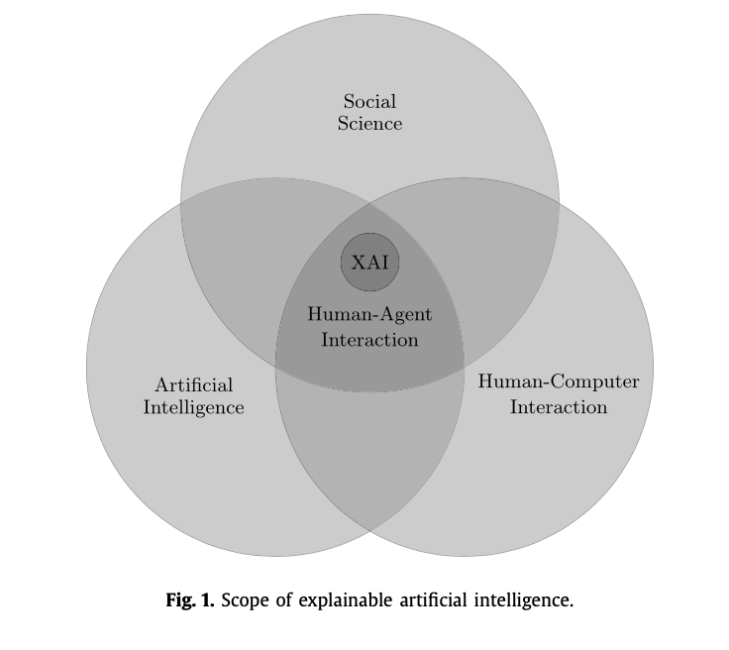
Machine- vs human-oriented
“Looking at how humans explain to each other can serve as a useful starting point for explanation in artificial intelligence”
Social explanations: how do people communicate explanations?
“the majority of what might look like causal attributions turn out to look like argumentative claim‐backings”
Explanation in artificial intelligence: Insights from the social sciences. Miller; AIJ 2019
Explaining in conversation: Towards an argument model. Antaki&Leudar. Journal of Social Psychology 1992

Slide 19
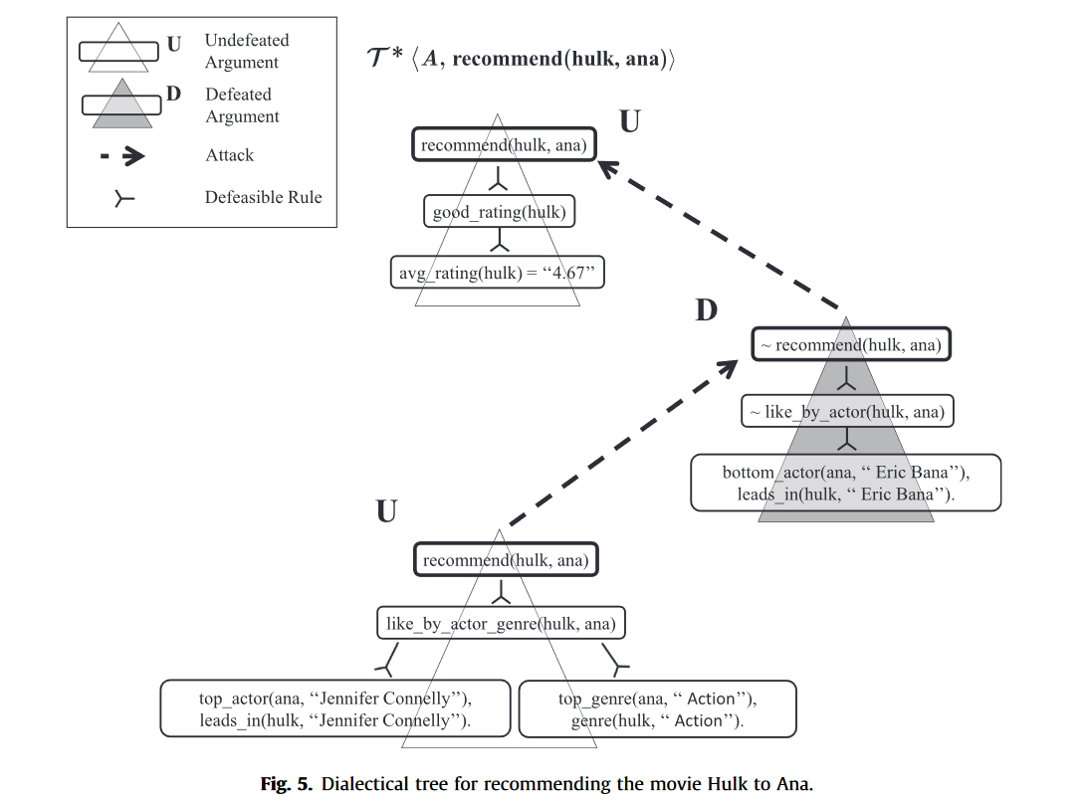
Argumentation-based explanations for recommender systems
Argument-based mixed recommenders and their application to movie suggestion. Briguez et al, ESWA2014

Slide 20
Part 2 – Background on (Abstract, Bipolar, Gradual) Argumentation
On the Acceptability of Arguments and its Fundamental Role in Nonmonotonic Reasoning, Logic Programming and n-Person Games.;
Dung; AIJ 1995.
On the Acceptability of Arguments in Bipolar Argumentation Frameworks;
Cayrol, Lagasquie-Schiex: ECSQARU 2005
Discontinuity-Free Decision Support with Quantitative Argumentation Debates;
Rago, Toni, Aurisicchio, Baroni ; KR2016
From fine-grained properties to broad principles for gradual argumentation: A principled spectrum;
Baroni, Rago, Toni, IJAR 2019
Notes:
AR 15 minutes

Slide 21


Computational Argumentation (alias “Argumentation in AI”)
Argumentation Framework
(abstraction of debate)
Argumentation Semantics
(evaluation of debate)
Properties (goodness of semantics)
preferences, probabilities
algorithms, systems
applications
$$\{α, …\}⊢\overline{β}$$
structured argumentation (ABA, DeLP,…)
-
abstract argumentation: admissible extension (set of “winning” arguments)
-
Existence
Uniqueness
abstract argumentation
+
$$\{β, …\}⊢γ$$
0.5
0.25
0.625
Dialectical Monotonicity:
attacks decrease strength, supports increase strength
bipolar argumentation
single arrows=attack (-)
0.5
double arrows=support (+)
quantified bipolar argumentation frameworks (QBAFs):
Arguments have an intrinsic strength
Semantics (e.g. DF-QuAD) to determine dialectical strength
Notes:
CAN WE GET RID OF AA FRAMEWORK AFTER ANIMATION 5 WHEN SHOWING 6? FT – YOUR CHOICE!

Slide 22
Example extension-based semantics
Given an abstract argumentation framework (Args, attacks), A⊆Args is
conflict-free (c-f) iff ∄ a,b∊A such that (a,b) ∊ attacks
admissible iff A is c-f and A defends itself against all attacks, i.e., for all a∊A such that (a,b) ∊ attacks for some b∊A, ∃ c∊A such that (c,a) ∊ attacks
complete iff it is admissible and contains all arguments it defends
grounded iff ⊆-minimal complete
stable iff c-f and for all a∊Args∖A, ∃ b∊A such that (b,a) ∊ attacks
The grounded extension is guaranteed to always (uniquely) exist and is tractable
−
−
Notes:
SAY: WE WILL USE GROUNDED AND STABLE ONLY ONLY
Grounded is computable in Polynomial time. It can be computed bottom up: unattacked args first, then all arguments they defend and so on – till no change. Green nodes amount to the grounded extension in the example

Slide 23
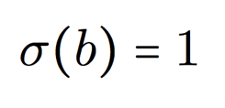
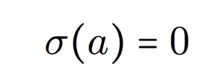


Example gradual semantics – DF-QuAD
Gradual Semantics uses numerical values, i.e. a strength σ, for argument evaluation
DF-QuAD is a gradual semantics for QBAFs (quantified bipolar argumentation frameworks), where arguments come with an intrinsic strength (called base score in DF-QuAD) up-front
−
+
b
a
c

Slide 24
Example gradual semantics – DF-QuAD
To compute the strength SF of argument x the function C combines three elements:
the base
score of x
a factor summarizing the attackers of x
a factor summarizing the supporters of x
using the sequence of the strengths of the attackers/supporters of x

Slide 25
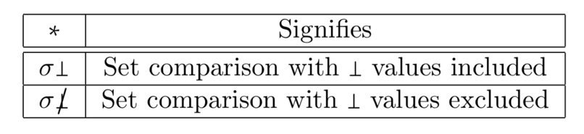
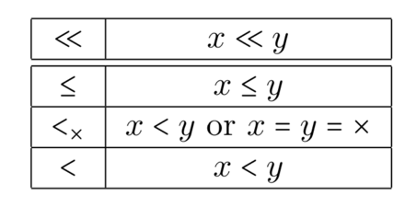
Properties of Gradual Semantics
−
33 Literature Properties
Attacker added
a
b
a
Are instances of /
Are implied by
Literature properties disagree on whether a’s strength always be reduced
11 Group Properties
Grouping is based on QBAFs and 2 parameters:
Are instances of /
Are implied by
4 Principles
(Strict) Balance:
+
−
−
c
b
a
d
Satisfied by h-Categorizer ^{[Besnard & Hunter 2000]} and Social Models ^{[Leite & Martins 2011]} among others.

Slide 26
Properties of Gradual Semantics
Strict Dialectical Monotonicity can be summarized as follows:
Adding an attacker decreases the strength of an argument.
Increasing the strength of an attacker decreases the strength of an argument.
Adding a supporter increases the strength of an argument.
Increasing the strength of a supporter increases the strength of an argument.
−
+
b
a
c
σ(a) = 0
σ(a) = 0.25
σ(c) = 0.5
σ(a) = 0.75
σ(a) = 0.5
σ(b) = 0.5
σ(a) = 1
σ(c) = 1
σ(b) = 1
Non-strict dialectical monotonicity relaxes the constraints.

Slide 27
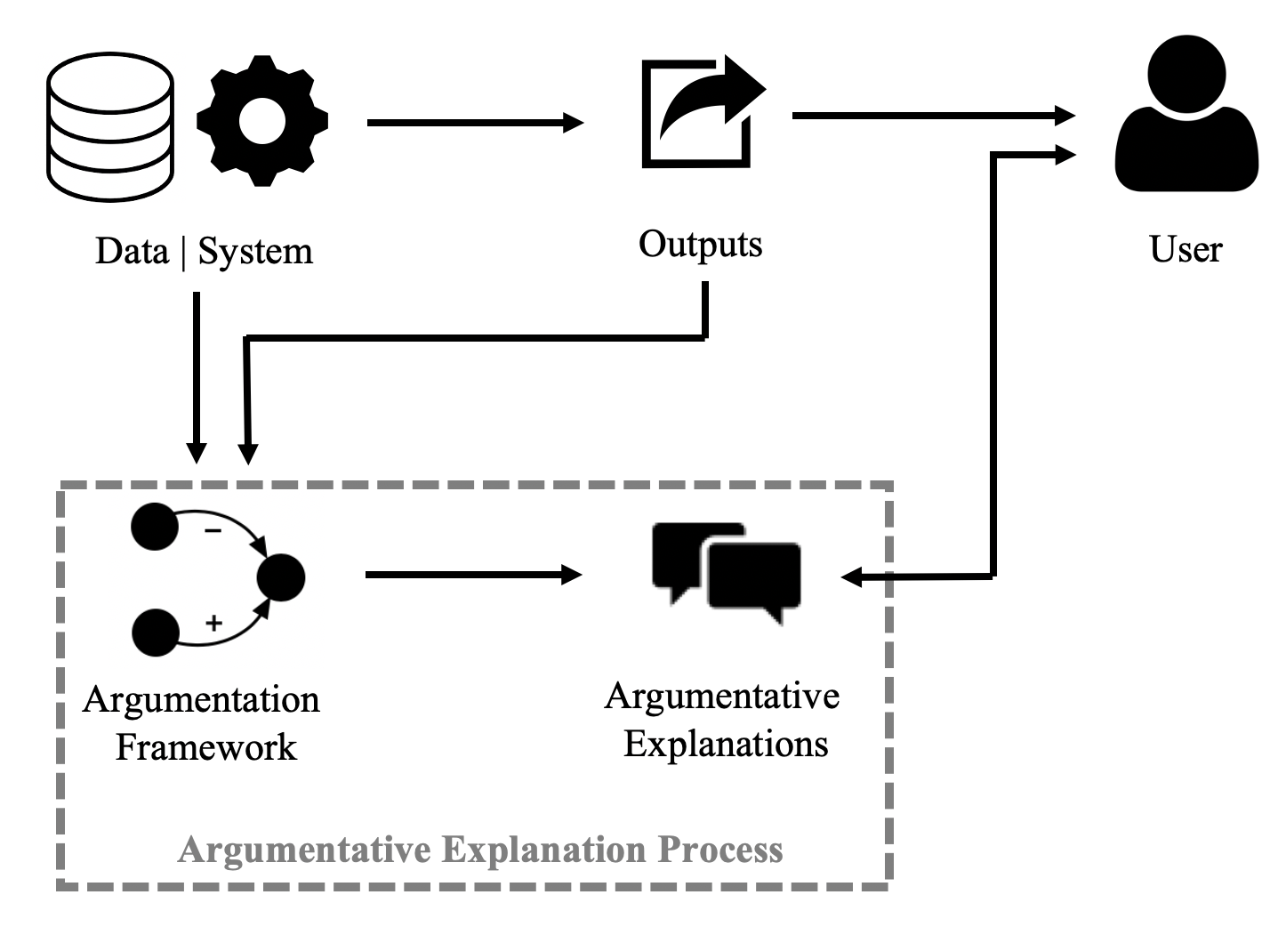
Computational Argumentation for XAI
Human-oriented, with potential to support deep, two-way interactions
Can capture non-monotonicity, paraconsistency, counterfactuality
Mature discipline (theory and systems, including on argumentation-based dialogues)
Note: with XAI we mean
Explaining AI
AI (in the form of computational argumentation) to explain
Notes:
Why argumentation instead of other KR formalisms?

Slide 28
Part 3: Argumentative Explanations
Part 3a: From systems to argumentation frameworks: 6 case studies:
(Explaining) Review aggregations
(Explaining) Recommender Systems
(Explaining) Pagerank
(Explaining) Scheduling
(Explaining) Prediction from data
(Explaining) Bayesian classifiers
Part 3b: From argumentation frameworks to argumentative explanations:
Content and format of explanations
User evaluations
User feedback
Notes:
FT: 10 minutes
NOTE: We focus mostly on the proposal by ourselves and others in CLArg group

Slide 29
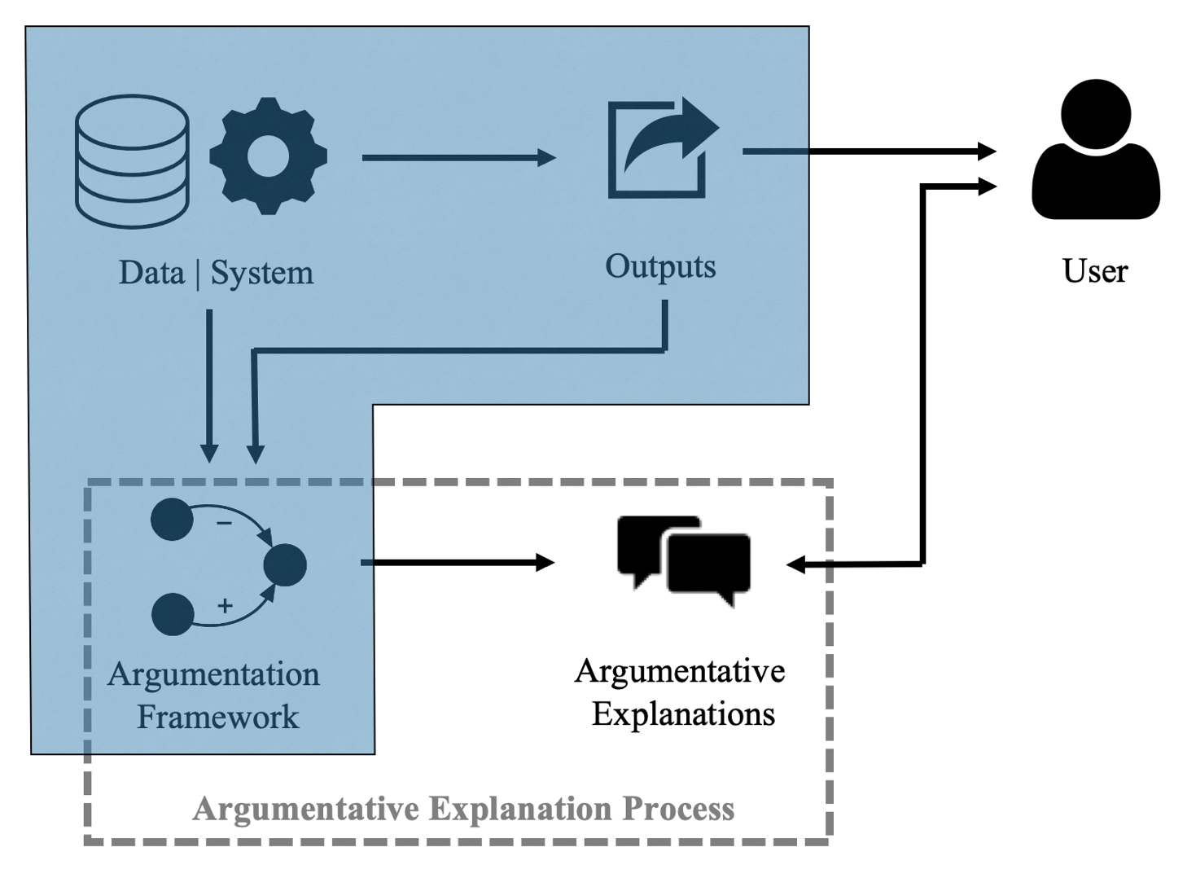
Part 3a: From Systems to Argumentation Frameworks

Slide 30
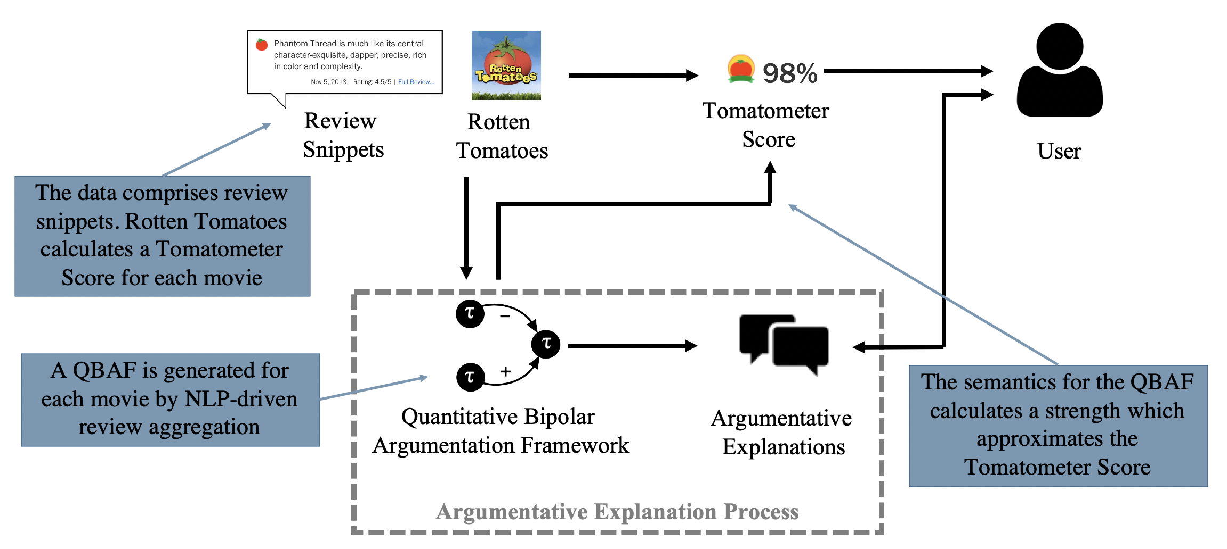
Case Study 1: Review Aggregation
Extracting Dialogical Explanations for Review Aggregations with Argumentative Dialogical Agents. Cocarascu et al. AAMAS2019
30

Slide 31








NLP-driven review aggregation –feature-based characterisation
Thanks to O. Cocarascu
a movie
Types of features:
Single (with one sub-feature), or
Multiple (with > one sub-feature)
Predetermined (using metadata/ontology), or
Mined (using NLP methods from textual reviews)
features
sub-features

Slide 32
NLP-driven review aggregation – Extracting phrases representing potential arguments
We analyse each critic's review independently
We tokenise each review into sentences
We split sentences into phrases when specific keywords (but, although, though, otherwise, however, unless, whereas, despite) occur
Each phrase may then constitute a potential argument from its critic (contributing a vote in the review aggregation at Step 3)
For example, from the following review for m = Wonder Wheel (from a single critic)
c1: Despite a stunning performance by Winslet and some beautiful cinematography by Storaro, Wonder Wheel loses its charms quickly and you’ll soon beg to get off this particular ride.
we extract two phrases:
p1: Despite a stunning performance by Winslet and some beautiful cinematography by Storaro
p2: Wonder Wheel loses its charms quickly and you’ll soon beg to get off this particular ride

Slide 33
Extracting Review Aggregations via NLP
Votes (positive/negative) are extracted from reviews on movies and (sub-)features
Votes are augmented using the parent relation (a vote for/against an argument is a vote for/against the argument's parent)
= votes generally positive
= votes generally negative
“Despite a stunning performance by Winslet and some beautiful cinematography by Vittorio Storaro, Wonder Wheel loses its charms quickly and you’ll soon be begging to get off this particular ride."
“…like the fairground ride for which it’s named, Wonder Wheel is entertaining.”
“As we watch Allen worry and nitpick over the way women fret over aging, painting Ginny as pathetic, jealous, insecure, and clownish, it's dull, unoriginal, and offensive. Frankly, we've had enough Woody Allen takes on this subject.”
Notes:
We mine votes can be mined using sentiment analysis or argument mining:
A positive/negative vote from a critic on a (sub-)feature of the movie signifies positive/negative stance on that (sub-)feature
A positive/negative vote on m signifies positive/negative stance on the overall movie

Slide 34
Extracting QBAFs from review aggregation
The arguments are the item and the (sub-)features
Each argument is assigned a base score, an aggregation of reviewers’ extracted votes on it
attacks are assigned along the parent relations where the votes have opposing polarities:
supports are assigned along the parent relations where the votes have the same polarity:
−
−
generally
– votes
generally
+ votes
generally
+ votes
generally
– votes
+
+
generally
+ votes
generally
+ votes
generally
– votes
generally
– votes

Slide 35
Example
Positive arg f’_{A1} supports positive arg f_{A}
Neutral arg f’_{A2} neither attacks not supports positive arg f_{A}
Positive arg f_{A} supports positive arg m
Negative arg f_{D} attacks positive arg m
Neutral arg f_{W} neither attacks nor supports positive arg m
Positive arg f’_{T1} supports positive arg f_{T}
Positive arg f_{T} supports positive arg m
+
+
−
+
+

Slide 36
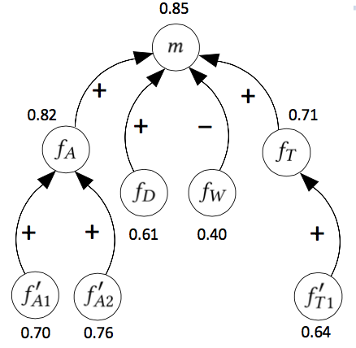
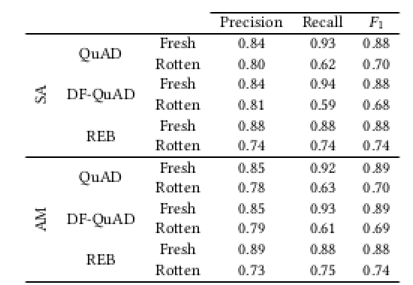
Argumentation semantics for “matching” TS scores
This allows to obtain dialectical strength of arguments,
e.g. using DF-QuAD (with intrinsic strengths given by critics’ mined votes)
As an example
(dialectical strengths are the numerical labels):
QuAD: Baroni et al 2015
REB: Amgoud &Ben-Naim 2017
Notes:
Restricted Euler-based semantics (REB) Leila Amgoud and Jonathan Ben-Naim. 2017. Evaluation of Arguments in
Weighted Bipolar Graphs. In Symbolic and Quantitative Approaches to Reasoning
with Uncertainty - 14th European Conference, ECSQARU

Slide 37
Case Study 2: Recommender Systems
Argumentation-Based Recommendations: Fantastic Explanations and How to Find Them. Rago et al. IJCAI2018
37
Notes:
AR: 10 minutes

Slide 38
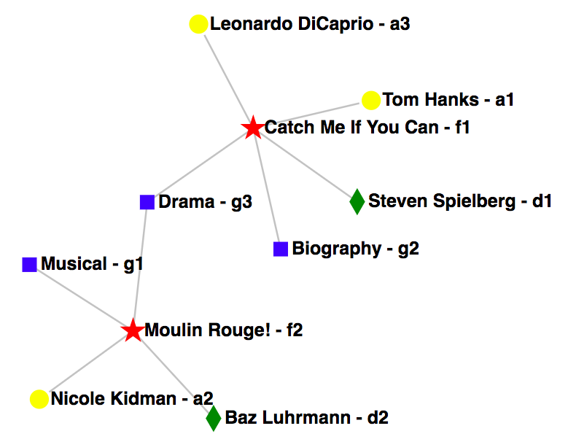






Aspect-Item Frameworks
An Aspect-Item framework (A-I) for supporting recommendations comprises:
items representing the entities to be recommended;
aspects representing the features of the items,
each with a specific type;
links showing which items hold which aspects;
users which give
ratings on item-aspects.
For a given user, predicted ratings are calculated for each item-aspect based on:
the user’s ratings;
user-specific constants;
similar users’ ratings.

Slide 39
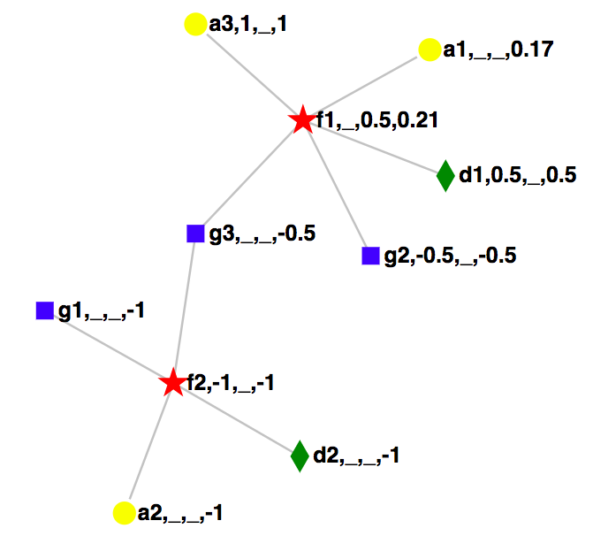
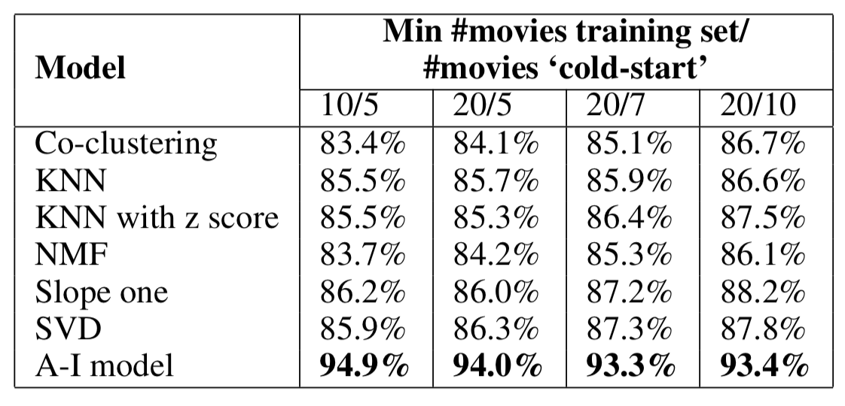
Aspect-Item Frameworks
Predicted ratings on a scale of [-1,1] propagate through the graph.
Averaging techniques for each item-aspect’s effect.
Unique weighting parameters for user similarities and preferences.
Unrated items with the highest predicted ratings are then recommended.
Accuracy is competitive with ML techniques:
Key: id, user rating, average similar user rating, predicted rating
Notes:
change

Slide 40

Extracting Argumentation Frameworks
We show how entities/relationships in an AI system can be viewed as arguments/relations:
Items/features may be seen as arguments that a user (dis)likes those items/features.
+
+
Relations may be extracted from the links between features and items.
i₁
f₁
i₂
?
?
If i₁ and i₂ hold f₁, and we have a positive rating from the user on i₁, how does this affect our arguments of whether the user likes the items/features?
Positive rating on i₁ → argument becomes “the user likes i₁”.
No rating on f₁ or i₂ → predicted ratings using their links to other items/features.
Since f₁ (without rating) is held by i₁ (with rating) → i₁ affects f₁.
The rating of i₁ is positive → i₁ affects f₁ positively (supports f₁).
No other effects from other entities → argument becomes “the user likes f₁”.
Since f₁ (with predicted rating) is held by i₂ (without rating) → f₁ affects i₂.
The rating of f₁ is positive → f₁ affects i₂ positively (supports i₂).
No other effects from other entities → argument becomes “the user likes i₂”.

Slide 41
Extracting (Tripolar) Argumentation Frameworks
Arguments are items and aspects
An item affects an aspect it holds iff the item has a rating from a user but the aspect does not.
An aspect affects an item iff the item does not have a rating from the user.
These effects are characterised as follows:
attacks iff the affecting item-aspect has a negative predicted rating;
supports iff the affecting item-aspect has a positive predicted rating;
neutralisers iff the affecting item-aspect has a predicted rating of zero.
Attacks/supports/neutralisers reduce/increase/neutralise an item-aspect’s predicted rating.
The argumentation framework is thus shown to satisfy a form of weak balance.

Slide 42
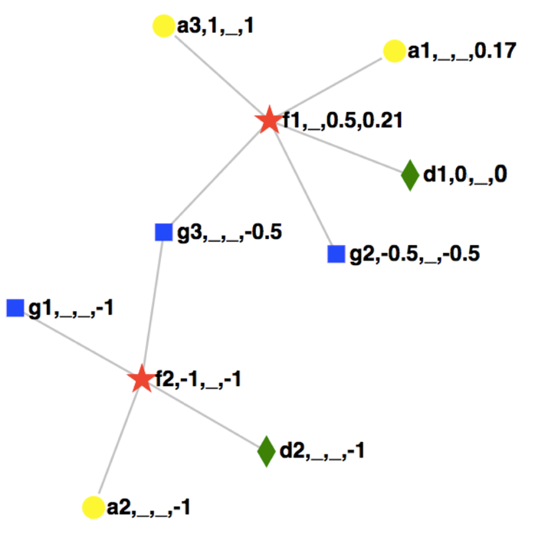
Extracting (Tripolar) Argumentation Frameworks
The extracted argumentation graph contains attacks, supports and neutralisers:
+
a₃
a₁
+
+
f₁
g₁
0
−
−
+
−
d₁
−
f₂
g₃
g₂
a₂
−
−
Key: id, user rating, average similar user rating, predicted rating
d₂
Notes:
BREAK

Slide 43
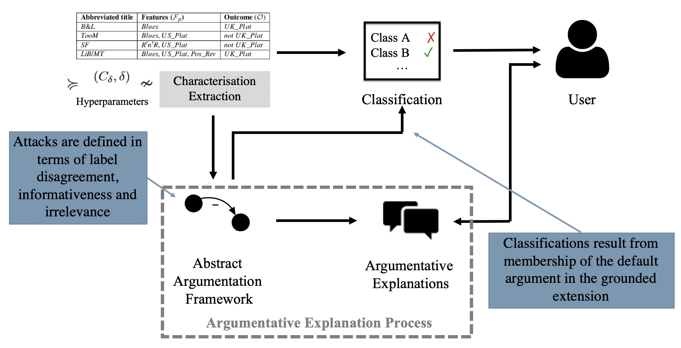
Case study 3: Prediction from data
Notes:
FT 20 minutes (10 for each method)

Slide 44
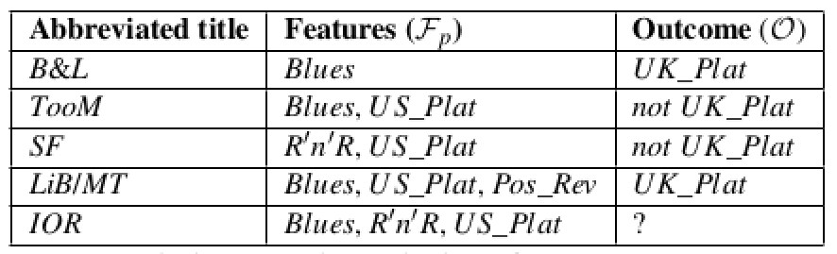
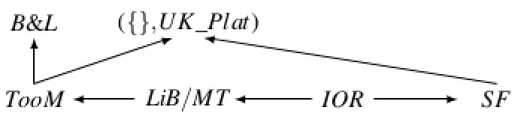
AA-CBR: from labelled data (with binary features) to abstract argumentation frameworks to case-based reasoning
Abstract Argumentation for Case-Based Reasoning. Cyras et al. KR2016
Past (labelled) cases
(with binary features)
New case
Arguments are (past or new) cases or a default argument, e.g., ({}, UK_Plat)
Attacks due to disagreement on label and “informativeness” (⊆) or
“irrelevance” (⊈)
AA framework
?= not UK_Plat because the default argument ({}, UK_Plat) does not belong to the grounded extension
Semantics: grounded extension

Slide 45
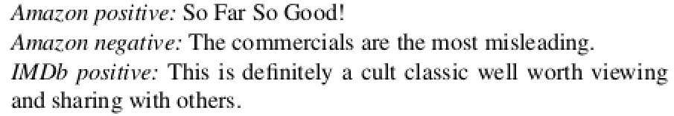

Data-Empowered Argumentation (DEAr): from (any?) labelled data to abstract argumentation frameworks to prediction
Data-empowered argumentation for dialectically explainable predictions. Cocarascu et al. ECAI 2020
Labelled data
Unlabelled datapoint (labelled ?)
characterisation extraction
(e.g. word clustering by similarity + vectorisation)
Arguments are (labelled or unlabelled) data points or a default argument,
e.g., ({}, -)
Attacks due to disagreement on label and “informativeness” or
“irrelevance”
AA framework
Label for unlabelled datapoint determined by membership of default argument in grounded extension
Semantics: grounded extension
Notes:
We use semantic similarity for clustering as follows: for two words to be deemed semantically similar they need to have the same sentiment polarity (e.g. “good” will be tested against “great” which has a positive polarity but not against “bad” which has a negative polarity) and the same part of speech (POS) tag (e.g. “good” will be tested against “amazing” which is an adjective but not against “work” which can be a verb or a noun depending on context). We use the semantic network ConceptNet and select the pairs that have relatedness score above 0.3.

Slide 46

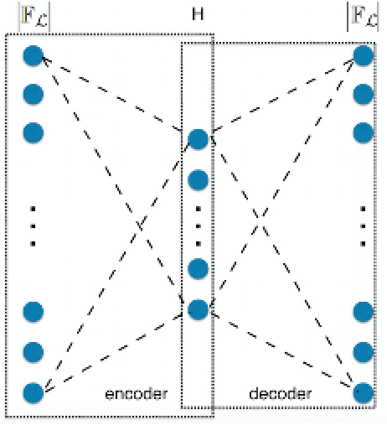
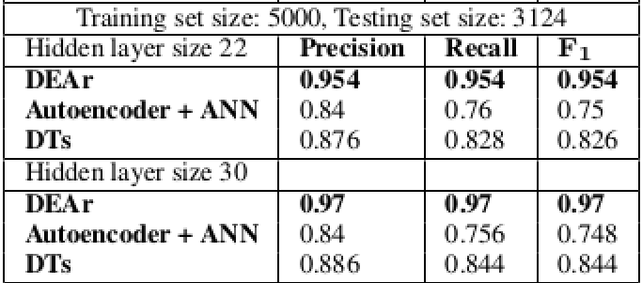
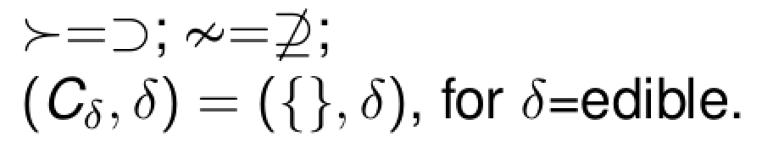
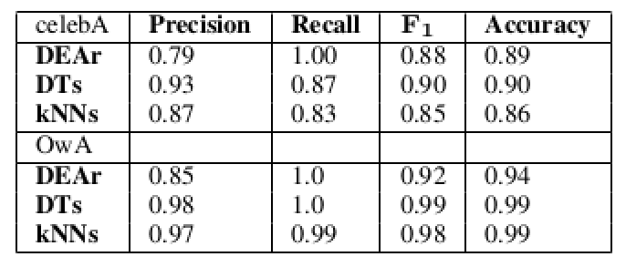
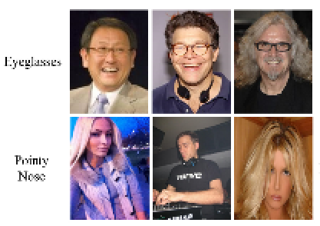
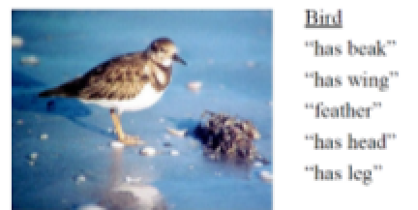
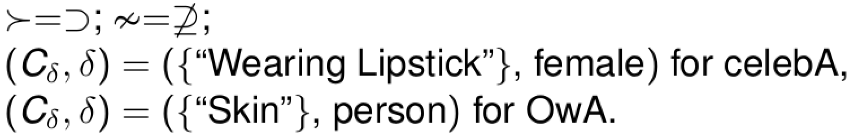
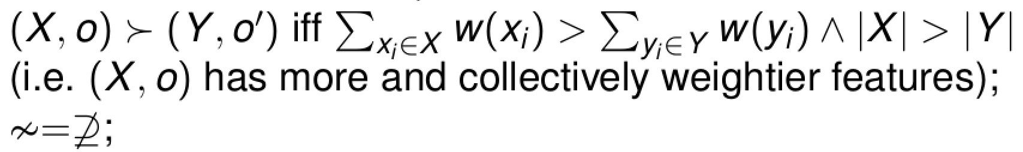
DEAr instances (Competitive predictions wrt Decision Trees, KNN)
characterisation extraction:
Autoencoder
characterisation extraction:
manual annotations
Sentiment analysis on (some of):
Amazon reviews dataset
IMDb reviews dataset
Notes:
Mushrooms: categorical data – so characterisation extraction is dimensionality reduction
Images: CelebA (under), OwA (over)
Performances omitted in the last experiment – they are in the paper. For the default: different choices work for different experiments there

Slide 47
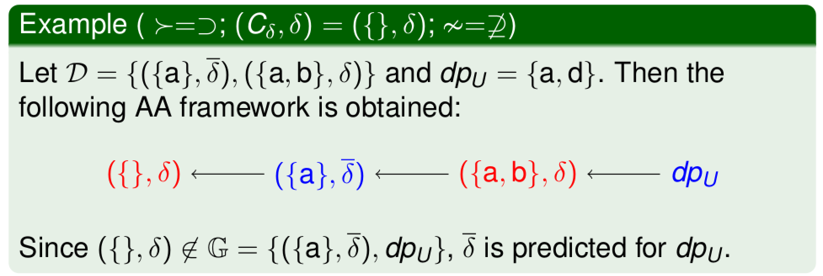
AA-CBR/DEAr: a simple example
grounded extension (in blue in the graph)
Notes:
Comment: this is a system that is argumentative by design, constructed directly from data. We will see how being argumentative allows it to be explainable – in that different argumentative explanations can be extracted from it

Slide 48
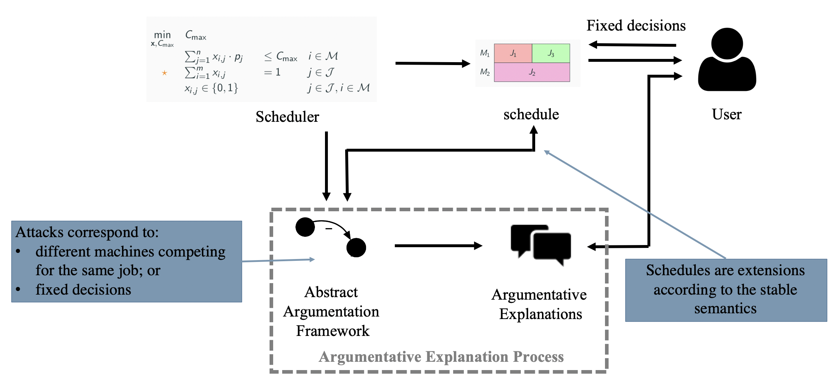
Case study 4: Scheduling
Argumentation for Explainable Scheduling. Cyras et al. AAAI 2019

Slide 49
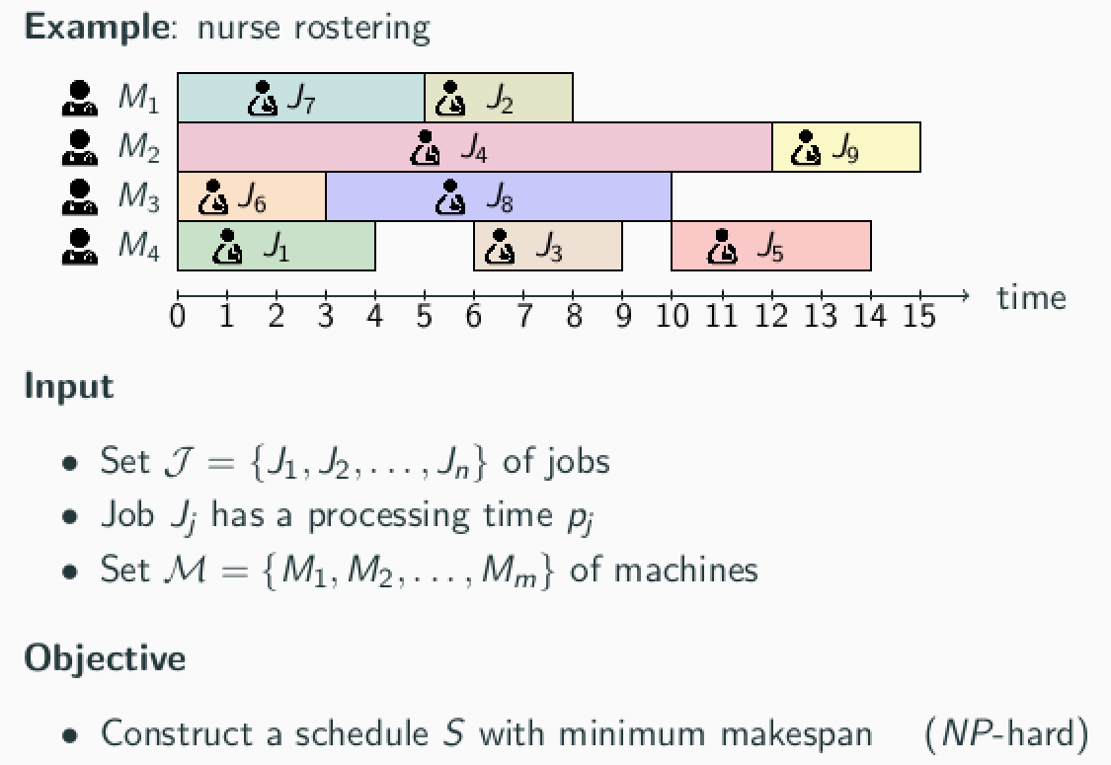
Makespan scheduling
Thanks to K. Cyras

Slide 50
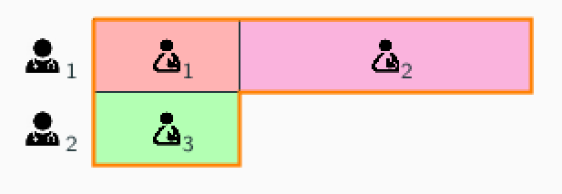
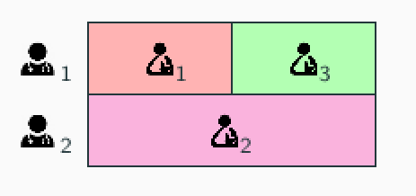
Why explanations?
An optimization solver recommends an optimal schedule S∗
The user inquires whether another schedule S could be used (‘what-if’ scenario)
Possibly fixing some decisions, i.e. (non-)assignments of jobs to machines, e.g., if execution of the schedule has already started
If S is not optimal, the user needs to know why (explanation)
User:
can I do this?
Explainable scheduler:
No! But you can do:

Slide 51
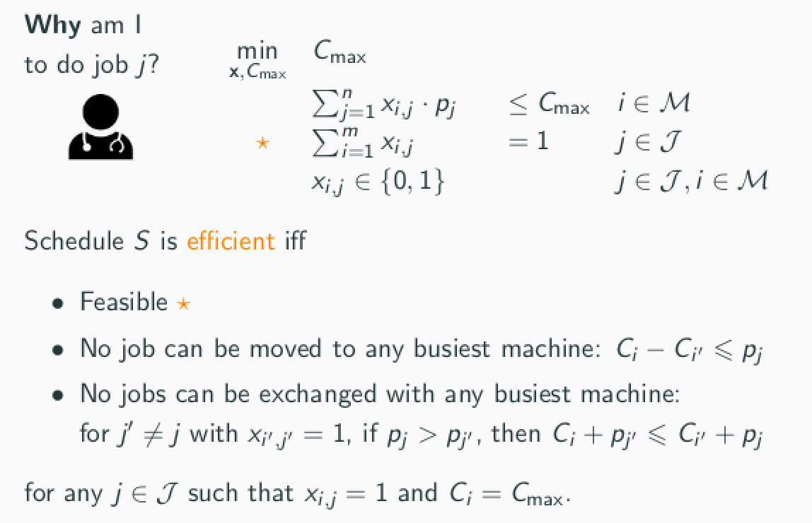

Towards explanation: approximate (efficient) solutions
Notes:
Feasibility is polynomial. The other two properties are satisfied by every optimal schedule (pairwise comparisons, local comaprisons, efficiently computed).
Machine is is the busiest. C_i is the summation in the first starred condition (c_i’ the same summation for machine i’)

Slide 52
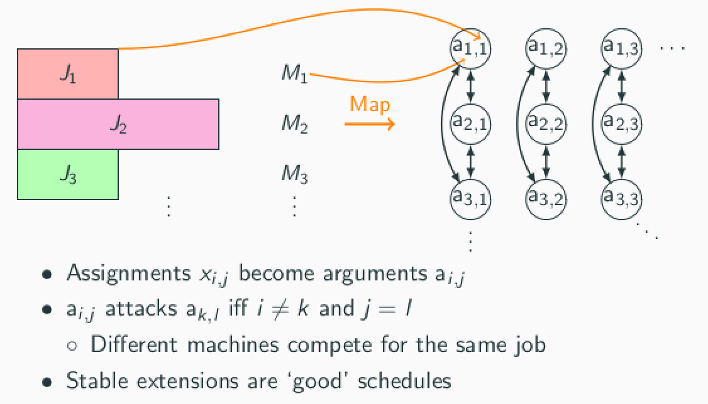
From ‘good’ (e.g. efficient) schedules to abstract argumentation

Slide 53


From (non-)attacks in non-stable extensions to explanations
The attack from a_{2,3} to a_{1,2} (on the right) explains why S (on the left) is not efficient
The non-attack from a_{1,2} to a_{1,1} explains why the schedule corresponding to the dotted extension (job 2 on machine 1, job 1 on machine 2) violates the fixed decision (that job 2 cannot be on machine 2)

Slide 54

An Explainable, Interactive Scheduling System
AI-assisted Schedule Explainer for Nurse Rostering. Cyras et al.
Best (innovative) demo at AAMAS 2020

Slide 55

Case study 5: PageRank
PageRank as an Argumentation Semantics. Albini et al. COMMA 2020
Notes:
AR 20 minutes (10 for each method)

Slide 56






PageRank
Thanks to E. Albini
PageRank is an algorithm to rank webpages in order to estimate their popularity/importance.
The formula for a ranking is as follows:
Random landing contribution with damping factor d and number of pages N
Web Graph $\left\langle P,L\right\rangle$ where the nodes $P$ are the pages and the directed edges $L$ are the links between pages
For each
incoming link
The score from a page linked to u, where the more links in a page the less its score is transferred to other pages

Slide 57
PageRank: Argumentative Abstraction
The obvious method would be a support argumentation framework:
Webpages as arguments;
Links as supports.
However, this violates dialectical monotonicity, as linking to more pages reduces supports’ effects.
$$α$$
$$γ$$
$$β$$
$$δ$$
$$ζ$$
$$ε$$
$${ θ}_{4}$$
$${ θ}_{1}$$
$${ θ}_{5}$$
$${ θ}_{2}$$
$${ θ}_{3}$$

Slide 58


PageRank: Argumentative Abstraction
Instead, a meta-argumentation framework can be introduced:
Arguments are the webpages.
Meta-arguments introduced between linked arguments representing the contribution.
Extracted relations also include attacks.
This new QBAF allows a reformulation of PageRank, with an appropriate base score, such that:
This new semantics satisfies the property of dialectical monotonicity.

Slide 59

PageRank: Why monotonicity matters
This new semantics was tested the frameworks based on the web graph of Wikipedia articles (965,748 pages and 7,388,700 links).
If we consider only the PageRank scores and supports, a graph explaining the link could be as follows, where node size indicates PageRank score.
Someone could think that Scottish People is the article contributing the most to the PageRank score of Celtic People.
In reality, Celtic Music is the article that gives the biggest contribution to the PageRank score of Celtic People.

Slide 60




PageRank: Why monotonicity matters
With the extracted QBAF, a more accurate picture is drawn:
The minimal contribution of Scottish People, due to its many outgoing links, is indicated.
Meanwhile the higher contribution of Celtic Music is indicated.
Further, the relations are monotonic, and so the explanation is intuitive for users.
+
Other applications of PageRank, in addition to the web, may be targeted in a similar manner, e.g.:
NFL rankings;
Traffic in smart cities.
+
+
+
+
-
+
+
-
-
+
Actual contribution towards Celtic People
+

Slide 61

Case Study 6: Bayesian Classifiers
Relation-Based Counterfactual Explanations for Bayesian Network Classifiers. Albini et al. IJCAI 2020
61

Slide 62


From Bayesian Classifiers to Decision Functions
Thanks to E. Albini
Bayesian Classifiers (BCs) make predictions on classification variables based on observations.
classifications
Decision functions may be extracted for these BCs.
$$play$$
$$\underline{o}utside$$
$$\underline{r}ain$$
$$\underline{w}ind$$
$$\underline{p}ressure$$
$$\underline{t}emperature$$
$$\underline{h}umidity$$
observations
For example: given the observations low (-) wind and temperature and high (+) humidity and pressure, rain is classified as negative and play outside as positive.
conditional dependencies
62

Slide 63

From Bayesian Classifiers to (Counterfactual) Argumentative Abstractions
Influences may be extracted for a BC, such that any influence from a variable to a classification is indicated.
$$play$$
$$\underline{o}utside$$
$$\underline{r}ain$$
$$\underline{w}ind$$
$$\underline{p}ressure$$
$$\underline{t}emperature$$
$$\underline{h}umidity$$
conditional dependencies
influences
In counterfactual explanations (CFXs), variables may be treated as arguments and relations constructed based on influences.
Relations are extracted when an influence satisfies the relation’s specified property wrt the decision function (i.e. the semantics).
63

Slide 64


Support Relations: Critical and Potential Influences
Influences may then be categorised as specified relations in the CFX by these properties:
A variable 𝛼 critically influences 𝛽 iff any change to variable 𝛼 directly brings a change in variable 𝛽.
A variable 𝛼 potentially influences 𝛽 iff a change to variable 𝛼 does not directly bring about a change in variable 𝛽 but it brings you closer to it.
A change of $p$ from $−$ to $+$
changes $r$ from $+$ to $−$
w–
A change of $h$ from $+$ to $−$
brings closer a change of $r$ from $+$ to $−$

Slide 65




Examples
In a naïve BC which predicts the class of a congressman given votes, indicating counterfactuals.
In a naïve BC that predicts the parole violation, identifying discriminatory bias.
Discrimination
Notes:
Un esempio d’applicazione di questo tipo di spiegazioni controfattuali è l’identificazione di classificatori discrimatori.
Per testare queste spiegazioni ho creato un classificatore Bayesiano che prevede se un carcerato violerà o meno la libertà vigilata.
Ho incluso volutamente tra le feature il sesso e l’etnia del carcerato.
Come visualizzato in questo esempio, una relazione di supporto critico è stata trovata:
tra il sesso e la classe
e tra l’etnia e la classe
evidenziando quindi una potenziale attitudine discriminatoria del classificatore.

Slide 66


Bayesian Classifiers: Other Argumentative Methods
In other work, support argumentation frameworks are extracted from Bayesian networks.
Distinctive characteristics of this alternative method:
Relations are extracted from the full Markov blanket of a variable;
Only one relation of support used, which is not counterfactual;
A variable may result in more than one argument.
Explaining Bayesian Networks Using Argumentation. S Timmer, JJ Meyer, H Prakken, S. Renooij & B Verheij; ECSQARU 2015

Slide 67

Part 3b: From Argumentation Frameworks to Argumentative Explanations
Notes:
AR 10 minutes (including FT’s bits)

Slide 68



Types of Explanations - Content
The content of an explanation is the information taken from the argumentation framework.
Requirements for this content may be selected based on the user and the application of the explanation.
Some simple ways to vary this content are by relation types or whether depth or width in the argumentation framework is utilised.

Slide 69

Format of Explanations: dispute (trees) from AA frameworks
Disputes between a proponent and an opponent
E.g. given abstract argumentation framework:
the following are (example) admissible dispute trees
explaining why argument a is dialectically acceptable:
−
−
−
−
−
b
a
c
f
d
e
−
Proponent: a
/ \
Opponent: b Opponent: c
| |
Proponent: d Proponent: f
Proponent: a
/ \
Opponent: b Opponent: c
| |
Proponent: e Proponent: e
On Computing Explanations in Argumentation. Fan & Toni; AAAI 2015
Notes:
FT here

Slide 70


Format of Explanations: visualised dispute trees
Explanations by arbitrated argumentative dispute. Cyras et al. ESWA 2019

Slide 71

From dispute trees to disputes
Notes:
FT here

Slide 72


Format of Explanations: conversations in controlled natural language
Thanks to K. Cyras
Guided by templates:
Notes:
FT here

Slide 73








Format of Explanations: conversations in controlled natural language
user: Why was The Post highly rated?
system: This movie was highly rated because the acting was great, although the writing was poor.
0.85
+
user: Why was the acting considered to be great?
0.26
+
−
system: The acting was considered to be great because Meryl Streep was great.
+
+
0.05
0.02
user: What did critics say about Meryl Streep being great?
0.05
0.07
system: “...Streep’s hesitations, rue, and ultimate valor are soul-deep...”
Notes:
FT here

Slide 74




Explanations in a variety of formats
The same explanatory content can also be delivered in a range of formats, e.g.
chart-based (i), linguistic narrative (ii), tabular (iii) and linguistic conversational (iv):
Notes:
AR 10 minutes

Slide 75

User Studies
Argumentation as a Framework for Interactive Explanations for Recommendations. Rago et al. KR2020
A user study was completed with the following interactive explanation (IE) styles:
IE1: Tabular format, utilising width, delivered statically;
IE2: Textual format, utilising depth, delivered statically;
IE3: Conversational format, utilising depth, delivered dynamically.
All explanation styles showed improvements in transparency:
Users were asked how the system works and the % correct increased after all types of IE.

Slide 76

User Studies
Users were also asked which they preferred of the IEs in pairwise comparisons:
IE1 (Tabular) vs. IE2 (Textual), giving a comparison of depth vs. width;
IE2 (Textual) vs. IE3 (Conversational), giving a comparison of static vs. dynamic.
There was no clear favourite, showing user preferences are diverse.

Slide 77
From Argumentative Explanations to Feedback
Argumentation frameworks support various styles of interactive explanation, e.g. conversational:
User: Why didn’t you recommend Catch Me If You Can (f₁) to me?
System: It was mainly due to the genres of the film, particularly Drama (g₃).
User: I don’t care about the genres of a film, reduce their importance.
+
a₃
a₁
The argumentation explanation for an argument is the subgraph of all nodes with a path to it
+
+
f₁
Aspects with biggest negative effects on f₁’s predicted rating determined
0
−
−
+
−
d₁
f₂
g₃
g₂
The RS may then reduce the user’s unique constant for genres of a film.
This reduces f₁’s predicted rating, therefore improves the RS’s accuracy.

Slide 78
From Argumentative Explanations to Feedback
Further, since the user hasn’t given a rating to g₃, they could ask for reasoning on it:
User: Why do you think I don’t like Dramas (g₃)?
System: It was mainly due to the fact that you didn’t like Moulin Rouge (f₂).
User: I made a mistake, I like this film.
This actual rating could then be corrected.
This would allow mistakes or changes in rating over time to be allowed for.
f₁
The argumentation explanation for g₃:
−
−
+
Items with biggest negative effects on g₃’s predicted rating highlighted
f₂
g₃

Slide 79

Potential Applications – Netflix
Why do we recommend this?
Why do we recommend this?
Why?
Why do we recommend this?
Why do we recommend this?
Recommendations equipped with explanations and potential interactions.
The % match score for a user is also explainable, interactive and adjustable.

Slide 80
Potential Applications – Netflix
The Ballad Of Buster Scruggs has a high match percentage because we thought you’d like the acting, mainly that of James Franco.
Users may interact with the system to provide feedback, including requesting deeper explanations.
Indeed, I like him!
Actually, I don’t like him.
Why did you think I like him?
Why did you think I like him?
We thought you’d like him because similar users liked 127 Hours, in which he acted.
Okay thanks!
I don’t care about similar users.
These users are not similar to me.
I don’t care about similar users.
Got it, updating your recommendations!
Feedback can be guaranteed to affect recommendations intuitively, e.g. here, similar users would be used less and the match score reduced.

Slide 81
Part 4 – Conclusions
Notes:
FT 5 minutes

Slide 82
Summary
Computational argumentation can empower (interactive) explanations
of a review aggregation system, scheduling systems, (argumentation-based) predictions from data
of a hybrid (collaborative filtering/content-based) recommender system, PageRank, Bayesian network classifiers
The explained systems may be
bespoke, argumentative by design (review aggregation system, DEAr, Aspect-Item recommender system)
existing, with post-hoc argumentative explanations (scheduling, PageRank, Bayesian network classifiers)
Argumentation Framework
?
Properties
?
Argumentation
Semantics
Properties

Slide 83
Formal Properties of explanations?
Cognitive Tractability
Explanations (e.g. pertaining to schedule S) are concise - polynomial in size
Computational Tractability
Explaining whether and why an output (e.g. a schedule S) is (not) good can be performed efficiently - in polynomial time
Soundness and Completeness (fidelity):
There exists an explanation why an output (e.g., a schedule) S is (not) good iff S is (not) good
Existence and Uniqueness
There always exists and explanation and it is unique
Argumentation for Explainable Scheduling.
Cyras et al. AAAI 2019
Relation-Based Counterfactual Explanations for Bayesian Network Classifiers. Albini et al. IJCAI2020

Slide 84
Conclusions
Computational argumentation can support explanations of various forms (trees, conversations, etc) for a variety of systems
Argumentation frameworks are mined from the systems (and underpinning data), guided by dialectical properties
Argumentation semantics as “matching” counterparts of decision processes in the systems
Open questions
Can machine arguing be applied to black-box models?
Is there a role for structured argumentation, preferences, probabilities in explanation?
Can argumentation-based explanations pave the way to human feedback to debug machines? What is their potential impact on manipulability?
Can we develop a scientific theory of argumentation-based explanation?
Thanks for your attention
Questions?

