Slide 1
Systematic Generalisation through Task Temporal Logic and Deep Reinforcement Learning

Slide 2
Authors
Borja G. Leon
Murray Shanahan
Francesco Belardinelli

Slide 3
Background

Slide 4
Three Topics
Systematic Generalisation
Symbolic AI
Deep Reinforcement Learning

Slide 5
Systematic Generalisation
Involves human ability of compositional learning
Example of Minecraft-like environment: “Get wood or iron”

Slide 6
Symbolic Artificial Intelligence
Formal Methods
Temporal Logic

Slide 7
Deep Reinforcement Learning
Neural Networks
Reward-based learning

Slide 8
Related Work

Slide 9
DRL & Systematic Generalisation
Compositional generalization through meta sequence-to-sequence learning
B. Lake 2019
Environmental drivers of systematicity and generalization in a situated agent
F. Hill et al. (2020)
Notes:
NNs struggle to generalize to larger-than training instructions
Egocentric perspective
Hard logical operators such as negation require a large number of instructions for Systematic Generalisation to emerge

Slide 10
DRL & Temporal Logic
Increasing number of works towards more expressive languages and extensions
Toronto Knowledge Representation group
Oxford Control and Verification group
Sapienza Artificial Intelligence and Knowledge Representation group

Slide 11
Contributions
A neuro-symbolic agent that combines strengths from Symbolic AI and Machine Learning targeting zero-shot Systematic Generalisation
Adapting the Symbolic Logic to the Learning Agent: Task Temporal Logic (TTL)
Neural Network Architectures that facilitate the “emergence” of Systematic Generalisation even with hard abstract operators

Slide 12
The Framework

Slide 13
The model
A Partially Observable Non-Markovian Reward Decision Process (PONMRDP) is a tuple M = 〈S, A, P,($φ$, r), Z, O, γ〉 where:
S is a set of states.
A is a finite set of actions.
P : S × A × S → [0, 1] is the transition probability distribution.
r($φ$) : (S × A)∗ → ℝ is the reward associated to the correspondent formally-expressed specification $φ$, which in this context is defined in Temporal Logic (TL).
Z is the set of observations
O : (S × A) → Z is the observation function
γ ∈ (0, 1] is the discount factor (used to discount future rewards).

Slide 14
Task Temporal Logic
TTL Syntax
$$φ∷=α | α∼ | T;T′ | T∪T′$$
A running example:
“get wood and iron, in any order, and then use the workbench”
$φ$_{shears} ≜ (get_wood ∩ get_iron) ; use_workbench
where T ∩ T’ ≡ (T; T’ ) ∪ (T’ ; T)

Slide 15
The Neuro-Symbolic Agent

Slide 16
The Symbolic Module
Given the logical operators the neural module can handle, “breaks” the specification in “manageable” Markovian subtasks PONMRDP → {POMDP}$φ$
Extends the observation with the current subtask to solve
A labelling function LI: Z→2AP
An internal reward function:

Slide 17
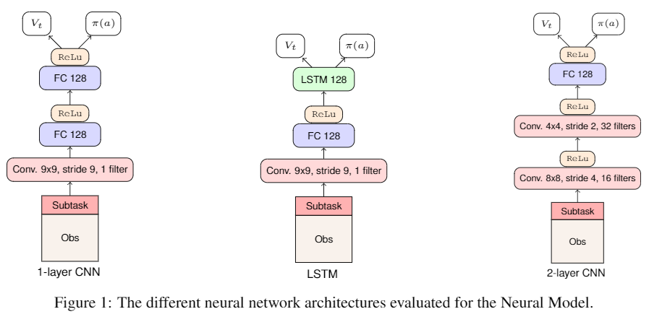
The Neural Module
Actor-Critic algorithm A2C
Key points for the ‘emergence’ of Systematic Generalisation:
Visual Invariance
Neural Network Architecture vs Number of Instructions

Slide 18
Experimental findings

Slide 19
The environment
We trained our agent on random 5x5 grid worlds surrounded by a 1-square wide wall, with training sets of |X₁| = 6, 10 or 20 different objects of resolution 9x9.
The total number of states is up to ∼1.92 e¹⁹
The extended observation adds an additional row becoming an input of 54*45

Slide 20
Architecture Matters: Training Vs Testing

Slide 21
Results: Negative & Positive Tasks

Slide 22
Results: Binary Choice Maps

Slide 23
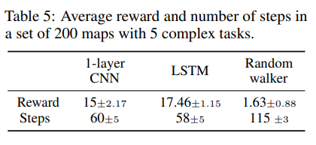
Results with the full Language

Slide 24
Conclusions
Emergence of Systematic Generalisation for Zero-Shot tasks when learning multiple operators including negation
Formal language and Symbolic AI integration facilitates the deployment of agent with easy-to-verify instructions
We have showed that the combination of neural-based and symbolic-based AI may be a fruitful marriage towards Safe and Systematically-Generalisable AI
Notes:
Empirical evidence that Systematic Generalisation can emerge for zero shot tasks even with hard operator such as negation without large numbers of training instructions

Slide 25
Questions? Systematic Generalisation through Task Temporal Logic and Deep Reinforcement Learning
https://www.doc.ic.ac.uk/~bg19/

