Slide 1
Project Group 50
Notes:
Good Morning, my name is Hsuan Te and I am the project leader of Microwatt. We are here today to present to you a framework for the management of phantom load.

Slide 2
Phantom Load
Standby Power
Internal Clocks, Remote Sensors etc.
Persistent
Small, but plentiful
Notes:
Phantom load is defined as the load that a device imposes even when it is turned off. It comes in the form of internal clocks, remote sensors and the like. It persists, even when the device is not being actively used. Although the load of one device may be small, it has become common for households to possess several of these devices, which will be covered by Jane Ng.

Slide 3
Outline
Research
Market Analysis
Cost of Phantom Load
Current Solutions
Design
Hardware
Software
Further Concepts
Notes:
In this presentation, the research team has conducted a market analysis to investigate the costs of phantom load and compared it to the current solutions available. The design team will then take you through the initial design of both the hardware and the software of the Microwatt device and I will then cover the further concepts of the device.

Slide 4
Notes:
Thank you Hsuan Te. In our research, we investigated on how viable it is to come up with a product that solves phantom load.

Slide 5
analysing phantom load
housing demographics
cost of phantom load
current commercial solutions
Notes:
First, we will look at whether there is a market to target at.
How much does phantom load costs
And finally there are products available in the market and how competent are they at solving phantom load.

Slide 6
housing demographics
99.5%
84%
94.7%
74.7%
in Singapore
Department of Statistics Singapore, Singapore in Figures, 2012
Notes:
We looked at some demographics to determine how much of the population owned a certain kind of appliance.
*pause
Singapore was picked as it is an energy-dependent nation and therefore would be significantly beneficial for them to be energy efficient. *click
about 80 percent of the people own a computer *click
almost all of them own a television *click
the same goes for washing machines *click
and nearly three quarters of the population has an air conditioner installed *click
that’s a lot of people and a lot of electronics. let’s talk about how much power they can waste. *next slide

Slide 7
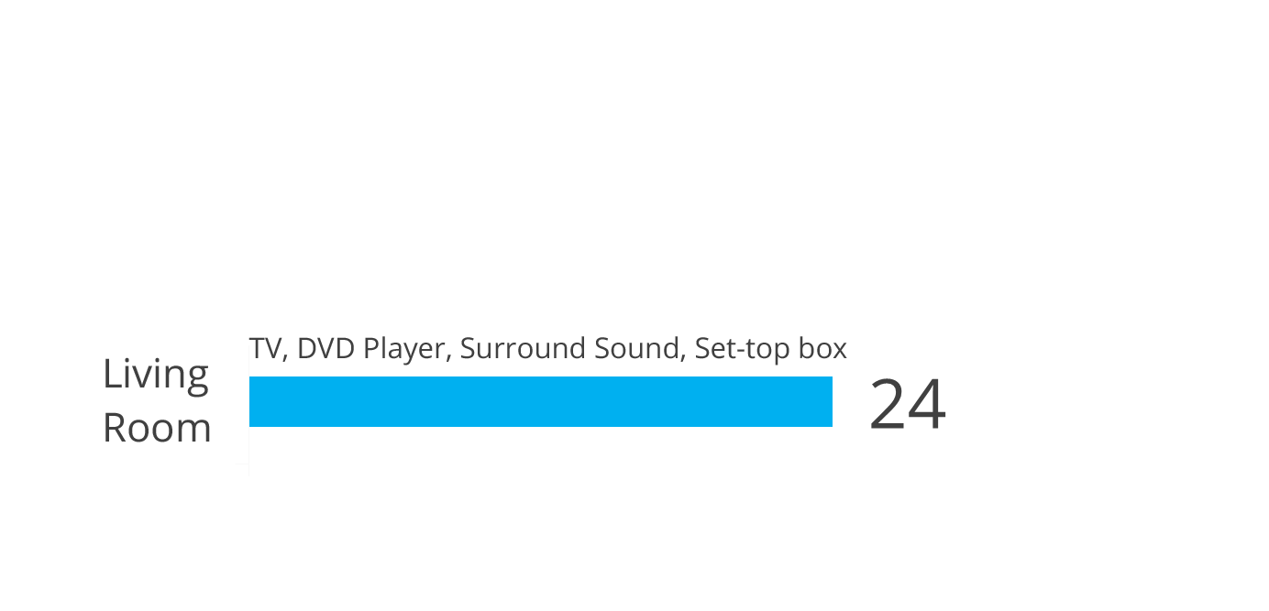
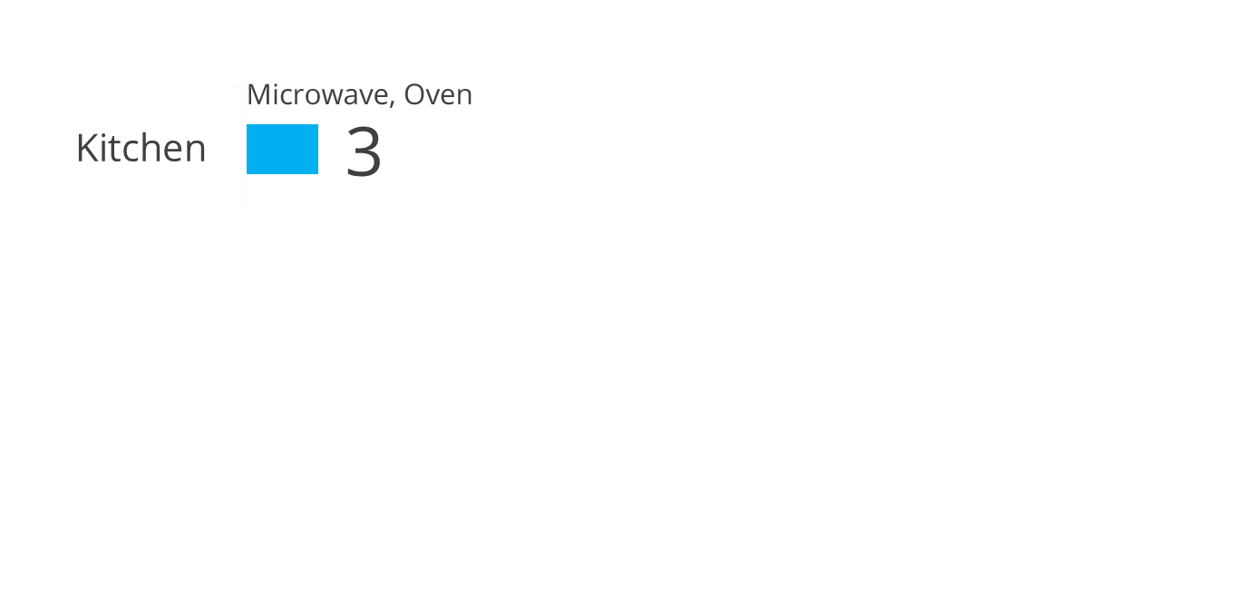
energy wastage
5
weeks
*
Total
monthly energy consumption / kWh
*IEEE, 2011, Standby Power End Users and Their Demand Management Impact on Household’s Load Shape
Notes:
so, *pause* exactly how much energy would average family waste in a month due to phantom load?
here’s what we’ve found from an IEEE research paper:
for your kitchen appliances combined, such as the oven, it comes to about 3 kWh *click
for items in your study, like a phone or laptop charger, it’s a total of about 7 *click
and by the far the worst: your tv, dvd player and sound system use more than twice the other two combined *click
this comes to a total of 34 kilowatt hours wasted each month *click
*click this is the same amount of energy that could power a light bulb for 5 weeks! *click

Slide 8
yearly cost
standby
total
(no standby)
monthly
≈
£33
£423*
~£35
______
12 months
in 1 year, you could save
enough for an entire month
*Department of Energy and Climate Change, Quarterly Energy Prices – March 2012
Notes:
how much will those precious units of energy cost you each year?
standby power will cost about £33 a year on average *click*
a year’s power bill, excluding standby power, would be about £400 *click*
divide that by 12 and you get the bill for each month *click*
when doing this research, we noticed something *click*
yearly standby power almost equals monthly power usage. *next slide*

Slide 9
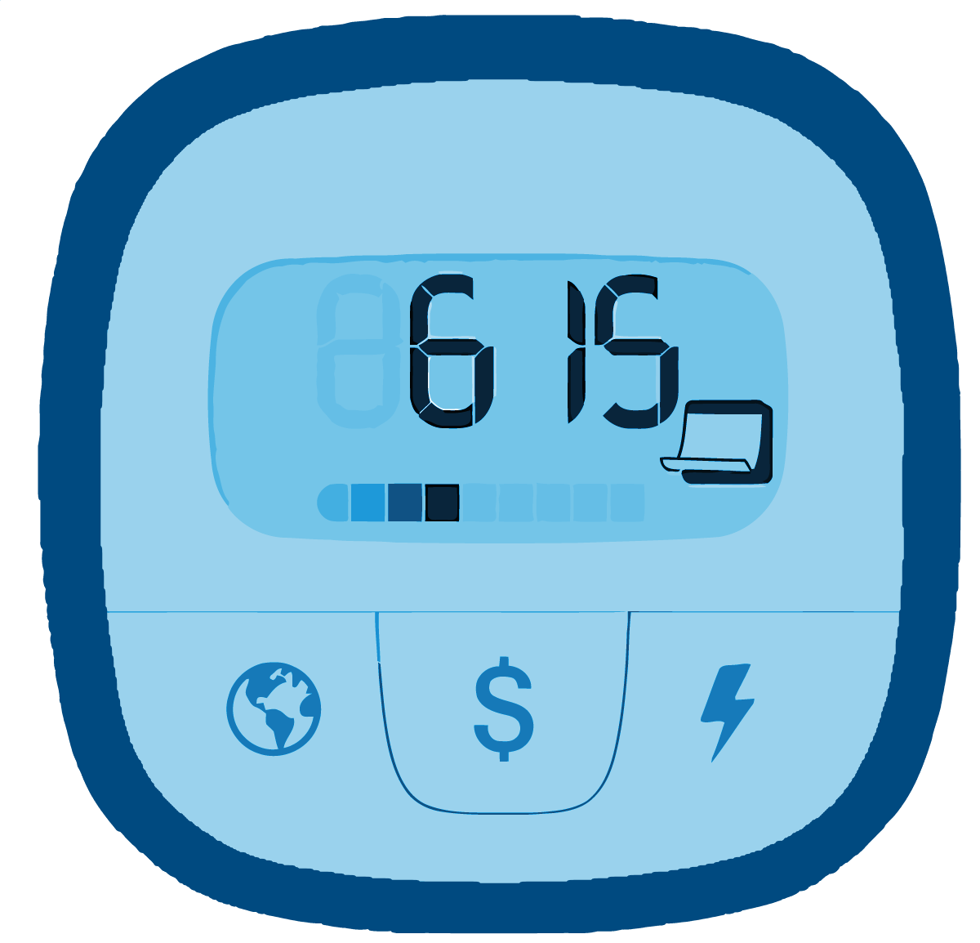
current solutions
very
high
cost
energy
efficient
devices
no
control
options
long
term
plan
power
monitoring
systems
smart
homes
incomplete solutions
Notes:
Things to change: Title for each image (energy efficient appliances, energy monitoring devices, intelligent home systems).
Fade images out
After gathering that there is a substantial market that needs to reduce phantom load and, that phantom load plays a significant role in the electricity bills, we look how we can reduce such unnecessary power wastage.
Cheapest and easiest way to solve phantom load - manually turn the main power off
Switches are often out of reach
Variety of products on the market which directly or indirectly helps the public reduce phantom load
First, we have the energy efficient appliances. This requires users to change all old appliances to energy efficient product such as energy Star products which has a limit of 1 watt standby power. This applies mainly to heavy duty appliances such as washing machines and is a long term solution which requires high investments.
Next, the energy monitoring devices displays the power consumption and its cost. It allows users to keep track of their power consumption habits. However, does not help users to switch the appliances of. It is not a direct approach to reducing phantom load.
Lastly, we have the intelligent home systems which also indirectly solves phantom load. It monitors energy usage and has scheduled on-off timing for the devies. However, it is expensive and seen as a luxurious product to own. This upsets the user’s money saving aims.
I will now pass on to Ben who will be talking about the hardware design of our product and how it can solve phantom load.
C) Intelligent Home Systems
Monitor energy usage and schedule on-off timings of devices
High-end approach, expensive
Does not target reducing phantom load
Jane

Slide 10
Notes:
Good morning. So, lets talk hardware. The backbone

Slide 11
Design Criteria
cost less than Phantom Load
measure power consumption
manage multiple devices

Slide 12
Notes:
Based on this, we have designed a solution. And we’re calling it *brief pause* micro-watt *click* *2 second pause* *next slide*

Slide 13
A Solution in 3 Parts
Wall Socket
Router
Cloud Servers
Notes:
So the wall module is powered by arduino, an open-source development platform. It has an onboard Zigbee chip to communicate wirelessly with the router as well as circuitry to measure the power consumption of the users’ device.
The router is the heart of the uWatt system and like the wall socket, it too is powered by arduino. It features a Zigbee chip to communicate with the wall sockets and WIZnet chip to communicate with the cloud.
Our cloud servers uses ubuntu server 11.10 and runs the ThingSpeak API. It communicates with the router using HTTP POST and GET

Slide 14
Over the air…
Wall, are you there?
Sends: Switch on/off
Server, are you there?
Sends: Data, Switch status
In Command
Wall is here
Reply: Data, Switch Status
Server is here
Reply: Switch on/off

Slide 15
Over the air…
Wall, are you there?
Sends: Switch on/off
Server, are you there?
Sends: Data, Switch status
Wall is here
Reply: Data, Switch Status
Server is here
Reply: Switch on/off

Slide 16
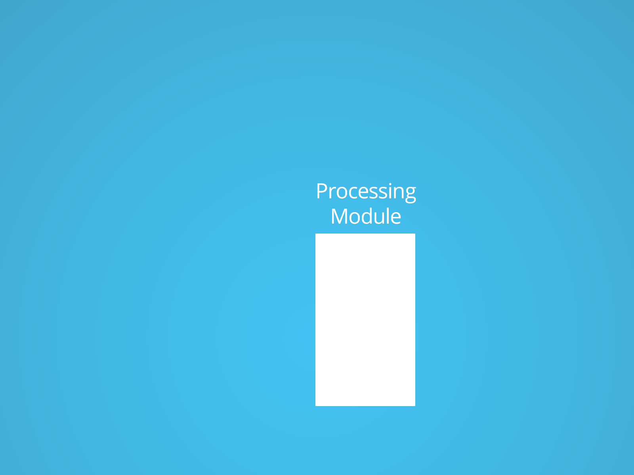
Wall Socket Schematic
Notes:
Following the open source application note from Atmel, we were able to design a power measurement circuit using passive components
The current is measured here using a Current Transducer and opamps to scale the gain and change the resolution
The voltage is measured by the biased resistor divider here
The analog signal is then fed into the AnalogDigital Converter of the Arduino Core
Using the UART connections available, the zigbee wireless chip can be attached to communicate with the router

Slide 17
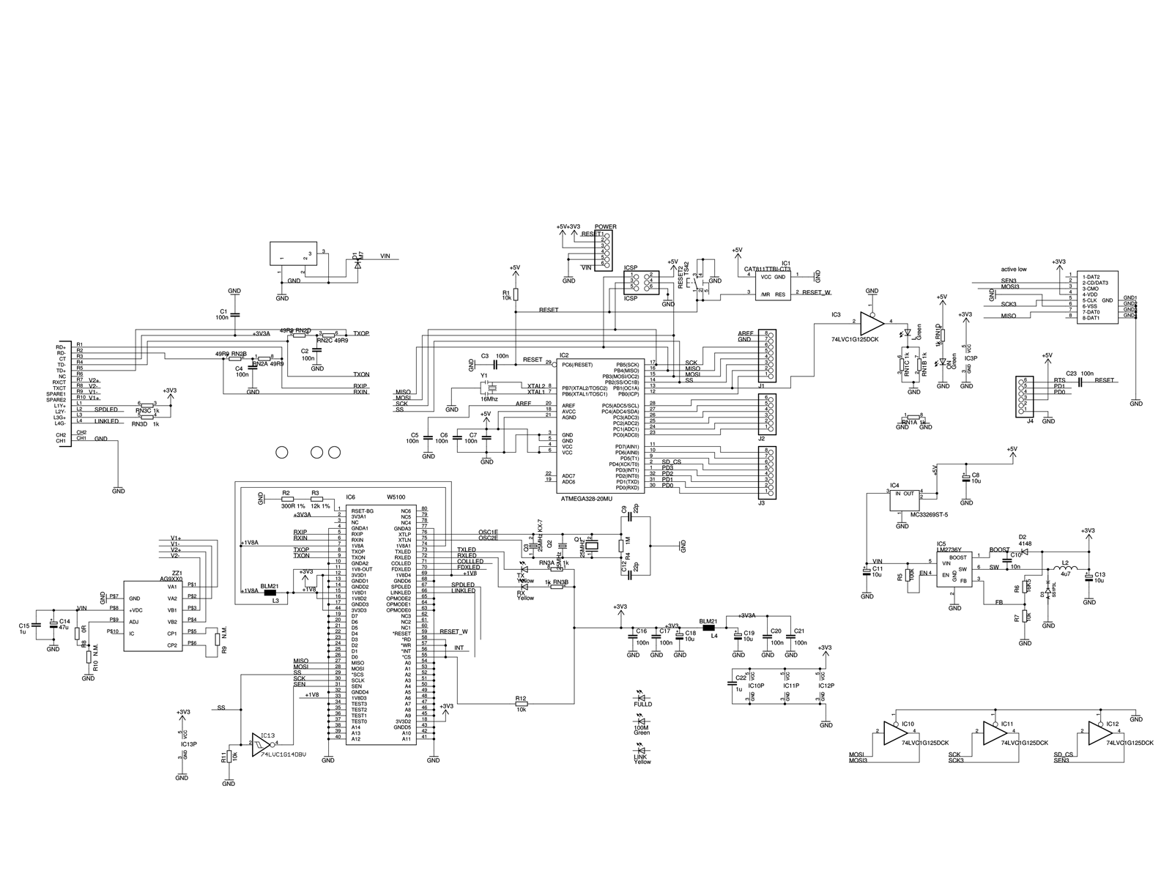
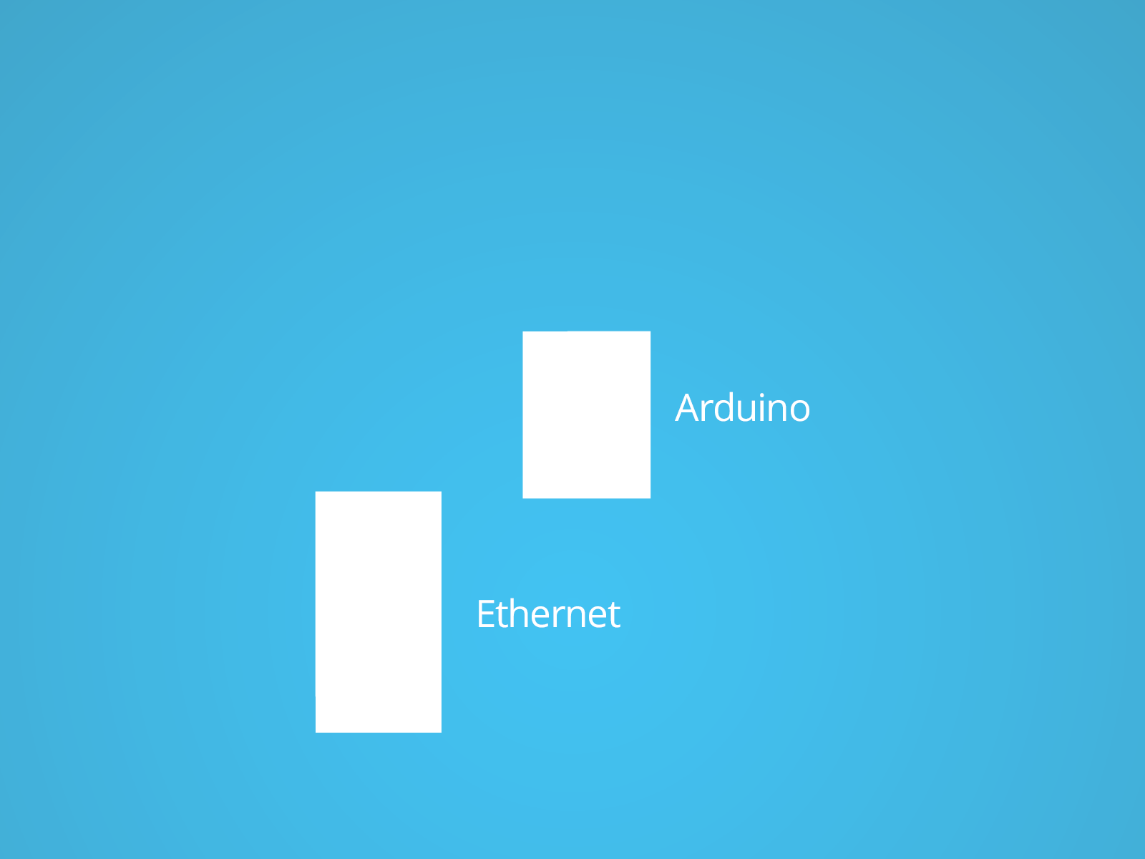
Router Schematic
Notes:
Following the Schematic of the Arduino Ethernet development board, it is possible to extract only the necessary components such as the WIZnet ethernet chip and the arduino CPU
The WIZnet 5100W have connections to connect to ethernet
And by using one of arduino’s many GPIOs, software serial can be used to connect zigbee

Slide 18
ThingSpeak Cloud Server

Slide 19
hardware cost
Wall Module
Router Module
Overhead
Total
~£15 x3
~£10
~£5
£60

Slide 20
Notes:
Let’s talk about how consumers will perceive the system as a whole, and how they will interact with it…

Slide 21
3 things
Simplicity
Flexibility
Accessibility
Notes:
Three things are key to an optimal user experience:
Simplicity
Flexibility
Accessibility
Now, I won’t bore with you describing each of these, but rather I’ll show you how these features would come into play on a day-to-day basis.

Slide 22
8:30am Leave
6:00pm Arrive
9
5
Notes:
Suppose you work 9 to 5, and you usually leave the house around 8:30 in the morning, and come back by 6. Ideally, you wouldn’t want your devices to be consuming power when you’re not around. With uWatt, you can schedule your devices to turn on or off automatically.

Slide 23
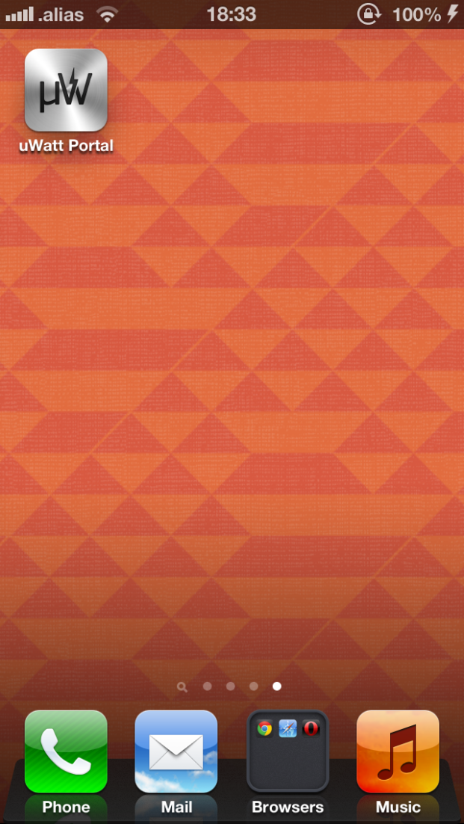
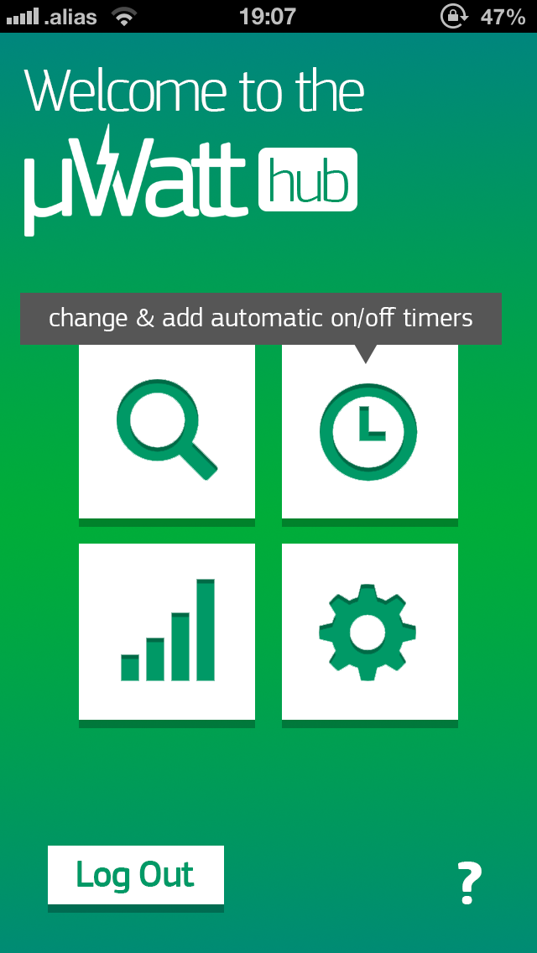
Notes:
All you have to do is simply pull out your smartphone and tap on the micro watt app icon to access your system. You’ll be connected to your network instantly and will arrive at the simple yet functional app home page.

Slide 24
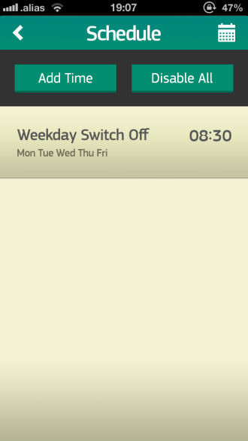
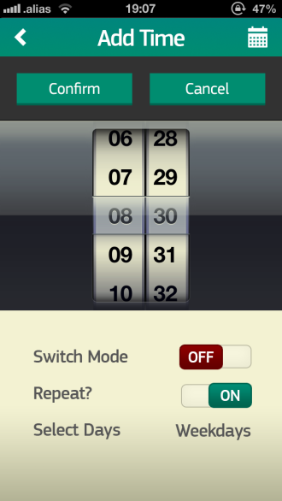
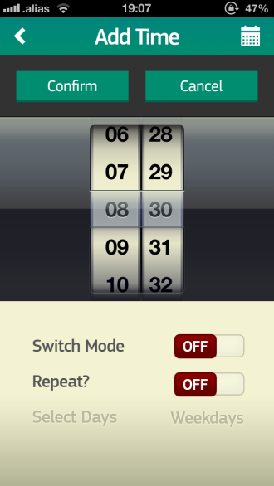
Notes:
From here you can control every aspect of the system. You can have an overview, add timers, view statistics and change more advanced settings.
We want to add a schedule, so we just tap on the clock icon and that takes us to the schedule page. Then tap on the Add Time button to make a create a new item. The time’s set to 8:30 and the mode is set to turn off the switches. We want to turn on repeat so we just tap the slider for it.
So we’ve got things set up to turn off everything Monday through Friday at 8:30am. All that’s left to do is hit confirm.
And there we have it, uWatt will take care of the rest.

Slide 25
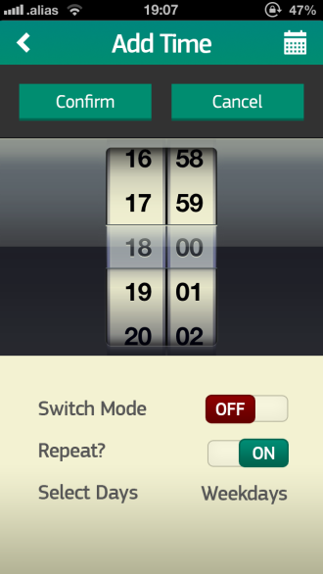
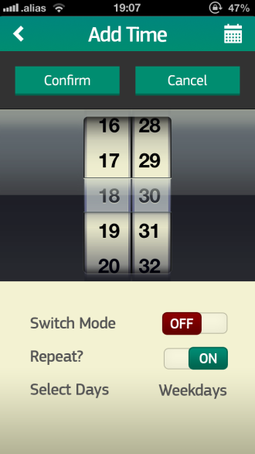
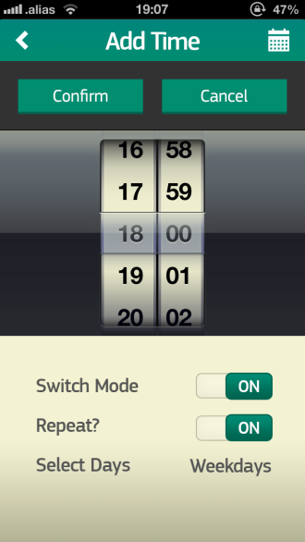
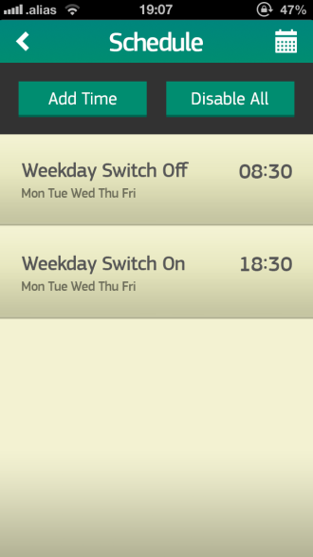
Notes:
And to add the timer to turn everything back on, we can quickly do the same.

Slide 26
Enter address
uwatt.com/login
Notes:
Let’s say you’re at work, and you want to start up your computer at home to access some files. Unfortunately, your smartphone is out of battery, and you can’t find your charger.
You can always use the universal micro watt web app.
Simply start up your favourite web browser and type youwatt.com forward-slash login and press enter.
You’ll be taken to the Overview page once you’ve logged in. Here you can see a summary of all the devices that are active or in stand-by mode, and how much you’ve saved in the week so far.
Anyway, you know you want to turn on the computer in your study. So in the list of rooms on the left, simply click on “Study”, and in the list of devices in “Standby”, click on Computer. And that’s all there is to it!

Slide 27
Notes:
So, to recap, micro watt is accessible: you can use a smartphone or any computer with an internet connection.
Micro watt is flexible: not only will it manage phantom load for you, but you can set automatic schedules
And finally as you saw, it very simple to use.

Slide 29
Concept
Eliminate Phantom Load
Step towards smart grids
Data Collection
Profile usage
Better load anticipation
Notes:
The main aim of Microwatt is to eliminate phantom load but it doesn’t stop there. By connecting all the devices into the household and enabling them to communicate through the internet, Microwatt can be a step towards smart grids in terms of data collection and profiling, which will allow better load anticipation.

Slide 30
Summary
Viable Market
Affordable
Easy to use
Notes:
To summarize, we’ve determined that there is a viable market out there that needs this device, we’ve determined that it is cheap to build and most importantly easy to use. To end off, we have prepared a video of the prototype in action.

Slide 31
?
Notes:
Q&A Slide

