Slide 1
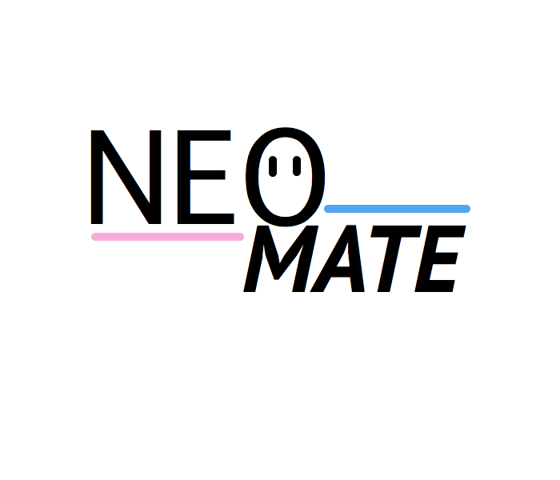
Yiu Man Fung
Benjamin Hou
Benjamin Moffatt
Vit Patkunan

Slide 2
Motivations
“A wearable system for monitoring movement of neonates”
Sensory feedback is essential in early life (spontaneous)
Connections to neural conditions such as cerebal palsy
Need a way to assess and quantify movement
Our product: NeoMate
NeoMate is a wearable system for monitoring movement of neonates
Live monitoring and logging of movement in all four limbs
Home and hospital version

Slide 3
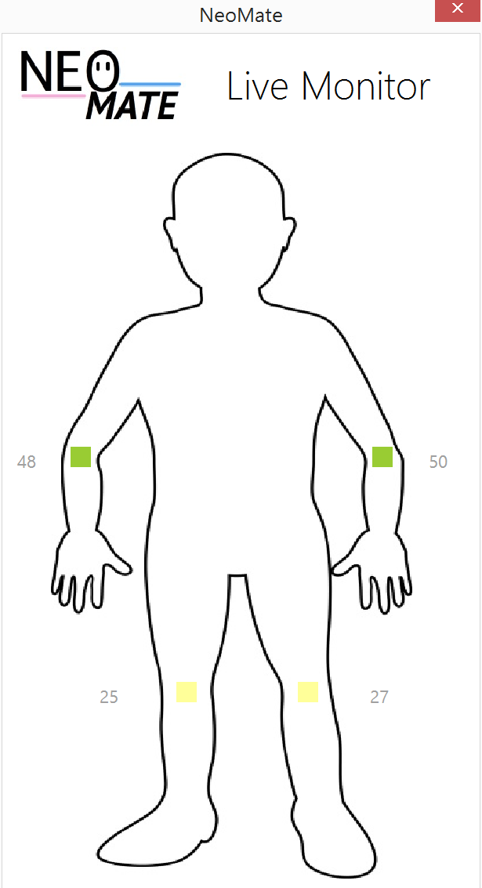
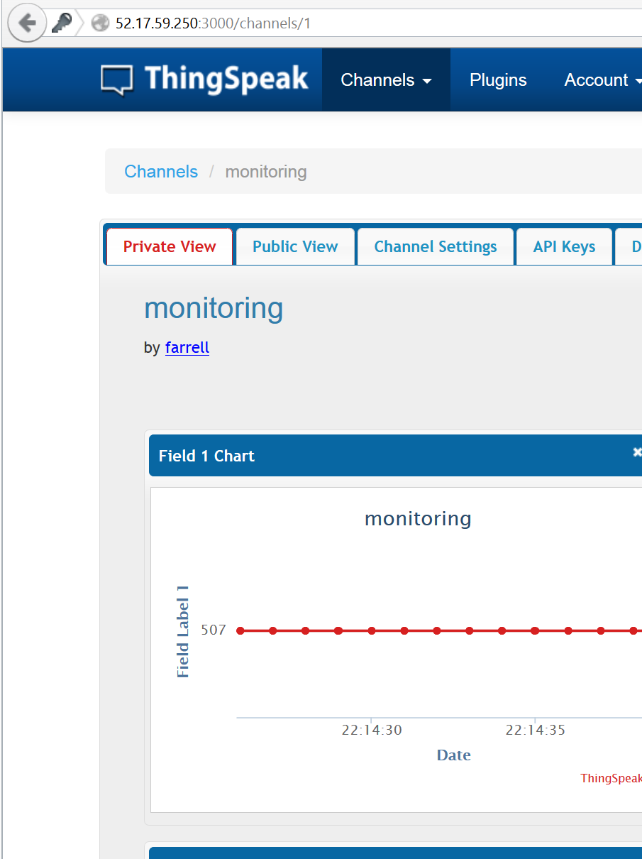
Features
Home
Hospital
Live measurement of moving limbs
Automated and
real-time data-logging
Cloud based uploading and storage
Mass monitoring of multiple NeoMates

Slide 4
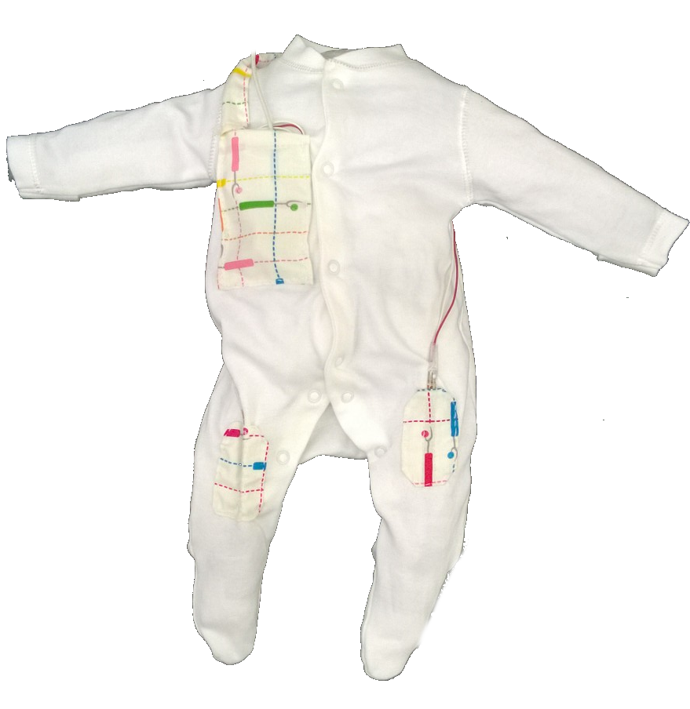
Design
4 flex sensors: one on each of the arms and legs
Sewn in pockets
Baby suit is machine washable (with electronics removed)
Chest pocket for electronics

Slide 5
Electronic design
Flex sensors act as potentiometer
Voltage data are processed by mBed
Different ways of showing the output and result
Android app for phones and tablet (real-time)
Excel with Visual Basic for data logging and graph plotting (4 hours of tracking, up to 12 hours)
Upload to cloud server for future use (Back-up)
Modular design: can be implemented for different sensors

Slide 6
Future developments
Implement more sensors, including breathing sensor
Printed circuit board
Enhanced bluetooth
Seizure alert
Accelerometer for orientation
Heartbeat monitoring

Slide 7
Questions?

