Slide 1


Iddo Tzameret IIIS, Tsinghua University Logic Conference, Tsinghua Oct. 2013
From Classical Proof Theory to P vs. NP

Slide 2
Complexity Theory
Does P = NP?
Can we find proofs as fast as we check them?
Central open problem in contemporary mathematics and science
P = PTIME: Efficiently computable problems;
Algorithms of polynomial run-time
Example:
Input: a proof in Peano Arithmetic (PA)
Output: output “yes’’ iff the proof is correct.
NP: Non-deterministic polynomial time; Problems whose solutions are efficiently verifiable
Example:
Input: a number k in unary and a statement S in the language of PA
Output: “yes” if exists a PA proof of S of ≤k number
of symbols

Slide 3
What can Proof Theory say about this problem?

Slide 4







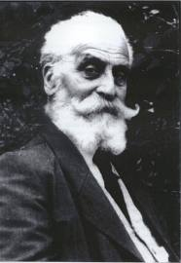


Formal Theory of Arithmetic
X(i)=1 iff i-th bit in string X is 1
Formally: range over finite sets of numbers, encoding binary string: {0,2,5} encodes string 10101
Length of string
Beginning with Peano Arithmetic
For convenience: Two-sorted theory:
1. Number sort: String sort:
2. Language:
3. Logical connectives: Quantifiers:
4. Axioms for the symbols
Example of axioms: , ,
Simplified view. Technical details missing.

Slide 5

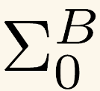
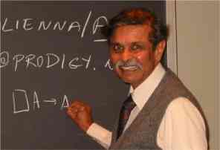
Formal Theory of Arithmetic
y≤|X|
Γ-Comprehension Axiom: for a set Γ of formulas:
for in Γ.
Determines what sets provably exist in the theory
If Γ is set of all formulas: gives us ‘too much power’!
Parikh 1971: What if we restrict Γ ?
Restriction: Γ = = set of formulas with only bounded number quantifiers (i.e., no string
quantifiers)
Example: X is a (binary) palindrome:

Slide 6
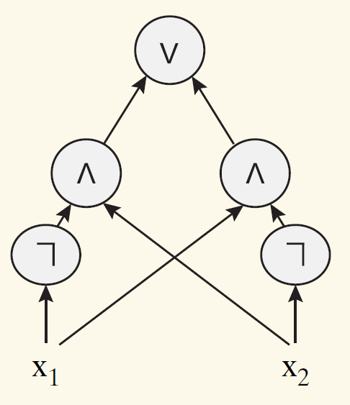
Bounded Arithmetic
So we get: PA, except that axioms assert only the existence of finite sets definable with formulas
(formulas with no string-quantifiers and with bounded number-quantifiers.)
Such formulas correspond to a (weak) complexity class: constant-depth Boolean circuits of polynomial-size (aka AC⁰). Denote this class C. And the theory T_{C}
First-order theory of arithmetic; Axioms state the existence of finite sets defined by class C. What kind of (string) functions essentially exist in our world?

Slide 7

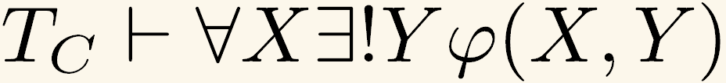

Definable Functions of T_{C}
What kind of functions our theory T_{C} can (essentially) prove to exist?
When do we say that a theory can prove the existence of a function f(X) (aka, a provably total function in the theory) ?
(There is a reason we require ; otherwise things become not interesting\useful)
Witnessing Theorem: A function is definable in T_{C} if and only if a function is in complexity class C.
For simplicity: only string inputs to function

Slide 8



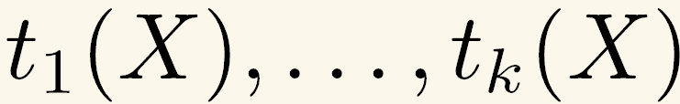
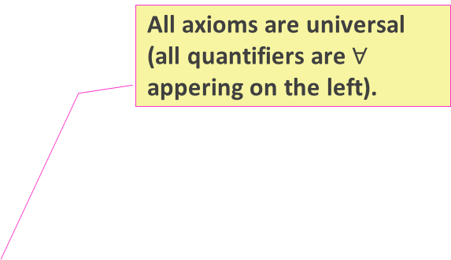
Witnessing Theorem for T_{C}
Witnessing Theorem: A function is definable in T_{C} if and only if a function is in complexity class C.
Proof: (⬅) This is not very hard.
The interesting part: (➔)
Assume is a definable function in T_{C} . We want to show it is in complexity class C.
All axioms are universal (all quantifiers are $∀$ appering on the left).
Herbrand Theorem: Let T be a universal theory and let
be a quantifier-free formula such that:
, then there are finitely many terms in the language such that:

Slide 9
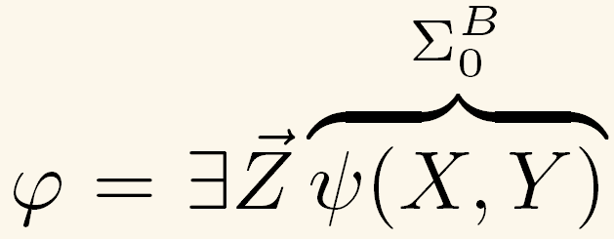
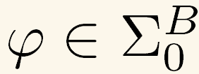

Proof of Witnessing Theorem for T_{C}
Need to show: if and
Then defines a function from C.
To apply Herbrand Theorem (and conclude Witnessing Theorem) we need:
T_{C} is universal theory
Make sure all terms in language describe functions from C;
We can assume
Herbrand Theorem: Let T be a universal theory and let
be a quantifier-free formula, such that: .
Then there are finitely many terms in the language
such that:
T_{C} is not universal. But we can add new function symbols and take out some axioms to get a universal theory that is a conservative extension of T_{C}
We add function symbols (with defining axioms) in C. And the C-closure of all functions is C itself.

Slide 10
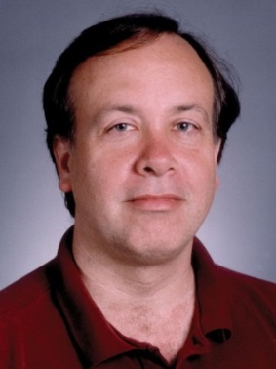
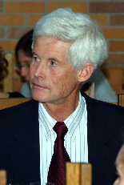
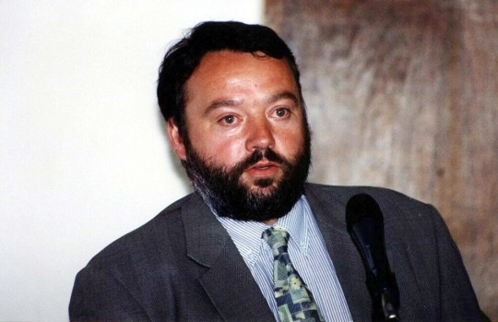

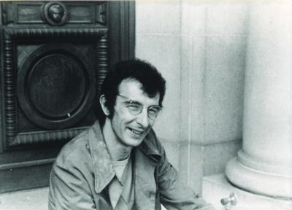
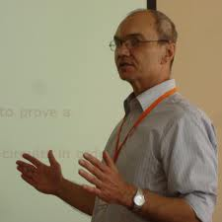
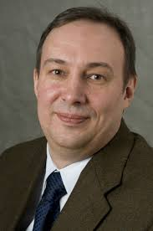
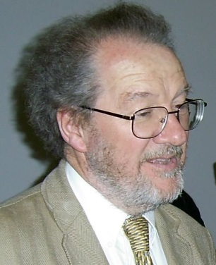
Some Credits
Bounded Arithmetic:
Parikh ’71, Cook ‘75, Paris & Wilkie ‘85, Buss ’85, Krajíček ‘90s, Pudlák ‘90s, Razborov ‘95, Cook & Ngyuen ’10 …
Krajicek
Nguyen
Paris
Buss
Cook
Pudlak
Razborov
Wilkie

Slide 11
Polynomial-Time Reasoning
Go beyond T_{C} : add axiom stating the existence of a solution to a complete problem for P:
P-Axiom: “The gates of a given monotone Boolean circuit with specified inputs can be evaluated”
Obtain the theory VP for ``polynomial time reasoning’’.
Witnessing Theorem for VP: the same as before, but now a function is definable in the VP iff it is a polynomial-time function!

Slide 12
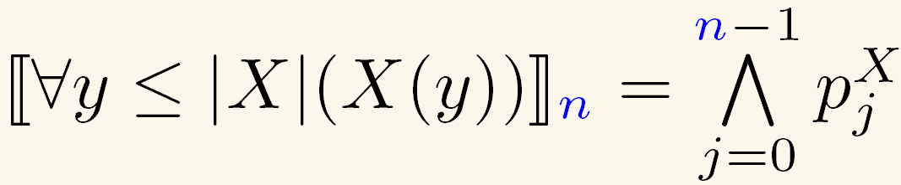
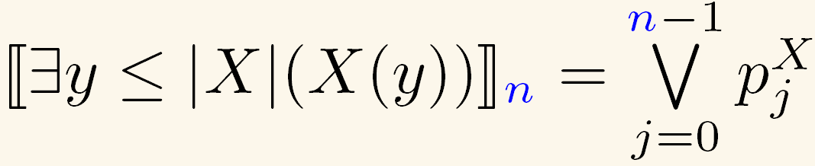
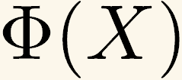



Propositional Translation
True formulas ➔ family of
propositional tautologies
formula
Let be a formula. If is true for every string length (in standard model )
Then the propositional translation of is a family of tautologies:

Slide 13
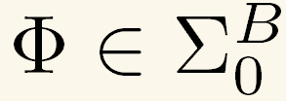


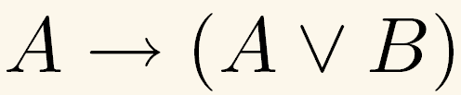
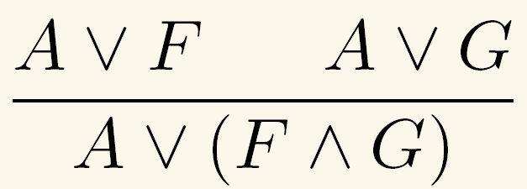
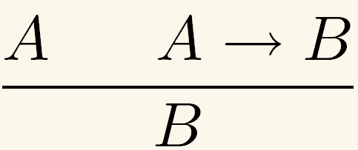
From First-Order Proofs to Propositional Proofs
Translation Theorem: If and then
has polynomial-size propositional proofs.
Propositional Proof:
(Hilbert style + extension rule = Extended Frege):
and successively apply inference rules to derive new formulas
Start from some axioms,

Slide 14






Propositional Proofs
THEOREM: If there exists a family of tautologies with no polynomial size Propositional Proofs, then:
it is consistent with the theory that
I.e., you can’t prove in polynomial-time reasoning that P=NP.
I.e., There is a model of VP where P≠NP.
Note: experience shows most contemporary complexity theory is provable in VP
Proof idea. Assume by a way of contradiction that it is inconsistent with that .
Then .
Hence, .
Then, by Translation Theorem there are polynomial-size propositional proofs of . Since the set of TAUTOLOGIES is coNP, , there are polynomial-size propositional proofs for all tautologies. Contradiction.

Slide 15
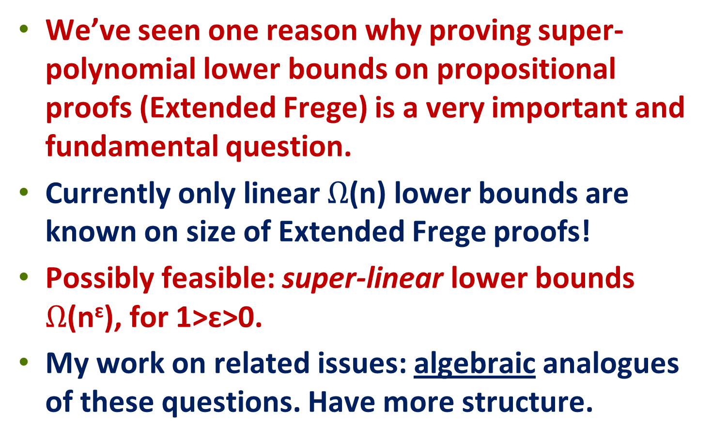
Conclusion
We’ve seen one reason why proving super-polynomial lower bounds on propositional proofs (Extended Frege) is a very important and fundamental question.
Currently only linear $Ω$(n) lower bounds are known on size of Extended Frege proofs!
Possibly feasible: super-linear lower bounds $Ω$(n^{ɛ}), for 1>ɛ>0.
My work on related issues: algebraic analogues of these questions. Have more structure.

Slide 16
Thank you !

