Slide 1
Short Refutations for Dense Random 3CNF Formulas
Sebastian Müller Iddo Tzameret Charles Univ., Prague Tsinghua Univ., Beijing
Notes:
1

Slide 2
Random 3CNF
n variables x₁,...,x_{n}
Example of 3-clause: (x₁ᴠx₂ᴠ¬x₅)
Random 3CNF: Choose independently (with repetitions) m clauses out of all possible 3-clauses.
If m>cn (for constant c>5): the 3CNF is unsatisfiable with probability 1-o(1).
We say: “a random 3CNF with m clauses is unsatisfiable with high probability”
Notes:
3

Slide 3
Our result
If m≥cn^{1.4} (for a constant c): random 3CNFs have polynomial-size propositional refutations with high probability, in which:
each proof-line is a formula of constant depth with threshold gates (TC⁰ –Frege proofs).
Notes:
3

Slide 4
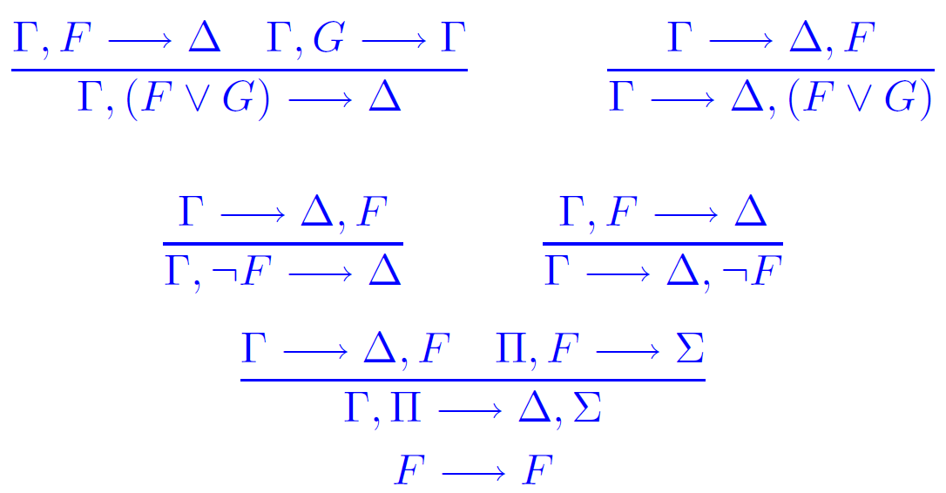
Propositional proofs
Take any standard textbook proof systems: Frege, sequent calculus, Hilbert style, Natural deduction… it doesn’t matter!
Two rules for each connective, one for each side:
Cut:
Axiom:

Slide 5
Complexity of proofs
Size of proof = number of symbols it takes to write down the proof
(= total size of all formulas in proof)
Example:
Size: 30
Every two Frege/sequent-proof systems are polynomially equivalent!
Depth of proof = maximal depth of a formula in a proof-line
¬X→¬X Y→ Y
¬X→¬X,Y Y→¬X,Y
¬XᴠY→¬X,Y
¬X,¬XᴠY→Y
Depth: 2
Notes:
7

Slide 6
Threshold logic
Unbounded fan-in formulas with threshold gates: Th_{i}(x₁,…,x_{m}), for any i,m.
Th_{i}(x₁,…,x_{m})=1 iff at least i of x_{j}’s are true.
Simple rules for introducing threshold gates.
A TC⁰-Frege proof of a family {f_{i} :i>0} of tautologies: a family of TC⁰-Frege proofs with constant bound on depth on all formulas in proofs
Notes:
Add picture of tc0 circuit

Slide 7
Hierarchy
Fundamental questions in logic/complexity: understand this hierarchy & prove separations
Frege
all proof line are formulas
TC⁰-Frege
all formulas are threshold formulas of constant depth
Resolution
all formulas are depth 0
Notes:
7

Slide 8
Random 3CNF Proof Complexity
A popular “average case” model of unsatisfiable formulas:
Random 3CNFs
With n variables and m clauses
Question: Given a proof system P, do we have short P-refutations for random 3CNFs?
Notes:
13

Slide 9
ZFC
….
….
Proof system
OUR RESULT: Polynomial-size TC⁰-Frege refutations for random 3CNF formulas with at least cn^{1.4} clauses
Frege
Polynomial-size refutations
Separates TC⁰-Frege from resolution in random 3CNF regime
TC⁰-Frege
Our result
…..
$Res(\sqrt{\log{n}/\log{\log{n}}}$)
[Razb03]
Resolution
[CS88,BSW01,
BKPS02]
Exponential lower bounds
cn
cn^{1.4}
cn^{1.5-e}
for 0<e
cn²/logn
Number of clauses
Notes:
Check references, and better bounds and their accuracy

Slide 10
How to construct short refutations?
Feige, Kim and Ofek (FOCS 2006): Random 3CNFs with cn^{1.4} clauses have polynomial-size witnesses for unsatisfiability (whp)!
This work (roughly): poly-size propositional (TC⁰-Frege) correctness-proof for these witnesses.
Notes:
33

Slide 11
Proof Overview

Slide 12
Feige-Kim-Ofek witnesses
Feige et al.: Almost surely a random 3CNF C with cn^{1.4} clauses has a witness for unsatisfiability
The FKO witness:
Witnesses for certain combinatorial properties of C that can be checked in polytime
The following is a central property….
Notes:
Draw illustration

Slide 13
Feige-Kim-Ofek witnesses
M is an nxn matrix constructed as follows:
Start: M=0
For every clause C_{r} in C and every i,j≤n:
Add ½ to M_{ij} if x_{i}, x_{j} are in C_{r} and have different signs
Add -½ to M_{ij} if x_{i}, x_{j} are in C_{r} and have same signs
Not hard to show:
#clauses satisfied as NAE by any
aЄ{-1,1}^{n} assignment is
(a^{t}Ma+3m)/4 ≤ (λn+3m)/4
Largest eigenvalue of M
(Part of) the FKO witness:
λ largest eigenvalue of M

Slide 14
Structure of argument
❶ Prove in TC⁰-Frege:
“CNF C has FKO witness → C unsatisfiable”
❷ Extract a TC⁰-Frege refutation of C from this proof
For simplicity:
❶ is done in the FO theory VTC⁰ [CN’10]:
VTC⁰ proofs translate into poly-size TC⁰-Frege proofs
Notes:
Draw illustration

Slide 15
Structure of argument
Here, C, w, C_{i} , A are sequences of propositional variables
❶ Prove in TC⁰-Frege:
“C is 3CNF and w is its FKO witness →
exists clause C_{i} in C such that C_{i}(A)=0”
Let C be random 3CNF with cn^{1.4} clauses
Whp exists FKO witness w
Plugging binary encoding of C,w into above: premise evaluates to TRUE
Notes:
Draw illustration

Slide 16
Structure of argument
Here, C, w, C_{i} , A are sequences of propositional variables
❶ Prove in TC⁰-Frege:
“ tautological sentence with no variables→
exists clause C_{i} in C such that C_{i}(A)=0”
Let C be random 3CNF with cn^{1.4} clauses
Whp exists FKO witness w
Plugging binary encoding of C,w into above: premise evaluates to TRUE
Notes:
Draw illustration

Slide 17
Structure of argument
Here, C, w, C_{i} , A are sequences of propositional variables
❶ Prove in TC⁰-Frege:
“ tautological sentence with no variables→
exists clause C_{i} in C such that C_{i}(A)=0”
Claim: Assigning binary encoding of C to consequence above yields ¬C
Notes:
Draw illustration

Slide 18
Structure of argument
Here, C, w, C_{i} , A are sequences of propositional variables
❶ Prove in TC⁰-Frege:
tautological sentence with no variables→
¬C
Claim: Assigning binary encoding of C to consequence above yields ¬C
QED
Notes:
Draw illustration

Slide 19
Bulk of work: prove the big implication in VTC⁰!
The main FO formula corresponding to (1):
Notes:
81

Slide 20
Spectral argument
We need to prove in the theory: for any aЄ{-1,1}^{n}: a^{t}Ma≤λn
The proof goes by breaking a to linear combination of M’s eigenvectors
Because the premise→conclusion form of the main formula:
when plugging-in the actual CNF with its corresponding values of M, λ, etc., the premise becomes true and disappears
Obstacles:
Proving statement of linear algebra (conjectured) beyond TC⁰-Frege
Fortunately:
Enough to state following:
Assuming λ₁,…, λ_{n}, and V, V⁻¹ are objects with the properties of eigenvalues and eigenvectors-matrix and its inverse, resp., then for any a in
{-1,1}^{n}: a^{t}Ma≤ λn
Notes:
85

Slide 21
Conclusions
Technical contribution: carry out certain spectral arguments inside weak proof systems
Conjecture: quasipolynomial depth-2-Frege works as well
All (spectral-based) refutation algorithms fits into TC⁰-Frege
Extract an algorithm?
Notes:
85

Slide 22
Thank You!

