Slide 1
Bounds on Equational Proofs
of Polynomial Identities
Pavel Hrubeš & Iddo Tzameret
Notes:
I’ll focus on the Algebraic aspect of our work; so I’ll always assume a field in the background, and polynomial identity over the field.

Slide 2
High School Problem
How to solve it by hand ?
Use the polynomial-ring axioms !
Associativity, commutativity, distributivity, 0/1-elements rules:
    f+0=f, f•1=f, f•0=0, f+g=g+f, f•g=g•f, f•(g+h)=f•g+f•h
    All number equalities: a+b=c, a•b=d (a,b,c,d in the field)
Notes:
9

Slide 3
High School Problem
Associativity, commutativity, distributivity, 0/1-elements rules:
    f+0=f, f•1=f, f•0=0, f+g=g+f, f•g=g•f, f•(g+h)=f•g+f•h
    All number equalities: a+b=c, a•b=d (a,b,c,d in the field)
Example:
Notes:
9

Slide 4
Main Question
Given an arithmetic formula Ф, what is the minimal number of such elementary operations one needs to perform in order to reach 0 ?
The problem of proving Ф=0 is equal to the problem of proving the equality of two given formulas
Notes:
9

Slide 5
The Formal Model:
Equational Proof Systems
Notes:
I think I shall only disscuss straight-line proofs. Then fragment to analytic depth-$3$ .
So it should be like this:
Into: this also shows examples of analytic proofs.
A TITLE PAGE: ----- STRAIGHT-LINE PROOFS ------
Arithmetic formulas
Rules
Application of a rule
Definition of a straight-line proof
Example of a straight-line proofs (same as before)
A TITLE PAGE: ------ ANALYTIC DEPTH 3 STRAIGHT-LINE PROOFS -------
Examples, depth-$3$ formulas, absent rule, motivation etc.
A TITLE PAGE: ------ LOWER BOUNDS ---------
The hard instance

Slide 6
Arithmetic formulas
Fix a field (say, the complex numbers)
An arithmetic formula over :

This formula computes the (formal) polynomial:
+
+
x₁
3
(x₁+x₂)•(x₂+3)=
x₁x₂+x₂²+3x₁+3x₂
x₂
x₂
Notes:
(usually we work over the complex numbers)

Slide 7
Equational Proofs
Proof-lines are equations between formulas
Axioms: polynomial-ring axioms:
Identity: f=f
zero element: f+0=0, f•0=0,
unit element: f•1=f,
Addition commutativity: f+g=g+f,
Product commutativity: f•g=g•f,
Distributivity: f•(g+h)=f•g+f•h
Number identities: a+b=c, a•b=d
(for any a,b,c,d in the field)
Notes:
9

Slide 8
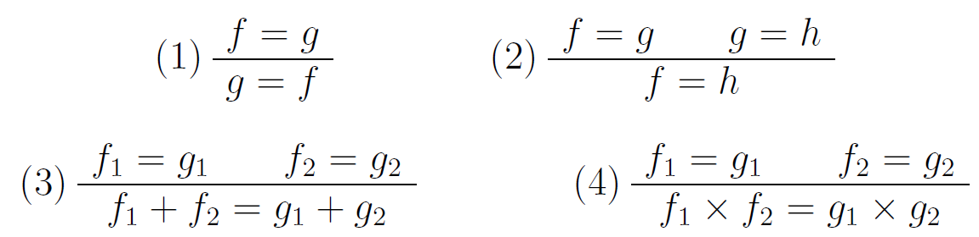
Equational Proofs
Derivation rules:
Notes:
9

Slide 9
Equational Proofs
DEF: An equational proof of t=s is a sequence of equations f₁=g₁,…,f_{m}=g_{m}, where f_{m}=g_{m} is t=s, and every equation f_{i}=g_{i} is either an axiom (of the polynomial-ring) or is derived from previous equations by one of the rules.
Notes:
9

Slide 10
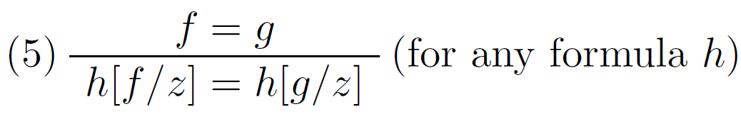
Equational Proofs
Proposition: We get a polynomially equivalent system if we replace rules (3) + (4) by:
Derivation rules:
Notes:
9

Slide 11
Motivations
Algebraic complexity:
  Polynomial Identity Testing (PIT): What kind of proofs are enough for ‘’deterministically’’ decide PIT?
Proof complexity:
  From semantic to syntactic algebraic propositional proof systems [Buss,Impagliazzo,Krajicek,Pudlak,Razborov & Sgall ‘96/7,Grigoriev & Hirsch ‘03]
Symbolic Mathematical Tools
Notes:
9

Slide 12
Overview of Our Results
Introducing several variants of equational proofs of varying strength and their relations
Upper bounds:
  Symmetric polynomials and close identities for counting
  Simulation of PIT procedures [DS06]
Lower bounds:
  Non-trivial exponential lower bounds
  Analytic depth-3 proofs
  One-way proofs (strictly ‘’analytic’’ proofs)
  Full equational proofs over rings with big computational complexity
Notes:
9

Slide 13
A Fragment:
Straight-Line Proofs
Notes:
I think I shall only disscuss straight-line proofs. Then fragment to analytic depth-$3$ .
So it should be like this:
Intro: this also shows examples of analytic proofs.
A TITLE PAGE: ----- STRAIGHT-LINE PROOFS ------
Arithmetic formulas
Rules
Application of a rule
Definition of a straight-line proof
Example of a straight-line proofs (same as before)
A TITLE PAGE: ------ ANALYTIC DEPTH 3 STRAIGHT-LINE PROOFS -------
Examples, depth-$3$ formulas, absent rule, motivation etc.
A TITLE PAGE: ------ LOWER BOUNDS ---------
The hard instance

Slide 14
Straight-Line Proofs
If we have both f→g and g→f we write f↔g
Every proof-line in a straight-line proof is an arithmetic formula
Elementary operations: f → g
(meaning that sub-formula f transforms into sub-formula g)
Application of an elementary operation f→g:
          A{f} → A{g}
A is a formula, f is a subformula in A.
Notes:
9

Slide 15
Straight-Line Proofs (dfn.)
Definition: A straight-line proof of Ф (=0) is a sequence of formulas F₁,…,F_{m}, where F₁= Ф and F_{m} is the 0 formula, and every formula F_{i} (i>1) derived from immediate previous formula by one of the following elementary operations……
Notes:
9

Slide 16
Elementary Operations
Standard polynomial-ring axioms:
Zero element: f+0↔f, f•0↔0
Unit element: f•1↔f
Addition commutativity: f+g↔g+f
Product commutativity: f•g↔g•f
Distributivity: f•(g+h)↔f•g+f•h
Number identities: a+b↔c, a•b↔d
(for all a,b,c,d in the field)
Notes:
9

Slide 17
Example (same as before)
(f•g↔g•f)
(f•1↔f)
(f•(g+h)↔f•g+f•h)
(f•1↔f)
(f•(g+h)↔f•g+f•h)
(a+b↔c)
(f•0↔0)
Notes:
9

Slide 18
Proposition: Straight-line proofs are polynomialy equivalent to tree-like equational proofs.
Notes:
9

Slide 19
A Fragment:
Analytic Proofs

Slide 20
Disallow clever tricks
Assume we don’t allow `clever/ingenoius’ tricks:
  Can’t add arbitrary f-f to A: A=A+f-f
  Adding arbitrary f-f:
    Doesn’t seem natural
    Doesn’t fit a mechanical procedure
Like Analytic (cut-free) proofs:
  Don’t allow the prover to use concepts not from the statement to be proved.
Notes:
9

Slide 21
Analytic Proofs
Analytic proofs are straight-line proofs in which we don’t allow:
0 → 0∙f
Of course, we do allow 0∙f→0
Notes:
9

Slide 22
Example (again, same as before)
(f•g↔g•f)
(f•1↔f)
(f•(g+h)↔f•g+f•h)
(f•1↔f)
(f•(g+h)↔f•g+f•h)
(a+b↔c)
(f•0→0)
Notes:
9

Slide 23
Lower Bounds
Notes:
2

Slide 24
Depth-3 Arithmetic formulas
Fix a field
Ф is a depth-3 (ΣΠΣ) arithmetic formula over :
+
x
.....
x
L_{ij}
L_{ij}
L_{ij}
L_{ij}
Where the L_{ij}’s are linear polynomials: a₁x₁+…+a_{n}x_{n}+a₀

Slide 25
Depth-3 Analytic Proofs (Def’n)
DEFINITION: Analytic straight-line proofs in which each proof line is a depth-3 formula.
+
x
.....
x
L_{ij}
L_{ij}
L_{ij}
L_{ij}
Where the L_{ij}’s are linear polynomials: a₁x₁+…+a_{n}x_{n}+a₀

Slide 26
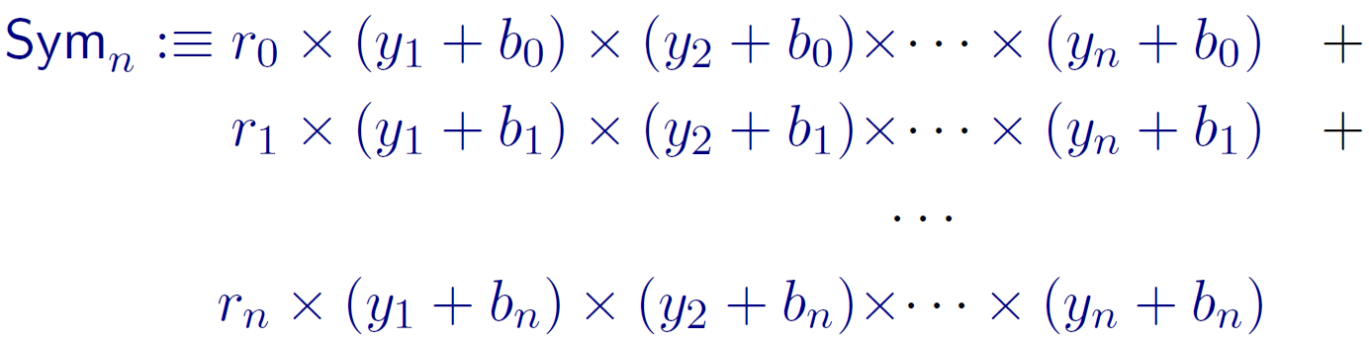
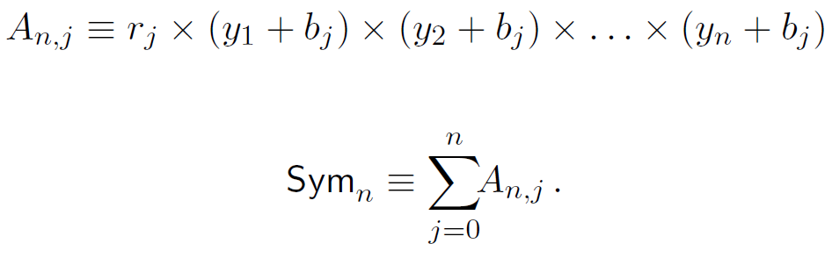
Hard Instances: first attempt
Symmetric polynomials
A_{n1}
There exist complex numbers r₀,…,r_{n} and n + 1 distinct nonzero complex numbers
b₀, …, b_{n} (each of which is different from 0,1), so that Sym_{n} computes the zero polynomial.

Slide 27
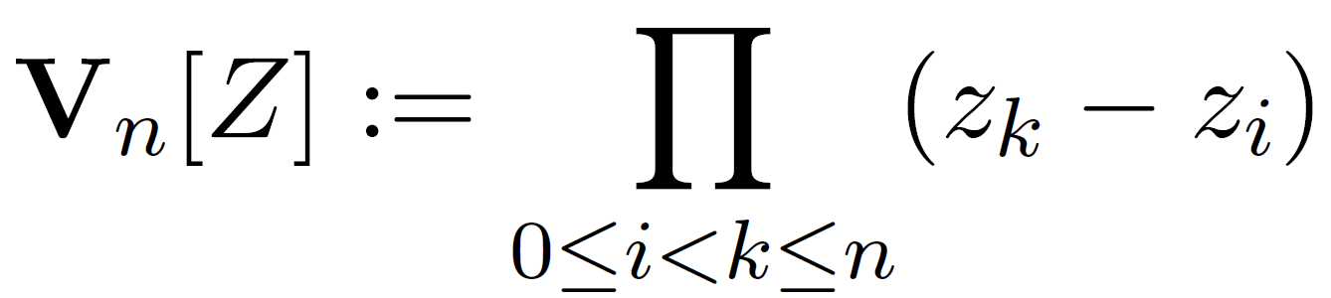
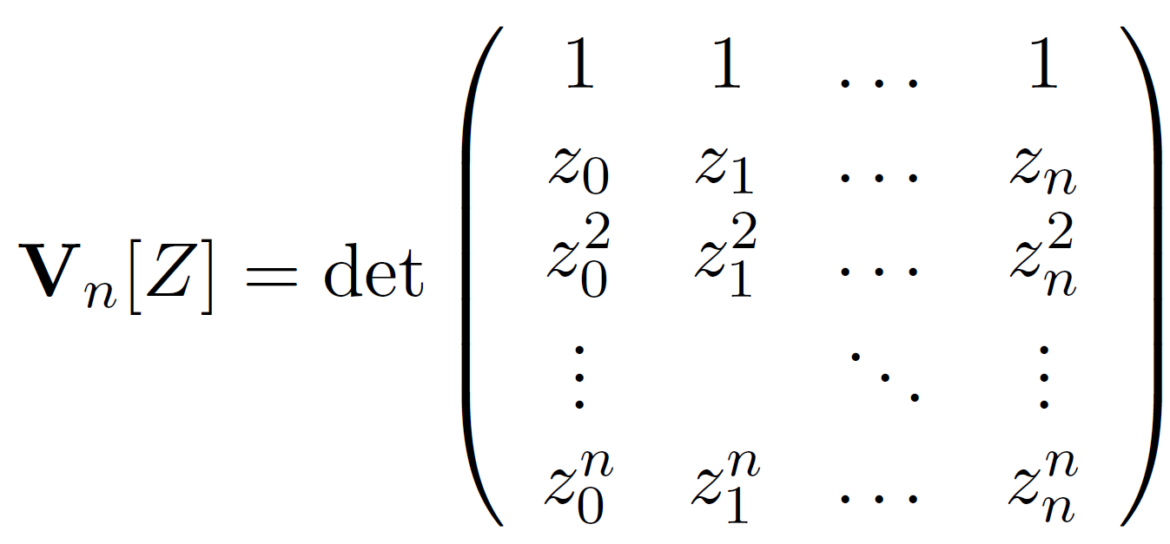
Hard Instances: second attempt
Replace constants r_{i}’s and b_{i}’s with new variables !
For Z={z₀,…,z_{n}}, define:
Vandermonde matrix

Slide 28
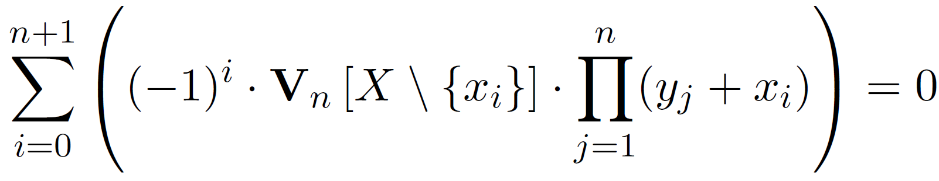
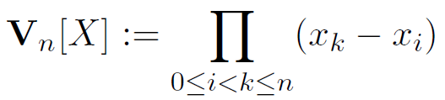
Hard Instances: second attempt
(Mys_{n}):=
(Mys_{n}) has variables X:=x₀,…,x_{n+1} and Y:=y₁,…,y_{n}

Slide 29
Our Lower Bound
Thm: Every depth-3 analytic straight-line proof of Mys_{n} has length 2^{Ω(n)}.
Technique: reduction of any depth-3 analytic proof of Mys_{n} to depth-3 Boolean formulas computing MAJORITY:
Follow the ‘paths’ of monomials along the proofs.
Use analyticity (no new monomials introduced).
Roughly, show that every Y-monomial must be written explicitly in the proof.

Slide 30
The
Lower Bound
Argument
Notes:
2

Slide 31
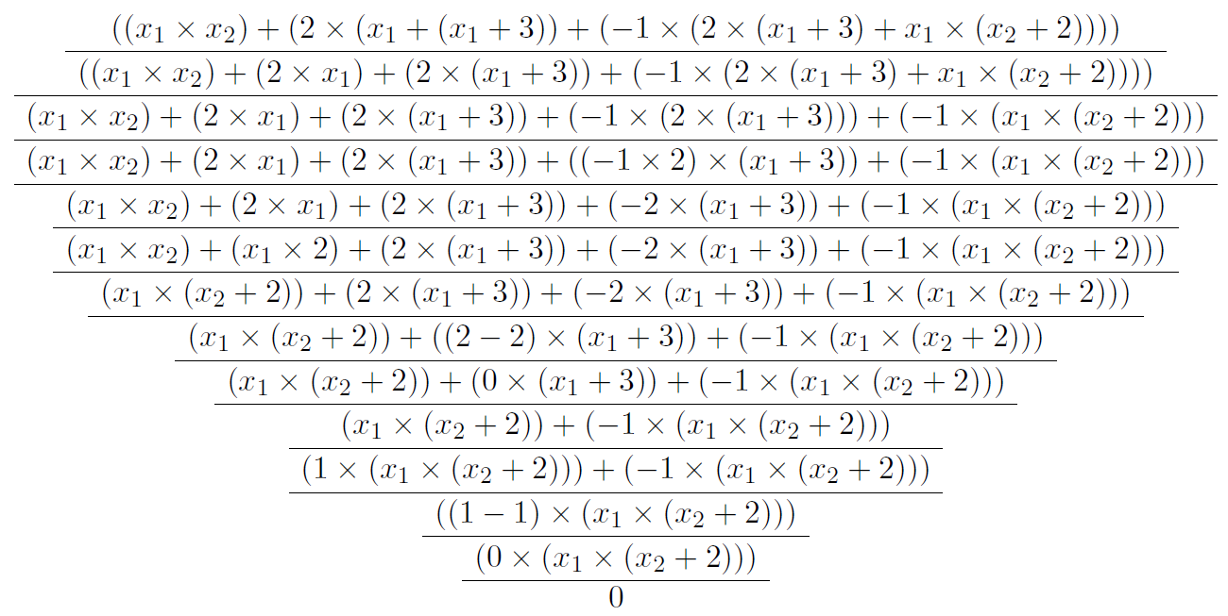
Graph of a Proof
Notes:
27

Slide 32
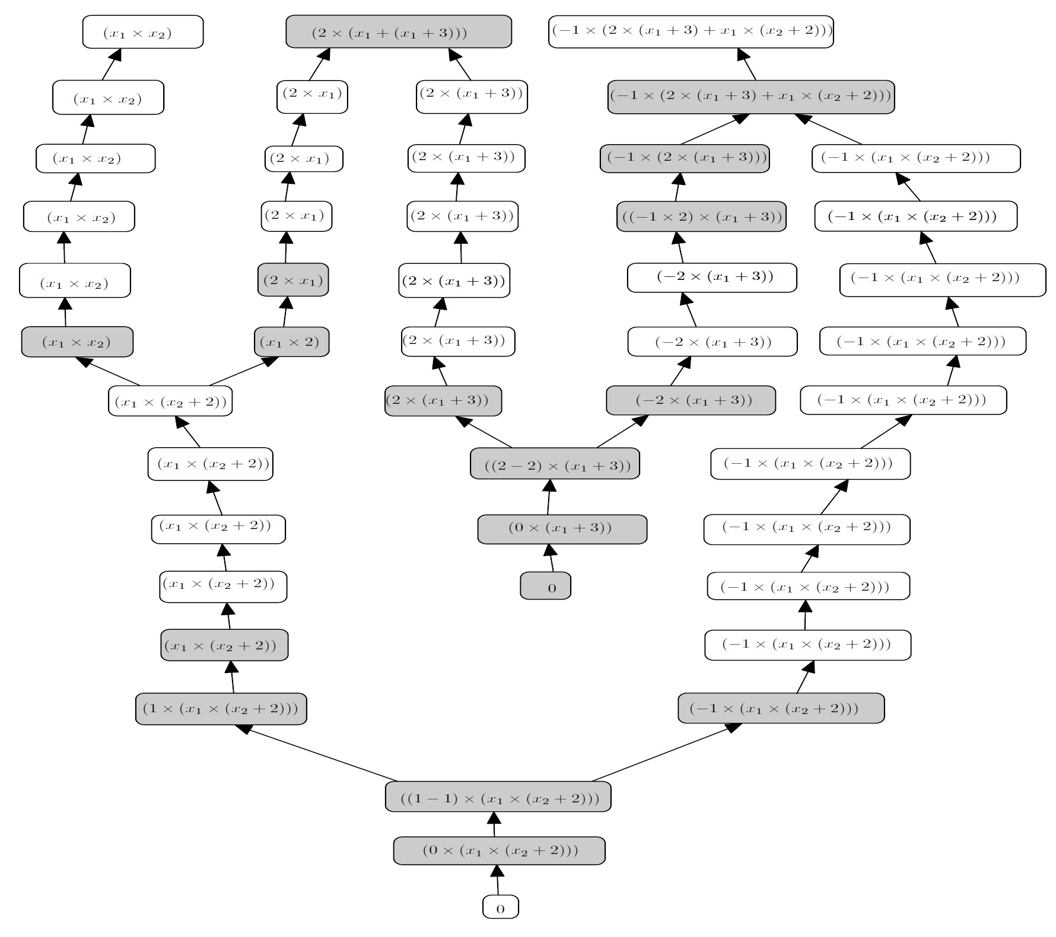
Graph of a Proof
Notes:
27

Slide 33
Recall that (Mys_{n}) looks like:
A_{i}
Denote by A_{i} the i^{th} summand in (Mys_{n}):
(Mys_{n}) = A₀ +…+A_{n+1}
Notes:
27

Slide 34
Def’n:Descendants of A_{i}’s
(Mys_{n})=
A₀ + A₁ + A₂ + ............ + A_{n+1}
Ф₂₁ + Ф₂₂ + Ф₂₃ + ............ + Ф_{2m}
Ф₃₁ + Ф₃₂ + Ф₃₃ + ............ + Ф_{3m}
Ф₄₁ + Ф₄₂ + Ф₄₃ + ............ + Ф_{4m}
Ф₅₁ + Ф₅₂ + Ф₅₃ + .......... + Ф_{5m}
Descendant of (only) A₀
........
Notes:
27

Slide 35
Cancellation Lemma
Definition: a monomial β occurs in a formula if β has a nonzero coefficient in the polynomial computed by the formula.
Lemma: Every monomial occurring in a descendant of A_{i} must be “canceled out” by a monomial in a descendant of A_{j}, for j≠i.
Proof. By soundness.
(Note that every possible Y-monomial occurs with a nonzero coefficient in every A_{i}.)
Notes:
27

Slide 36
Cancellation Lemma (illustration)
Every monomial occurring in a descendant of A_{i} must be “canceled out” by a monomial in a descendant of A_{j}, for j≠i.
Mys_{n}=
A₀ + A₁ + A₂ + ............ + A_{n+1}
0
Notes:
27

Slide 37
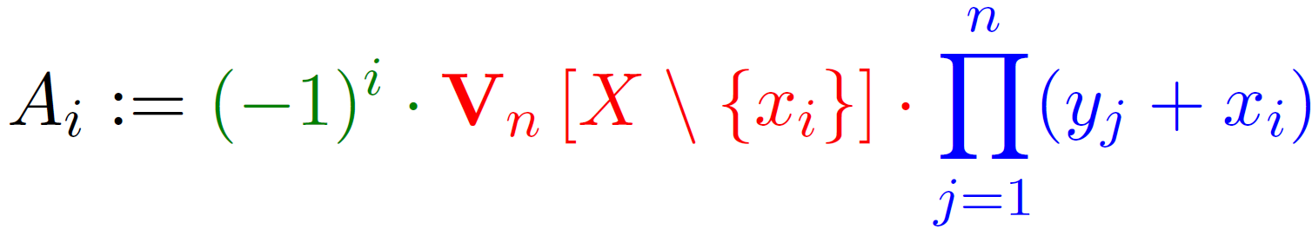
Descendant Lemma
Let m=n(n+1)/2+n (=deg(Mys_{n})).
Every degree m descendant of A_{i} looks like this:
Proof. By induction on proof-length (consider all rule applications).
Recall:
C•X•Y
C-part=Product of constant linear forms
Y-part=Contains only Y and {x_{i}} variables
X-part=Contains only X\{x_{i}} variables
Notes:
27

Slide 38
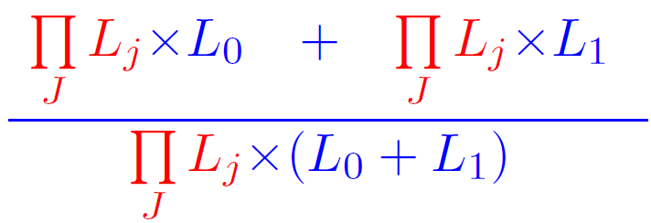
Observation
In depth-3 proofs, the only factoring allowed is the following:
Where L₀,L₁ are linear forms
(otherwise, we get a depth-4 formula).
Notes:
27

Slide 39
Corollary
If C•X•Y is a descendant of A_{i} and C’•X’•Y’ is a descendants of A_{j}, for j≠i, (both of degree m) and factoring is applied to C•X•Y
and C’•X’•Y’, then:
and Y and Y’ are similar up to one linear form (we’ll assume they’re completely similar for simplicity).
By Descendant Lemma both Y and Y’ do not contain x variables ➔ the Y-part must appear separately in the lower line !
C•X•Y and C’•X’•Y’ are similar up to one linear form
C•X•Y + C’•X’•Y’
C•X•Y
Notes:
27

Slide 40
Example
1(7-6)*x₅x₆(2x₃-x₁)(x₂-3)*(4y₁+y₂)(1+y₄)y₃ + 1(7-6)*x₅x₆(x₄+2x₀)(x₂-3)*(4y₁+y₂)(1+y₄)y₃
1(7-6)*x₅x₆(2x₃-x₁+x₄+2x₀)(x₂-3)*(4y₁+y₂)(1+y₄)y₃
Y-part appears separately
CONCLUSIONS:
1.Let β be a Y-monomial of degree n/2.
2. β has a nonzero coefficient in some A_{i}.
3.By Cancellation Lemma: β must be canceled out by descendants of other A_{j} (j≠i).
4.By Corollary: β appears separately in some ΠΣ formula in the proof:
(…+y₁+…)(…+y₂+…)….(…+y_{n/2}+…) x f
Notes:
27

Slide 41
Concluding: Reduction to MAJ_{n}
Consider all n/2-degree Y-monomials. Each must appear fully in the proof, as follows:
(…+y₁+…)(…+y₂+…)….(…+y_{n/2}+…) x f
Take the set of all these ΠΣ subformulas:
{(…+y₁+…)(…+y₂+…)….(…+y_{n/2}+…),…,(…+y₁+…)(…+y₂+…)….(…+y_{n/2}+…)}
Discard every symbol different than y variables
Transform products to ANDs and plus to ORs.
We obtain a set of CNF formulas, the disjunction of which computes MAJORITY_{n} (by multilinearity of proof-lines):
{(…Vy₁V…)Λ(…Vy₂V…)Λ…Λ(…Vy_{n/2}V…) ,…,
(…Vy₁V…)Λ(…Vy₂V…)Λ…Λ(…Vy_{n/2}V…)}
Notes:
27

Slide 42
Conclusions
Equational proofs are a natural formalism connecting proof complexity and algebraic complexity
Extension of proof system to other languages of interst in complexity theory
Upper bounds are as intersting as lower bounds
Notes:
27

Slide 43
Thank You !

