Slide 1
Are Matrix Identities Hard Instances for Strong Proof Systems?
Iddo Tzameret
Royal Holloway, and Tsinghua University
University of London
(Joint work with Fu Li)

Slide 2
Strong proof systems: Current affairs
Best lower bound: Ω(n²)
No non-trivial conditional lower bounds
No non-explicit lower bounds
No hard candidates (almost)

Slide 3
We propose
New algebraic technique to lower bound strong arithmetic or propositional proof systems (e.g. Extended Frege)
Identify new natural hard candidates

Slide 4
In a nutshell
Propose matrix identities as hard candidates for strong proof systems
Matrix identity: (non-commutative) polynomial that vanishes over matrices of a given dimension
Give some lower bounds
Formulate a natural conjecture to realize fully our approach

Slide 5
Matrix identities

Slide 6
(Commutative) polynomials
Formal sum of (commutative) monomials (order of multiplication doesn’t matters).
Example: The commutator [X,Y]:=XY-YX is the zero polynomial

Slide 7
Tautologies
Logical connectives: $∧,⊕\text{,≡}$XOR, $(AND, XOR and$ Equivalent, resp.)
True functional identities over GF(2):
1+(1+x)(x) =1+x+x²=1
Polynomial identities
Formal commutative polynomial identities
Notes:
Inaccurate: cause the field in polynomial identities can be of characteristic 0. However, this apparently does not constitute an obstacle, since we can “simulate” these fields within Extended Frege proofs.

Slide 8
Non-commutative polynomials:
Formal sum of non-commutative monomials (order of multiplication matters).
Example: The commutator XY-YX is a non-zero polynomial

Slide 9
Matrix identities
Mat_{d}(𝔽) := d⨯d matrices over field 𝔽.
Assume 𝔽 is of characteristic 0 (e.g. rationals)
A matrix identity f(x₁,…,x_{n}) of Mat_{d}(𝔽) is a non-commutative polynomial over x₁,...,x_{n} that is zero for all assignments of matrices:
for all vectors a of d⨯d matrices: f(a)=0

Slide 10
Matrix identities
Example: xy-yx is a nonzero non-commutative polynomial, but it's not an identity of Mat_{d}(𝔽) (when d>1):

Slide 11
Matrix identities
1 x 1 “matrix” identities
(commutative) polynomial identities
2 x 2 Matrix identities
Non-commutative polynomial that is always zero for 2x2 matrices
f(x₁,…,x_{n})=0, for all x₁,…,x_{n} in Mat_{d}(F)
3 x 3 Matrix identities
4 x 4 Matrix identities …
Chain
1x1 matrix identities $⊂$ 2x2 matrix identities
$⊂$ 3x3 matrix identities …

Slide 12
Bird’s eye view of Our approach

Slide 14
Extended Frege
≤_{p}
Arithmetic proofs
(Hrubes & T. ‘09,’12)
≤_{p}
Mat₂(F) proofs
≤_{p}
Mat₃(F) proofs
We identify a new hierarchy within Extended Frege (algebraic, not circuit-based hierarchy)
Conditional $Ω$(n^{2d}) lower bounds in this hierarchy
Conjecture: for encoded n x n matrix identities, Mat_{n}(F) proofs p-equivalent to arithmetic proofs.

Slide 15
Arithmetic proof systems

Slide 16
Arithmetic proofs
Establish (commutative) polynomial identities
Proof-lines: equations between algebraic circuits
Axioms: polynomial-ring axioms
Rules: Transitivity of “=“; +,x introduction, etc.
Circuit-axiom: F=G,
if F and G are identical when the circuits are unwinded into trees
Rules:
Axioms:
Notes:
15’

Slide 17
Arithmetic proofs
field identities axiom
2∙3=6
x=x
reflexivity axiom
product rule
commutativity axiom
3x∙2=2∙3x
2∙3x=6x
transitivity
3x∙2=6x
Notes:
15’

Slide 18
Arithmetic proofs
By Rekchow’s theorem: Over GF(2) (and plausibly over the integers) arithmetic proofs are also propositional proofs of the translated tautology

Slide 19
proof systems for Mat_{d}(𝔽) – Identities

Slide 20
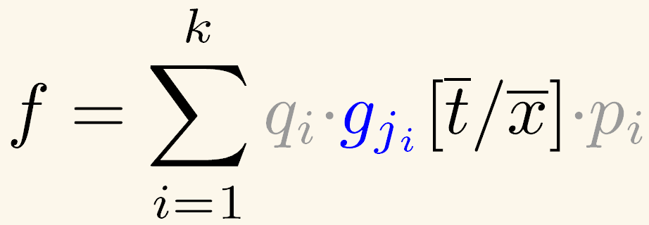
Basis of matrix identities
A finite basis B={g₁,...,g_{m}} of the identities of Mat_{d}(F) is a set of non-commutative polynomials that generate all possible identities of Mat_{d}(F) (we can also substitute variables x₁,..,x_{n} by polynomials):
Every identity f of Mat_{d}(F) can be written as:
for some polynomials q_{i}’s, t_{i}’s and p_{i}’s.

Slide 21
Arithmetic Proofs for
Mat_{d}(𝔽)
Simply replace the commutativity axiom
Axioms:
Basis of Mat_{d}(𝔽) – identities
By Kemer ’87 there is always a finite basis

Slide 22
lower bounds for Mat_{d}(𝔽)–Proofs

Slide 23
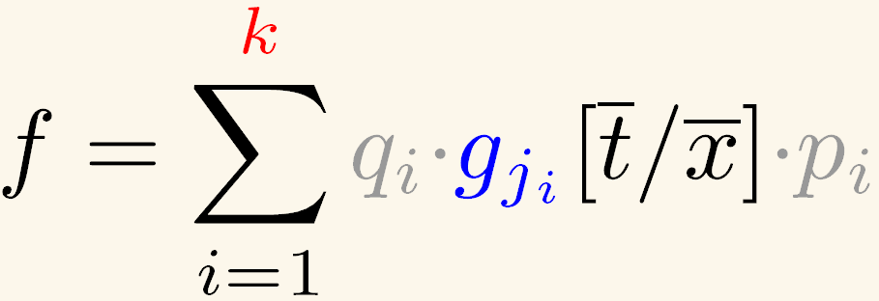
Complexity measure
Q_{B}(f)=min k such that:
I.e., how many substitution instances of generators from basis B needed to generate an identity of Mat_{d}(𝔽) ?
Basis of Mat_{d}(𝔽) B={g₁,…, g_{m}}

Slide 24
Our Lower Bound
Generalize Hrubes (‘11) for d=1
Thm [Fu and T. ‘14]: For every d>2, and every finite basis B of the identities of Mat_{d}(𝔽) , there exists a degree 2d+1 polynomial identity f with n variables, such that Q_{B}(f)=$Ω$(n^{2d}).
It’s open to find bases for Mat_{d}(𝔽) (“the Specht problem”)
Proof idea:
1. Use Amitsur-Levitzki Theorem (1950);
2. Counting argument; Extension of Hrubes (‘11)
3. Use other structural properties of Mat_{d}(𝔽) identities .

Slide 25
Corollary
Minimal number of basis generators-instances needed to generate an identity of Mat_{d}(𝔽) is a lower bound on basis’ axiom-instances in Mat_{d}(𝔽)-proofs
$\text{C}\text{orollary}\text{: } Ω$(n^{2d}) lower bound on number of lines in Mat_{d}(𝔽)-proofs.

Slide 26
Towards Arithmetic proofs lower bounds

Slide 27
Extended Frege
≤_{p}
Arithmetic proofs
(Hrubes & T. ‘09,’12)
≤_{p}
Mat₂(F) proofs
≤_{p}
Mat₃(F) proofs
Number of lines $Ω$(n^{2d}) lower bounds in this hierarchy
Conjecture: for encoded n x n matrix identities, Mat_{n}(F) proofs p-equivalent to arithmetic proofs.

Slide 28
Translating matrix identities
Matrix identity f of Mat_{d}(F) ➔ set of d² (commutative) polynomial identities over variables X.
Example:
X·Y=I
Now can use arithmetic proofs to prove the four equations !
➔
Treat X,Y as 2x2 matrices:

Slide 29
Conjecture
Conjecture: For any fixed d, and a circuit equation G=0 computing a matrix identity g=0, the minimal size of an arithmetic proof of the d² corresponding identities of G=0 is Ω(Q_{B}(g)).
In other words: proving matrix identities of Mat_{d}(𝔽) entry-wise cannot be faster than “proving” them using substitution instances of the generating sets of Mat_{d}(𝔽) .

Slide 30
Intuition: The following are equivalent for proving matrix identities:
Reason with variables X₁, . . . ,X_{n} that range over matrices;
Reason with variables that range over the entries x_{ijk} (for i,j,k ∈[n]) of the matrices X₁, . . . ,X_{n}

Slide 31
Exponential lower bounds
We can hope for even exponential lower bounds: the dimension d increases with n.

Slide 32
Conclusions

Slide 33
Extended Frege
≤_{p}
Arithmetic proofs
(Hrubes & T. ‘09,’12)
≤_{p}
Mat₂(F) proofs
≤_{p}
Mat₃(F) proofs
We identify a new hierarchy within Extended Frege (algebraic, not circuit-based hierarchy)
Conditional $Ω$(n^{2d}) lower bounds in this hierarchy
Conjecture: for encoded n x n matrix identities, Mat_{n}(F) proofs p-equivalent to arithmetic proofs.

Slide 34
Thanks for Listening! questions, Comments, suggestions, objections?

Slide 36
What’s the connection?
Observation (Hrubes ’11): The minimal arithmetic proof of f=g >= Q₁(\hat f-\hat g), where \hat f is the noncommutative poly computed by circuit f.
Proof: By induction on number of lines t in proof.
Base: t=1. f=g is an axiom.
If f=g not the commutativity axiom, say h+0=h, then \hat (h+0)-\hat h =0\in F<X>. Hence Q₁(0)=0.
Otherwise, f=g is the axiom uv=vu, for u,v circuits, and so Q₁(uv-vu)=1.

Slide 37
Complexity measure: how many substitution instances of generators are needed to generate an identity for Mat_{d}[F] ?
The case of d=1:
Let Q₁(f) be the minimal number of substitution instances of commutators [x,y] needed to generate identities of Mat₁[F].
i.e., min k such that f in I<[t₁,t’₁],…,[t_{k},t’_{k}]>, for some t’s in F<X>.
Example: Q₁(sum_{i,j\in n} xixj ) = 1
sum_{i,j\in n} xixj = (x1+…+xn)*(x1+…+xn)

Slide 38
The lower bound proof

Slide 39
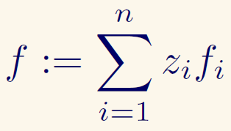
What are the hard identities f ?
We call it the s-formulas:
where
For some n fixed f_{i}’s:

Slide 40
We’ll only show that to generate n f_{i}’s: f₁,…,f_{n} by s_{2d} polynomials we need $Ω$(n^{2d}) many generators:
Q(f₁,…,f_{n})= $Ω$(n^{2d})
(To combine them into
we need more work.)

Slide 41
By counting
(total # of n-tuples of f1,…,fn) vs.
(total # of n-tuples f1,…,fn we can generate with q s_{2d} generators)
(We show that q=$Ω$(n^{2d}).)
Lemma: For any d and polynomials p₁,…,p_{n}:

Slide 42
Thus we can assume w.l.o.g. that the substitutions in the generators’ variables are linear forms:

Slide 43
Recall:
So, total # of possible n-tuples of f_{i}’s:
(for each i=1,..n choose which of the
c_{j}’s in f_{i} are 1).

Slide 44
total # of n-tuples f₁,…,f_{n} we can generate with q s_{2d}-generators:
choose 2d x q linear forms x choose q field elements for coefficients of linear combination:
We get:
implying:
Q.E.D.
Assume field is finite. The other case can also be handled.

Slide 45
Lemma
Lemma: For any d and polynomials p₁,…,p_{n}:
deg > d monomials in p_{i} not counted in LHS
Property of s_{2d}(x₁,..,x_{2d}): assigning a constant to a variable makes it 0.
Thus:
Degree 0 monomial in p_{i} doesn’t contribute to LHS;
Degree >1 monomial in p_{i} can contibute to LHS only if it multiplies a constant in some p_{j}, j≠j. Hence, we get 0 again.

Slide 46
The algebraic problem
Let F<X> be the ring of noncommutative polynomials over variables x₁,x₂,…
i.e., every polynomial is a formal sum of noncommutative monomials with coefficients from the field F.
E.g., the commutator [x₁,x₂]:= x₁x₂ – x₂x₁ is not the zero polynomial.

Slide 47
The algebraic problem
Let A be a (not necessarily commutative, but associative) F -algebra.
E.g.: the dxd matrix algebra Mat_{d}( ).
An identity of A is a noncommutative polynomial f(x₁,..,x_{n}) in F<X>,, where for all vectors a from A^{n}, f(a)=0.
E.g.: x₁x₂ – x₂x₁ is an identity of
Mat₁( F ) (but not of Mat_{d}( ) if d>1)

Slide 48
Consider the set of identities over Mat_{d}[F].
Kemer ‘87: Identities of Mat_{d}[F] can be generated (in the two-sided ideal) by substitution instances of a finite set G of polynomials g₁…g_{c} in F<X
I.e., every identity f in F<X> over Mat_{d}(F) can be written as:
for some polynomials Q_{i}’s, t_{i}’s and P_{i}’s in F<X .

Slide 49
Example for d=1 case (Mat₁[F]):
All identities of Mat₁[F] can be generated by substitution instances of a single polynomial:
the commutator [x,y]=xy-yx :
f is an identity of Mat₁[F] iff
f in <[x_i,x_j]: i neq j in N
(all ideals are two sided ideals).

Slide 50
Complexity measure: how many substitution instances of generators are needed to generate an identity for Mat_{d}[F] ?
The case of d=1:
Let Q₁(f) be the minimal number of substitution instances of commutators [x,y] needed to generate identities of Mat₁[F].
i.e., min k such that f in I<[t₁,t’₁],…,[t_{k},t’_{k}] , for some t_{i}’s in F<X>.
Example: Q₁(x₁x₃-x₃x₁+x₂x₃-x₃x₂)=?
=1 since: (x₁+x₂)x₃-x₃(x₁+x₂)=x₁x₃-x₃x₁+x₂x₃-x₃x₂

Slide 51
Upper bound on Q₁(f): O(n²).
We have a matching non-explicit lower bound:
Thm (Hrubeš 2011): There exists a (non-explicit) polynomial identity of Mat₁[F], f in F<X>, where Q₁(f)=$Ω$(n²).
Proof follows by a counting argument and some algebraic properties of the commutators.

Slide 52
The case of Mat_{d}[F] for d>1
For d>1, what are the identities of Mat_{d}[F] ?
not all cases are known precisely; dates back to Amitzur and Levitski 1950.
Some cases are known, some are only conjectured.

Slide 53
Mat_{d}[F] for d=2
Thm (Drenski 1981): For char(F)=0, all identities of Mat₂(F) are generated by
s₄ formulas and the hall formulas
where
and h(x₁,x₂):=[[x₁,x₂]²,x₁]
Note: assume from now that char(F)=0.
Every identity f in F<X> over Mat₂(F) can be written as:
For some polynomials Q_{i}’s, P_{i}’s and sequences of polynomials g^{i}’s in F<X>.

Slide 54
Mat₂[F]
Define Q_{Mat2[F]}(f) as the min number of substitution instances needed to generate an identity in Mat₂[F].
Upper bound on Q_{Mat2}(f) ?
It must be O(n⁴): every identity f with n variables can be generated by all s_{2d}(x_{i1},x_{i2},x_{i3},x_{i4}), for all $\left({n \atop 4}\right)$ choices x vars, and the hall identities h(x_{i1},x_{i2}), for all $\left({n \atop 2}\right)$variables.
We prove a corresponding lower bound:
Thm: There exists (non-explicit) f such that f is identity of Mat₂(F) and Q_{Mat2}(f)=Ω(n⁴).
We generalize this to any degree d….

Slide 55
Generalization
Leron (1973): All multilinear polynomial identities of degree 2d+1 of Mat_{d}(F) are generated by the s_{2d} identities.
for some polynomials g_{i}’s.
We show:
Thm: For any d, there exists a degree 2d+1 (non-explicit) polynomial identity f of Mat_{d}(F) with n variables, such that Q_{s2d}(f)=$Ω$(n^{2d}).

Slide 56
Conjecture
So the conjecture boils down to:
let f,g be two circuits where = be a true identity of Mat_{d}[F].
Size s arithmetic proofs of ${⟦f=g⟧}_{d}$ →
size s P_{Matd} proof of f=g

Slide 57
Translating matrix identities
Any identity of Mat_{d}[F] corresponds to a set of d² commutative polynomial identities.
Example: If AB-1 is an “identity” in Mat₂[F], then it corresponds to the 4 identities ${⟦AB−1⟧}_{2}$ induced by:
$\left(\begin{matrix}A_{11} & A_{12} \\ A_{21} & A_{22}\end{matrix}\right)$ $\left(\begin{matrix}B_{11} & B_{12} \\ B_{21} & B_{22}\end{matrix}\right)$ - $\left(\begin{matrix}1 & 0 \\ 0 & 1\end{matrix}\right)$
i.e., A₁₁B₁₁+A₁₂B₂₁-1 = 0 ….
Conjecture: The minimal size of an arithmetic proof of ${⟦f⟧}_{d}$is at least $Q_{B}(f)$.

