Slide 1
A New Characterisation of Propositional Proofs Iddo Tzameret Royal Holloway, University of London Joint work with Fu Li (Tsinghua) and Zhengyu Wang (Harvard)

Slide 2
Sketch

Slide 3
Sketch: a major open problem in proof complexity stems from seemingly weak results
Cannot quickly compute in parallel some non-commutative functions
(quite weak assumption)
Cannot have short propositional-calculus proofs for some tautologies
3

Slide 4
Part I: Propositional Proofs & Complexity

Slide 5
Logic Design, Circuit Verification
(x₁v¬x₂vx₃)Λ(x₄vx₂vx₃)Λ(¬x₁vx₄)Λ(¬x₃)Λ(¬x₄)
encode
ϕ propositional formula
SAT-solver
What if ϕ is
unsatisfiable?
What is the proof in this case?
“satisfiable” / ”unsatisfiable”
A satisfying assignment to ϕ
(the proof of satisfiability of ϕ)
Notes:
3

Slide 6
Prove a formula ϕ is unsatisfiable: write the truth table
We’ll talk about more compact proofs!
“Proof of un-satisfiability”
= “refutation”
= “proof of always-satisfiability”
= Tautology
Notes:
3.40

Slide 7
The Fundamental Questions
Is there a way to prove every unsatisfiable formula with a short proof?
If yes: NP=coNP
If not: NP≠coNP
NP
coNP
P
Unsatisfiable
formulas
Notes:
5❷ Is there a fast algorithm that finds short proofs for unsatisfiable formulas?

Slide 8
Propositional Proofs
Propositional-calculus: any standard textbook proof system for propositional tautologies
Start from axioms and derive, using derivation rules, new tautologies, all written as Boolean formulas

Slide 9
Example: propositional proof
Aᴠ¬A
axiom
Bᴠ¬B
(Aᴠ¬A)ᴠB
F
FᴠX
(Bᴠ¬B)ᴠA
(AᴠB)ᴠ¬A
Associativity, commutativity
(AᴠB)ᴠ¬B
FᴠX FᴠY
Fᴠ(XΛY)
(AᴠB)ᴠ(¬A Λ¬B)
FᴠX FᴠY
Fᴠ(XΛY)
((AᴠB) ᴠ (¬A Λ¬B))Λ((Bᴠ¬B)ᴠA)
Notes:
4’

Slide 10
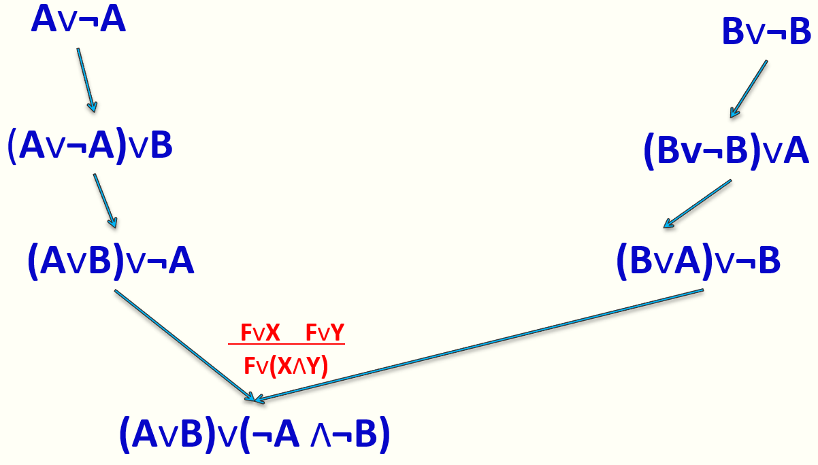
Propositional Proofs
Size of proof = number of symbols it takes to write down the proof (= total number of logical gates + variables in proof)
Example: size = 41
10
Notes:
7

Slide 11

Can we prove super-polynomial size lower bounds on propositional proofs?
The resounding answer:
“No, we can't!” (at least for now)
Major open question: prove that there is a family { f₁, f₂, f₃, …} of tautologies such that for no polynomial p(∙), the minimal propositional-calculus proof size of f_{n} is at most p(|f_{n}|)

Slide 12
Motivations
SAT-solvers: based on proof-search algorithms (limits on SAT-solving algorithms)
Fundamental hardness question (from 70’s)
Progress towards NP≠coNP
Deeper meta-mathematical reasons: not that far from P≠NP (proving super-polynomial lower bounds on strong proof systems implies P≠NP with respect to “polynomial-time reasoning”)
12
Notes:
9’
Motivations: understand the circuit based Frege hierarchy; separations, possible separations, understand better analogy with circuit complexity, if any.
--Note: the rules have to be slightly accommodated when speaking about circuits and not formulas: the similarity rule

Slide 13
Part II: Non-Commutative Computation

Slide 14
Fix a field 𝔽 (e.g., ℚ).
Non-commutative functions: e.g. compute a function of matrices over 𝔽 in parallel and in time O(log n) (n is number of matrices):
f (X,Y):=X•Y – 2Y•X
This is a non-commutative formula (tree)
Size = number of nodes
output
+
Depth can be assumed
O(log n), for n number of variables
(By our variant of Hrubes & Wigderson’14)
˟
˟
-2
˟
X
Y
Y
X
Notes:
1. Parallel computation

Slide 15
Non-Commutative Formulas: a Weak Model
Nisan ‘91: determinant and
permanent require
non-commutative formulas
of 2^{Ω(n)} size
Proof: size of a non-commutative
formula computing f ≥ sum of ranks
of matrices associated with f .
output
+
˟
˟
-2
˟
X
Y
Y
X
Notes:
1. Parallel computation

Slide 16
Part III: Our Results

Slide 17
Main Result: demonstrate a natural map between tautological formulas 𝑇 to non-commutative polynomials 𝑝, such that:
And conversely, when T is a DNF:
𝑇 has a polynomial-size propositional proof
𝑝 has a polynomial-size non-commutative formula
𝑇 has a quasi-polynomial size propositional proof (n^{O(log n)})
𝑝 has a polynomial-size non-commutative formula (over GF(2))
17
Notes:
9’
Motivations: understand the circuit based Frege hierarchy; separations, possible separations, understand better analogy with circuit complexity, if any.
--Note: the rules have to be slightly accommodated when speaking about circuits and not formulas: the similarity rule

Slide 18
Significance
Renewed hope to prove strong lower bounds on propositional proofs
Proof vs. computation correspondence: not as simple as perceived
No known barriers to strong lower bounds in proof complexity (contrasts Grochow & Pitassi [FOCS’14])
𝑇 has no polynomial-size propositional proof
𝑝 has no polynomial-size non-commutative formula
18
Notes:
9’
Motivations: understand the circuit based Frege hierarchy; separations, possible separations, understand better analogy with circuit complexity, if any.
--Note: the rules have to be slightly accommodated when speaking about circuits and not formulas: the similarity rule

Slide 19
The Argument: characterising a proof as a single non-commutative formula
19
Notes:
9’
Motivations: understand the circuit based Frege hierarchy; separations, possible separations, understand better analogy with circuit complexity, if any.
--Note: the rules have to be slightly accommodated when speaking about circuits and not formulas: the similarity rule

Slide 20



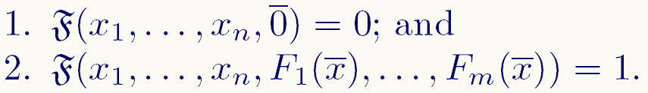
Map between tautologies T and non-commutative polynomials p: Write CNF’s x₁ ⋁ ¬ x₂ , ¬ x₂ ⋁ x₁ , x₂ (1) as non-commutative polynomials equations: (1-x₁) x₂ = 0 , x₂ (1-x₁) = 0 , 1-x₂ = 0 (2) So (1) is satisfied by a given 0-1 assignment iff (2) is.
Non-commutative Ideal Proof System (IPS):
Let be a system of unsatisfiable non-commutative polynomial equations and assume the following are part of the F_{i}’s:
A non-commutative IPS refutation of the F_{i}’s is a non-commutative polynomial such that:
20

Slide 21
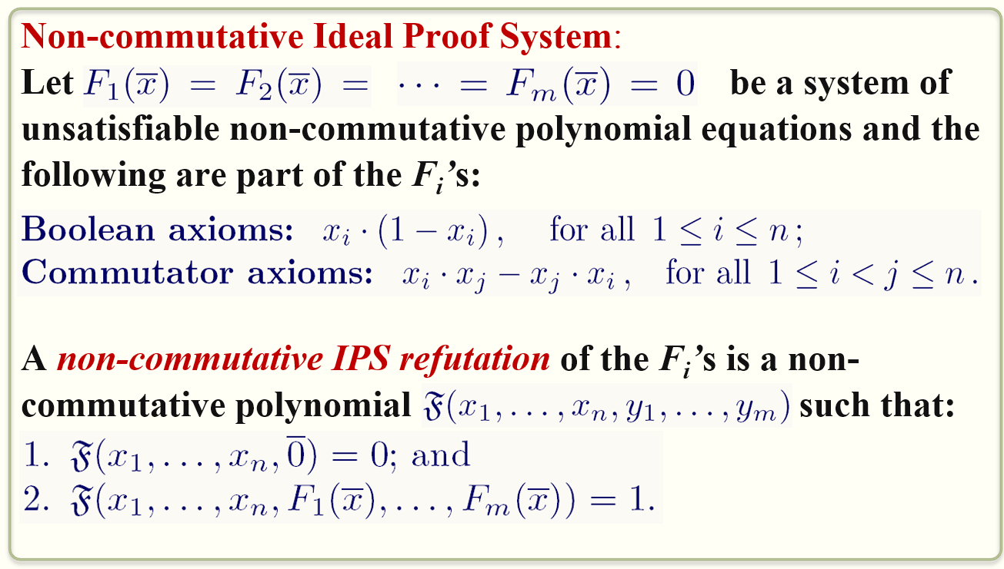
Example: x₁ ⋁ ¬ x₂ , ¬ x₂ ⋁ x₁ , x₂ (1)
Transform to non-commutative polynomials:
(1-x₁) x₂ = 0 , x₂ (1-x₁) = 0 , 1-x₂ = 0 (2)
So (1) is satisfied by a given 0-1 assignment iff (2) is.
Non-commutative IPS refutation:
(1-x₁) x₂ + x₂ x₁ + 1-x₂ + x₁x₂ - x₂ x₁ =
x₂ - x₁x₂ + x₂ x₁ + 1-x₂ + 1 + x₁x₂ - x₂ x₁ = 1
So, non-commutative IPS refutation is: y₁+y₂+y₃+y₄
(1-x₁) x₂ + x₂ x₁ + 1-x₂ + x₁x₂ - x₂ x₁
y₁ + y₂ + y₃ + y₄
21
Notes:
9’
Motivations: understand the circuit based Frege hierarchy; separations, possible separations, understand better analogy with circuit complexity, if any.
--Note: the rules have to be slightly accommodated when speaking about circuits and not formulas: the similarity rule

Slide 22
1st Direction of Simulation (by example)
𝑇 has a polynomial-size propositional proof
𝑝 has a polynomial-size non-commutative formula
x₁ ⋁ ¬ x₂ , ¬ x₂ ⋁ x₁ , x₂
Transform to non-commutative polynomials:
(1-x₁) x₂ = 0 , x₂ (1-x₁) = 0 , 1-x₂ = 0
Intuitive algebraic refutation:
(1-x₁) x₂ = 0
x₂ x₁ = 0
+
x₂ = 0
1-x₂ = 0
+
1 = 0
22
Notes:
9’
Motivations: understand the circuit based Frege hierarchy; separations, possible separations, understand better analogy with circuit complexity, if any.
--Note: the rules have to be slightly accommodated when speaking about circuits and not formulas: the similarity rule

Slide 23
Example (cont.)
Algebraic proof (that is close to propositional proofs) [Grigoriev and Hirsch 2003]:
(1-x₁) x₂ = 0
x₂ x₁ = 0
+
(1-x₁) x₂ + x₂ x₁ = 0
rewrite
x₂ - x₁x₂ + x₂ x₁ = 0
rewrite
x₂ - x₁x₂+ x₁x₂ = 0
rewrite
x₂ + x₁x₂(-1+1) = 0
rewrite
1-x₂ = 0
x₂ + x₁x₂ •0 = 0
rewrite
x₂ = 0
+
1+x₂-x₂ = 0
Skipping some rules…
1 = 0
23
Notes:
9’
Motivations: understand the circuit based Frege hierarchy; separations, possible separations, understand better analogy with circuit complexity, if any.
--Note: the rules have to be slightly accommodated when speaking about circuits and not formulas: the similarity rule

Slide 24
Example (cont.)
Algebraic proofs simulate propositional proofs [Grigoriev and Hirsch 2003]:
(1-x₁) x₂ = 0
x₂ x₁ = 0
+
(1-x₁) x₂ + x₂ x₁ = 0
rewrite
(1-x₁) x₂ + x₂ x₁ + 1-x₂ + x₁x₂ - x₂ x₁
x₂ - x₁x₂ + x₂ x₁ = 0
y₁ + y₂ + y₃ + y₄
rewrite
x₂ - x₁x₂+ x₁x₂ = 0
𝑇 has a polynomial-size propositional proof
𝑝 has a polynomial-size non-commutative formula
rewrite
x₂ + x₁x₂(-1+1) = 0
rewrite
1-x₂ = 0
x₂ + x₁x₂ •0 = 0
rewrite
x₂ = 0
+
1+x₂-x₂ = 0
Skipping some rules…
24
1 = 0
Notes:
9’
Motivations: understand the circuit based Frege hierarchy; separations, possible separations, understand better analogy with circuit complexity, if any.
--Note: the rules have to be slightly accommodated when speaking about circuits and not formulas: the similarity rule

Slide 25
2nd Direction of Simulation
𝑇 has a quasi-polynomial size Frege proof (n^{O(log n)})
𝑝 has a polynomial-size non-commutative formula (over GF(2))
The proof: long with many parts.
Uses structural results in algebraic circuit complexity
A reflection principle for non-commutative IPS in propositional proofs:
A propositional proof of:
“(F has a non-commutative IPS-proof) ➔ F ”
25
Notes:
9’
Motivations: understand the circuit based Frege hierarchy; separations, possible separations, understand better analogy with circuit complexity, if any.
--Note: the rules have to be slightly accommodated when speaking about circuits and not formulas: the similarity rule

Slide 26
Part IV: Towards Propositional-Calculus Lower Bounds ?

Slide 27
𝑇 has no polynomial-size propositional proof
𝑝 has no polynomial-size non-commutative formula
𝑇 has a polynomial-size propositional proof
𝑝 has a polynomial-size non-commutative formula
How to prove lower bounds on non-commutative formulas? Nisan ‘91 rank technique:
Non-commutative algebraic branching programs (stronger than non-commutative formulas)
1. Every path computes the
product of its labels
2. Every node computes
the sum of its
incoming paths
source
Layer #
0
x₁
2x₂
((3x₂)x₁+(2x₂)x₃)x₃
+((3x₂)2x₂+ (2x₂)x₁)2x₃
3x₂
1
3x₂
x₁
x₁
x₁
x₁
x₃
2x₂
2
2x₂
x₃
x₃
x₃
2x₃
3x₂
x₂
3
x₁
2x₂
x₃
2x₃
2x₂
3x₂
x₂
4
x₂
3x₂
2x₁
2x₁
5
27
sink
Notes:
9’
Motivations: understand the circuit based Frege hierarchy; separations, possible separations, understand better analogy with circuit complexity, if any.
--Note: the rules have to be slightly accommodated when speaking about circuits and not formulas: the similarity rule

Slide 28
Example: f(x₁,x₂,x₃) = x₁x₂x₃+x₂x₃x₁+x₁x₃x₂
Consider branching program computing f:
source
Layer #
Corollary: the number of nodes in any ABP computing f is at least the rank of M_{f}
x₁
x₂
x₂
x₃
x₃
v₁
v₂
v₃
2
x₃
x₂
x₁
 | v₁ | v₂ | v₃
x₁x₁
x₂x₂
x₃x₃
x₁x₂ | 1
x₁x₃ |  | 1
x₂x₁
x₂x₃ |  |  | 1
x₃x₁
x₃x₂
 | x₁ | x₂ | x₃
x₁x₁
x₂x₂
x₃x₃
x₁x₂ |  |  | 1
x₁x₃ |  | 1
x₂x₁
x₂x₃ | 1
x₃x₁
x₃x₂
sink
 | x₁ | x₂ | x₃
v₁ |  |  | 1
v₂ |  | 1
v₃ | 1
M_{f}
x
=
28
Notes:
9’
Motivations: understand the circuit based Frege hierarchy; separations, possible separations, understand better analogy with circuit complexity, if any.
--Note: the rules have to be slightly accommodated when speaking about circuits and not formulas: the similarity rule

Slide 29
Thank You !
I’m hiring a PhD student!

Slide 30
Additional Details

Slide 31
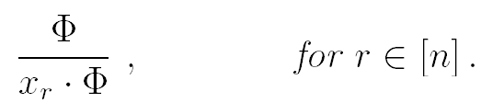
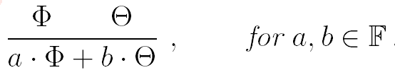
Non-commutative IPS simulates propositional proofs
Start with a propositional proof:
Example: Hilbert style proof:
We use the following translation of Boolean formulas to arithmetic formulas:
3. We can translate the rules with this mapping; but it’s better to introduce simple algebraic rules of inference:
And then show they simulate the (arithmetic version of the) rules, axioms above
31
Notes:
9’
Motivations: understand the circuit based Frege hierarchy; separations, possible separations, understand better analogy with circuit complexity, if any.
--Note: the rules have to be slightly accommodated when speaking about circuits and not formulas: the similarity rule

Slide 32
Non-commutative IPS simulates propositional proofs (cont.)
Need to be careful:
In propositional proofs formulas are syntactic terms; derivation are syntactic
So we need to add rules for deriving two (syntactic) different formulas for computing the same polynomial:
Example of rewrite rule: G(t·s) → G(s·t)
Conclusion: We can ``arithmetize’’ propositional proofs.
Thm (Krajicek ’95): Propositional proofs can be balanced (i.e. the proof-tree is of O(log s) depth, for s = size of proof).
32
Notes:
9’
Motivations: understand the circuit based Frege hierarchy; separations, possible separations, understand better analogy with circuit complexity, if any.
--Note: the rules have to be slightly accommodated when speaking about circuits and not formulas: the similarity rule

Slide 33
Non-commutative IPS simulates propositional proofs (cont.)
It remains: simulate arithmetic propositional proofs by non-commutative IPS.
(See example before.)
Proof. By induction on proof length we construct the non-commutative formula based on the ``skeleton’’ of the (``arithmetized”) propositional proof.
Example: The product rule:
Original proof: x_{j}G derived from G
Simulation: by induc. hyp.:
P(x₁,…,x_{n} ,F₁,…,F_{m} , “axioms”)=G.
So we define P’:=x_{j}P and we have:
P’(…,0)=0 and P’(…,0)=x_{j}G
33
Notes:
9’
Motivations: understand the circuit based Frege hierarchy; separations, possible separations, understand better analogy with circuit complexity, if any.
--Note: the rules have to be slightly accommodated when speaking about circuits and not formulas: the similarity rule

Slide 34
source
layer
0
x₁
3x₂
2x₂
1
3x₂
x₁
2x₂
x₃
x₁
x₁
2
2x₂
x₃
x₃
x₃
2x₃
3x₂
x₂
3
x₁
2x₂
x₃
2x₃
2x₂
3x₂
x₂
4
x₂
3x₂
2x₁
2x₁
5
sink
Notes:
9’
Motivations: understand the circuit based Frege hierarchy; separations, possible separations, understand better analogy with circuit complexity, if any.
--Note: the rules have to be slightly accommodated when speaking about circuits and not formulas: the similarity rule

