Slide 1
Proofs of Polynomial Identities
Pavel Hrubeš & Iddo Tzameret
IAS, Princeton
ASCR, Prague
Notes:
I’ll focus on the Algebraic aspect of our work; so I’ll always assume a field in the background, and polynomial identity over the field.

Slide 2
The Problem
How to solve it by hand ?
Use the polynomial-ring axioms !
associativity, commutativity, distributivity, 0/1-elements rules, number equalities
Example: x₁• (x₂+3) = x₂•x₁+3x₁ ?
x₁• (x₂+3) = x₁•x₂+x₁•3 = x₂•x₁+x₁•3 = x₂•x₁+3x₁
Distributivity
Commutativity
Commutativity
Notes:
4
Add dot to first linef+0=f
, f•1=f, f•0=0, f+g=g+f, f•g=g•f, f•(g+h)=f•g+f•h
: a+b=c, a•b=d (a,b,c,d in the field)

Slide 3
Main Question
Given an arithmetic formula Ф computing the zero polynomial, what is the minimal number of such elementary operations one needs to perform in order to reach 0 ?
The problem of proving Ф=0 is equal to the problem of proving the equality of two given formulas
Polynomial Identity Testing (PIT): determine if Ф=0 ?
Notes:
7

Slide 4
The Model:
Equational Proof Systems

Slide 5
Arithmetic formulas
Fix a field (say, the complex numbers)
An arithmetic formula over :
X
This formula computes the (formal) polynomial:
+
+
x₁
(x₁+x₂)•(x₂+3)=
x₁x₂+x₂²+3x₁+3x₂
x₂
x₂
3
Notes:
(usually we work over the complex numbers)
12

Slide 6
Equational Proofs
Proof-lines are equations between formulas
Definition (Equational proofs): Start from axioms and derive new identities by derivation rules.
Axioms: polynomial-ring axioms (schemes):
Identity: f=f
zero element: f+0=f, f•0=0
unit element: f•1=f
Addition commutativity: f+g=g+f
Product commutativity: f•g=g•f
Distributivity: f•(g+h)=f•g+f•h
Number identities: a+b=c, a•b=d
(for any a,b,c,d in the field)
Notes:
14

Slide 7
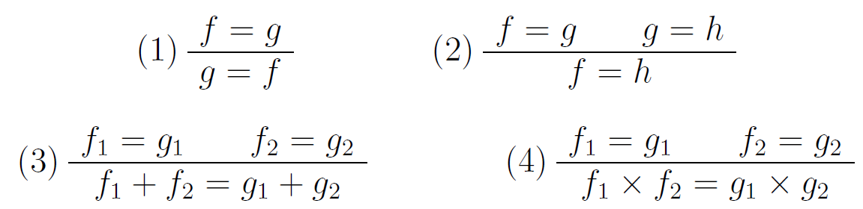
Equational Proofs
Derivation rules:
Notes:
17

Slide 8
Example
Ring identities
2∙3=6
x=x
Reflexivity axiom
(х) rule
Commutativity axiom
3x∙2=2∙3x
2∙3x=6x
Transitivity
3x∙2=6x
Reflexivity axiom
3xy=3xy
symmetry
6x=3x∙2
(+) rule
3xy+6x=3xy+3x∙2
3xy+3x∙2=3x∙(y+2)
Distributivity axiom
Transitivity
3xy+6x=3x∙(y+2)
Notes:
25

Slide 9
Motivations
Algebraic complexity:
Polynomial Identity Testing (PIT):
Upper bounds → Efficient
non-deterministic algorithms (important problem)
Lower bounds → Symbolic manipulations not enough for efficient deterministic algorithms (even this is not known)
Notes:
37

Slide 10
Motivations (cont.)
Work over GF(2) and add axiom x²=x, for all variables x
Proof complexity:
Our model can be easily extended to standard logical proof systems (Frege).
Close connection to algebraic propositional proofs:
Buss,Impagliazzo,Krajicek,Pudlak,Razborov, Sgall ‘96/7
Grigoriev & Hirsch ‘03
Notes:
41

Slide 11
What we know
Is the model too weak ?
We know equational proofs simulate PIT algorithms that use the rank bounds
(Dvir-Shpilka ‘06,
Saxena-Seshadhri `09):
Notes:
55

Slide 12
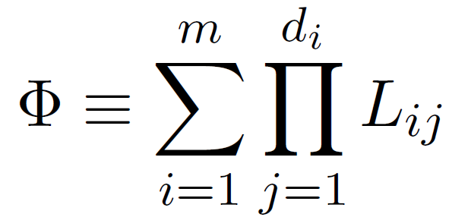
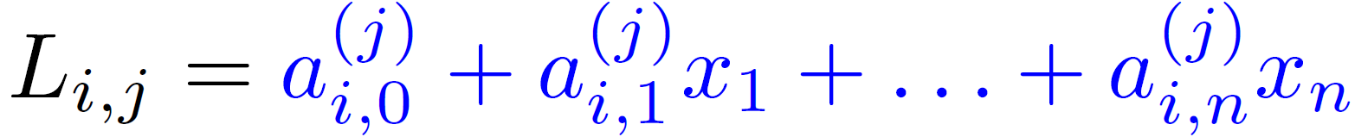
Depth-3 Arithmetic formulas
Ф is a depth-3 (ΣΠΣ) arithmetic formula over a fixed field :
+
x
.....
x
...L_{1d1}
…L_{mdm}
L₁₁
L_{m1}
Where the L_{i,j}’s are linear polynomials over :
Notes:
5

Slide 13
Theorem: For all identically zero depth-3 formulas over a field F with a logarithmic top fan-in there are quasipolynomial-size equational proofs. (The proofs have bounded depth.)
Proof: For a depth-3 formula G define
rank(G):= rank of all the linear forms in G
Thus, if rank(G) is low enough:
1.Within our proof system, use a linear transformation to get from G a circuit G’ with few variables ;
2. Expand all variables in G’ and cancel out all monomials.
Notes:
10

Slide 14


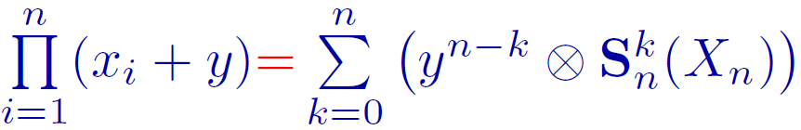
What we know
All degree k monomials with x_{n}
Lower bounds ?
Hard candidates ?
[Grigoriev-Hirsch ’03]: suggested identities based on symmetric polynomials written as depth-3 formulas.
[Hrubes-T ‘09]: there are short depth-4 proofs for the symmetric polynomials (Newton identities), and other variants based on polynomial intepolation.
(Important in proof complexity)
Theorem: Over fields , s.t. , there are polynomial-size depth-4 proofs of:
All degree k monomials without x_{n}
X_{n}={x₁,…,x_{n}}
Notes:
55

Slide 15
What we know
Lower bounds – not much.
Over rings we can have an exponential lower bound on number of proof-lines [Hrubes-T ‘09]
When we restrict severely the model we have exponential lower bounds over fields [Hrubes-T ‘09]
Notes:
55

Slide 16
No Barriers
Lower bounds
Already for depth-3 equational proofs we don’t know how to prove lower bounds ?
It’s not trivial, but (possibly) not a “barrier”…
Notes:
55

Slide 17
Conclusions
Equational proofs are a natural formalism connecting proof complexity and the PIT problem
Approach to PIT upper/lower bounds
Upper bounds are as interesting as lower bounds:
Symmetric polynomials are easy already for depth-4 proofs.
Another way of looking at propositional (Frege) proofs…. applications in proposition proof complexity
Notes:
27

Slide 18
Thank You !

Slide 19
Simulation of
known PIT algorithms
Notes:
BREAK

Slide 20
Symmetric Polynomials

Slide 21
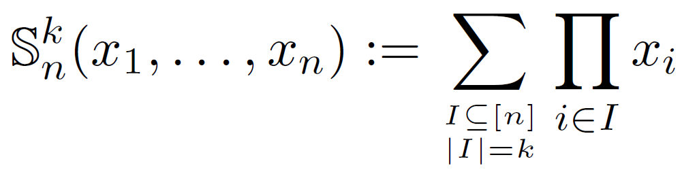

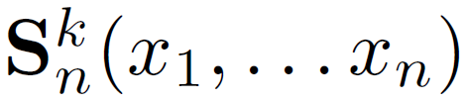
Symmetric Polynomials
Ben-Or: Over large enough there are
polynomial-size (in n) arithmetic formulas of depth-3 for the symmetric polynomials (denoted ).
We show that basic properties of such formulas are already provable with depth-4 equational proofs:
Notes:
32

Slide 22

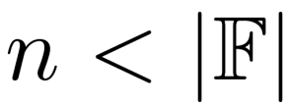
Symmetric Polynomials
Suggestion of [GH03]: symmetric polynomials of depth-3 are hard candidates for equational proofs.
All degree k monomials with x_{n}
Theorem: Over fields , s.t. , there are polynomial-size depth-4 proofs of:
1.
2.
All degree k monomials without x_{n}
X_{n}={x₁,…,x_{n}}
Notes:
35

Slide 23

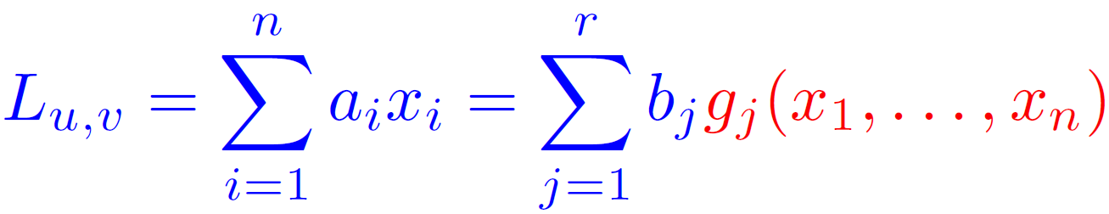
Theorem (DS’06): Let G be a depth-3 minimal, simple, identically zero, of degree d, and fan-in of the top plus gate k. Then,
Exist r=rank(G) linear forms g_{i}’s: g₁(x₁,…,x_{n}), ……, g_{r}(x₁,…,x_{n}), such that the following are true linear equalities:
NOTE: linear forms have polynomial-size in n proofs
So there is a short proof of:
+a₀
By (DS’06) Thm, (d+r)^{r} is quasipolynomial for constant k
since the right hand side can be viewed as a formula with r variables: expand all “g_{j}-monomials’’, and prove it’s identical to the zero polynomial.
Notes:
25

Slide 25
Lower bounds over
specific rings
Notes:
BREAK

Slide 26
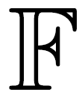


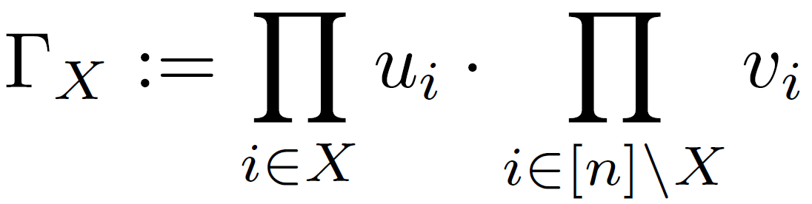
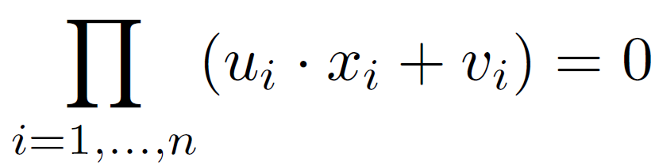
F a field, R:= F[u1,…,un,v1,…,vn].
Define for any X se [::
Let S:=R/I .
Define identity (E) over S[x₁,…,x_{n}] :
(E)
Notes:
27

Slide 27
Thank You !

Slide 28

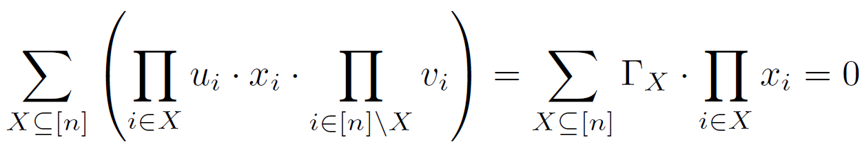
(E)
Claim: (E) is true identity over S; in fact for every ideal J in R:
(E) is true in R/J iff J I
Proof:
(E) =
Notes:
27

Slide 29
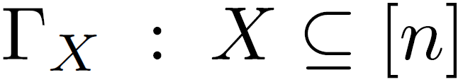
(E)
Claim: (E) is true identity over S; in fact for every ideal J in R:
(E) is true in R/J iff J I
Lemma: Let H R. If ideal(H)=I, then |H|>2^{n}.
Proof: Essentially, because the dimension of the vector space span( of ) is 2^{n}.
Notes:
27

Slide 30
(E)
Claim: (E) is true identity over S; in fact for every ideal J in R:
(E) is true in R/J iff J I
Lemma: Let H R. If ideal(H)=I, then |H|>2^{n}.
Lower bound proof idea: Count the number of constant rules (that is, ring S=R/I identities) occurring in the proof. The set of these rules generate I, and so we are done.
Notes:
27

Slide 34
Equational Proofs
DEF: An equational proof of t=s is a sequence of equations f₁=g₁,…,f_{m}=g_{m}, where f_{m}=g_{m} is t=s, and every equation f_{i}=g_{i} is either an axiom (of the polynomial-ring) or is derived from previous equations by one of the rules.
Notes:
20

Slide 35

(E)
Thm: Size of proofs of (E) over S is at least 2^{n}.
Proof: Count number of constant rules (i.e., ring S=R/I identities) occurring in the proof:
define H:
if proof contains g₃=g₁+g₂ ➔ add g₃-(g₁+g₂) to H
if proof contains g₃=g₁*g₂ ➔ add g₃-(g₁*g₂) to H
Since g₃=g₁+g₂, g₃=g₁*g₂ are constant S-identities ➔
g₃=g₁+g₂, g₃=g₁*g₂ in I ➔ H se I.
Since proof is sound, (E) is true identity over R/ideal(H) ➔
(by claim) I se ideal(H).
Finally ideal(H)=I ➔ (by lemma) |H|>2^{n} .
Notes:
27

Slide 36
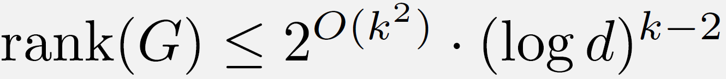
Simulation of Dvir-Shpilka (cont’)
Theorem (DS06): Let G be
minimal, simple, identically zero, of degree d(>1), and fan-in of the top plus gate k(>2). Then,
Let G be depth-3 formula in variables x₁,…,x_{n}.
Recall we are proving (not computing):
so we can assume wlog that G is minimal (otherwise, prove every zero subset sum separately).
assume wlog that G is simple (otherwise, factorize all common linear forms).
Notes:
18

Slide 37
F a field, R:= F[u1,…,un,v1,…,vn].
Define for any X se [::
Let S:=R/I .
Define identity (E) over S[x₁,…,x_{n}] :
(E)
Notes:
27

Slide 38
Depth-3 Arithmetic formulas
Fix a field
Ф is a depth-3 (ΣΠΣ) arithmetic formula over:
+
x
.....
x
...L_{1d1}
…L_{mdm}
L₁₁
L_{m1}
Where the L_{i,j}’s are linear polynomials:
Notes:
5

Slide 39
Our Results
Laying the basics:
Introducing variants of equational proofs
Determine their relations
Upper bounds:
For Symmetric polynomials and close identities for counting (in depth-4); Important in proof complexity
Simulation of PIT procedures [Dvir-Shpilka 06] (in bounded depth)
Lower bounds:
Full equational proofs over specific rings
Restricted analytic depth-3 proofs
One-way proofs (strictly ‘’analytic’’ proofs)
[GH03] suggested these are hard identities
Notes:
55

