Slide 1
Frege Lower Bounds & Algebraic Circuit Complexity
Iddo Tzameret Royal Holloway, University of London

Slide 2
Sketch

Slide 3
❶
[Li, T, Wang CCC’15]:
Frege =_{quasi-poly} non-commutative-IPS
Lower bounds on non-commutative formulas for certain polynomials
Frege lower bounds
3

Slide 4
❷
[Forbes, Shpilka, T, Wigderson CCC’16]:
New IPS fragments lower bounds
4

Slide 5
Frege Proofs

Slide 6
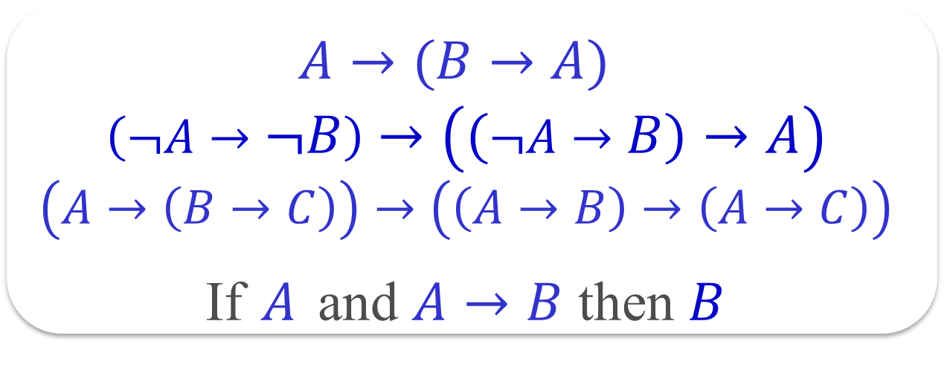
Frege Proofs
Any standard textbook proof system for propositional tautologies
Start from axioms and derive, using derivation rules/axioms, new tautologies, all written as Boolean formulas:
$A→(B→A)$
$$\left(¬A→¬B\right)→\left(\left(¬A→B\right)→A\right)$$
$$\left(A→\left(B→C\right)\right)→\left(\left(A→B\right)→\left(A→C\right)\right)$$
If $A$ and $A→B$ then $B$

Slide 7

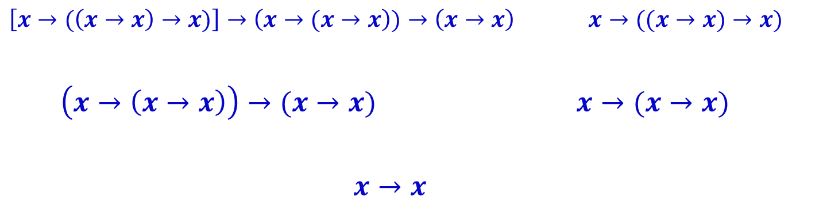
Frege Proofs
$A→(B→A)$
$$\left(¬A→¬B\right)→\left(\left(¬A→B\right)→A\right)$$
$$\left(A→\left(B→C\right)\right)→\left(\left(A→B\right)→\left(A→C\right)\right)$$
If $A$ and $A→B$ then $B$
$$\left[x→(\left(x→x\right)→x)\right]→\left(x→(x→x\right))→\left(x→x\right) x→((x→x)→x)$$
$\left(x→\left(x→x\right)\right)→(x→x)$ $x→(x→x)$
$x→x$
Example: size = 41
Size of proof = number of symbols it takes to write down the proof (= total number of logical gates + variables in proof)

Slide 8
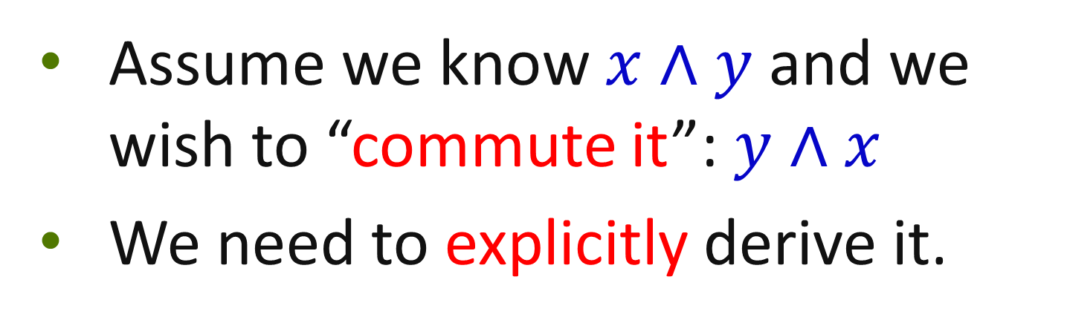
Observation about Frege Proofs
Assume we know $x∧y$ and we wish to “commute it”: $y∧x$
We need to explicitly derive it.

Slide 9
Can we prove super-polynomial size lower bounds on Frege proofs?
Major open question: prove that there is a family { f₁, f₂, f₃, …} of tautologies such that for no polynomial p(∙), the minimal propositional-calculus proof size of f_{n} is at most p(|f_{n}|)

Slide 10
(Algebraic) Non-Commutative Formulas

Slide 11
Fix a field 𝔽 (e.g., ℚ or GF(2)).
Non-commutative polynomials: e.g., compute a function of matrices over 𝔽
f (X,Y):=X•Y – 2Y•X
This is a non-commutative formula (tree)
Size = number of nodes
output
+
Depth can be assumed
O(log n), for n number of variables
(By [LTW15] variant of Hrubes & Wigderson’14)
˟
˟
-2
˟
X
Y
Y
X

Slide 12
Non-Commutative Formulas Lower Bounds
Nisan ‘91: determinant and
permanent require
non-commutative formulas
of 2^{Ω(n)} size
Raz, Shpilka ‘05:
Efficient deterministic PIT algorithm
for non-commutative formulas
Lower bound proof (very simple, in retrospect): lower bound the rank of the coefficients matrix
output
+
˟
˟
-2
˟
X
Y
Y
X
Notes:
1. Parallel computation

Slide 13
❶ Thm [Li, T., Wang ’15]: Exists a semi-explicit map between propositional 𝑇 to non-commutative polynomials 𝑝, such that:
And conversely, when T is a DNF:
𝑇 has a polynomial-size Frege proofs
𝑝 has a polynomial-size non-commutative formula
𝑝 has a polynomial-size non-commutative formula (over GF(2))
𝑇 has a quasi-polynomial size Frege (n^{O(log n)})
13

Slide 14
The Argument: We characterize a proof as a single non-commutative formula by introducing: The non-commutative IPS [following the (commutative) IPS of Grochow-Pitassi ’14]
14

Slide 15
The Non-Commutative Ideal Proof System

Slide 16



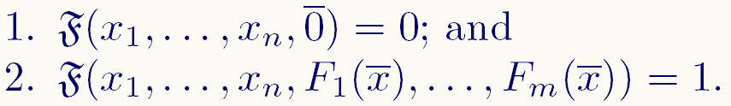
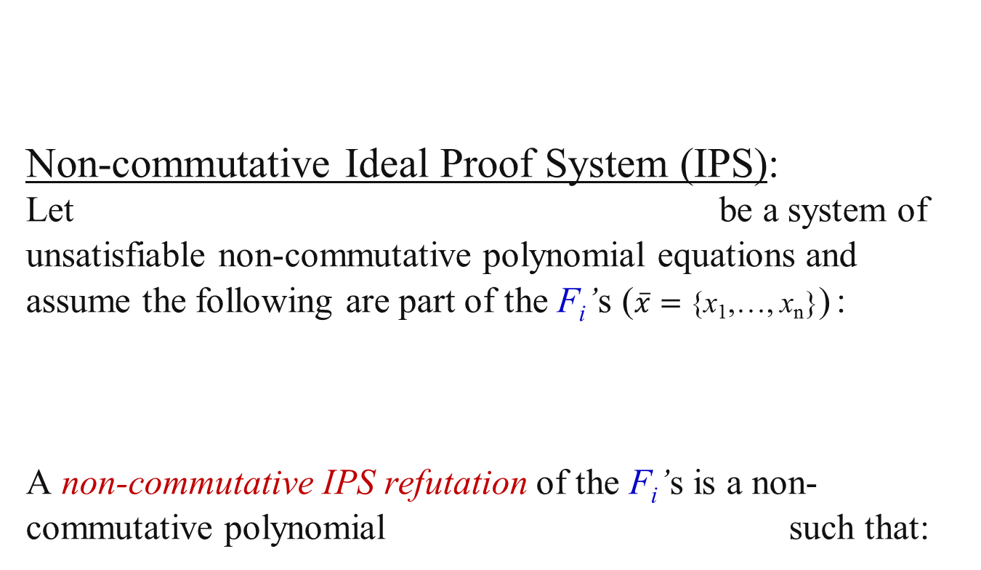
First, a CNF’s x₁ ⋁ ¬ x₂ , ¬ x₂ ⋁ ¬ x₁ , x₂ (1) as non-commutative polynomial equations: (1-x₁) x₂ = 0 , x₂ x₁ = 0 , 1-x₂ = 0 (2) So (1) is satisfied by a given 0-1 assignment iff (2) is.
Non-commutative Ideal Proof System (IPS):
Let be a system of unsatisfiable non-commutative polynomial equations and assume the following are part of the F_{i}’s ($\overline{x}=$ {x₁,…, x_{n}}) :
A non-commutative IPS refutation of the F_{i}’s is a non-commutative polynomial such that:
Map between propositional T’s and non-commutative polynomials p

Slide 17
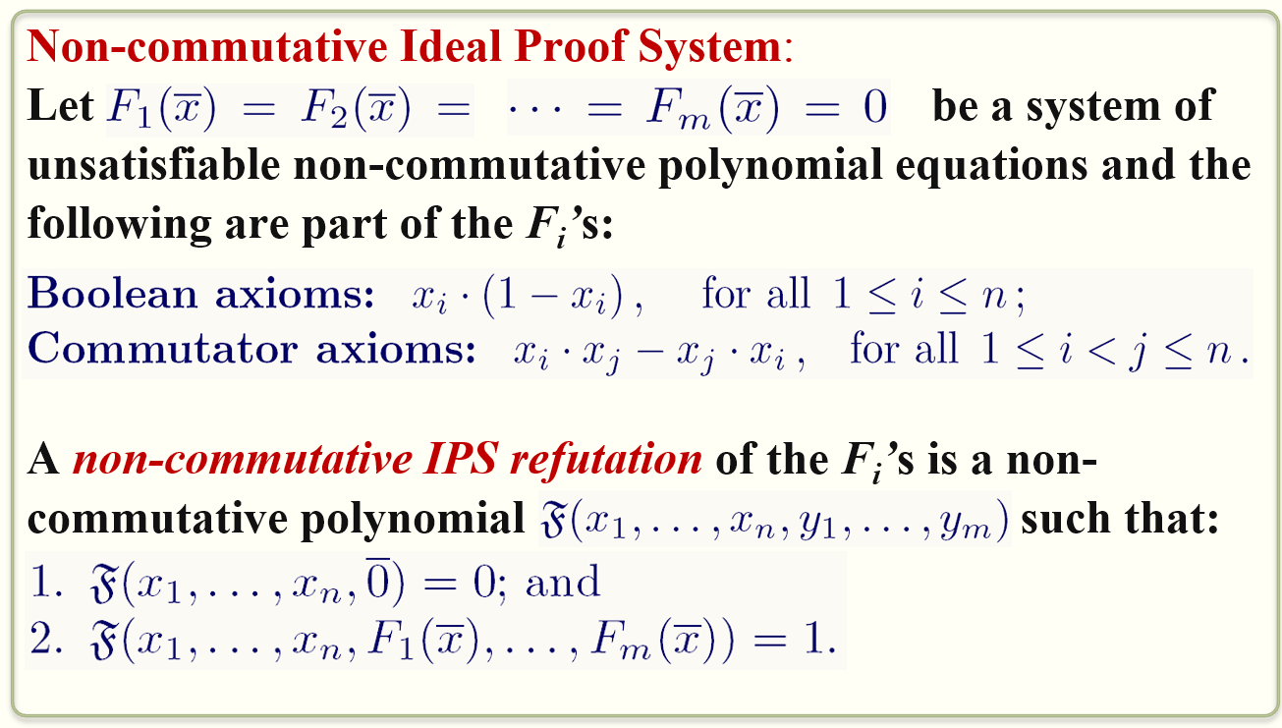
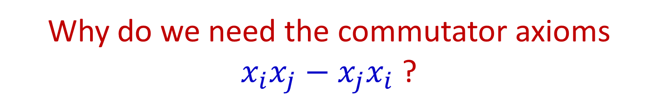
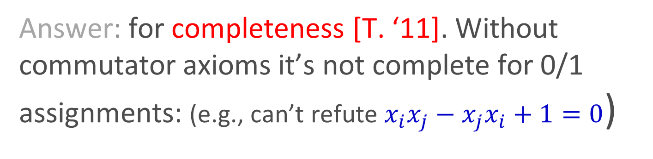
Why do we need the commutator axioms $x_{i}x_{j}−x_{j}x_{i}$ ?
Answer: for completeness [T. ‘11]. Without commutator axioms it’s not complete for 0/1 assignments: (e.g., can’t refute $x_{i}x_{j}−x_{j}x_{i}+1=0$)
17

Slide 18
Example: unsatisfiable CNF:
(1-x₁) x₂ = 0 , x₂ x₁ = 0 , 1-x₂ = 0
Non-commutative IPS refutation:
(1-x₁) x₂ + x₂ x₁ + 1-x₂ + x₁x₂ - x₂ x₁ =
x₂ - x₁x₂ + x₂ x₁ + 1-x₂ + x₁x₂ - x₂ x₁ = 1
So, non-commutative IPS refutation is: y₁+y₂+y₃+y₄
(1-x₁) x₂ + x₂ x₁ + 1-x₂ + x₁x₂ - x₂ x₁
y₁ + y₂ + y₃ + y₄
PIT for non-commutative formulas means: it’s a Cook-Reckhow propositional proof system

Slide 19
Non-Commutative IPS Simulates Frege

Slide 20
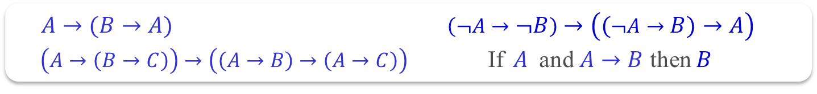
Non-commutative IPS simulates Frege
Start with a Frege proof:
We use the following translation of Boolean formulas to arithmetic formulas:
$A→(B→A)$ $\left(¬A→¬B\right)→\left(\left(¬A→B\right)→A\right)$
$\left(A→\left(B→C\right)\right)→\left(\left(A→B\right)→\left(A→C\right)\right)$If $A$ and $A→B$ then $B$
1
0
200

Slide 21
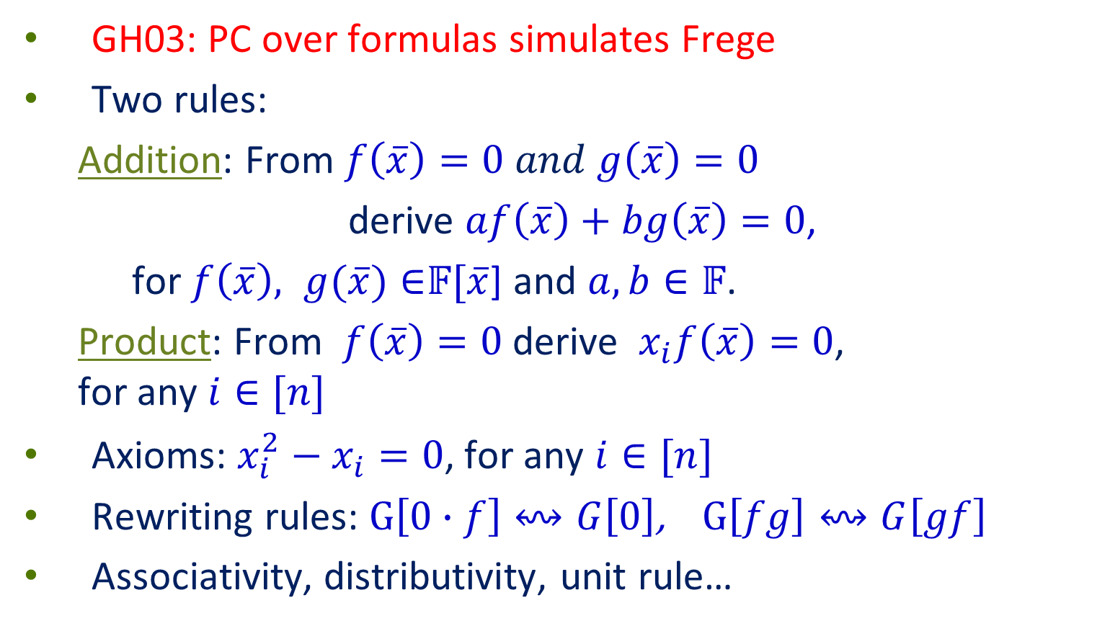
PC over Formulas: Formal Definition [Grigoriev, Hirsch ’03]
GH03: PC over formulas simulates Frege
Two rules:
Addition: From $f\left(\overline{x}\right)=0 and g\left(\overline{x}\right)=0$
derive $af\left(\overline{x}\right)+bg\left(\overline{x}\right)=0$,
for $f\left(\overline{x}\right), g(\overline{x})∈$𝔽[$\overline{x}$] and $a,b∈𝔽$.
Product: From $f\left(\overline{x}\right)=0$ derive $x_{i}f\left(\overline{x}\right)=0$, for any $i∈[n]$
Axioms: $x_{i}^{2}−x_{i}=0$, for any $i∈[n]$
Rewriting rules: $G\left[0∙f\right]↭G\left[0\right]$, $G\left[fg\right]↭G\left[gf\right]$
Associativity, distributivity, unit rule…
21

Slide 22
Converting the Proof DAG into a Tree
Thm (Krajicek ’95): Frege proof DAGs can be transformed into proof-trees with only a polynomial increase in size.
22

Slide 23
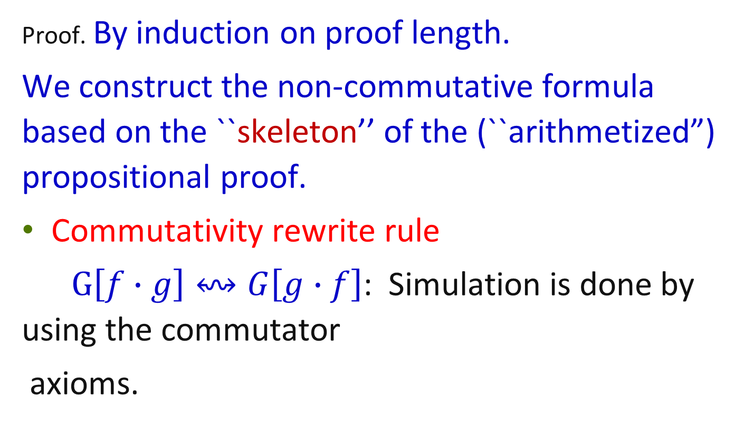
Small PC over formulas proof of G ➔ Small non-commutative IPS proof of G
Proof. By induction on proof length.
We construct the non-commutative formula based on the ``skeleton’’ of the (``arithmetized”) propositional proof.
Commutativity rewrite rule
$G\left[f∙g\right]↭G\left[g∙f\right]$: Simulation is done by using the commutator
axioms.
23

Slide 24
Second Direction of Simulation
Thm: Frege quasi-polynomially (n^{O(log n)}) simulates non-commutative IPS over GF(2) (for tautological DNFs)
The proof:
Consists of many simulations of structural results in algebraic circuit complexity
244

Slide 25
❷
[Forbes, Shpilka, T, Wigderson CCC’16]:
New IPS fragments lower bounds
25

Slide 26
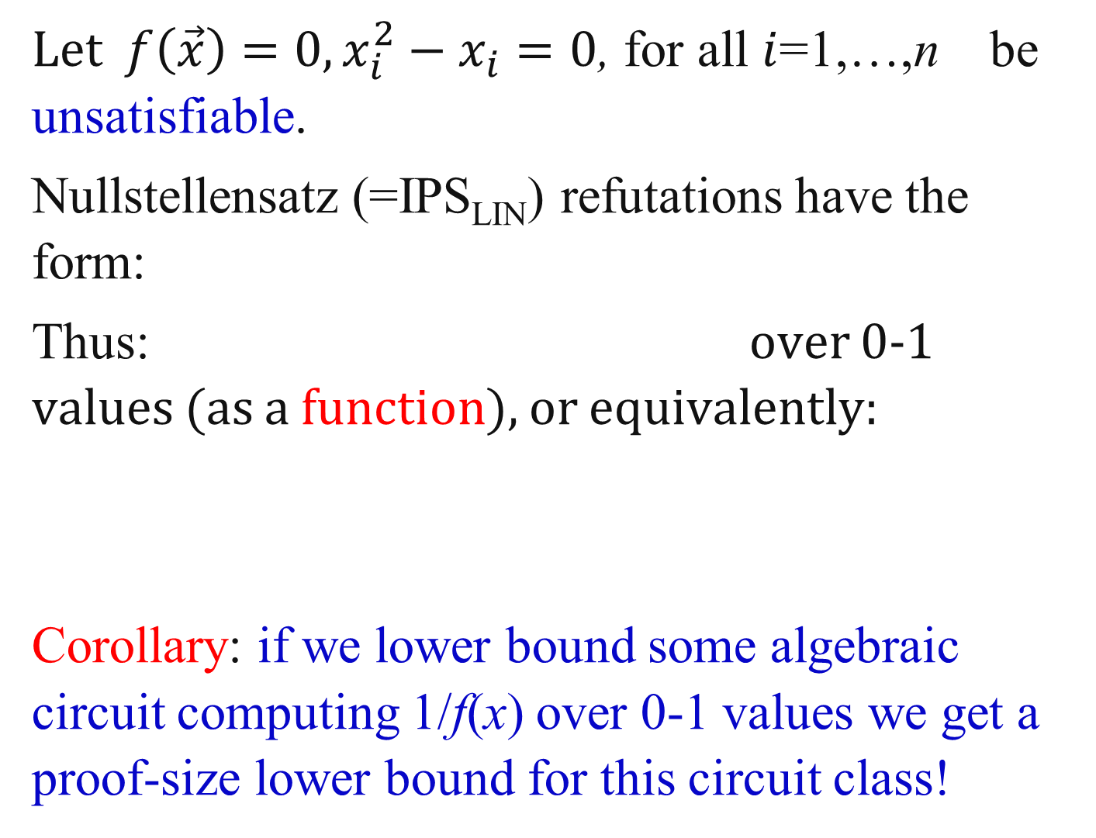
Functional Framework
Let $f\left(\vec{x}\right)=0,x_{i}^{2}−x_{i}=0$, for all $i$=1,…,n be unsatisfiable.
Nullstellensatz (=IPS_{LIN}) refutations have the form:
Thus: over 0-1 values (as a function), or equivalently:
Corollary: if we lower bound some algebraic circuit computing 1/f(x) over 0-1 values we get a proof-size lower bound for this circuit class!
f(x)=0 is unsatisfiable over 0-1 values, so it’s okay!

Slide 27
Success of the Framework: roABPs, Multilinear Formulas
Take f(x) = x₁ y₁+…+x_{n} y_{n} - b, for b>n
Then computing 1/(x₁ y₁+…+x_{n} y_{n} - b) over 0-1 requires exponential-size read once algebraic branching program (roABP) (for some fixed order, say, x₁<x₂<…<x_{n})
Can be made to work for any order;
We also have a lower bound for multilinear formulas
27

Slide 28
Read Once Algebraic Branching Programs
Level i has only univariate polynomials in x_{i} labeling edges
Each variable appears only in a single level (read once)
Every path computes the product of its labels
Every node computes the sum of its incoming paths
f(x₁,x₂,x₃) = x₁x₂x₃+2x₁x₂² +x₁³x₂x₃²
source
Layer #
0
x₁
x₁³
1
x₂
x₂²
x₂
v₁
v₃
2
v₂
x₃
2
x₃²
3
sink
288

Slide 29
Lower bound example via dimension argument: f(x₁,x₂,x₃) = x₁x₂x₃+2x₁x₂² +x₁³x₂x₃²
Consider branching program computing f :
source
Layer #
Corollary: the number of nodes in any roABP computing f is at least the rank of M_{f}
x₁
x₁³
x₂
x₂²
x₂
v₁
v₂
v₃
2
x₃
2
x₃²
 | v₁ | v₂ | v₃
x₁x₁
x₂x₂
x₃x₃
x₁x₂ | 1
x₁x₂² |  | 1
x₁³x₂ |  |  | 1
x₂x₃
x₃x₁
x₃x₂
 | 1 | x₃² | x₃
x₁x₁
x₂x₂
x₃x₃
x₁x₂ |  |  | 1
x₁x₂² | 2
x₁³x₂ |  | 1
x₂x₃
x₃x₁
x₃x₂
sink
 | 1 | x₃² | x₃
v₁ |  |  | 1
v₂ | 2
v₃ |  | 1
M_{f}
x
=
29
Notes:
9’
Motivations: understand the circuit based Frege hierarchy; separations, possible separations, understand better analogy with circuit complexity, if any.
--Note: the rules have to be slightly accommodated when speaking about circuits and not formulas: the similarity rule

Slide 30
Coefficient Dimension Lower Bound for function 1/(x₁ y₁+…+x_{n} y_{n} - b) over 0-1
We can that the rank of M_{f} for any polynomial f computing 1/(x₁ y₁+…+x_{n} y_{n} - b) over 0-1 is exponential.
Proof is not very hard;
Use a degree lower bound on f (i.e., that f must be of degree precisely n [lower bound already in Impagliazzo, Pudlak, Sgall ‘99]).
30

Slide 31
Conclusions and Open Problems

Slide 32
Conclusions & Open Problems
New lower bound technique for fairly strong proof systems; Purely algebraic (non-combinatorial)
Open questions:
Prove lower bounds on IPS fragments for CNFs (more than single axiom)
Formidable open problem: prove lower bounds on non-commutative IPS?

Slide 33
Thank you for Listening !

Slide 34
Answers to Potential Questions Arising

Slide 35
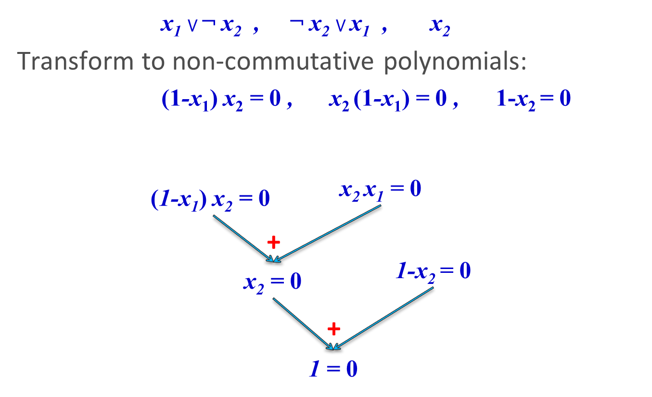
Polynomial Calculus (PC) over Formulas
[Grigoriev and Hirsch 2003]:
(1-x₁) x₂ = 0
x₂ x₁ = 0
+
(1-x₁) x₂ + x₂ x₁ = 0
rewrite
x₂ - x₁x₂ + x₂ x₁ = 0
rewrite
x₂ - x₁x₂+ x₁x₂ = 0
rewrite
x₂ + x₁x₂(-1+1) = 0
rewrite
1-x₂ = 0
x₂ + x₁x₂ •0 = 0
rewrite
x₂ = 0
+
1+x₂-x₂ = 0
Skipping some rules…
1 = 0

