Slide 1
Algebraic Proofs over Noncommutative Formulas
Iddo Tzameret
Academy of Sciences, Prague

Slide 2
Introduction: Algebraic Proof Systems

Slide 3
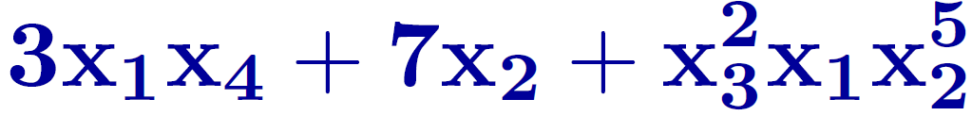
Algebraic Proofs
Fix a field
A polynomial is a sum of formal products of variables and field elements
Demonstrate a collection of polynomial-equations has no 0/1 solutions over
Example:
x₁-x₁x₂=0, x₂-x₂x₃=0, 1-x₁=0, x₃=0
x_{i}(1-x_{i}) =0 for every i
Notes:
3

Slide 4
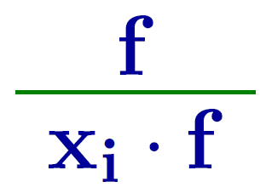
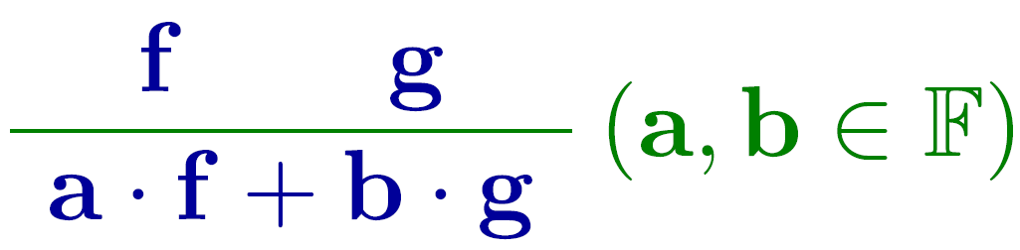
The Polynomial Calculus
Defn: A Polynomial Calculus (PC) refutation of p₁, ..., p_{k} is a sequence of polynomials terminating with the polynomial 1, generated as follows:
This enables completeness over 0/1 unsatisfiable collections of polynomials
Axioms: p_{i ,} x_{i}(1-x_{i})
Inference rules:
Notes:
5

Slide 5
The Polynomial Caluclus
x₁-x₁x₂
=0
x₂-x₂x₃
=0
1-x₁
×
×
=0
x₃
=0
x₁x₂-x₁x₂x₃
x₁x₃-x₁x₂x₃
=0
=0
+
×
x₃x₁-x₁x₂
=0
x₁x₃
+
=0
x₁-x₁x₃
=0
+
1-x₁x₃
=0
+
=0
1
Notes:
6

Slide 6

Complexity Measures of Algebraic Proofs
Measuring the size of algebraic proofs:
By total number of monomials:
Equals measuring total size of formulas
Known exponential lower bounds
Our measure: by noncommutative formula size
By total algebraic formula sizes :
Simulates Frege (Buss et al. 96, Grigoriev and Hirsch 03)
Notes:
8

Slide 7



Noncommutative Formulas
Fix a field
A noncommutative polynomial is a sum of formal ordered products of variables and field elements
F<x1..xn> = the ring of noncommutative polynomials
Like commutative polynomial ring, except that the axiom of commutativity of polynomials does not hold.
Notes:
10

Slide 8






Noncommutative Formulas
Ordered binary tree
Variables X₁,...,X_{n} or field elements on leaves
Gates on nodes:
Children of product gates are ordered
Every gate in the formula computes
a polynomial in
Example: (X₁ · X₃) ·(X₂ + 1) = x₁x₃x₂ + x₁x₃
Notes:
11

Slide 9
Known facts about noncommutative formulas
Exponential lower bounds on noncommutative formulas computing Permanent, Determinant (Nis91)
Simple rank arguments: the rank of a certain matrix associated with a polynomial lower bounds the size of formulas
Efficient Polynomial identity testing (PIT) (RS04)
Notes:
13

Slide 10
Our Motivations
Extend “minimaly” frontier of algebraic proof complexity (slightly stornger than depth 2-PC)
Rank arguments based lower bounds in proof complexity
Applicable also to multilinear proofs (RT06,08)
Notes:
15

Slide 11
Results
Notes:
15

Slide 12

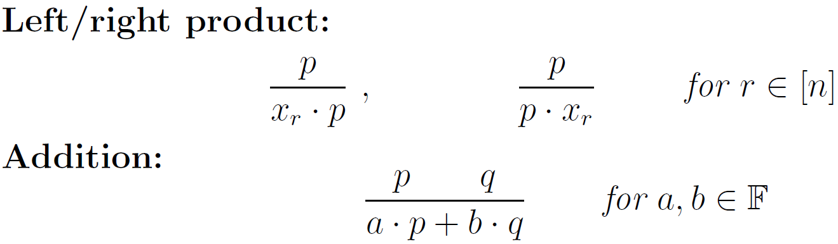
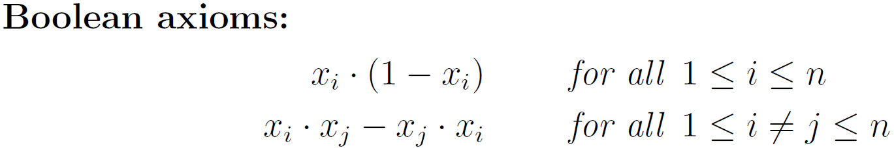
Results
Def: PC over noncommutative formulas (NFPC)
Proof lines are noncommutative polynomials from F<x1…xn>
Proof lines written as noncommutative formulas
Rules:
Note: “Semantic” proof system
Notes:
18

Slide 13
Results
Def: PC over noncommutative formulas (NFPC)
Proof lines are noncommutative polynomials from F<x1…xn>
Rules:
Theorem: NFPC ≥ Frege
Advantage: Polynomial verifiable (by PIT procedure) algebraic analogue of Frege, without rewriting rules (needed in [GH03])
“Too strong” for lower bounds
Notes:
19

Slide 14
Results
PC over ordered formulas (OFPC) (1st definition)
Proof lines are noncommutative polynomials from F<x1…xn> where the product order respects a fixed linear order
Rules: like PC (addition and product by variable)
Proof lines: written as noncommutative formulas
Ordered formulas: very weak circuit class
Theorem: OFPC > PCR (and PC, resolution)
Proof: Use a simulation of R⁰(lin) : fragment of resolution over linear equations (from [RT08])
Notes:
21

Slide 15
Polynomial Calculus over
Ordered Formulas (OFPC)

Slide 16




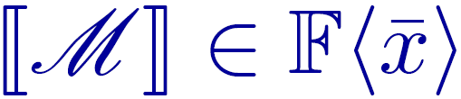





Let < be a linear order on variables x₁,…,x_{n}
Define: Map as follows:
M monomial in then [[M]]\in F<X> is ordered by < .
=S biMi\in F[x] , then [f]] =S bi[[Mi]] \in
Define: An ordered formula of f\inF[x] I is a noncommutative formula computing .
Conclusion: No need to talk about noncommutative polynomials:
Def: (PC over ordered formulas (OFPC)): PC proofs where each polynomial p\in F[x] is written as an ordered formula.
Notes:
24

Slide 17

Def: (PC over ordered formulas (OFPC)): PC proofs where each polynomial p\in F[x] is written as an ordered formula.
In other words: OFPC is just like measuring PC proofs by their total ordered formula size (instead of the standard ssig size).
Notes:
26

Slide 18
OFPC:
Possible Lower Bound Approach
(substitution method)

Slide 19


Possible Lower Bound Approach
Suffices: Demonstrate a set of polynomials Q s.t. every PC refutation of Q contains a polynomial with large oredered formula size.
Q_i(x1..xn)}i=1^m (m=poly(n )) : unsatisfiable set of constant degree polynomials (including Boolean axioms x_{i}²-x_{i}), and m=poly(n).
Assume every PC refutation of Qi’s ‘s has degree ω(log(n)) (we know there exists such Q_i ’s)
Substite: x_i→fi(y): , we get:
Notes:
29

Slide 20

Possible Lower Bound Approach
Q_i(x1..xn)}i=1^m (m=poly(n )) : unsatisfiable set of constant degree polynomials (including Boolean axioms x²-x), and m=poly(n).
Assume every PC refutation of Qi’s ‘s has degree ω(log(n)) (we know there exists such Q_i ’s)
Substite: x_i→fi(y): , we get:
Note
still unsatisfiable.
May assume that have disjoint variables.
Notes:
29

Slide 21








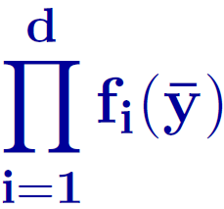

The key idea: size of orderded formula may grow exponentially with degree
Proposition: F field, Y={y1,..,yl} vars and < linear order on . Then, for any m<=l there exist f1(y)..fd(y) from F[y1..yl] where fi(y) ‘s over disjoint variables (and d<= l/m ) and such that:
fi(y have linear size ordered formulas (O(m))
rod-f has size ordered formula
Notes:
34

Slide 22
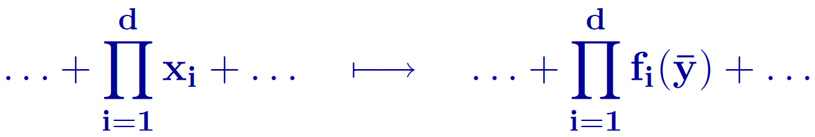

Idea
Show that every PC refutation of
contains a polynomial which is “close” to a substitution instance of a high-degree polynomial in original x_{i} variables:
Note: question independent of noncommutative formulas
Notes:
36

Slide 23

Conditional Lower Bound
Proposition: Exists substitution s.t.
IF: every PC refutation of
(1)
contains a polynomial g\inF[y] s.t. the t^{th} homogenous compononet g^{(t)} is a substitution instance of a degree ω(log(n)) multilinear polynomial from F[x] .
THEN: Every OFPC refutation of (1) is of superpoly size.
Notes:
38

Slide 24
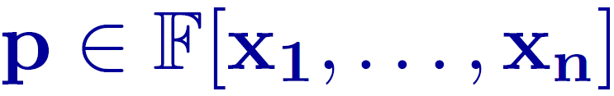


More Details: The Size=Rank Measure
Def: Given a degree d polynomial , for any 0≤k≤d define M_{k}(p) as the matrix s.t.:
(i) Rows correspond to degree k noncommutative monomials over
a .
(ii) Columns correspond to degree d-k noncommutative monomials over .
(iii) For every degree k monomial M and every degree d-k monomial N , the entry in M_{k}(p) on row M and column N is the coefficient of (degree d) monomial MN in p.
Define rank(p) := Σ_{k=0..d} rank(M_{k}(p))
Notes:
40

Slide 25
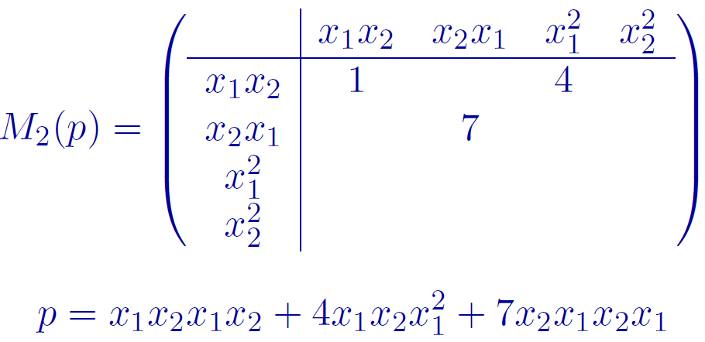
More Details: The Rank Measure
Notes:
41

Slide 26
Thank You!

