Slide 1

Doloto:
Code Splitting for Web 2.0 Applications
Ben Livshits and Emre Kiciman
Microsoft Research
Redmond, WA

Slide 2
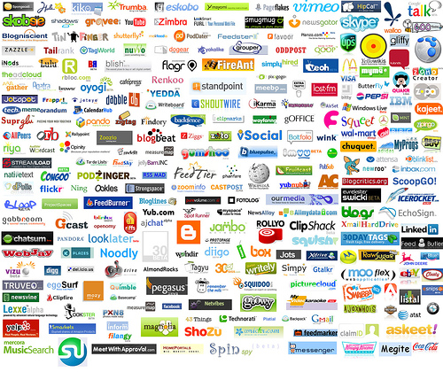
Web 2.0 is Upon Us

Slide 3



Web 1.0 → Web 2.0
Server-side
computation
JavaScript
+ DHTML
Static HTML
Client-side
computation
Client-side
rendering

Slide 4
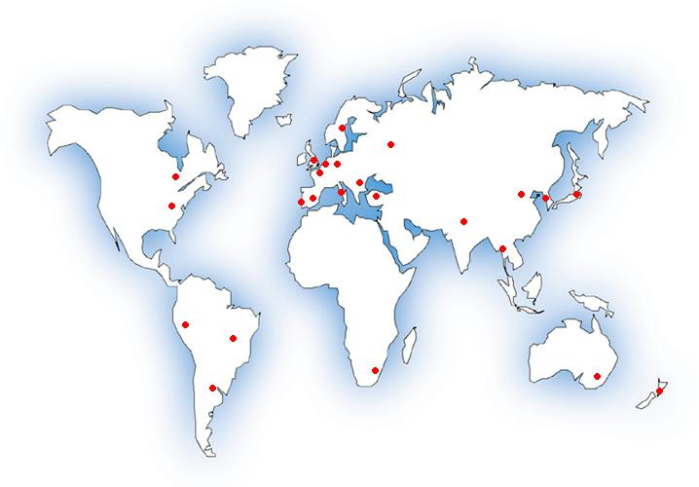




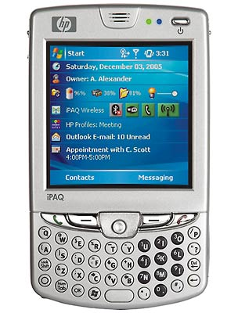
Distributed Applications
Run your code here
Server
Clients

Slide 5

Catch-22
Execution can’t start without the code
Move code to client for responsiveness

Slide 6
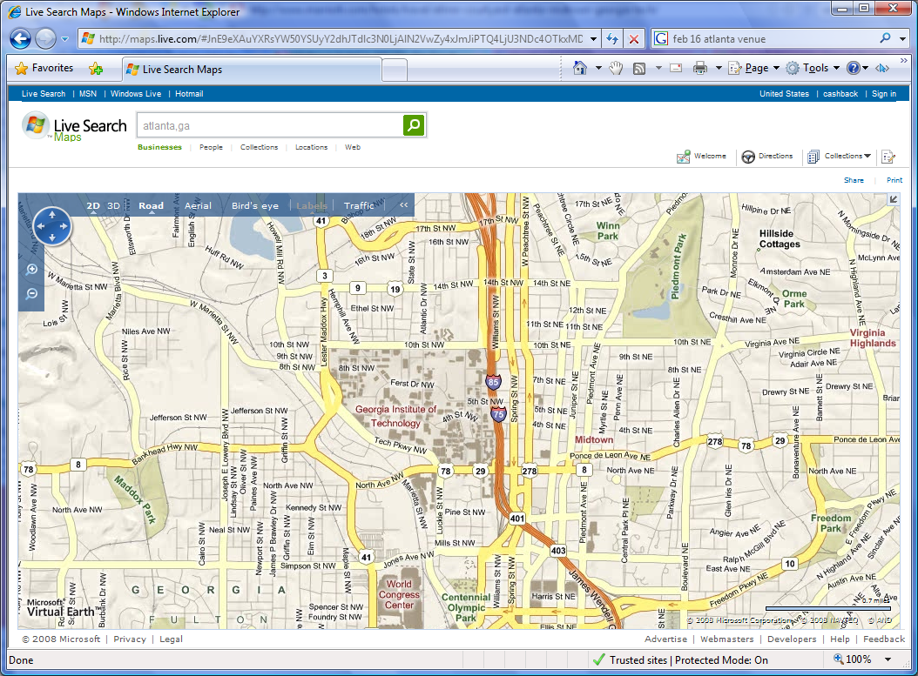
A Web 2.0 Application Disected
Talks to 14 backend services
(traffic, images,
directions, ads, …)
1+ MB code
70,000+ lines of JavaScript code downloaded
2,855 Functions
Notes:
Update the map

Slide 7
Lots of JavaScript Code

Slide 8
Motivation for Doloto
Idea behind Doloto
  Start with a small piece of code on the client
  Download required code on demand (pull)
  Send code when bandwidth available (push)
Leads to better application responsiveness
  Interleave code download & execution
  Faster startup times
  Rarely executed code is rarely downloaded

Slide 9
Doloto: the Steps
  [training] Runtime training to collect access profile
  [rewriting] Function rewriting or “stubbing” for on-demand code loading
  [prefetch] Background prefetch of clusters as the application is running

Slide 10
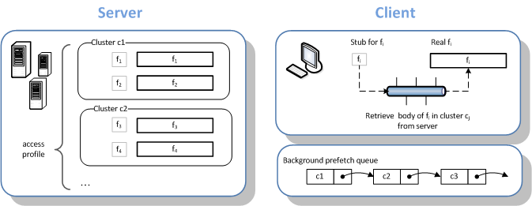
Runtime Picture

Slide 11
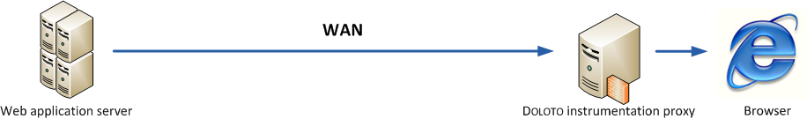
Training Phase
Instrument every function
Record the first-execute timestamp
Look for gaps to find clusters

Slide 12
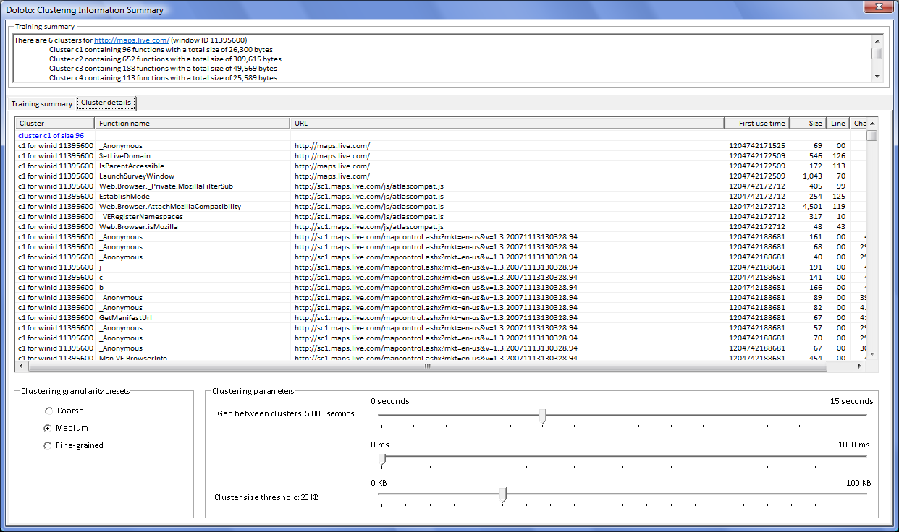
Doloto Training Tool
  [training] Runtime training to collect access profile (AjaxView Fiddler plugin)
  [rewriting] Function rewriting or “stubbing” for on-demand code loading
  [prefetch] Background prefetch of clusters as the application is running

Slide 13
Architecture of Doloto
  [training] Runtime training to collect access profiles
  [rewriting] Function rewriting or “stubbing” for on-demand code loading
  [prefetch] Background prefetch of clusters as the application is running

Slide 14
Code Rewriting
C1
C2
Rewrite JavaScript code one file at a time
Recombine clusters into individual files

Slide 15
Automated Function Splitting
var g = 10;
function f1(){
var x=g+1;
…
…
…
…
…
return …;
}
var g = 10;
var real_f1;
function f1() {
if(!real_f1){
var code = load(“f1”);
real_f1 = eval(code);
f1 = real_f1;
}
return real_f1.apply(this,
arguments);
}
eval($exp(“f1”), “”); // 21 chars

Slide 16
Architecture of Doloto
  [training] Runtime training to collect access profiles
  [rewriting] Function rewriting or “stubbing” for on-demand code loading
  [prefetch] Background prefetch of clusters as the application is running

Slide 17
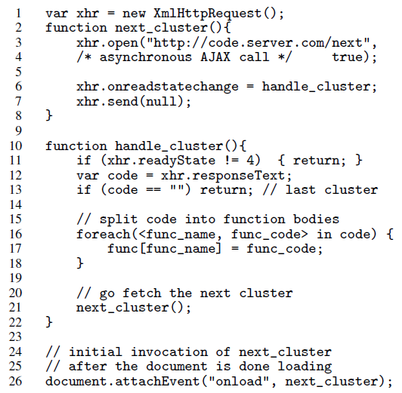
Cluster Prefetching

Slide 18
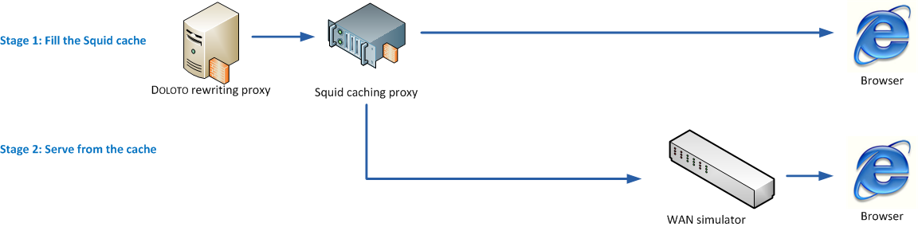
Application Benchmarks
Application | Download Size
Chi game | 104
Bunny Hunt | 16
Live.com | 1,436
Live Maps | 1,909
Google Spreadsheets | 499

Slide 19
Size Savings with Doloto

Slide 20
Runtime Savings with Doloto

Slide 21
Conclusion
Doloto: effective profile-driven optimization
Our approach is general: Silverlight
Enables larger more complex distributed apps
Dynamic code loading for distributed applications of the future

Slide 22
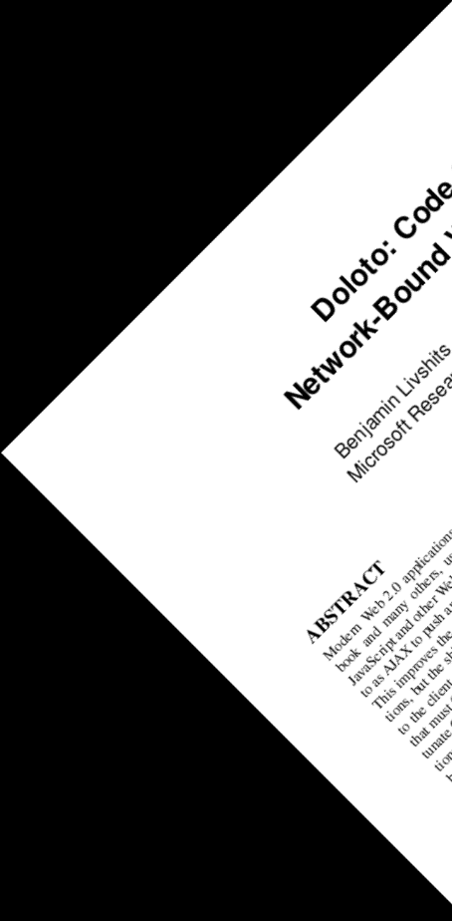

Contact us
Ben Livshits (livshits@microsoft.com)
Doloto MSR _

