Slide 1

Merlin
Specification Inference for Explicit Information Flow Problems
Benjamin Livshits, Aditya V. Nori, Sriram K. Rajamani
Microsoft Research
Anindya Banerjee
IMDEA Software

Slide 2
Mining Security Specifications
Problem: Can we automatically infer which routines in a program are sources, sinks and sanitizers?
Technology: Static analysis + Probabilistic inference
Applications:
  Lowers false errors from tools
  Enables more complete flow checking
Results:
  Over 300 new vulnerabilities discovered in 10 deployed ASP.NET applications

Slide 3
Motivation

Slide 4
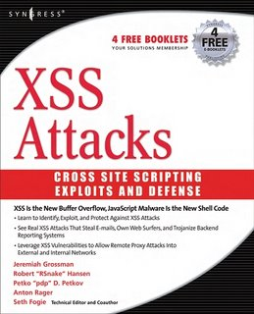




Static Analysis Tools for Security
Web application vulnerabilities are a serious threat!
Cat.Net

Slide 5
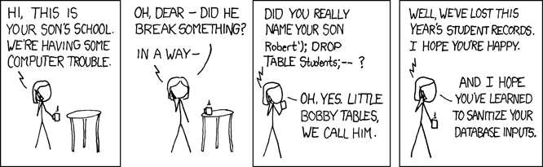
Web Application Vulnerabilities
$username = $_REQUEST['username'];
$sql = "SELECT * FROM Students WHERE username = '$username';

Slide 6
Propagation graph
void ProcessRequest()
{
string s1 = ReadData1("name");
string s2 = ReadData2("encoding");
string s11 = Prop1(s1);
string s22 = Prop2(s2);
string s111 = Cleanse(s11);
string s222 = Cleanse(s22);
WriteData("Parameter " + s111);
WriteData("Header " + s222);
}
Propagation graph
m1→ m2 iff information flows “explicitly”
from m1 to m2

Slide 7
Specification
Vulnerability
Source
  returns tainted data
Sink
  error to pass tainted data
Sanitizer
  cleanse or untaint the input
Regular nodes
  propagate input to output
Every path from a source to a sink should go through a sanitizer
Any source to sink path without a sanitizer is an information flow vulnerability

Slide 8
Information flow vulnerabilities
void ProcessRequest()
{
string s1 = ReadData1("name");
string s2 = ReadData2("encoding");
string s11 = Prop1(s1);
string s22 = Prop2(s2);
string s111 = Cleanse(s11);
string s222 = Cleanse(s22);
WriteData("Parameter " + s111);
WriteData("Header " + s222);
}
Vulnerabilities?

Slide 9
Information flow vulnerabilities
void ProcessRequest()
{
string s1 = ReadData1("name");
string s2 = ReadData2("encoding");
string s11 = Prop1(s1);
string s22 = Prop2(s2);
string s111 = Cleanse(s11);
string s222 = Cleanse(s22);
WriteData("Parameter " + s111);
WriteData("Header " + s222);
}
source
source
sanitizer
sink

Slide 10
Information flow vulnerabilities
void ProcessRequest()
{
string s1 = ReadData1("name");
string s2 = ReadData2("encoding");
string s11 = Prop1(s1);
string s22 = Prop2(s2);
string s111 = Cleanse(s11);
string s222 = Cleanse(s22);
WriteData("Parameter " + s111);
WriteData("Header " + s222);
}
source
source
sanitizer
sink

Slide 11
Goal
Given a propagation graph, can we infer a specification or ‘complete’ a partial specification?
Assumption
Most flow paths in the propagation graph are secure

Slide 12
Algorithms

Slide 13
Merlin Architecture
Program
Merlin
Initial specification
Final specification
Prop. graph construction
Factor graph construction
Probabilistic inference
Cat.Net
Vulnerabilities

Slide 14
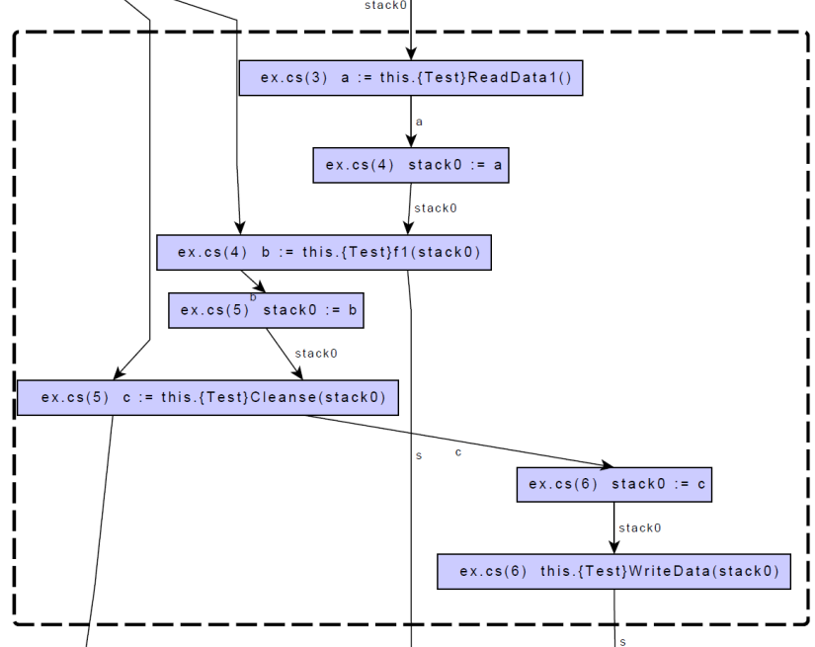
Propagation Graph Construction
void ProcessRequest()
{
string s1 = ReadData1("name");
string s2 = ReadData2("encoding");
string s11 = Prop1(s1);
string s22 = Prop2(s2);
string s111 = Cleanse(s11);
string s222 = Cleanse(s22);
WriteData("Parameter " + s111);
WriteData("Header " + s222);
}
Cat.Net

Slide 15
Inference?
source
?
source
source
sanitizer
?
sink
sink
source
source
sanitizer
?

Slide 16
Path constraints
For every acyclic path m₁ m₂ … m_{n} the probability that m₁ is a source, m_{n} is a sink, and m₂, …, m_{n-1} are not sanitizers is very low
source
sink
ReadData1
Prop1
Cleanse
WriteData
Exponential number of path constraints: O(2^{|V|})!

Slide 17
Triple constraints
For every triple <m₁, m_{i}, m_{n}> such that m_{i} is on a path from m₁ to m_{n}, the probability that m₁ is a source, m_{n} is a sink, and m_{i} is not a sanitizer is very low
source
sink
ReadData1
Prop1
WriteData
source
sink
ReadData1
Cleanse
WriteData
Cubic number of triple constraints: O(|V|³)!

Slide 18
Minimizing Sanitizers
source
source
sink

Slide 19
Minimizing Sanitizers
For every pair of nodes m₁, m₂ such that m₁ and m₂ lie on the same path from a potential source to a potential sink, the probability that both m₁ and m₂ are sanitizers is low
source
sink
ReadData1
Prop1
Cleanse
WriteData

Slide 20
Need for probabilistic constraints
a
Triple constraints
  ¬(a ∧ ¬b ∧ d)
  ¬(a ∧ ¬c ∧ d)
Avoid double sanitizers
  ¬(b ∧ c)
  a ∧ d ⇒ b
  a ∧ d ⇒ c
  ¬(b ∧ c)
b
c
d

Slide 21
Boolean formulas as probabilistic constraints
(x₁∨ x₂) ∧ (x₁∨ ¬x₃)
C₁
C₂
f(x₁, x₂, x₃) = f_{C1}(x₁, x₂) ∧ f_{C2}(x₁, x₃)
1 if x₁∨ x₂ = true
0 otherwise
f_{C1}(x₁, x₂) =
f_{C2}(x₁, x₃) =
1 if x₁∨ ¬x₃ = true
0 otherwise

Slide 22
Boolean formulas as probabilistic constraints
(x₁∨ x₂) ∧ (x₁∨ ¬x₃)
C₁
C₂
f(x₁, x₂, x₃) = f_{C1}(x₁, x₂) ∧ f_{C2}(x₁, x₃)
0.9
1 if x₁∨ x₂ = true
0 otherwise
f_{C1}(x₁, x₂) =
f_{C2}(x₁, x₃) =
0.1
0.9
1 if x₁∨ ¬x₃ = true
0 otherwise
0.1
p(x₁, x₂, x₃) = f_{C1}(x₁, x₂) × f_{C2}(x₁, x₃)/Z
Z = ∑_{x1, x2, x3} (f_{C1}(x₁, x₂) × f_{C2}(x₁, x₃))

Slide 23
Solution = Marginalization
marginal
p_{i}(x_{i}) = ∑_{x1} … ∑_{x(i-1)} ∑_{x(i+1)} … ∑_{xN} p(x₁, … , x_{N})
Step 1: choose x_{i} with highest p_{i}(x_{i}) and set x_{i} = true if p_{i}(x_{i}) is greater than a threshold, false otherwise
Step 2: recompute marginals and repeat Step 1 until all variables have been assigned
Notes:
Change font

Slide 24
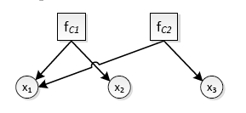
Factor graphs: efficient computation of marginals
f_{C1}(x₁, x₂) =
f_{C2}(x₁, x₃) =
1 if x₁∨ x₂ = true
0 otherwise
1 if x₁∨ ¬x₃ = true
0 otherwise

Slide 25
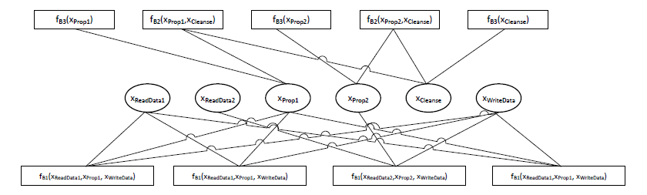
Factor Graphs
Notes:
Try to increase font size

Slide 26
Probabilistic Inference
 | Source | Sanitizer | Sink
ReadData1 | .95 | .001 | .001
ReadData2 | .5 | .5 | .5
Cleanse | .5 | .5 | .5
WriteData | .5 | .5 | .85
…
Probabilistic
Inference
 | Source | Sanitizer | Sink
ReadData1 | .95 | .001 | .001
ReadData2 | .5 | .5 | .5
Cleanse | .01 | .997 | .03
WriteData | .5 | .5 | .85
…

Slide 27
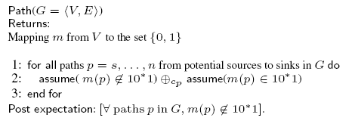
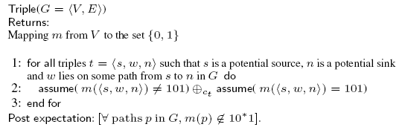
Paths vs. Triples
Theorem
Path refines Triple

Slide 28
Experiments

Slide 29
Implementation
Merlin is implemented in C#
  Uses CAT.NET for building the propagation graph
  Uses Infer.NET for probabilistic inference
    http://research.microsoft.com/infernet

Slide 30
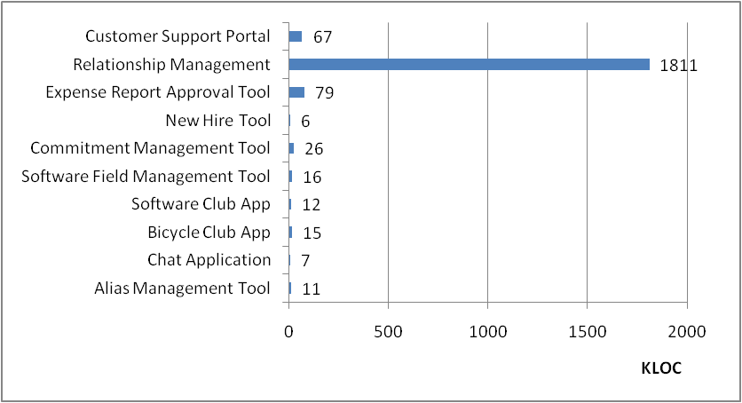
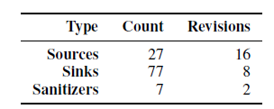
Experiments
10 line-of-business applications written in C# using ASP.NET

Slide 31
Summary of Discovered Specifications
Notes:
6, 38, 26

Slide 32
Summary of Discovered Vulnerabilities
Original
With Merlin
False positives eliminated

Slide 33
Experiments - summary
10 large Web apps in .NET
Time taken per app < 4 minutes
New specs: 167
New vulnerabilities: 322
False positives removed: 13
Final false positive rate for CAT.NET after Merlin < 1%

Slide 34
Summary
Merlin is first practical approach to infer explicit information flow specifications
Design based on a formal characterization of an approximate probabilistic constraint system
Able to successfully and efficiently infer explicit information flow specifications in large applications which result in detection of new vulnerabilities

Slide 35
http://research.microsoft.com/merlin

