Slide 1

Gatekeeper
Mostly Static Enforcement of
Security & Reliability Policies for JavaScript Code
Salvatore Guarnieri, University of Washington
Ben Livshits, Microsoft Research

Slide 2
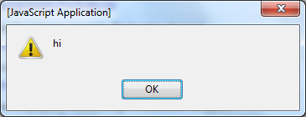
Catch me if you can
alert(‘hi’);
program
malicious
don’t want to allow alert box
?
can we figure this out statically?
Notes:
Real policy early on – alert is too toy of a policy

Slide 3
alert(‘hi’);
document.write( “<script>alert(‘hi’);</script>”);
var d = document;
var w = d.write;
w(“<script>alert(‘hi’);”);

Slide 4
eval(“do”+”cu”+”ment.write(”+…
var e = window.eval;
e(“do”+”cu”+”ment.write(”…”);

Slide 5
var e = new Function(“eval”);
e.call(
“do”+”cu”+”ment.write(”…”);
var e = new
Function(unescape(“%65%76%61%6C”));
e.call(“do”+”cu”+”ment.write(”…”);
Notes:
The idea of this exercise is that static analysis of JavaScript is very hard

Slide 6
Gatekeeper
Static analysis for JavaScript
General technology we developed for JavaScript
This paper
Use to enforce security and reliability policies
Analyze Web widgets
Focus on whole program analysis. Contrast with:
JavaScript language subsets (do a little of)
JavaScript code rewriting (do a little of)
Can use for performance optimizations, etc.

Slide 7
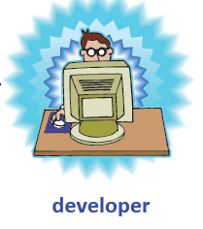
Goal of Gatekeeper:
Reason about JavaScript code statically
alert(‘hi’);
Gatekeeper
Notes:
The question we are trying to address is “Can we reason about JavaScript code?” So, here’s the setup. There’s a developer who produces JavaScript code. Like, alert(‘hi’). What does that do? It brings up a dialog box. Suppose we want to limit that behavior. This is what Gatekeeper tries to do statically.

Slide 8
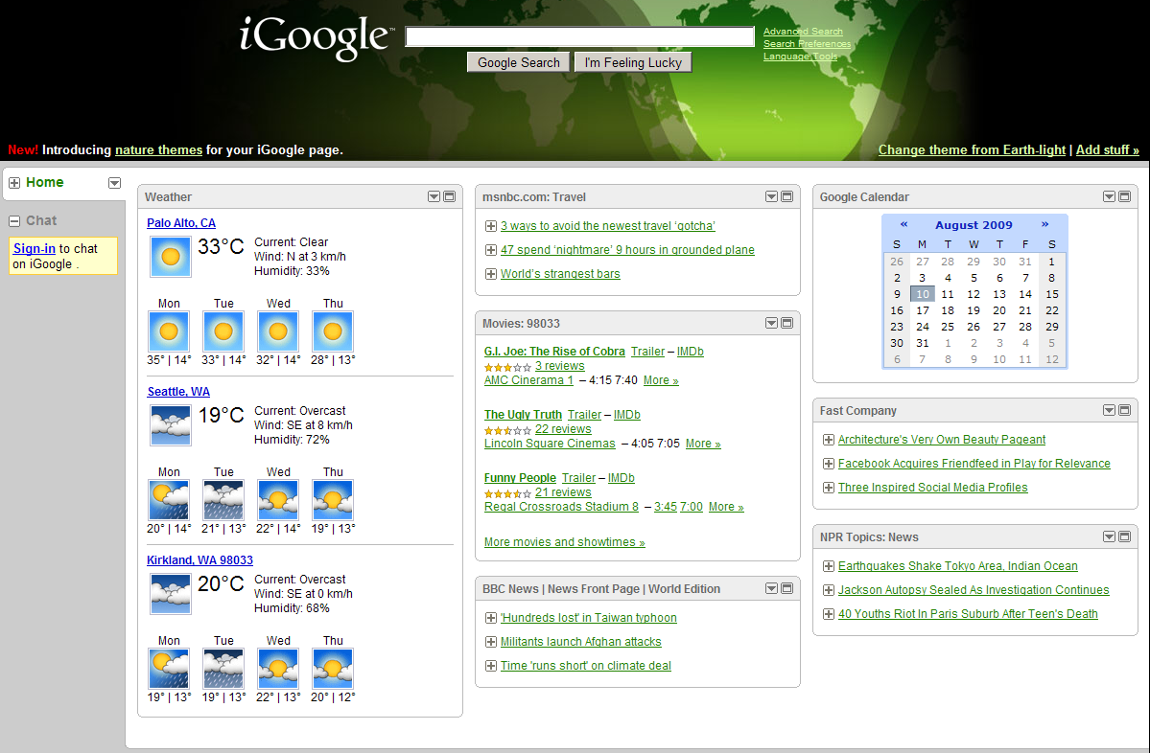
JavaScript Widgets
// register your Gadget's namespace
registerNamespace("GadgetGamez");
// define the constructor for your Gadget (this must match the name in the manifest xml)
GadgetGamez.gg2manybugs = function(p_elSource, p_args, p_namespace) {
// always call initializeBase before anything else!
GadgetGamez.gg2manybugs.initializeBase(this, arguments);
// setup private member variables
var m_this = this;
var m_el = p_elSource;
var m_module = p_args.module;
/****************************************
** initialize Method
****************************************/
// initialize is always called immediately after your object is instantiated
this.initialize = function(p_objScope)
{
// always call the base object's initialize first!
GadgetGamez.gg2manybugs.getBaseMethod(this, "initialize", "Web.Bindings.Base").call(this, p_objScope);
var url = "http://www.gadgetgamez.com/live/2manybugs.htm"
m_iframe = document.createElement("iframe");
m_iframe.scrolling = "yes";
m_iframe.frameBorder = "0";
m_iframe.src = url;
m_iframe.width="95%";
m_iframe.height="250px";
p_elSource.appendChild(m_iframe);
};
GadgetGamez.gg2manybugs.registerBaseMethod(this, "initialize");
/****************************************
** dispose Method
****************************************/
this.dispose = function(p_blnUnload) {
//TODO: add your dispose code here
// null out all member variables
m_this = null;
m_el = null;
m_module = null;
// always call the base object's dispose last!
GadgetGamez.gg2manybugs.getBaseMethod(this, "dispose", "Web.Bindings.Base").call(this, p_blnUnload);
};
GadgetGamez.gg2manybugs.registerBaseMethod(this, "dispose");
/****************************************
** Other Methods
****************************************/
};
GadgetGamez.gg2manybugs.registerClass("GadgetGamez.gg2manybugs", "Web.Bindings.Base");

Slide 9
Widgets are everywhere…
We use over 8,500 widgets to evaluate Gatekeeper
Widget counts
Lines of code

Slide 10

Gatekeeper: Deployment Step on Widget Host
Hosting site: control widgets by enforcing policies:
No alert
No redirects
No document.write
Widget:
…
alert(‘hi’);
…

Slide 11
Outline
Statically analyzable subset JavaScript_{SAFE}
Points-to analysis for JavaScript
Formulate nine security & reliability policies
Experiments

Slide 12
Techniques

Slide 13
Start with Entire JavaScript…
EcmaScript-262
  var e = new Function(“eval”);
  e.call(
  “do”+”cu”+”ment.write(”…”);
  var e = new
  Function(unescape(“%65%76%61%6C”));
  e.call(“do”+”cu”+”ment.write(”…”);
Notes:
We start with the full JavaScript language with a lot of nasty features and throw away a bunch of them.

Slide 14
Remove eval & Friends…
EcmaScript 262
- eval
- setTimeout
- setInterval
- Function
- with
- arguments array
-----------------------
= JavaScript_{GK}

Slide 15
Remove Unresolved Array Accesses…
EcmaScript 262
JavaScript_{GK}
- innerHTML assignments
- non-const array access a[x+y]
--------------------------------
= JavaScript_{SAFE}
var z = ‘ev’ + x + ‘al’;
var e = document[z];
eval is back!
Notes:
You might be wondering, I’ve see eval, Function, etc. But what’s wrong with unresolved array accesses? Well, this is what.

Slide 16
Now, this is Amenable to Analysis!
EcmaScript 262
JavaScript_{GK} – need basic instrumentation to prevent runtime code introduction
JavaScript_{GK}
JavaScript_{SAFE}
_{s ::=}
  _{// assignments}
  _{v1=v2}
  _{v = bot}
  _{return v}
  _{// calls}
  _{v = new v0(v1,…,vn)}
  _{v=v0(vthis,v1,…,vn)}
  _{// heap}
  _{v1=v2.f}
  _{v1.f=v2}
  _{// declarations}
  _{v=function(v1,…,vn){s}}
JavaScript_{SAFE} – can analyze fully statically without resorting to runtime checks
Notes:
Need to make a point that despite removing things, much is analyzable

Slide 17
How Many Widgets are in the Subsets?
JavaScript_{SAFE}
JavaScript_{GK}
Ultimately, can analyze
65-97% of all widgets
Notes:
You might be wondering: are these subsets too restrictive? Are they useful in practice?

Slide 18
Sound analysis: ensures that our policy checkers find all violations
Input
program
JavaScript_{SAFE}
Sound
JavaScript_{GK}
Sound with instrumentation
Everything else
No guarantees

Slide 19
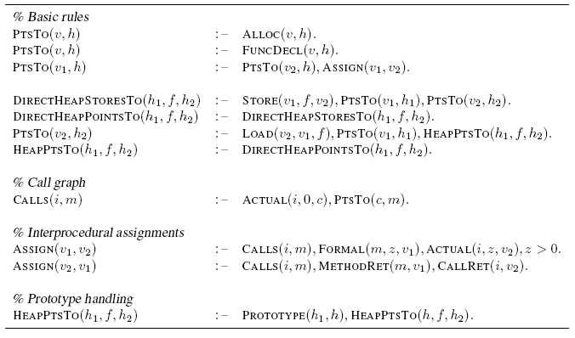
Points-to Analysis in Gatekeeper
Program representation
Points-to analysis
  Inclusion-based
  Field-sensitive
  Build call graph on the fly
Tricky issues:
  Prototypes
  Function closures
Analysis is expressed in Datalog
PointsTo(var, heap)
Notes:
Pointer-analysis is a building block for our policies. Analysis is highly declarative

Slide 20
Datalog Policy for Preventing document.write
1. DocumentWrite(i) :-
2. PointsTo("global", h1),
3. HeapPointsTo(h1, "document", h2),
4. HeapPointsTo(h2, "write", h3),
5. Calls(i, h3).
document.write('<Td><Input Type="Button" Name="' + i + '" Value=" " Class="blokje" onClick="wijzig(this.form,this)"></Td>');
document.write ("<" + "script language='javascript' type='text/javascript' src='");
document.write('<iframe id="dynstuff" src="" '+iframeprops+'></iframe>')

Slide 21
Experimental Evaluation

Slide 22
Policies for Widget Security & Reliability
AlertCalls(i) :- PointsTo("global", h), HeapPointsTo(h, "alert", h2), Calls(i, h2) .
DocumentWrite(i) :- PointsTo("global", h1), HeapPointsTo(h1, "document", h2), HeapPointsTo(h2, "write", h3), Calls(i, h3) .
DocumentWrite(i) :- PointsTo("global", h1), HeapPointsTo(h1, "document", h2), HeapPointsTo(h2, "writeln", h3), Calls(i, h3) .
InnerHTML(v) :- Store(v, "innerHtml", _) .
BuiltinObject(h) :- PointsTo("global", h1), HeapPointsTo(h1, "String", h) .
BuiltinObject(h) :- PointsTo("global", h1), HeapPointsTo(h1, "Date", h) .
BuiltinObject(h) :- PointsTo("global", h1), HeapPointsTo(h1, "Array", h) .
BuiltinObject(h) :- PointsTo("global", h1), HeapPointsTo(h1, "Boolean", h) .
BuiltinObject(h) :- PointsTo("global", h1), HeapPointsTo(h1, "Math", h) .
BuiltinObject(h) :- PointsTo("global", h1), HeapPointsTo(h1, "Function", h) .
BuiltinObject(h) :- PointsTo("global", h1), HeapPointsTo(h1, "Document", h) .
BuiltinObject(h) :- PointsTo("global", h1), HeapPointsTo(h1, "Window", h) .
Reaches(h1, f, h2) :- HeapPointsTo(h1, f, h2) .
Reaches(h1, f, h2) :- HeapPointsTo(h1, _, h), Reaches(h, f, h2) .
FrozenViolation(v, h1) :- Store(v, _, _), PointsTo(v, h1), BuiltinObject(h1) .
FrozenViolation(v, h1) :- Store(v, _, _), PointsTo(v, h1), BuiltinObject(h2), Reaches(h2, f, h1) .
LocationObject(h) :- PointsTo("global", h1), HeapPointsTo(h1, "location", h) .
WindowObject(h) :- PointsTo("global", h1), HeapPointsTo(h1, "window", h) .
StoreToLocationObject(h) :- PointsTo("global", h1), HeapPointsTo(h1, "window", h2), DirectHeapStoreTo(h2, "location", h) .
StoreToLocationObject(h) :- PointsTo("global", h1), HeapPointsTo(h1, "document", h2), DirectHeapStoreTo(h2, "location", h) .
StoreToLocationObject(h) :- PointsTo("global", h1), DirectHeapStoreTo(h1, "location", h) .
StoreInLocationObject(h) :- LocationObject(h1), DirectHeapStoreTo(h1, _, h) .
CallLocationMethod(i) :- LocationObject(h), HeapPointsTo(h, "assign", h1), Calls(i, h1) .
CallLocationMethod(i) :- LocationObject(h), HeapPointsTo(h, "reload", h1), Calls(i, h1) .
CallLocationMethod(i) :- LocationObject(h), HeapPointsTo(h, "replace", h1), Calls(i, h1) .
WindowOpenMethodCall(i) :- WindowObject(h1), HeapPointsTo(h1, "open", h2), Calls(i, h2) .
1
Alert calls
2
Frozen violations
3
Document.write
Location change
4
Location assign
5
Window open
XMLHttpRequest
6
7
Global store
8
ActiveXExecute (taint)
9
Apply to all widgets
36 lines
Live.com only
Vista Sidebar only
Notes:
Line this up better

Slide 23
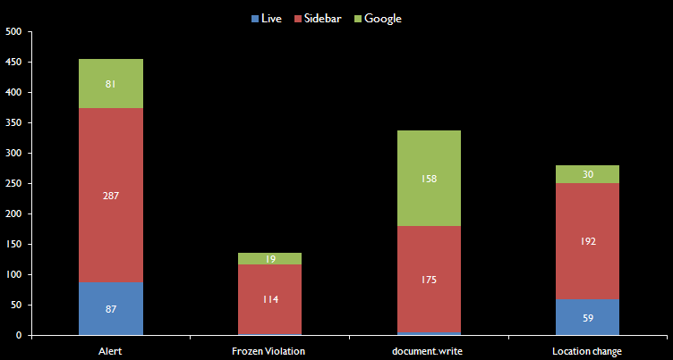
Policy Checking Results
Warnings
1,341 warnings found total
False positives
Span 684 widgets
2 widgets
113 false positives
Took us about 12 hours to check these
Manual inspection effort

Slide 24
False Positives
common.js:
function MM_preloadImages() {
var d=m_Doc;
if(d.images){
if(!d.MM_p) d.MM_p=new Array();
var i,j=d.MM_p.length,
a=MM_preloadImages.arguments;
for(i=0; i<a.length; i++)
if (a[i].indexOf("#")!=0){
d.MM_p[j]=new Image;
d.MM_p[j++].src=a[i];
}
}
}
Why not more false positives?
  Most violations are local
  But this is policy-specific – a global taint policy might produce other results

Slide 25
Conclusions
_{Gatekeeper:} _{Static analysis for JavaScript}
_{Technique: points-to analysis}
_{Focus: analyzing widgets}
Results:
1,341 policy violations
false positives affect 2 widgets

Slide 26


Contact us
Gatekeeper security project MSR _

