Slide 1
Spectator: Detection and Containment of JavaScript Worms
Ben Livshits and Weidong Cui
Microsoft Research
Redmond, WA

Slide 2
Web Application Security Arena
Web application vulnerabilities are everywhere
Cross-site scripting (XSS)
Dominates the charts
“Buffer overruns of this decade”
Key enabler of JavaScript worms

Slide 3
The Samy Worm
Unleashed by Samy as a proof-of-concept in October 2005
Worm name | Type of site | Release date
Samy/MySpace | Social networking | Oct-05
xanga.com | Social networking | Dec-05
SpaceFlash/MySpace | Social networking | Jul-06
Yamanner/Yahoo! Mail | Email service | Jun-06
QSpace/MySpace | Social networking | Nov-06
adultspace.com | Social networking | Dec-06
gaiaonline.com | Online gaming | Jan-07
u-dominion.com | Online gaming | Jan-07

Slide 4
Consequences?
Samy took down MySpace (October 2005)
Site couldn’t cope: down for two days
Came down after 13 hours
Cleanup costs
Yamanner (Yahoo mail) worm (June 2006)
Sent malicious HTML mail to users in the current user’s address book
Affected 200,000 users, emails used for spamming

Slide 5
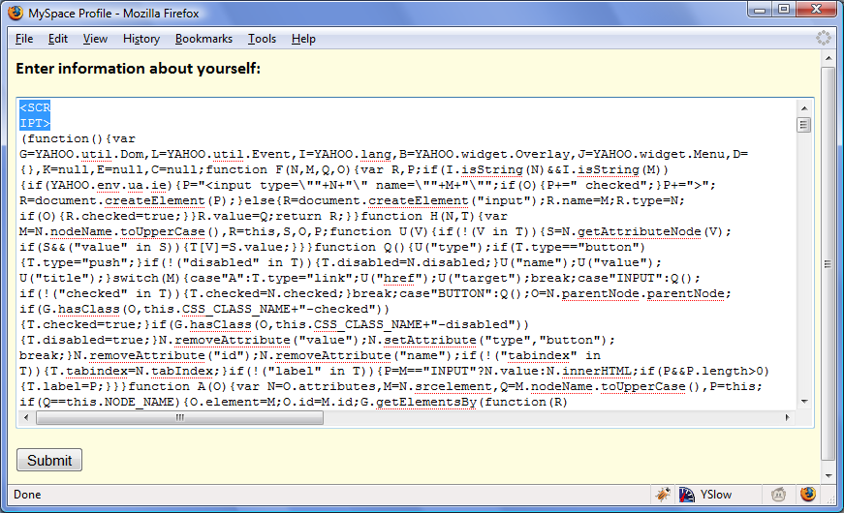
Samy: Worm Propagation
Initial infection:
Samy’s MySpace page
Injected JavaScript payload exploits a XSS hole
Propagation step:
User views an infected page
Payload executes
Adds Samy as friend
Add payload to user’s page

Slide 6
What’s at the Root of the Problem?
Worms of the previous decade enabled by buffer overruns
JavaScript worms are enabled by cross-site scripting (XSS)
Fixing XSS holes is best, but some vulnerabilities remain
The month of MySpace bugs
Database of XSS vulnerabilities: xssed.com

Slide 7
What Can We Do?
Existing solutions rely on signatures
Ineffective: obfuscated and polymorphic JavaScript worms are very easy to write
Most real-life worms are obfuscated
Fundamental difficulties
Server can’t tell a user request from worm activity
Browser doesn’t know where JavaScript comes from

Slide 8
Spectator Project Contributions
Spectator: first practical solution
Scalable, small constant-time end-to-end latency overhead
Deployment models for large sites supporting load balancing
Evaluation of Spectator:
Large-scale simulation setup for evaluating scalability and precision
Applied Spectator to a real site during worm propagation

Slide 9
Spectator: Approach and Architecture

Slide 10
Worm Propagation
u₁ uploads to his page
u₂ downloads page of u₁
u₂ uploads to his page
u₃ downloads page of u₂
u₃ uploads to his page
…
payload
u₁
u₂
u₃
Propagation chain
Preserve causality of uploads, store as a graph
Detect long propagation chains
Report them as potential worm outbreaks

Slide 11
Spectator Architecture
Server-side application
page
Spectator proxy
page
tag
Client-side tracking
tag₁ -> tag₂
request
request
U₁
U₂
tag

Slide 12
Causality Propagation on Client/Server
Tagging of uploaded input
<div>
<b onclick="javascript:alert(’...’)">...</b>
</div>
Client-side request tracking
Injected JavaScript and response headers
Propagates causality information through cookies on the client side
<div spectator_tag=56>

Slide 13
Data Representation: Propagation Graph
Propagation graph G:
Records causality between tags (content uploads)
Records IP address (approximation of user) with each
Worm: Diameter(G) > threshold d
<t₉, ip₀>
<t₃, ip₀>
<t₇, ip₀>
<t₈, ip₀>
<t₅, ip₀>
<t₀, ip₀>
<t₁, ip₁>
<t₂, ip₀>
<t₆, ip₀>
<t₄, ip₂>

Slide 14
Approximation Algorithm Complexity
Determining diameter precisely is exponential
Scalability is crucial
Thousands of users
Millions of uploads
Use greedy approximation of the diameter instead
 | Precise algorithm | Approximate algorithm
Upload insertion time | O(2^{n}) | O(1) on average
Upload insertion space | O(n) | O(n)
Worm containment time | O(n) | O(n)

Slide 15
Experiments

Slide 16
Experimental Overview
Large-scale simulation with OurSpace:
Mimics a social networking site like MySpace
Experimented with various patterns of site access
Looked at the scalability
Real-life case study:
Uses Siteframe, a third-party social networking app
Developed a JavaScript worm for it similar to real-life ones

Slide 17
OurSpace: Large-Scale Simulations
Test-bed: OurSpace
Every user has their own page
At any point, a user can read or write to a page
Write(U₁, “hello”); Write(U₁, Read(U₂)); Write(U₃, Read(U₁));
Various access scenarios:
Scenario 1: Worm outbreak (random topology)
Scenario 2: A single long blog entry
Scenario 3: A power law model of worm propagation

Slide 18
Latency of Maintaining Propagation Graph
Tag addition overhead pretty much constant

Slide 19
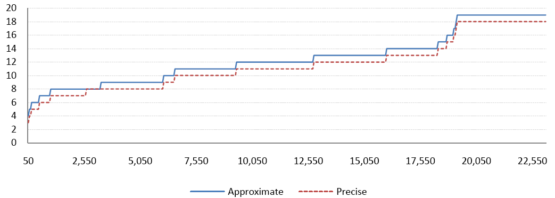
Approximation of Graph Diameter
Approximate worm detection works well

Slide 20
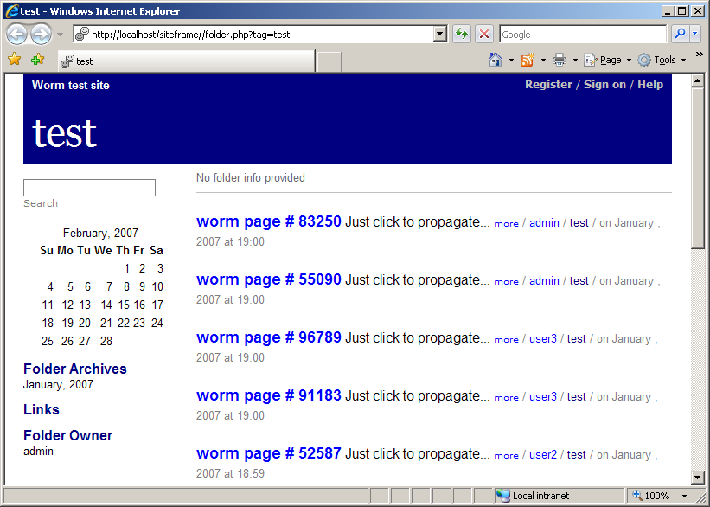
Siteframe Experiment
Real-life worm experimentation is difficult
Used Siteframe, open-source blogging system
Found an exploitable XSS
Developed a worm for it
Scripted user behavior
Spectator flags the worm

Slide 21
Conclusions
First defense against JavaScript worms
Fast and slow, mono- and polymorphic worms
Scales well with low overhead
Essence of the approach
Perform distributed data tainting
Look for long propagation chains
Demonstrated scalability and effectiveness

