Slide 1
Doloto:
Code Splitting for AJAX Applications
Ben Livshits and Emre Kiciman
Microsoft Research
Redmond, WA

Slide 2
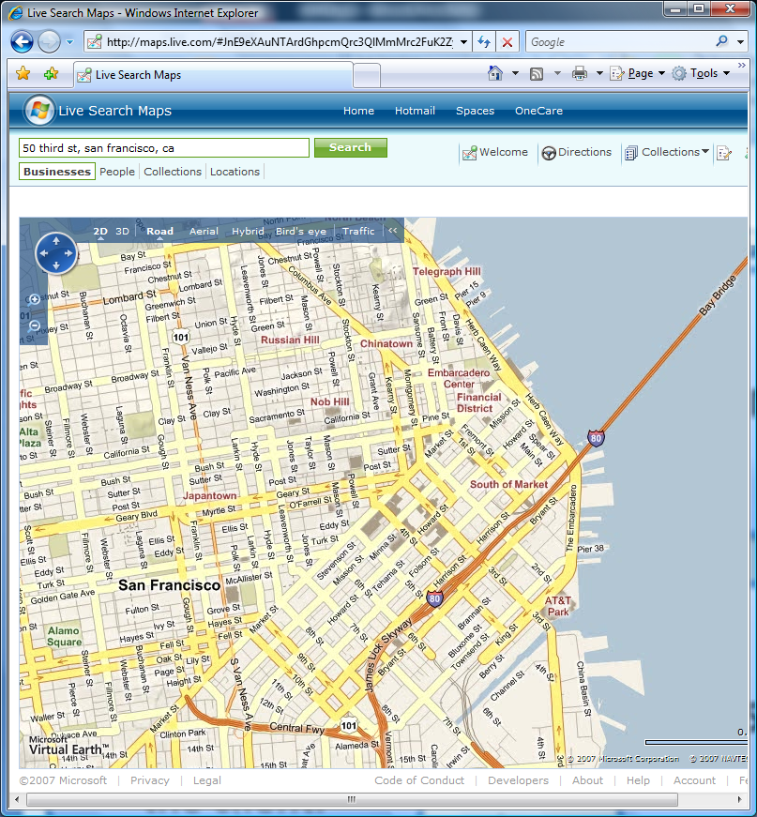
A Web 2.0 Application Disected
Talks to 14 backend services
(traffic, images,
directions, ads, …)
1+ MB code
70,000+ lines of JavaScript code downloaded
2,855 Functions
Notes:
Update the map

Slide 3
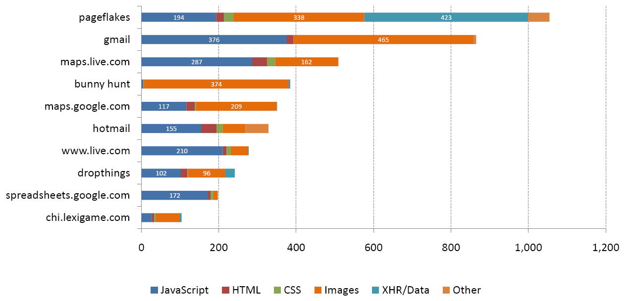
AJAX Apps Have Lots of Code
Up to 90% of a Web 2.0 app is JavaScript code!

Slide 4
Why AJAX?
Client-side JavaScript code
  Reduces latency and improves user experience
  Avoids constant network round trips
Catch-22
  Takes a while to transfer code to the client
  Code can be MBs in size
  Application execution is blocked until code arrives

Slide 5
Motivation for Doloto
Idea behind Doloto
  Start with a small piece of code on the client
  Download required code on demand (pull)
  Send code when bandwidth available (push)
Leads to better application responsiveness
  Interleave code download & execution
  Faster startup times
  Rarely executed code is rarely downloaded

Slide 6
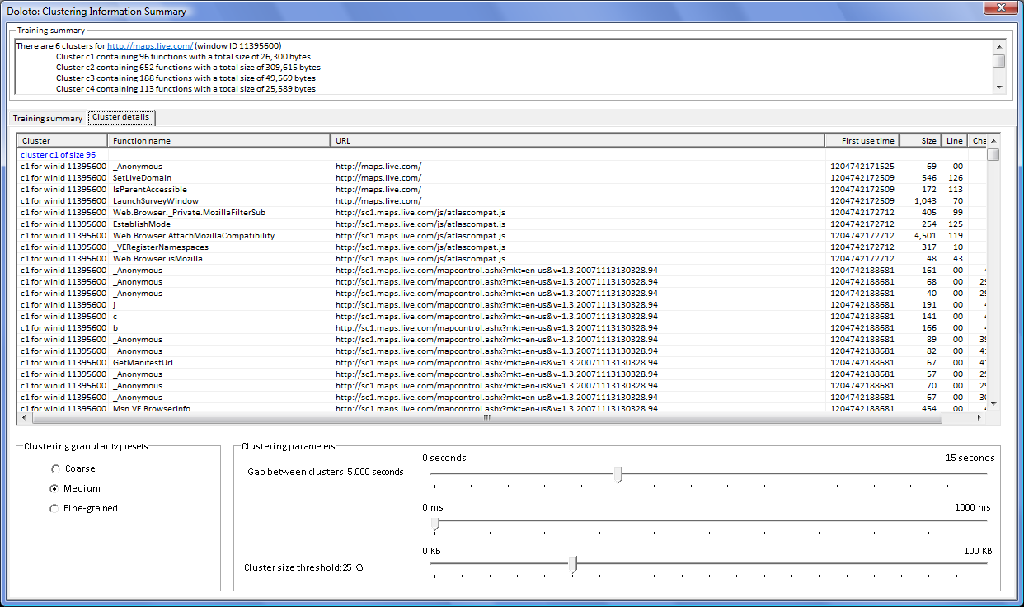
Doloto Training Tool
  [training] Runtime training to collect access profile (AjaxView Fiddler plugin)
  [rewriting] Function rewriting or “stubbing” for on-demand code loading
  [prefetch] Background prefetch of clusters as the application is running

Slide 7
Automated Function Splitting
var g = 10;
function f1(){
var x=g+1;
…
…
…
…
…
return …;
}
var g = 10;
var real_f1;
function f1() {
if(!real_f1){
var code = load(“f1”);
real_f1 = eval(code);
f1 = real_f1;
}
return real_f1.apply(this,
arguments);
}
  [training] Runtime training to collect access profiles
  [rewriting] Function rewriting or “stubbing” for on-demand code loading
  [prefetch] Background prefetch of clusters as the application is running
eval($exp(“f1”), “”); // 21 chars

Slide 8
Architecture of Doloto
  [training] Runtime training to collect access profiles
  [rewriting] Function rewriting or “stubbing” for on-demand code loading
  [prefetch] Background prefetch of clusters as the application is running

Slide 9
Size Savings with Doloto

Slide 10
Runtime Savings with Doloto

Slide 11


Contact us
Ben Livshits (livshits@microsoft.com)
Doloto MSR _

